Slide 1

Welcome to ISPD 2015 ACM International Symposium on Physical Design

Slide 2
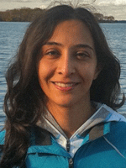
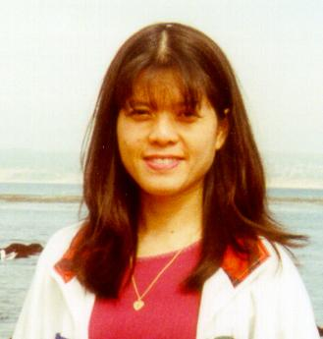
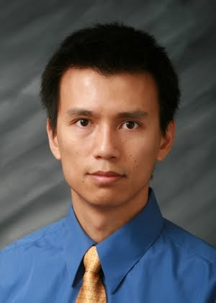
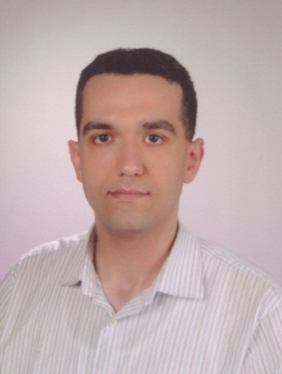
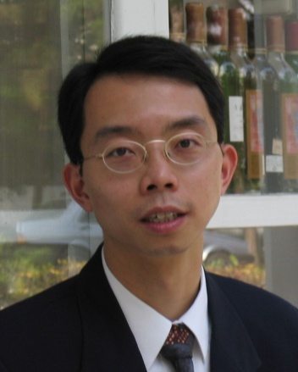
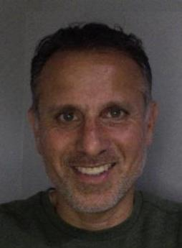
Organization Committee
General Chair
Azadeh Davoodi
Univ. of Wisconsin
Technical Program Chair
Evangeline Young
Chinese Univ. of Hong Kong
Steering Committee Chair
Cliff Sze
IBM Research
Publications Chair
Mustafa Ozdal
Intel
Publicity Chair
Chris Chu
Iowa State Univ.
Contest Chair
Ismail Bustany
Mentor Graphics
Notes:
.

Slide 3
Hotel Logistics
Complimentary internet access in guest rooms
Free wireless internet access in symposium room (Big Sur)
Select “Have Coupon” , Use password: “hgipublic3”
Complimentary parking at the hotel
All meetings in this room (Big Sur)
Breaks at Vista Del Mar right outside of Big Sur
All meals at Presidio room (same floor across the hall, above the lobby area)
Your badge will also serve as lunch/dinner ticket

Slide 4
Technical Program Committee
Technical Program Chair
Evangeline Young
Chinese Univ. of Hong Kong
Aiqun Cao (Synopsys)
David Chinnery (Mentor Graphics)
Stephan Held (Univ. of Bonn)
Dwight Hill (Synopsys)
Tsung-Yi Ho (National Cheng Kung Univ.)
Andrew Kennings (Univ. of Waterloo)
Jens Lienig (Dresden Univ. of Technology)
Guojie Luo (Peking Univ.)
Yu-Yen Mo (Oracle)
Sherief Reda (Brown Univ.)
William Swartz (TimberWolf Inc.)
Atsushi Takahashi (Tokyo Institute of Technology)
Natarajan Viswanathan (IBM Research)
Alexey Volosskiy (AMD)
Jackey Yan (Cadence)
Jens Lienig (Dresden Univ. of Technology)
Hailong Yao (Tsinghua Univ.)
Cheng Zhuo (Intel)

Slide 5
Technical Program
44 abstract submissions and 37 full submissions, authors from
US, Taiwan, India, China, Japan, Hong Kong, Canada, France, Germany, Israel, Brazil, Korea
185 reviews, 5 reviews per submission
14 accepted papers (37.8% acceptance rate)

Slide 6
Symposium Logistics
Speakers
Check in with your Session Chair and load your slides prior to your session
Keep on time
All slides will be posted (as pdf’s) on the ISPD website; if not okay, please inform your Session Chair
Session Chairs
Know your speakers, help to load slides in advance
Keep your sessions on time
Audiences
Please set your cell phones to silent/vibration mode
Questions are encouraged, interruptions are okay! Please identify yourself before asking questions

Slide 7
Steering Committee
Cliff Sze
IBM Research
Steering Committee Chair
Ismail Bustany (Mentor Graphics)
Yao-Wen Chang (National Taiwan University)
Patrick Groeneveld (Synopsys)
Inki Hong (Cadence)
Cheng-Kok Koh (Purdue University)
Malgorzata Marek-Sadowska (UC Santa Barbara)
Noel Menezes (Intel)

Slide 8
Invited Talks
Industry
LETI
IC Manage
Mentor Graphics
Nangate
Sage Design Automation
Academia
Dresden Univ. of Technology
Stanford
UCSB
Univ. of Toronto
NCSU
Reutlingen Univ.
UFRGS
Also have an entire invited session on FreePDK at 10:30am on Wednesday.

Slide 9
Best Paper Award Candidates
Session 2: Q-Learning Based Dynamic Voltage Scaling for Designs with Graceful Degradation, (Yu-Guang Chen, Wan-Yu Wen, Tao Wang, Yiyu Shi and Shih-Chieh Chang)
Session 3: A Cell-Based Row-Structure Layout Decomposer for Triple Patterning Lithography, (Hsi-An Chien, Szu-Yuan Han, Ye-Hong Chen and Ting-Chi Wang)
Session 7: Timing-Driven Placement Based on Dynamic Net-Weighting for Efficient Slack Histogram Compression, (Chrystian Guth, Vinicius Livramento, Renan Netto, Renan Fonseca, José Luís Güntzel and Luiz Santos)

Slide 10



2015 ACM International Symposium on Physical Design
Best Paper Award
Presented to
Hsi-An Chien, Szu-Yuan Han, Ye-Hong Chen and Ting-Chi Wang
for the paper
“A Cell-Based Row-Structure Layout Decomposer
for Triple Patterning Lithography”
Cliff C. N. Sze
Steering Committee Chair
Azadeh Davoodi
General Chair
Evangeline F.Y. Young
Technical Program Chair
March 29 – April 1, 2015

Slide 11
ISPD Lifetime Achievement Award
Express appreciation to our pioneers
Trace their contributions
Explore directions along their steps
Link senior/junior researchers together
Past award recipients:
2014: Dr Bryan Preas
2013: Prof Yoji Kajitani
2012: Prof C.-L. Liu
2011: Prof Ernest Kuh

Slide 12
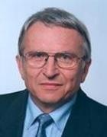
ISPD Lifetime Achievement Award
Session 6: Commemoration for Prof. Kurt Antreich
Tuesday 4-5:45 pm
Session Chair: Andrew Kahng (UCSD)
“The Early Days of Circuit Placement”, Martin D.F. Wong (UIUC).
“Force-Directed Placement of VLSI Circuits”, Hans Eisenmann (PDF Solutions GmbH).
“Beyond GORDIAN and KRAFTWERK: EDA Research at TUM”, Ulf Schlichtmann (Technische Universität München).
Please join us when we present this year's award to Prof. Kurt Antreich which will be at the end of the session.
Many thanks to Prof Helmut Graeb for his efforts in organizing the session.

Slide 13
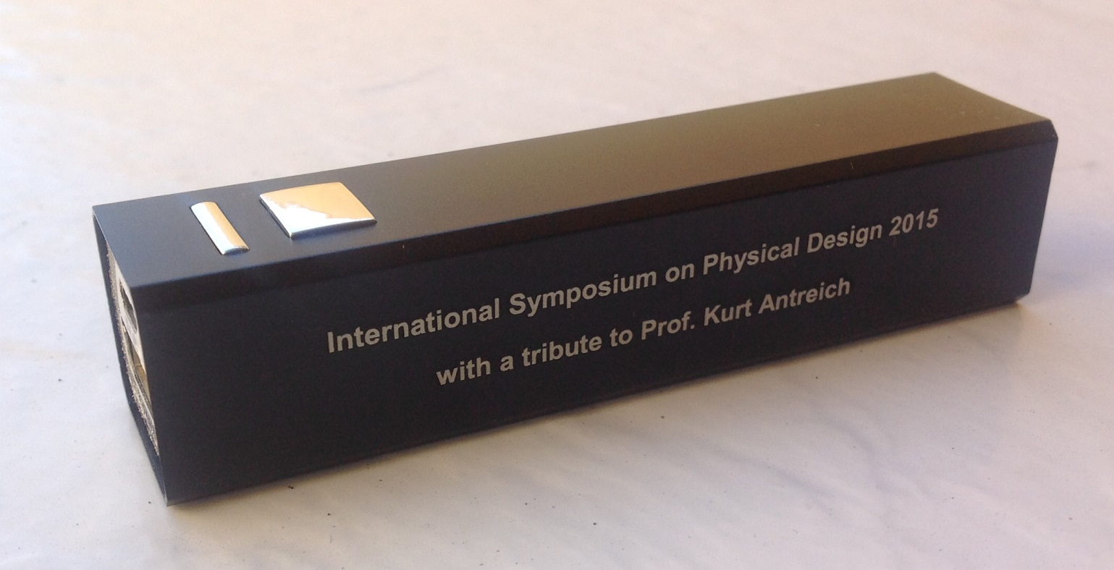
Souvenir for Tribute to Prof. Antriech
Power bank, lithium ion battery
5V input/output , max 2.1A
Has USB and micro-pin cord for charging iphone , ipad, …
LED indicator (red: charging, green: charged, blue: providing charge)
Not allowed in checked luggage but OK in carry-on when taking flight

Slide 14
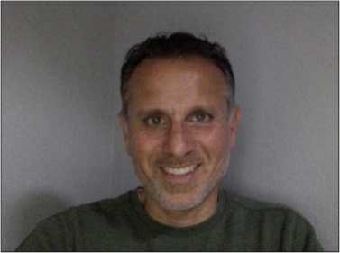
Blockage-Aware Detailed Routing-Driven Placement Contest
Organized by Mentor Graphics Team:
Ismail Bustany (Contest Chair)
David Chinnery
Joseph Shinnerl
Vladimir Yutsis
John Jones
Clive Ellis
Strong support by Shankar Krishnamoorthy, Chief Scientist and Head of R&D, IC Implementation Division, Mentor Graphics.
Co-sponsored by ACM SIGDA.
A Challenging benchmark suite: Modified Intel and IBM designs with irregular placeable area, narrow placement channels, fence regions, maximum logic area utilization limits, & complex design rules.
Placement routing quality evaluated by Mentor’s Olympus-SoC place & route tool.
12 initial teams from Asia, Europe, & North America.
7 final placer binary submissions.
Winners to be announced Wednesday AM (Session 7: Placement & Contest).

Slide 15

Monterey Movie Tour
Scenic tour of Monterey with a twist!
Wednesday afternoon, pick up at hotel at 2pm, drop back at 5pm
Still have space 10 more seats in the bus

Slide 16









Sponsors
Sponsor:
Technical co-sponsor:
Industry Financial Sponsors:

Slide 17
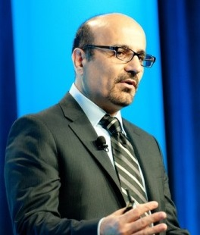
Keynote
3D VLSI:
Next Generation 3D Integration Technology
Dr. Karim Arabi
Vice President, Engineering at Qualcomm
Head of Corp. R&D ASIC
Published more than 100 papers
Holds several patents covering key SOC design technologies

