Slide 1

Analog Circuit and Layout Synthesis Revisited
Rob A. Rutenbar Bliss Professor and Head

Slide 2
A Talk in 3 Parts
Looking back: Analog history in review
Reflection: What we got right (& not…)
Looking forward: New opportunities

Slide 3

Looking Back….
-
+

Slide 4
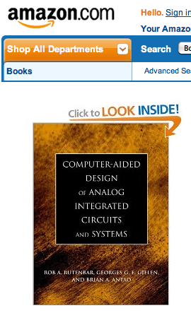








A Little Analog History…
In first decade (more or less) of 21st century, lots of startups doing first ‘real’ products, based on previous decade of R&D

Slide 5




A Little History…
Most of them died; a few got bought by big EDA players; technologies added to big, flagship analog/mixsig platforms

Slide 6
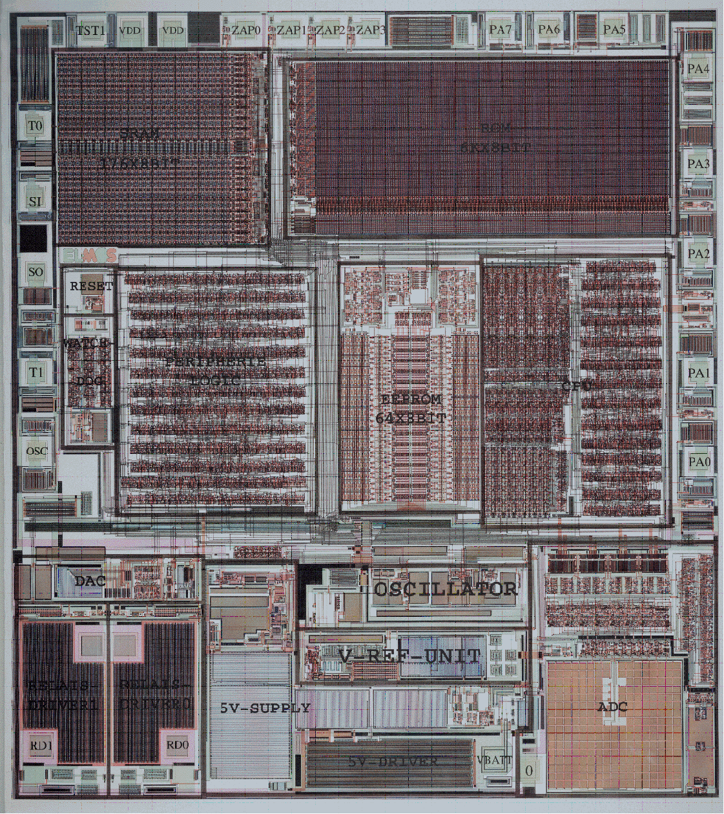
We Made Some Real Progress
Digital Methodology
Synthesis
Optimization
Verification
Reuse & IP
Analog Methodology
Toward Synthesis
Toward Layout
Toward Stat Optimize
Toward Reuse & IP

Slide 7
Core Strategy: Optimization-Based Design
All successful approaches have this overall structure
Use some clever form of heuristic or numerical search
Optimization engine: proposes candidate circuit solutions
Evaluation engine: evaluates quality of each candidate
Cost-based search: cost metric represents “goodness” of design
Optimization
Engine
Evaluated
Circuit
Performance
Candidate
Circuit
Design
Evaluation
Engine

Slide 8
Key Example: Sizing/Centering Tools
For device-level ckt design, you have to do these tasks
80/4
80/4
Gain 60dB
UGF 111MHz
Phase 60deg
Slew 2V/us
CMRR: 60dB
PSRR: 70dB
THD: 1%
...
Generate
proper
specs
Design
proper
circuit topology
Design
proper device
sizing/biasing
Optimize for
centering,
yield
Optimization works well here

Slide 9
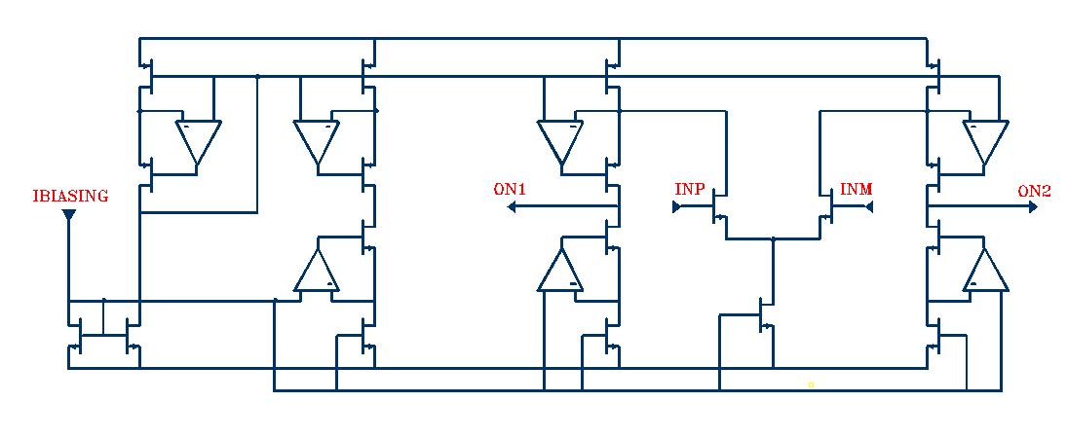
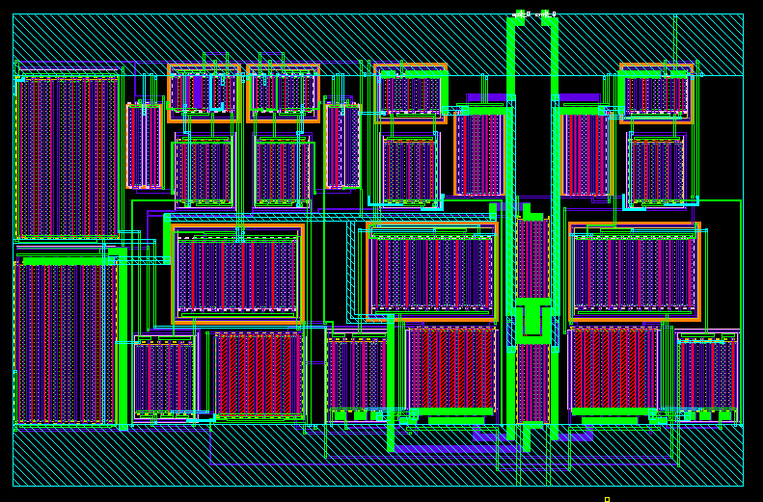
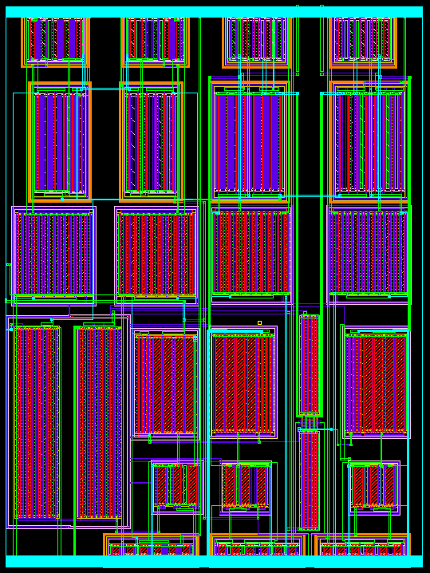
Some Commercial Successes
Ex: Sizing (and also layout) very useful for migration
Can size, optimize for perform/yield, layout, migrate …
STMicroelectronics result [Shah, Dugalleix, Lemery DATE02]
BIASING
AMPLIFIER
Area: ~9000 μm²
Auto
Sizing
Auto
Layout
Power: 9.15mW
180nm
Auto
Sizing
Auto
Layout
Area: ~4000 μm²
120nm
0.12
m
m
Power: 1.1mW
[Source: Cadence]
Both sizing and layout

Slide 10
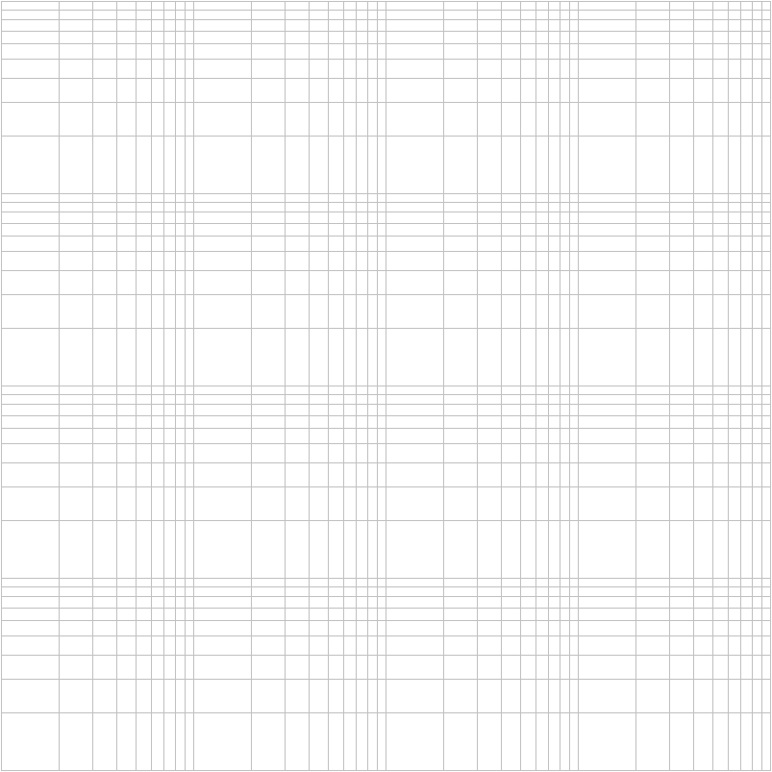
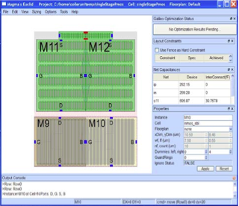
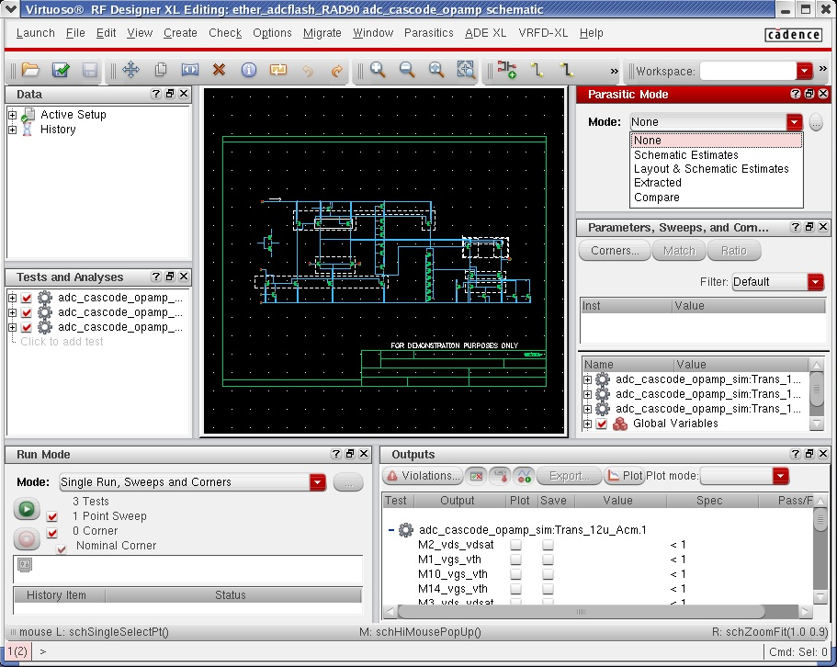
This is the Landscape that Emerged…
Simulation-based tools (“SPICE-in-the-loop”)
PRO: same setup as validation
PRO: quicker to set up
CON: slowest to run; scaleup?
Analytical modeler tools (“convex”, “smooth” etc)
PRO: run really, really fast
PRO: scale up to big things
CON: long setup; accuracy?
year
How long
to run?
month
week
day
Ex: Magma (SNPS) Titan AVP
hour
hour
day
week
year
How long to setup?
Ex: Cadence Virtuoso ADE
month

Slide 11
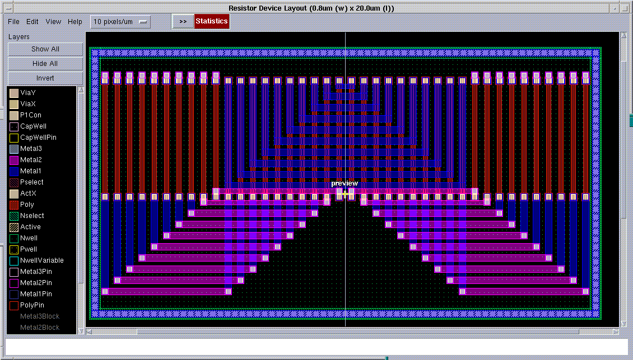
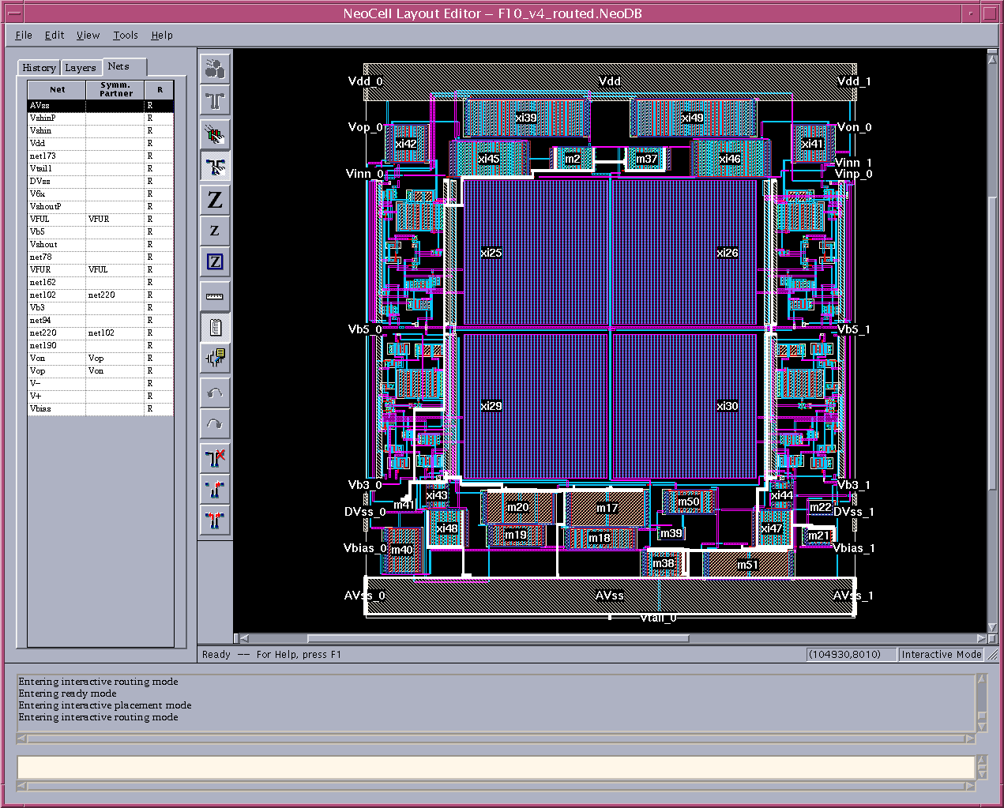
Core Layout Model: Design at 3 Levels
Devices play role like gate-level cells in digital ASIC, but more complex, malleable; we need device-generators
Macroscopic level, its all more like floorplanning, placement, routing
DEVICE
CELL
SYSTEM

Slide 12
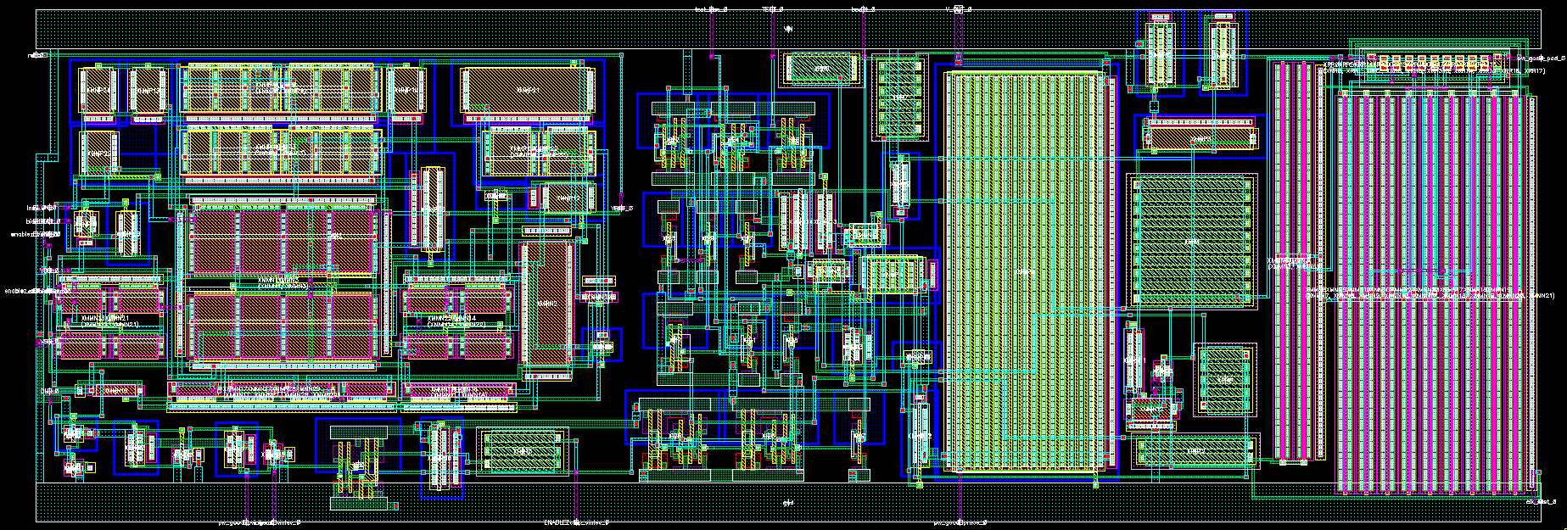
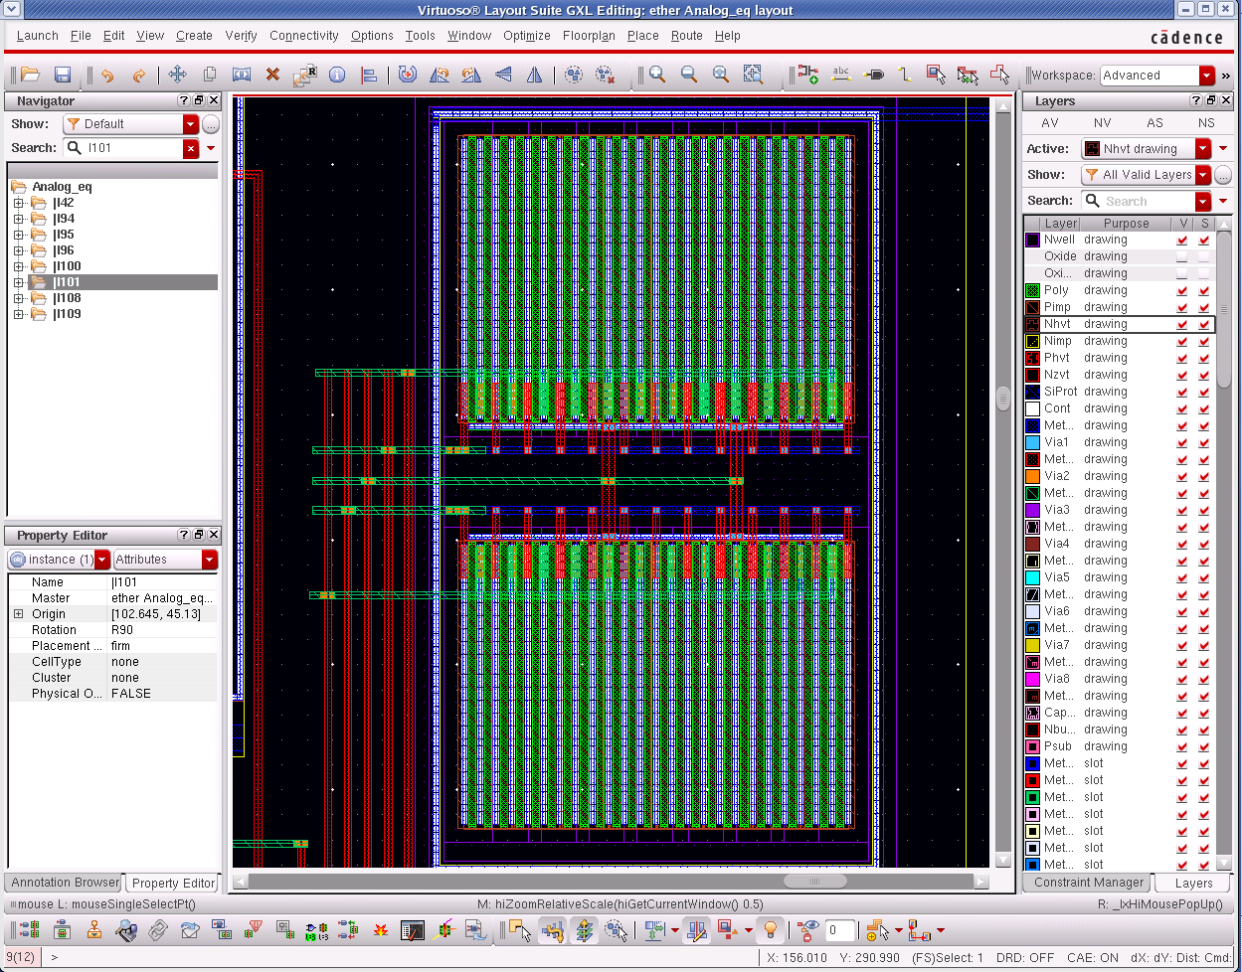
Analog Layout: DeviceGen + Place/Route
To first order, this is a (very constrained) place/route task…
But with very complex generators for atomic pieces (devices)
Source: Cadence
Image provided by ©2010 Cadence Design Systems, Inc.
All rights reserved worldwide

Slide 13
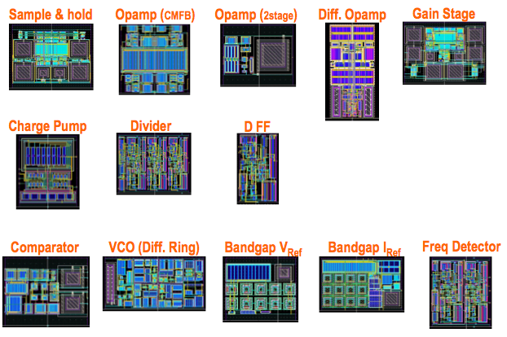
{Topologies+Sizing+Layout} → Soft IP Library
A library of topologies, constraints, and validation (sim) steps

Slide 14

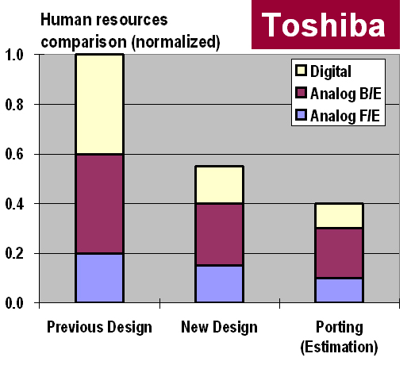
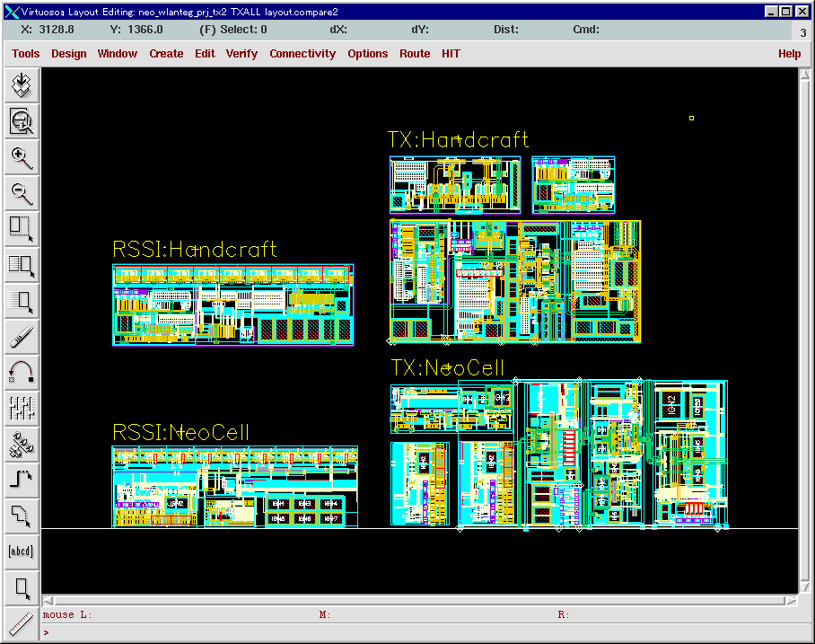
Again, Some Commercial Successes…
Handcrafted
Automatic Place/Route
Courtesy: Neolinear, Cadence

Slide 15
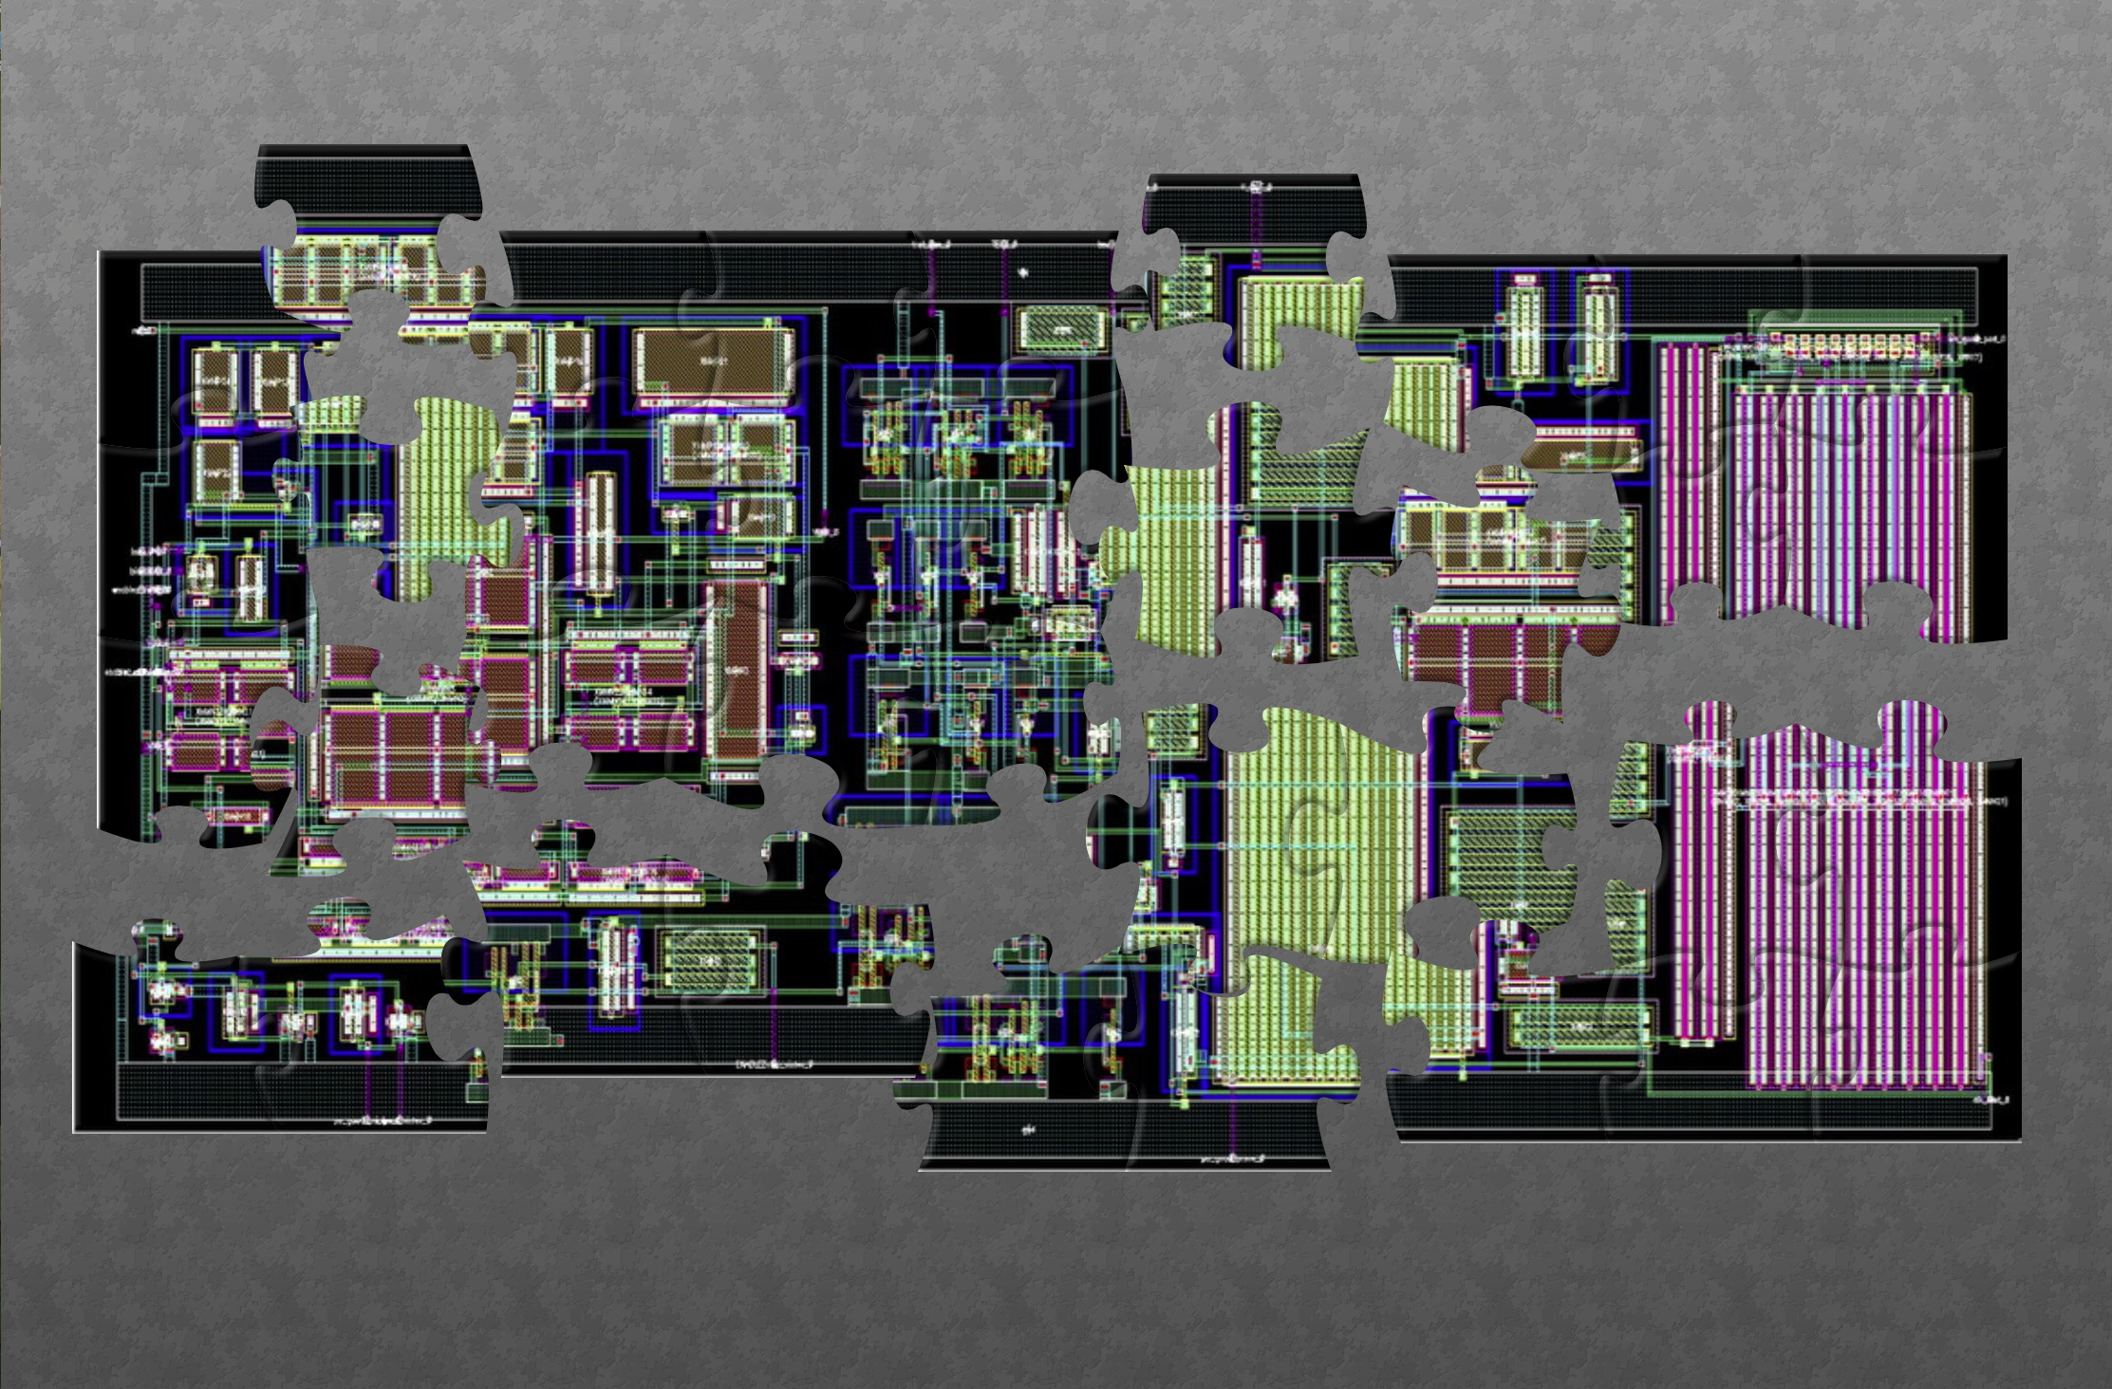
So, despite successes, why is analog NOT just ‘solved’ …?

Slide 16

Pause, Reflect…
-
+
?
…first, I propose to commit Philosophy
(I warned you….)

Slide 17

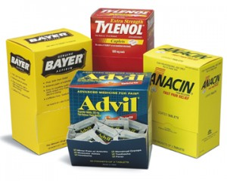
Aggressive Philosophical Proposition…
There are, in real world, only 2 kinds of EDA tools
INSURANCE
PAIN RELIEF
…and you must figure out what kind you are building

Slide 18
Lessons Learned from First-Gen Tools
Things we got RIGHT
Tools based on optimization
Models & setup for custom design are critical synthesis IP
Tools embedded in same design flows as manual ckt design
Divide & conquer (capture/synth/gen/P&R, etc) critical
Things we MISSED
Usage models – how real people do real designs
(I’ve called this “the Sociology of Circuit Design”)

Slide 19
My 1st Generation of Sizing Synthesis Tools
Built Sizing Optim
Then Constraint Mgr
Then Statistical Centering
Sizing
Expected
Designer
Interest
Statistical
Center
Constraint
Manage

Slide 20
My 1st Generation of Sizing Synthesis Tools
Built Sizing Optim
Then Constraint Mgr
Then Statistical Centering
Statistical
Center
Constraints
Actual
Designer
Interest
Sizing

Slide 21
Why this “Inversion” of Tool Interest
Revisit the sociology of the problem
Question: Is circuit sizing/biasing difficult (painful?) YES
Question: Will circuit design experts admit this? NO
Question: Is circuit centering for statistics painful? YES
Question: Will circuit design experts admit this? YES
Question: Is circuit setup for IP reuse painful? YES
Question: Will circuit design experts admit this? YES

Slide 22
1st Gen Synthesis Tools Revisited
Built Sizing Optim
Then Constraint Mgr
Then Statistical Centering
Statistical
Center
Constraints
Actual
Designer
Interest
Sizing

Slide 23
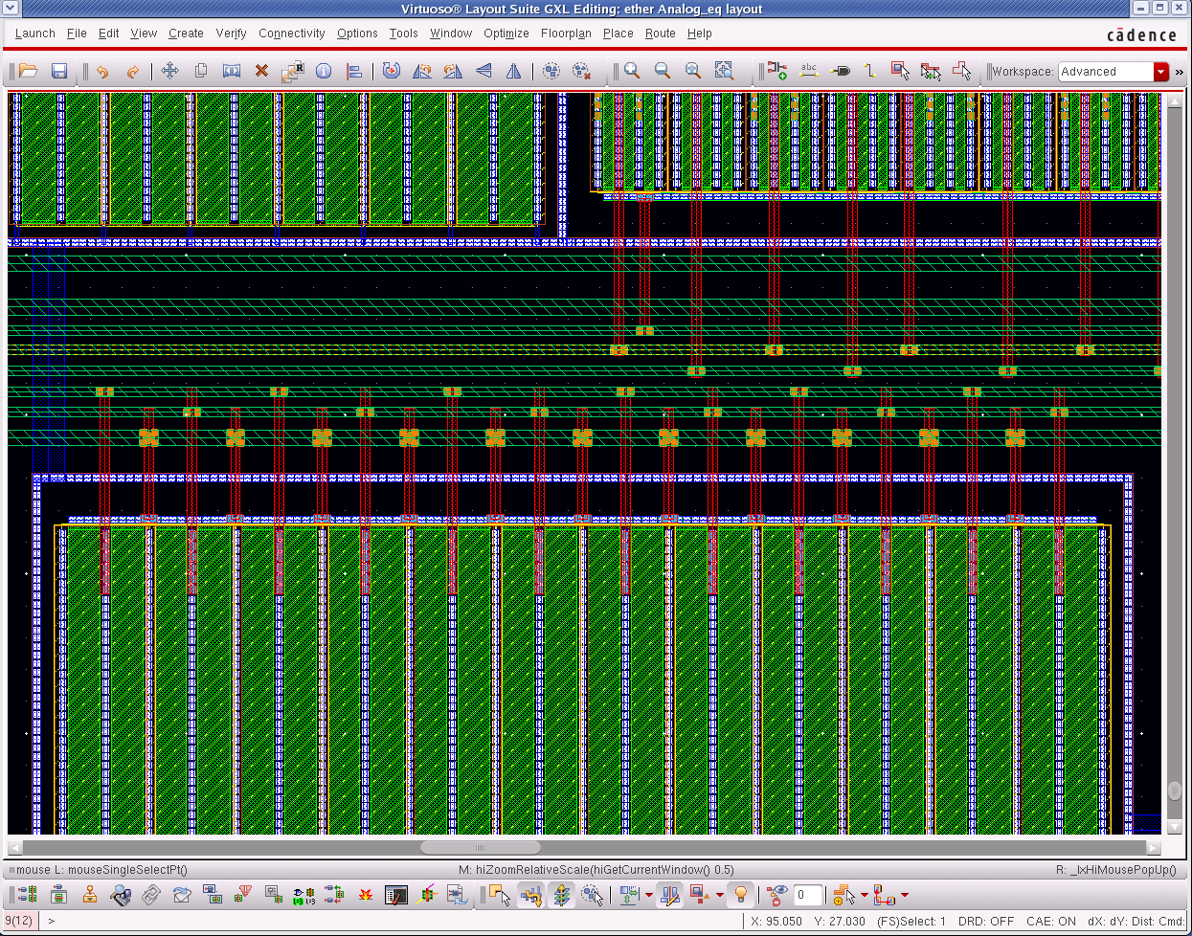
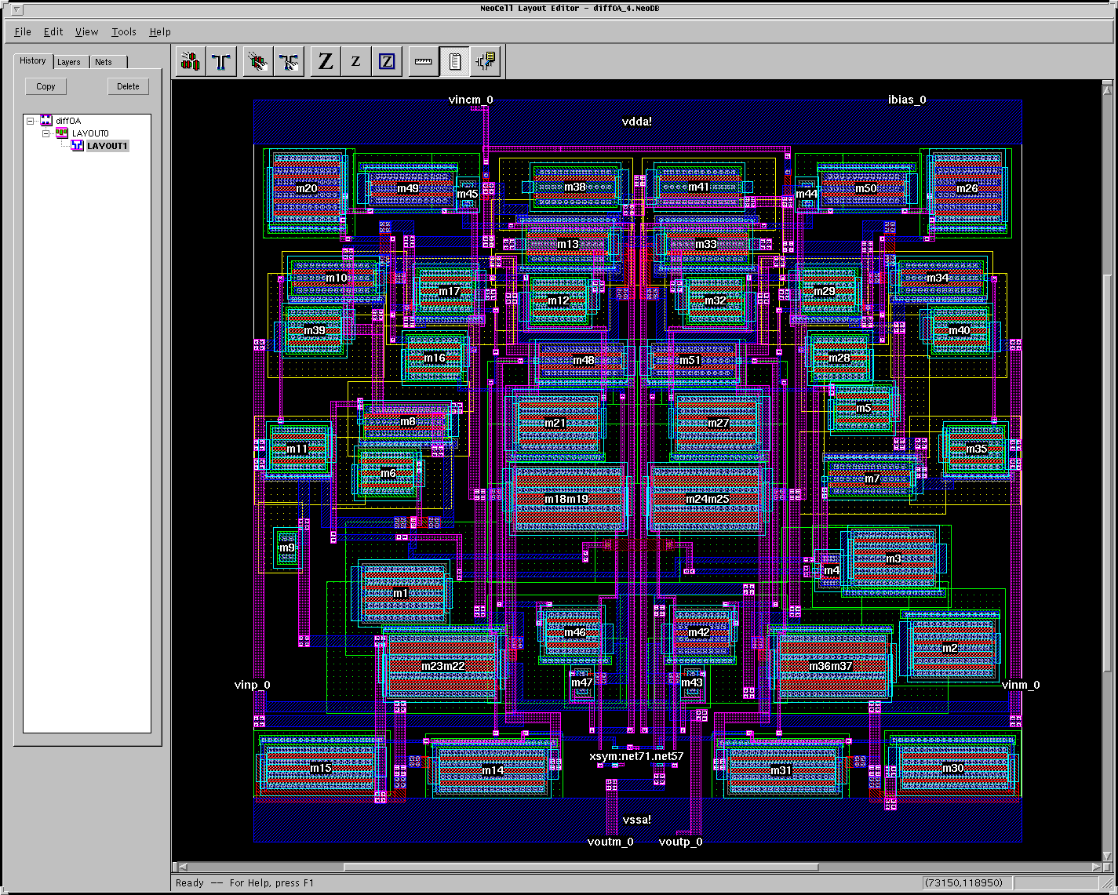
My 1st Gen of Layout Synthesis Tools
Built Device Generators
And Placer
And Router
Placer
Router
Expected
Designer
Interest
Gen

Slide 24
My 1st Gen of Layout Synthesis Tools
Built Device Generators
And Placer
And Router
Gen
Placer
Router
Actual
Designer
Interest

Slide 25
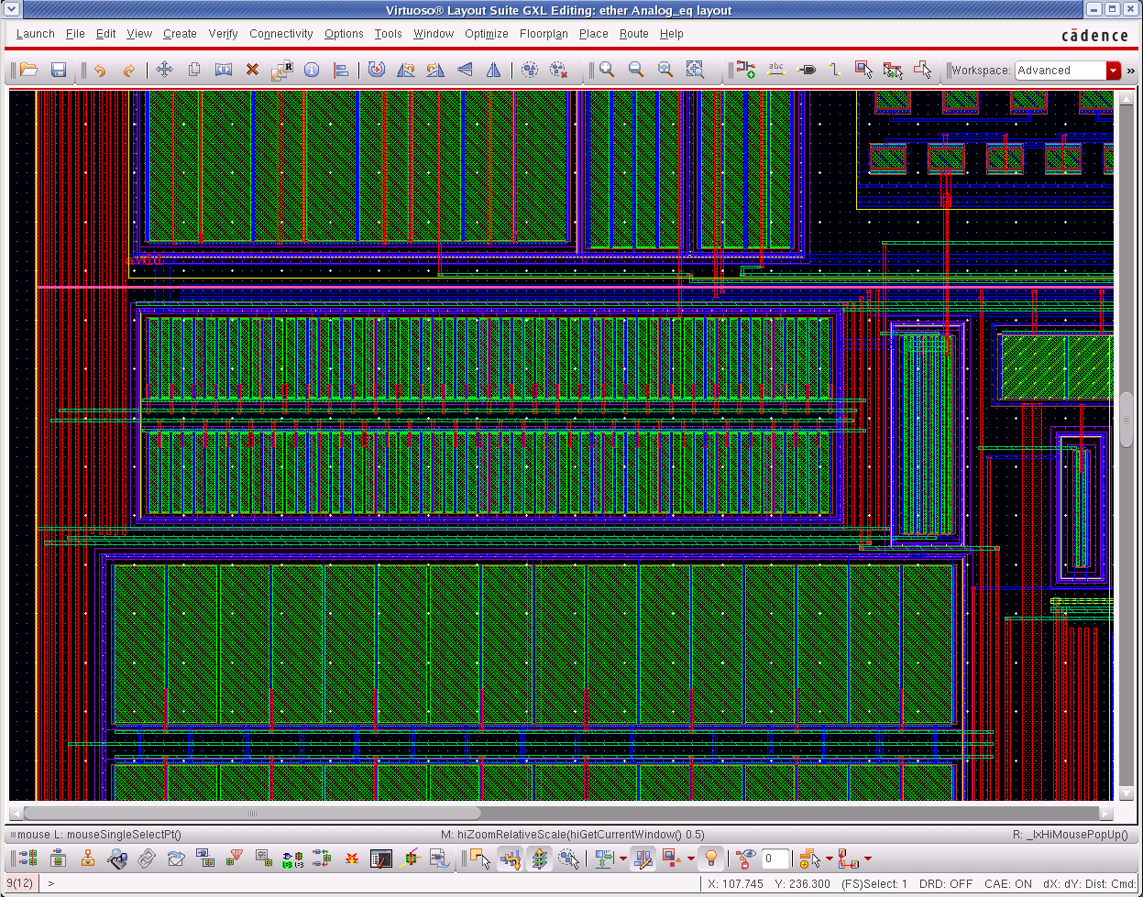
Why? #1 Your Schematic is NOT What You Lay Out
Analogy: Tech Mapping in ASIC
Map to what can really work in layout
Groups of devices w/ complex constraints
Surprise: enormous pain here to get right; gen’s reduce layout time & reduce size (a lot)
COMPLEX PLACEMENTS INSIDE GENERATORS
COMPLEX ROUTING INSIDE GENERATORS

Slide 26
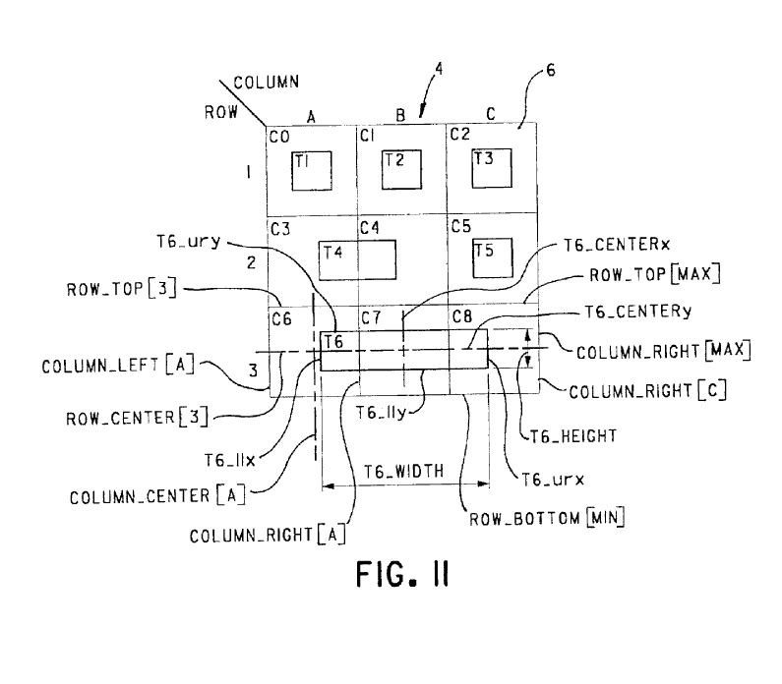
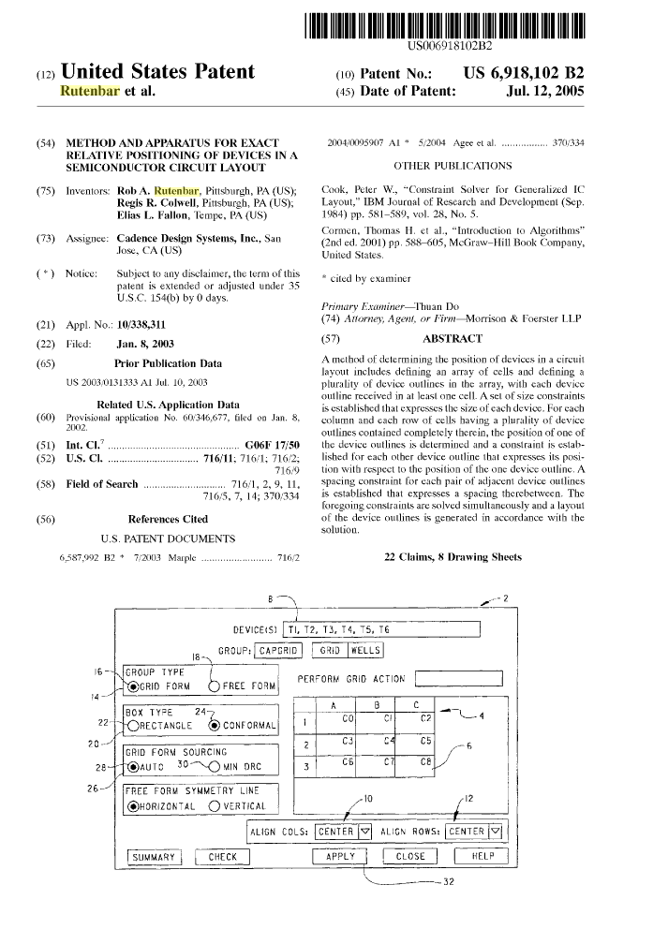
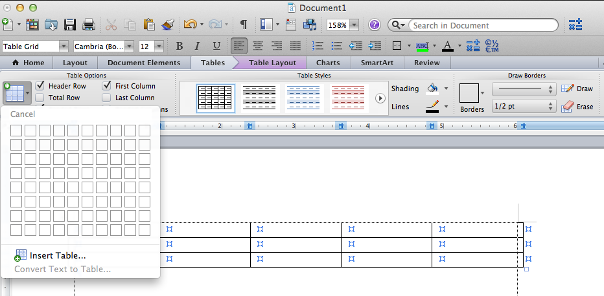
Surprising, Rich PD Area: Optimizers+Shapes+People

Slide 27
Why #2: Curse of Analog Aesthetics…
A thought experiment: I want 12 analog layouts of same ckt

Slide 28
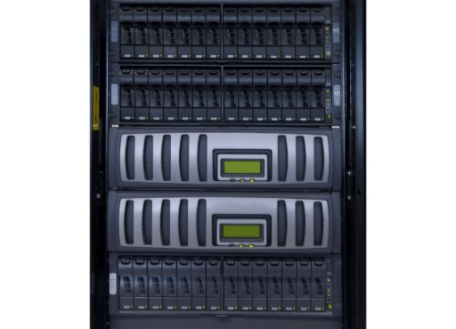
Why #2: Curse of Analog Aesthetics…
Experimental method: 11 layout experts && 1 CAD tool

Slide 29
Why #2: Curse of Analog Aesthetics…
Probability→1, will get 12 different layouts, all correct

Slide 30
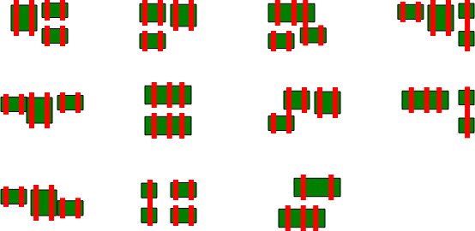
Why #2: Curse of Analog Aesthetics…
Probability→1, all humans think all other layouts look “wrong”
???

Slide 31

The Problematic Sociology of Analog Aesthetics
Hey, that looks strange, right?
Why this remarkable, relentless focus on “my way” of layout?
Aesthetics is often a surrogate for correctness
Not everything that matters in analog is robustly – or even explicitly, and correctly – represented in the design process.
Consequence: Aesthetics used for insurance!

Slide 32
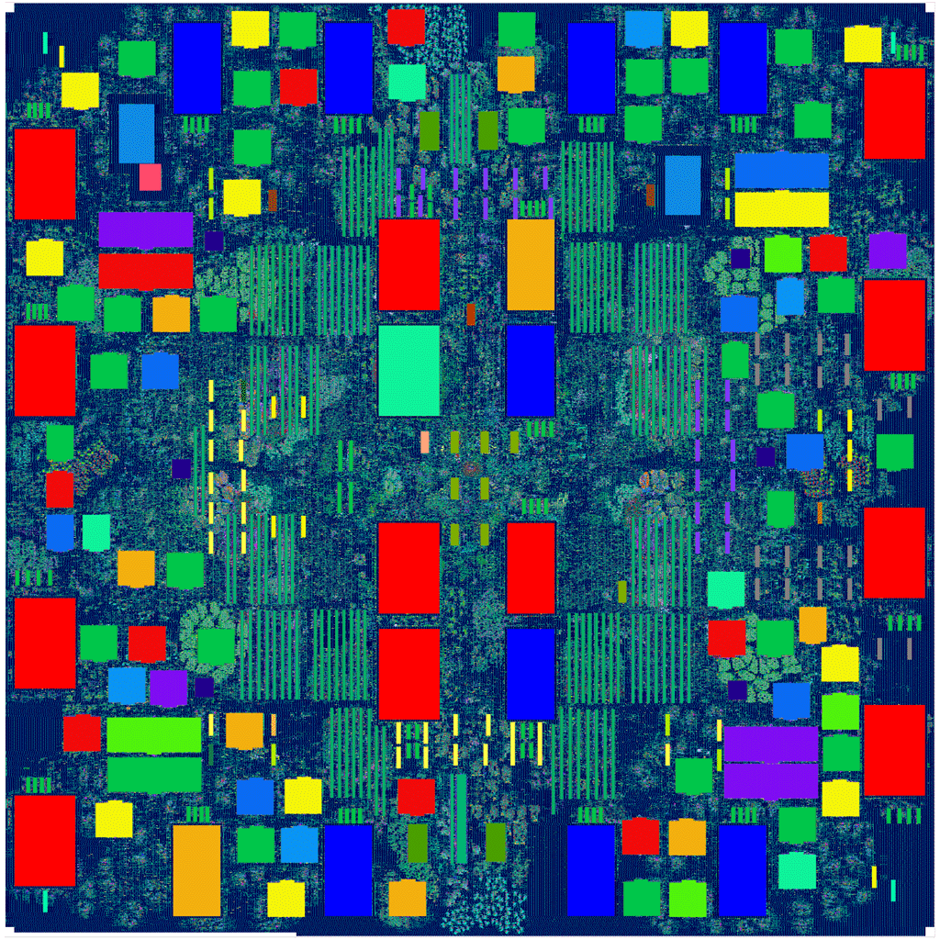

Aesthetic Engineering Dominates Analog Layout
This does not happen when you design 100M digital gates…
Why? Pain relief
of automation
is JUST SO BIG
Copyright © 1993, The National Gallery, London
Copyright © 1993, The National Gallery, London

Slide 33

Nevertheless—Many Successes, and Surprises
If it wasn’t really good, perhaps nobody would be stealing it…
Google’s helpful link to recipe to steal our circuit synthesis tool
For my CDNS friends: yes, link is now DEAD

Slide 34
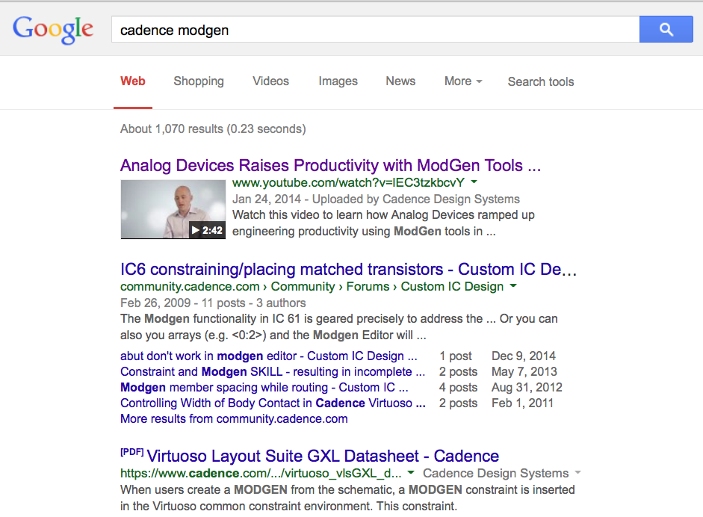
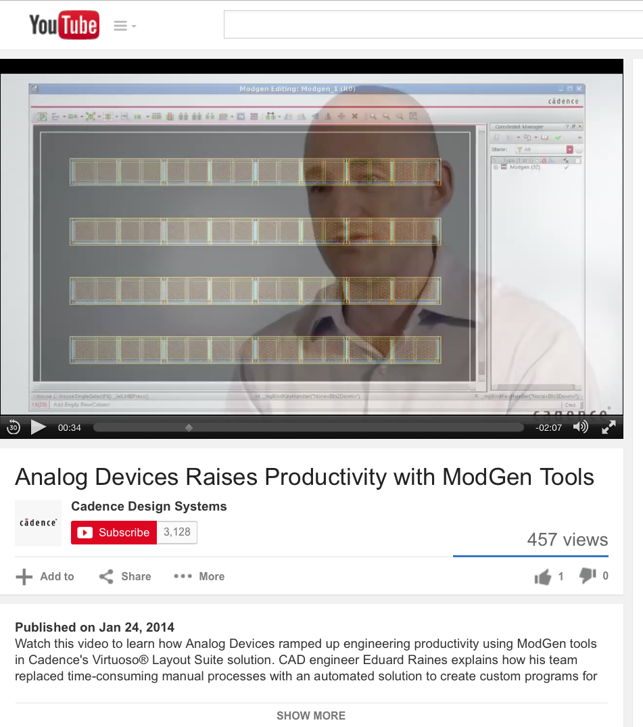
Nevertheless—Many Successes, and Surprises
How much do designers like smart device generators (the Cadence ModGen tools)…?

Slide 35

Future Opportunity….
-
+

Slide 36
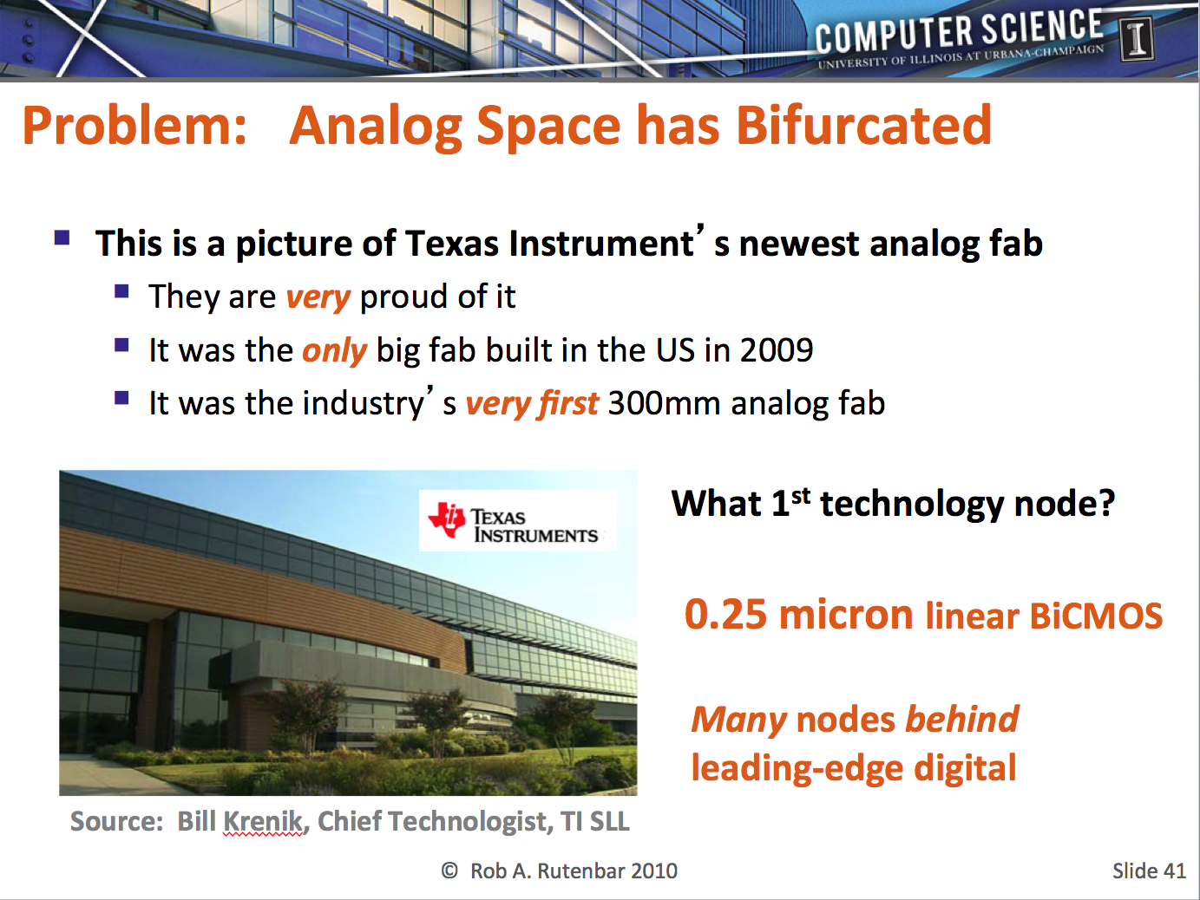
Ongoing Analog Bifurcation
When I was here talking in 2010, I showed this slide:

Slide 37
Context: Bifurcating Analog Space
Different kinds of design
problems driving a SPLIT
−
+
CHEAP analog
Need the function, cheap
Don’t need big SOC integration
Don’t need 10M gates of logic
PRO
Cheap, fewer nm effects
CON
Can’t integrate lots of gates
AGGRESSIVE analog
Need function AND integration
Essential for lowest-power and highest-volume parts
PRO
Power, access to 50M+ gates
CON
Nanometer grief is worse here

Slide 38
TODAY’S Bifurcating Analog Space
2001
2005
2010
2015
2020
130nm
90nm
65nm
45nm
32nm
22nm
14nm
10nm
7nm
5nm
Cheap analog
Aggressive analog
2010
Today, most CHEAP ANALOG is
moving rapidly toward whatever
is the LAST PLANAR CMOS NODE
AGGRESSIVE
analog in 14nm
→ 10nm
~28nm
WHY?

Slide 39


TODAY’S Bifurcating Analog Space
2001
2005
2010
2015
2020
130nm
90nm
65nm
45nm
32nm
22nm
14nm
10nm
7nm
5nm
CHEAP
AGGRESSIVE …….NEXT
CONNECTIVITY, MOBILITY,
INTERNET-OF-THINGS…
LOW
POWER
==

Slide 40
TODAY’S Analog CAD Opportunities
2001
2005
2010
2015
2020
130nm
90nm
65nm
45nm
32nm
22nm
14nm
10nm
7nm
5nm
CHEAP
AGGRESSIVE …….NEXT
LAST PLANAR NODE CMOS
Old problems: Worse
Grand challenge: Aesthetics
NEW NON-PLANAR NODES
New problems: Many
Grand challenge: FinFets

Slide 41
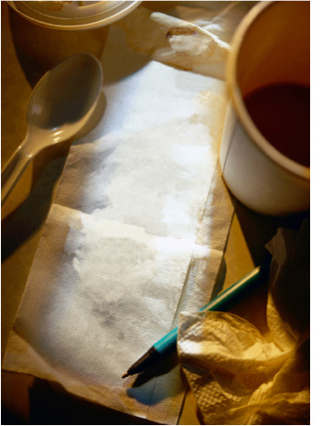
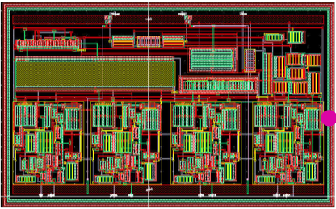
“Aesthetics Grand Challenge” for Layout
Allow layout designers to communicate geometric intent quickly and accurately, and use this to drive automatic layouts…
(1) Obtained Easy+Fast (interactive, real-time)
(2) Appear Trustworthy (exactly match designer’s aesthetics)
Think:
Floorplanning

Slide 42
‘Corollary’ Challenge
What layout happens in generators? What in place/route?
Hint: At final CMOS nodes, interesting action in both
GEN
PLACE & ROUTE

Slide 43
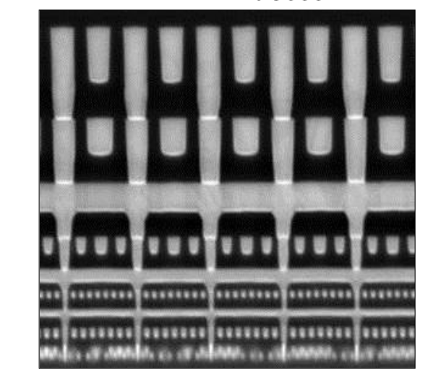
The FinFet Challenge
Devices are radically different, dominated by litho regularity
Interconnect stack also different, very fine pitch for lower Metals
Source: Jan et al, “A 22nm SOC platform technology featuring 3-D tr-gate and high-k/metal gate, optimized for ultra low power, high performance and high density SOC applications,”, Prof IEEE IEDM, 2012.
Source: R. Borkar, N. Bohr, S. Jourdan, Advancing Moore’s Law on 2014. Aug 11, 2014. Intel Corp.

Slide 44
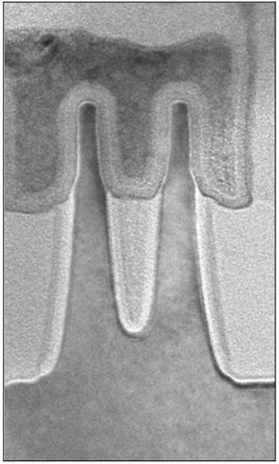
FinFet Consequence: Placement
Custom analog cells look like row-based layout…
gate
DUMMY
fin
fin
fin
fin
ACTIVE
fin
ACTIVE
fin
diffusion
DUMMY DEVICES, ON ALL SIDES
ACTIVE DEVICES
Strict matching rules (dummies)
Strict density rules (FEOL, MEOL)
Strict gradient rules for transition
Hard to do this by hand…
Source: R. Borkar, N. Bohr, S. Jourdan, Advancing Moore’s Law on 2014. Aug 11, 2014. Intel Corp.

Slide 45
FinFet Consequence: Routing
Lower metals very resistive (narrow) – can’t use for all signals
Intra-cell routing up stack to cross cell (like ASICs…)
DUMMY
ACTIVE
ACTIVE
??
DUMMY
ACTIVE
Source: Jan et al, “A 22nm SOC platform technology featuring 3-D tr-gate and high-k/metal gate, optimized for ultra low power, high performance and high density SOC applications,”, Prof IEEE IEDM, 2012.

Slide 46
FinFet Problems for Analog Layout
Electromigration
Analog wires carry big current
Sizing/tapering to meet rules
Self-heating
Wide (parallel) dev’s w/ current
Result: hot device problems
Signal and power routing
Many wires w/ varying currents
Sizing not just EM, also DC drop
Coloring, multi-exposure litho
Difficult for analog too
Worse: more custom design here
Geometrically, electrically
challenging to do RIGHT

Slide 47
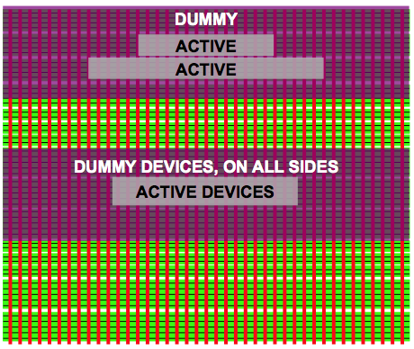
FinFet Upside (Sort of…) for Analog CAD
2001
2005
2010
2015
2020
130nm
90nm
65nm
45nm
32nm
22nm
14nm
10nm
7nm
5nm
CHEAP
AGGRESSIVE …….NEXT
Circuit Designer
Circuit Designer
Layout Designer
Layout Designer

Slide 48
Summary
Looking backward: Analog tools
CAD= Optimization + constraints
Learned: aesthetics & usage matter
Many successes ….
Looking ahead: Analog Tools
Analog essential for power/mobile
Time to take fresh look at aesthetics
FinFet: so different, so painful
Great opportunities ahead for PD

