Slide 1
Common-Centroid FinFET Placement
Considering the Impact of Gate Misalignment
ACM International Symposium on Physical Design 2015
Po-Hsun Wu*, Mark Po-Hung Lin**, Xin Li***, and Tsung-Yi Ho****
*Dept. of CSIE, National Cheng Kung University, Tainan, Taiwan
** Dept. of EE, National Chung Cheng University, Chiayi, Taiwan
*** Dept. of ECE, Carnegie Mellon University, Pittsburgh, PA, USA
**** Dept. of CS, National Chiao Tung University, Hsinchu, Taiwan

Slide 2
Outline
Introduction
Problem Formulation
Preliminary
Current Mismatch due to Gate Misalignment
Common-Centroid FinFET Placement Algorithms
Experimental Results
Conclusions

Slide 3
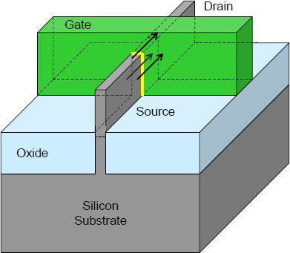
Introduction
Short channel effect
  Circuit performance, power dissipation, and reliability of circuits
New device technologies for circuit reliability improvement
Fin Field Effect Transistor (FinFET)
  Three-dimensional (3-D) structure
  Less leakage current
  Less threshold voltage variation
  Analog circuit application
Some lithography-induced process variations, such as gate misalignment, become more severe [23]
Source: Intel Corporation
[23] A rigorous simulation based study of gate misalignment effects in gate engineered
double-gate (DG) MOSFETs [Sarangia et al., Superlattices Microstruct.’13]

Slide 4
Gate Misalignment
A FinFET without gate misalignment (Figure (a)):
  Ideal situation
A real FinFET with gate misalignment (Figure (b)):
  The misaligned distance can be as large as 5nm [Valin et al., TED’12]
  Threshold voltage increase and drain current decrease
  Current mirror and differential pair
: Expected position of the printed gate
: The printed gate with drain-side misalignment
: The printed gate with source-side misalignment
Gate
Source
Drain
Source
Drain
-10
-5
0
5
10
(nm)
-10
-5
0
5
10
(nm)
(a)
(b)

Slide 5
Analog Related Works
Common-centroid transistor placement
  [Lin et al., DAC’09], [Lin et al., TCAD’11], [Long et al., ISCAS’05]
  [Ma et al., TCAD’11], [Ma et al., ICCAD’07], [Xiao et al., ASPDAC’09],
  [Yan et al., ISVLSI’06], and [Zhang et al., ICCCAS’10]
  General common-centroid rules including coincidence, symmetry, dispersion, and compactness
  However, none of them considered the impact of gate misalignment
  Chirality condition of transistors [Long et al., ISCAS’05]
Common-centroid capacitor placement
  [Huang et al., TODAES’13], [Li et al., TCAD’14], [Lin et al., ICCAD’12]
  [Lin et al., TCAD’12], [Lin et al., TCAD’13], and [Lin et al., DAC’14]
  These works are still not associated with the FinFET technology

Slide 6
Our Contribution
In this paper, we propose the novel common-centroid FinFET placement flow and algorithms
Our contributions can be summarized as follows:
  Consider the impact of gate misalignment and dispersion for next generation analog circuit design
  Derive a new quality metric for evaluating the matching quality of a current mirror
  Achieve much better current matching among transistors in a current mirror while maintaining high dispersion degree

Slide 7
Introduction
Problem Formulation
Preliminary
Current Mismatch due to Gate Misalignment
Common-Centroid FinFET Placement Algorithms
Experimental Results
Conclusions

Slide 8
Problem Formulation
Input: A netlist containing a set of sub-transistors of n FinFETs and general common-centroid rules
Objective: Determine the positions and orientations of all sub-transistors while minimizing the current mismatch, minimizing total placement area, and maximizing the dispersion degree
Constraint: Satisfy general common-centroid rules
*4- | -3* | *2- | -4*
-1* | -4* | *4- | -3*
*3- | -4* | *4- | *1-
*4- | -2* | *3- | -4*

Slide 9
Introduction
Problem Formulation
Preliminary
  Current Mirror
  Circuit Mismatch
  Spatial Correlation Model
Current Mismatch due to Gate Misalignment
Common-Centroid FinFET Placement Algorithms
Experimental Results
Conclusions

Slide 10
Current Mirror
Produce a constant replicated current, I_{Copy}, of a scaled transistor, T_{S}, by copying the reference current, I_{Ref}, of a reference transistor, T_{R}
  W _{TS} = n × W _{TR}, I_{Copy} = n × I_{ref}
A current mirror may have several replicated currents with different scaling factors
I_{Ref}
I_{Copy}
T_{R}
T_{S}
(a) A current mirror

Slide 11
Circuit Mismatch
Matching quality optimization of a current mirror
The circuit mismatch occurs due to process variation [10]
  Systematic mismatch
  Random mismatch
To reduce systematic mismatch
  Divide all transistors into several
  smaller and identical sub-transistors
  Place them symmetrically with
  respect to a common center point
To reduce random mismatch
  Distribute all sub-transistors throughout a placement
  Exhibit the highest degree of dispersion
  Measure the dispersion degree by the spatial correlation model [10]
: Gate : Fin
: Diffusion : Metal
  : Common center point
D
M₁
S
M₂
D
D
M₂
S
M₁
D
(a)
[10] Mismatch-aware common-centroid placement for arbitrary-ratio
capacitor arrays considering dummy capacitors [Lin et al., TCAD’12]

Slide 12


Spatial Correlation Model
Assume that all sub-transistors are arranged in an r × c matrix
For any two sub-transistors, st_{i} and st_{j}, located at the entries in the r_{i}^{th} row and c_{i}^{th} column and the r_{j}^{th} row and c_{j}^{th} column, their correlation coefficient ρ_{ij}
where ρ_{u} = 0.9 and l = 1 [17]
For n transistors, the dispersion degree L
(1)
(2)
[17] Impact of capacitance correlation on yield enhancement of
mixed-signal/analog integrated circuits [Luo et al., TCAD’08]

Slide 13
Introduction
Problem Formulation
Preliminary
Current Mismatch due to Gate Misalignment
  Evaluation of Current Mismatch
  A Case Study
Common-Centroid FinFET Placement Algorithms
Experimental Results
Conclusions

Slide 14
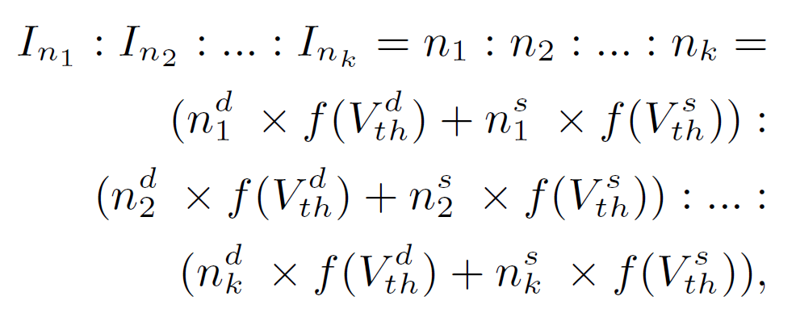
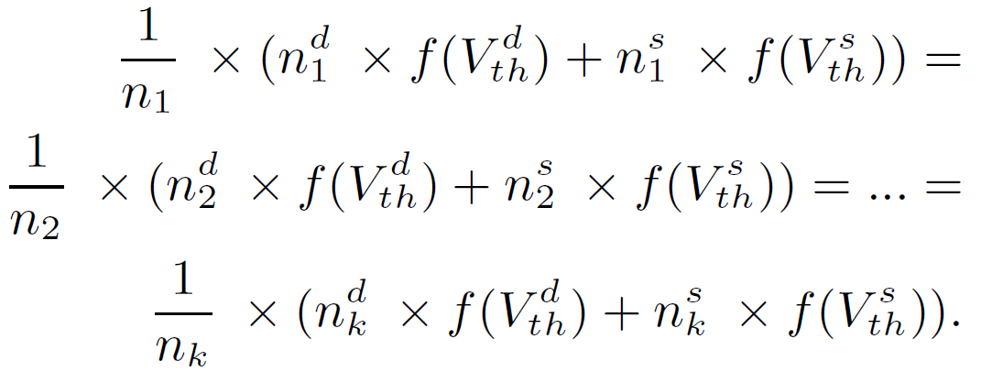
Evaluation of Current Mismatch (1/3)
Drain current variation due to the gate misalignment
Evaluate the current mismatch of a current mirror with the impact of gate misalignment
Given a set of k transistors and each transistor, t_{i}, contains n_{i} sub-transistors with determined orientations
Based on the multiplication property of equality
(3)
(4)

Slide 15
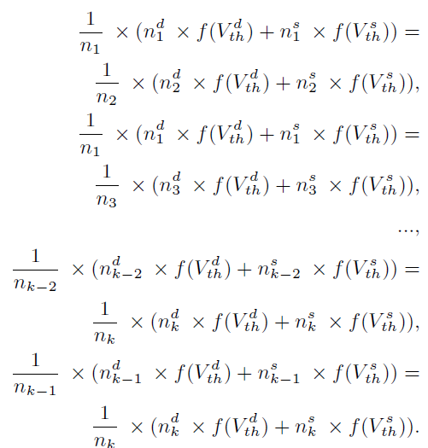
Evaluation of Current Mismatch (2/3)
After splitting the Equation (4), we can obtain a set of k×(k-1) equalities
(5)

Slide 16
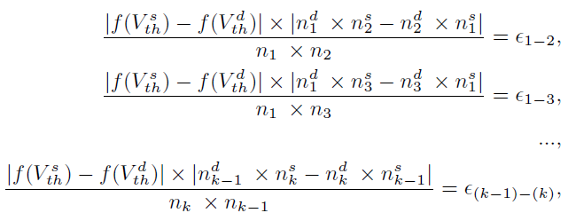
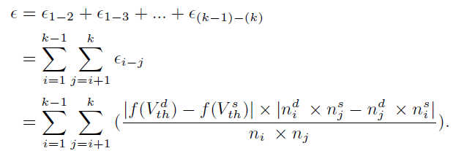
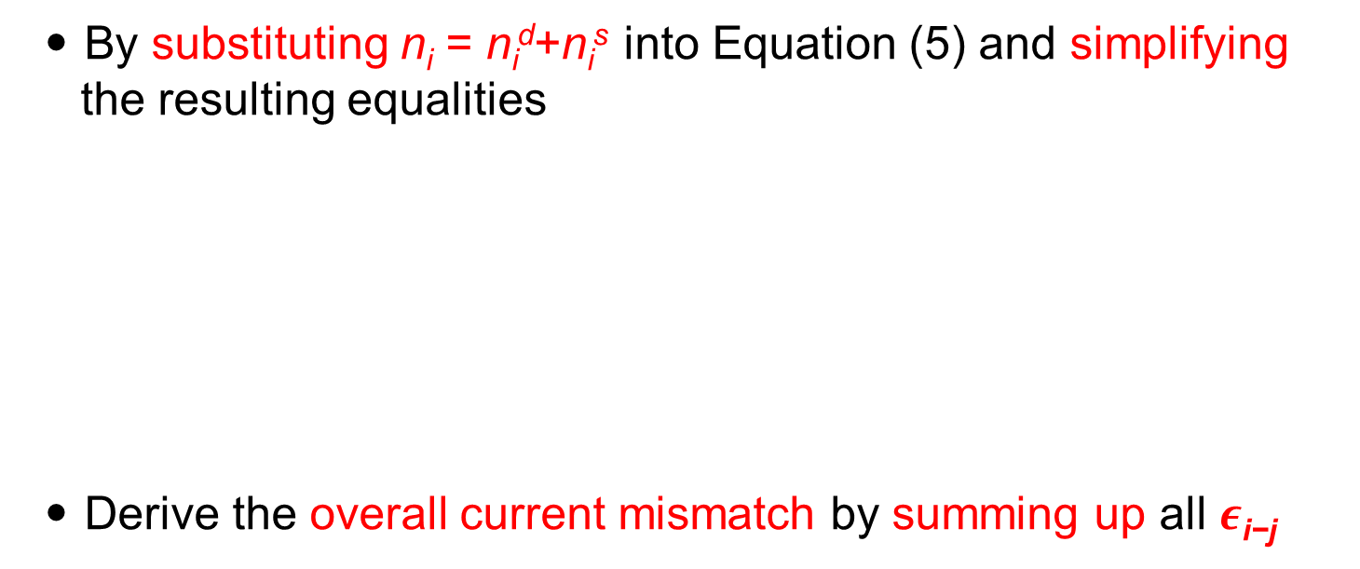
Evaluation of Current Mismatch (3/3)
By substituting n_{i} = n_{i}^{d}+n_{i}^{s} into Equation (5) and simplifying the resulting equalities
Derive the overall current mismatch by summing up all $ε\text{i}\text{−}\text{j}$
(6)
(7)

Slide 17
A Case Study
Estimate the drain current of each transistor based on the BSIM-CMG model [15]
*: Drain -: Source
I_{Ref}
*2- | -3* | *4- | -4*
-3* | *4- | -4* | *1-
-1* | *4- | -4* | *3-
-4* | *4- | -3* | *2-
*3- | -4* | *2- | -4*
-4* | *3- | -4* | *1-
-1* | *4- | -3* | *4-
-4* | *2- | -4* | *3-
*4- | -3* | *2- | -4*
-1* | -4* | *4- | -3*
*3- | -4* | *4- | *1-
*4- | -2* | *3- | -4*
I₂
I₃
I₄
M₁
M₄
M₂
M₃
(a)
(b)
(c)
(d)
Table 1: Comparisons of the simulated current ratios, current mismatch (ϵ) and dispersion degree (L) for different common-centroid placements in (b)–(d).
Placements | # of Sub-transistors | Simulated Current Ratio | ϵ | L
Figure (b) | 2, 2, 4, 8 | 1.00 : 0.93 : 2.07 : 4.00 | 0.16 | 5.6827
Figure (c) |  | 1.00 : 0.93 : 1.93 : 4.14 | 0.17 | 5.7338
Figure (d) |  | 1.00 : 1.00 : 2.00 : 4.00 | 0.00 | 5.7459
[15] BSIM 3v3.2 MOSFET model users' manual [Liu et al., Technical Report’98]

Slide 18
Introduction
Problem Formulation
Preliminary
Current Mismatch due to Gate Misalignment
Common-Centroid FinFET Placement Algorithms
  Determination of Sub-transistor Orientations
    Minimum-weight Clique Model
  Common-Centroid FinFET Placement Considering Dispersion and Diffusion Sharing
  Dispersion Degree Maximization
Experimental Results
Conclusions

Slide 19
Determination of Sub-transistor Orientations
Enumerate all configurations of sub-transistor orientations
A k-finger FinFET has k+1 configurations
Minimum-weight Clique Problem
Configuration 1
Configuration 2
3 drain-side misalignment
0 source-side misalignment
2 drain-side misalignment
1 source-side misalignment
S
A
D
S
A
D
S
A
D
S
A
D
S
A
D
S
A
D
(a)
(b)
Configuration 3
Configuration 4
1 drain-side misalignment
2 source-side misalignment
0 drain-side misalignment
3 source-side misalignment
S
A
D
S
A
D
S
A
D
S
A
D
S
A
D
S
A
D
(c)
(d)

Slide 20
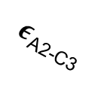

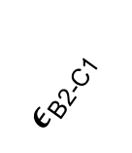
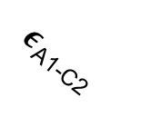
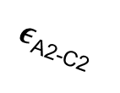

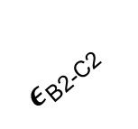
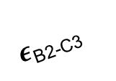


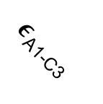
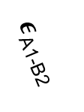
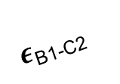

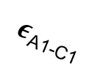
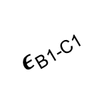
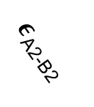
Minimum-weight Clique Problem [3]
n_{i}^{s}: n_{i}^{s} sub-transistors with source-side misalignment
n_{i}^{d}: n_{i}^{d} sub-transistors with drain-side misalignment
$ε$_{ti-tj}: the current mismatch between t_{i} and t_{j}
n_{A1}^{s}, n_{A1}^{d}
$ε$_{A1-C1}
$ε$_{A1-C2}
n_{A2}^{s}, n_{A2}^{d}
$ε$_{A2-C1}
$ε$_{A2-C2}
n_{C1}^{s}, n_{C1}^{d}
$ε$_{A1-C3}
$ε$_{A2-B1}
$ε$_{A1-B2}
$ε$_{A2-C3}
$ε$_{A2-B2}
$ε$_{A1-B1}
$ε$_{B1-C1}
n_{C2}^{s}, n_{C2}^{d}
$ε$_{B1-C2}
$ε$_{B2-C2}
$ε$_{B2-C1}
$$ε\text{B}\text{1−}\text{C}\text{3}$$
n_{B1}^{s}, n_{B1}^{d}
n_{C3}^{s}, n_{C3}^{d}
$ε$_{B2-C3}
n_{B2}^{s}, n_{B2}^{d}
[3] Introduction to Algorithms [Cormen, McGraw-Hill’01]

Slide 21
Introduction
Problem Formulation
Preliminary
Current Mismatch due to Gate Misalignment
Common-Centroid FinFET Placement Algorithms
  Determination of Sub-transistor Orientations
  Common-Centroid FinFET Placement Considering Dispersion and Diffusion Sharing
    Euler Path
    Dispersion Degree Maximization during Searching the Euler Path
  Dispersion Degree Maximization
Experimental Results
Conclusions

Slide 22
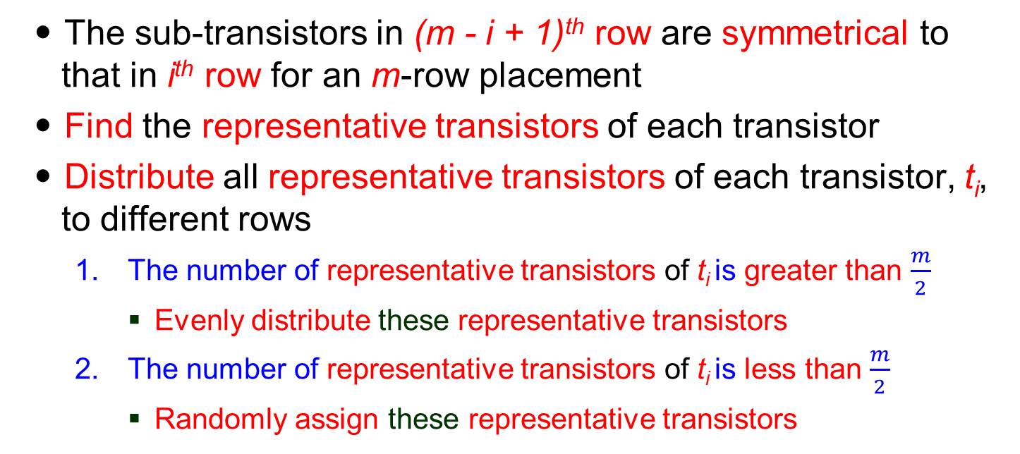
Common-Centroid FinFET Placement Considering Dispersion and Diffusion Sharing
The sub-transistors in (m - i + 1)^{th} row are symmetrical to that in i^{th} row for an m-row placement
Find the representative transistors of each transistor
Distribute all representative transistors of each transistor, t_{i}, to different rows
  The number of representative transistors of t_{i} is greater than $\frac{m}{2}$
    Evenly distribute these representative transistors
  The number of representative transistors of t_{i} is less than $\frac{m}{2}$
    Randomly assign these representative transistors
*1-
-2*
-3*
*3-
*: Source
-: Drain
*4-
-4*
*4-
-4*
*5-
-5*
*3-
*4-
-5*
*5-
*5-
-5*
-5*
*5-
-5*
*5-
*1-
-4*
-5*
*5-
(a)
(b)

Slide 23
Euler Path
Construct the diffusion graph and find the Euler path [20] to generate the respective placement for each row
Two representative transistors are called unrelated transistors if they belong to different transistors
Two representative transistors are called related transistors if they belong to the same transistor
*i-: Gate misalignment
from Source to Drain
-i*: Gate misalignment
from Drain to Source
: Transistor 1
: Transistor 2
: Transistor 3
: Drain terminal
: Source terminal
D
D
-1*
-2*
*2-
*3-
*3-
-3*
S
S
(a)
(b)
[20] Automated hierarchical CMOS analog circuit stack generation with intramodule connectivity and matching considerations [Naiknaware et al., JSSC’99]

Slide 24


Dispersion Degree Maximization during Searching the Euler Path
(1)
(2)
To maximize the dispersion degree
  Maximize
    Minimize the distance of unrelated transistors
  Minimize
    Maximize the distance of related transistors
Repeat the above steps for each row and produce the symmetrical row
D
: Transistor 1
: Transistor 2
: Transistor 3
*: Source
-: Drain
S
*3-
-2*
*3-
-1*
*2-
-3*
(a)
(b)

Slide 25
Introduction
Problem Formulation
Preliminary
Current Mismatch due to Gate Misalignment
Common-Centroid FinFET Placement Algorithms
  Determination of Sub-transistor Orientations
  Common-Centroid FinFET Placement Considering Dispersion and Diffusion Sharing
  Dispersion Degree Maximization
    Shortest Path Problem
Experimental Results
Conclusions

Slide 26
Dispersion Degree Maximization
Adjust the relative positions of different sub-transistors among different rows
Placement rotation
  Iteratively move the sub-transistor at the end of the row to the beginning of the row
The simultaneous selection of the best placement of different rows is formulated as the shortest path problem
*4- | -3* | *2- | -4*
-4* | *4- | -3* | *2-
(a) Initial placement
(b) Derivation 1
*2- | -4* | *4- | -3*
-3* | *2- | -4* | *4-
(c) Derivation 2
(d) Derivation 3

Slide 27
Shortest Path Problem
Each row is represented by a group node
Each possible placement is denoted by an element node
The weight of each edge between two element nodes is the dispersion degree
: Group node
Ri^{j}
: Element node
R_{i}¹R_{i+1}¹
Weight
R₁¹
R_{i}¹
R_{i+1}¹
R_{m}¹
0
0
0
R₁²
R_{i}²
R_{i+1}²
R_{m}²
0
S
.
.
.
.
.
.
.
.
.
.
.
.
T
0
0
R₁^{k}
R_{i}^{k}
R_{i+1}^{k}
R_{m}^{k}

Slide 28
Introduction
Problem Formulation
Preliminary
Current Mismatch due to Gate Misalignment
Common-Centroid FinFET Placement Algorithms
Experimental Results
  Experimental Setup
  Numerical Comparisons
Conclusions

Slide 29
Experimental Setup
Implemented our algorithm in MATLAB language on a 3.4 GHz Windows machine with 16GB memory
Comparison
  [14] Thermal-driven analog placement considering device matching [Lin et al., TCAD’11]
  Without gate misalignment
Tested on a set of current mirrors with different width ratios of the scaled transistors
Table 2: Benchmark statistics.
Testcases | # of Sub-transistors
CM1 | 1, 1
CM2 | 1, 1, 2
CM3 | 1, 1, 2, 4
CM4 | 1, 1, 2, 4, 8
CM5 | 1, 1, 2, 4, 8, 16
CM6 | 1, 1, 2, 4, 8, 16, 32
CM7 | 1, 1, 2, 4, 8, 16, 32, 64
CM8 | 1, 1 ,2, 4, 8, 16, 32, 64, 128

Slide 30
Numerical Comparisons
Table 3: Comparisons of simulated current ratios, current mismatch (ϵ), and dispersion degree (L), based on Lin et al.’s and our approaches.
Test Cases | Lin et al.’s approach [14] |  |  | Our approach |  |  | Comparison (%)
 | Simulated Current Ratio | ϵ / L | Time (s) | Simulated Current Ratio | ϵ / L | Time (s) | ϵ / L | Time
CM1 | 1:0.93 | 0.07/0.90 | 0.01 | 1:1 | 0.00/0.90 | 0.01 | -100/0.00 | 0.00
CM2 | 1:1:1.85 | 0.14/2.73 | 0.02 | 1:1:2 | 0.00/2.73 | 0.02 | -100/0.00 | 0.00
CM3 | 1:1:1.85:3.92 | 0.22/5.55 | 0.03 | 1:1:1.93:3.86 | 0.12/5.58 | 0.04 | -46.14/0.61 | 33.10
CM4 | 1:1:1.85:3.92:4.00 | 0.35/9.19 | 0.04 | 1:1:1.93:3.93:7.63 | 0.24/9.48 | 0.05 | -30.00/3.18 | 25.13
CM5 | 1:1:1.85:3.77:8.00: 15.11 | 0.41/13.69 | 0.07 | 1:1:1.93:3.86:7.78: 15.48 | 0.28/14.23 | 0.11 | -32.29/3.94 | 71.45
CM6 | 1:0.93:1.92:3.85 :7.48: 15.11 : 31.26 | 0.41/13.69 | 0.20 | 1:1:1.93:3.93:7.63: 15.33:30.89 | 0.45/19.91 | 0.55 | -25.72/4.31 | 180.87
CM7 | 1:1:1.85:3.85:7.92: 15.63 : 31.11 : 60.95 | 0.79/25.23 | 0.75 | 1:1:1.93:3.86:7.71: 15.26 :30.81:61.77 | 0.48/26.36 | 3.38 | -38.83/4.47 | 351.26
CM8 | 1:0.93:1.85:3.85:7.55: 15.48:31.26:61.77:122.70 | 0.93/32.13 | 3.44 | 1:1:1.93:3.86:7.71: 15.48:30.96:61.92:122.60 | 0.54/33.62 | 5.10 | -41.86/4.63 | 48.19

Slide 31
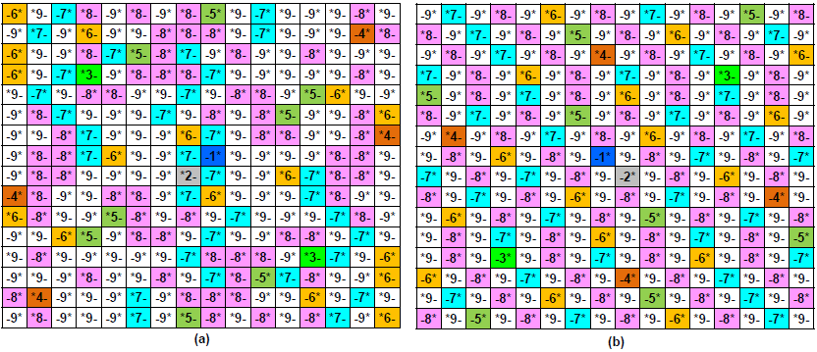
Generated Placement of CM8
*: Drain -: Source
The resulting common-centroid FinFET placements of CM8. (a) The placement generated by Lin et al.’s approach.
(b) The placement generated by our approach.

Slide 32
Introduction
Problem Formulation
Preliminary
Current Mismatch due to Gate Misalignment
Common-Centroid FinFET Placement Algorithms
Experimental Results
Conclusions

Slide 33
Conclusions
In this paper, we have introduced the impact of gate misalignment to the drain current of different common-centroid FinFET placements
We have proposed a novel placement flow and algorithms to generate the common-centroid FinFET placements while considering the impact of gate misalignment and dispersion
Experimental results have shown that the proposed algorithms can effectively reduce the impact of gate misalignment to the drain current and maximize the dispersion degree of a common-centroid FinFET placement

Slide 34
Thank You for
Your Attention!

