Slide 1

Q-Learning Based Dynamic Voltage Scaling for Designs with Graceful Degradation
Yu-Guang Chen^{1,2}, Wan-Yu Wen¹, Tao Wang²,
Yiyu Shi², and Shih-Chieh Chang¹
¹Department of CS, National Tsing Hua University, HsinChu, Taiwan
²Department of ECE, Missouri University of Science and Technology, Rolla, Mo, USA
Notes:
Ladies and gentlemen, good morning. The topic of today’s talk is “Critical Path Monitor Enabled Dynamic Voltage Scaling for Graceful Degradation in Sub-Threshold Designs.”
I am Yu-Guang Chen from National Tsing Hua University, Hsinchu, Taiwan.
This is a joint work with my friends Tao Wang, Kuan-Yu Lai, Wan-Yu Wen, and Prof. Yiyu Shi from Missouri University of Science and Technology, USA. And my advisior Shih-Chieh Chang from National Tsing Hua University, Hsinchu Taiwan.
The motivation of this work is as follows.

Slide 2
Outline
Introduction and Motivation
Q-Learning Based DVS Scheme
Experimental Results
Conclusions

Slide 3
Outline
Introduction and Motivation
Q-Learning Based DVS Scheme
Experimental Results
Conclusions

Slide 4
Introduction and Motivation
Power consumption is an significant problem in modern IC designs.
Dynamic voltage scaling (DVS) can efficiently reduce operating power.
  Dynamically switch operating voltage and/or operating frequency
  Workload, Process, Environment variations

Slide 5
Introduction and Motivation
The key concept of DVS is to decide the optimal operating voltage for different scenarios.
Deterministic DVS schemes
  Construct state table off-line on various statistical analysis.
  Optimal voltage comes from the real-time feedback and the state table.

Slide 6
Introduction and Motivation
Hard for two reasons:
  Many uncertainties are non-Gaussian and tightly correlated;
  Much information may not be known a priori.
Reinforcement learning based DVS schemes
  Dynamically adjust the policy at runtime based on the system performance
  through various learning procedures

Slide 7
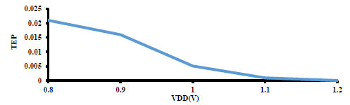
Introduction and Motivation
Graceful degradation
  Allow timing errors to occur with a low probability
  Significantly reduce operating power
  Timing Error Probability (TEP)
  Only a few prior works consider DVS with Graceful degradation

Slide 8
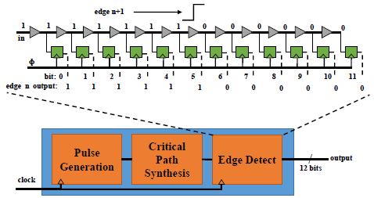
Introduction and Motivation
Critical Path Monitor (CPM)
  Measures critical path delays
  Reflects the influence of process and temperature variations dynamically

Slide 9
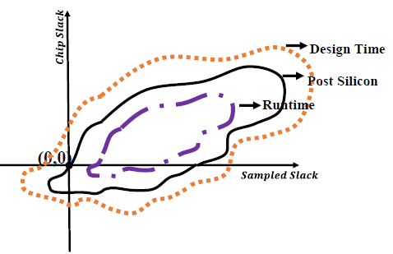
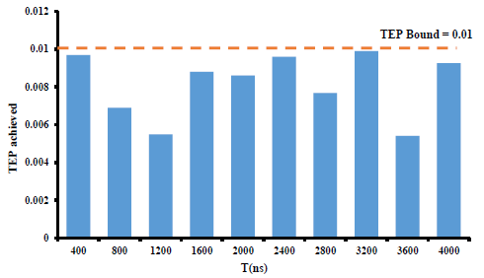
Introduction and Motivation
Motivation example
  Deterministic joint probability density function (JPDF) based DVS scheme for graceful degradation
  Calls for learning based DVS schemes

Slide 10
Problem Formulation
Given
  A chip with CPM placed,
  the voltage candidates for DVS, and
  a TEP bound and a timing window length for TEP measurement,
Determine
  The optimal operating voltages at runtime based on the sampled slack from the CPM
Goal
  The operating power is minimized.

Slide 11
Outline
Introduction and Motivation
Q-Learning Based DVS Scheme
Experimental Result
Conclusions

Slide 12
Framework
Construct 2D state table
  Row → particular operating voltage candidate
  Column → particular reading from the CPM
  Score → corresponding combination of operating voltage and sampled slack from CPM
Voltage\Slack | 0.1ns | 0.2ns | 0.3ns | … | 1.0ns
0.8V | 1 | 2 | 5 | … | 10
0.9V | 4 | 3 | 8 | … | 8
1.0V | 8 | 10 | 10 | … | 4
1.1V | 10 | 8 | 8 | … | 2
1.2V | 3 | 5 | 4 | … | 1

Slide 13
Framework
Optimal operating voltage decision
  DVS controller samples the slack from the CPM
  Identifies the voltage candidate with the highest score in the corresponding column
  Change the operating voltage
Voltage\Slack | 0.1ns | 0.2ns | 0.3ns | … | 1.0ns
0.8V | 1 | 2 | 5 | … | 10
0.9V | 4 | 3 | 8 | … | 8
1.0V | 8 | 10 | 10 | … | 4
1.1V | 10 | 8 | 8 | … | 2
1.2V | 3 | 5 | 4 | … | 1

Slide 14
Framework
Optimal operating voltage decision
  DVS controller samples the slack from the CPM
  Identifies the voltage candidate with the highest score in the corresponding column
  Change the operating voltage
Voltage\Slack | 0.1ns | 0.2ns | 0.3ns | … | 1.0ns
0.8V | 1 | 2 | 5 | … | 10
0.9V | 4 | 3 | 8 | … | 8
1.0V | 8 | 10 | 10 | … | 4
1.1V | 10 | 8 | 8 | … | 2
1.2V | 3 | 5 | 4 | … | 1

Slide 15
Framework
Optimal operating voltage decision
  DVS controller samples the slack from the CPM
  Identifies the voltage candidate with the highest score in the corresponding column
  Change the operating voltage
Voltage\Slack | 0.1ns | 0.2ns | 0.3ns | … | 1.0ns
0.8V | 1 | 2 | 5 | … | 10
0.9V | 4 | 3 | 8 | … | 8
1.0V | 8 | 10 | 10 | … | 4
1.1V | 10 | 8 | 8 | … | 2
1.2V | 3 | 5 | 4 | … | 1

Slide 16
Framework
Optimal operating voltage decision
  DVS controller samples the slack from the CPM
  Identifies the voltage candidate with the highest score in the corresponding column
  Change the operating voltage
Voltage\Slack | 0.1ns | 0.2ns | 0.3ns | … | 1.0ns
0.8V | 1 | 2 | 5 | … | 10
0.9V | 4 | 3 | 8 | … | 8
1.0V | 8 | 10 | 10 | … | 4
1.1V | 10 | 8 | 8 | … | 2
1.2V | 3 | 5 | 4 | … | 1

Slide 17
Framework
Optimal operating voltage decision
  DVS controller samples the slack from the CPM
  Identifies the voltage candidate with the highest score in the corresponding column
  Change the operating voltage
Voltage\Slack | 0.1ns | 0.2ns | 0.3ns | … | 1.0ns
0.8V | 1 | 2 | 5 | … | 10
0.9V | 4 | 3 | 8 | … | 8
1.0V | 8 | 10 | 10 | … | 4
1.1V | 10 | 8 | 8 | … | 2
1.2V | 3 | 5 | 4 | … | 1

Slide 18
Q-learning
Applies to Markov decision problems with unknown costs and transition probabilities.
State
  A legal status
Action
  A legal transition from one state to another
Q-table
  Store Q-values for each state-action pair
  Expected pay-off from choosing the given action from that state
  Are updated through reward and penalty policies

Slide 19
Q-learning Based DVS Scheme
State
  A combination of an operating voltage and a sampled slack.
Action
  A voltage transition under the same sampled slack.
Q-table
  Store Q-values from changing the operating voltage under the same sampled slack.

Slide 20
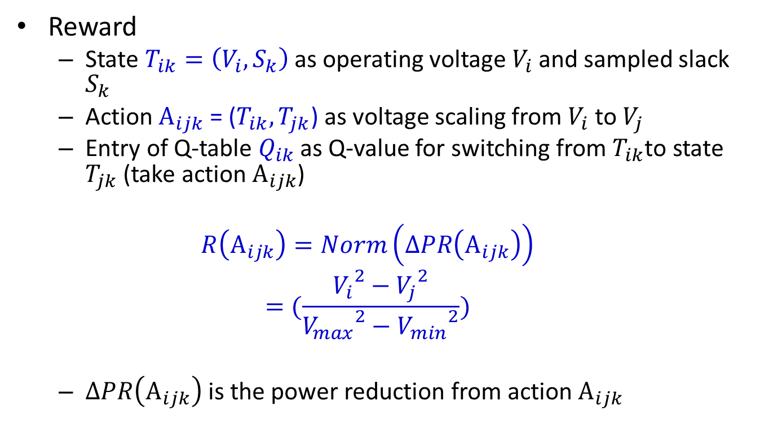
Q-learning Based DVS Scheme
Reward
  State $T_{ik}=\left(V_{i},S_{k}\right)$ as operating voltage $V_{i}$ and sampled slack $S_{k}$
  Action $A_{ijk}$ = ($T_{ik}, T_{jk}$) as voltage scaling from $V_{i}$ to $V_{j}$
  Entry of Q-table $Q_{ik}$ as Q-value for switching from $T_{ik}$to state $T_{jk}$ (take action $A_{ijk}$)
  $$R\left(A_{ijk}\right)=Norm\left(∆PR\left(A_{ijk}\right)\right)$$
  $$=(\frac{{V_{i}}^{2}−{V_{j}}^{2}}{{V_{max}}^{2}−{V_{min}}^{2}})$$
  $∆PR\left(A_{ijk}\right)$is the power reduction from action$A_{ijk}$

Slide 21
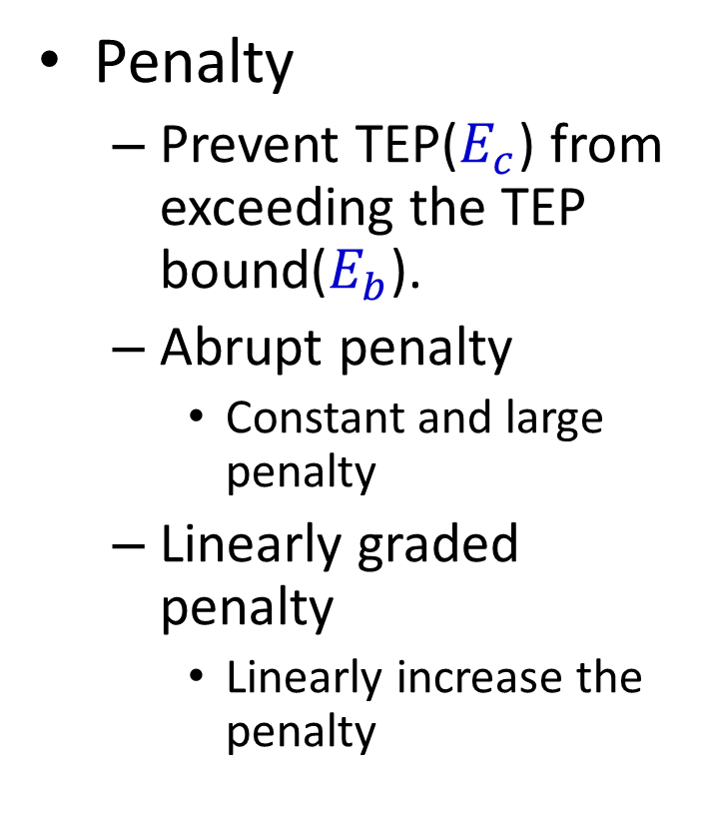
Q-learning Based DVS Scheme
Penalty
  Prevent TEP($E_{c}$) from exceeding the TEP bound($E_{b}$).
  Abrupt penalty
    Constant and large penalty
  Linearly graded penalty
    Linearly increase the penalty

Slide 22
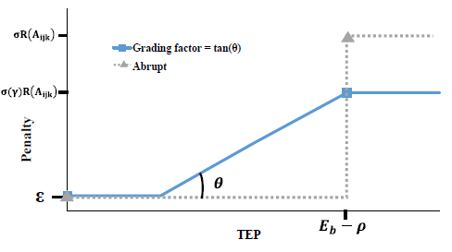
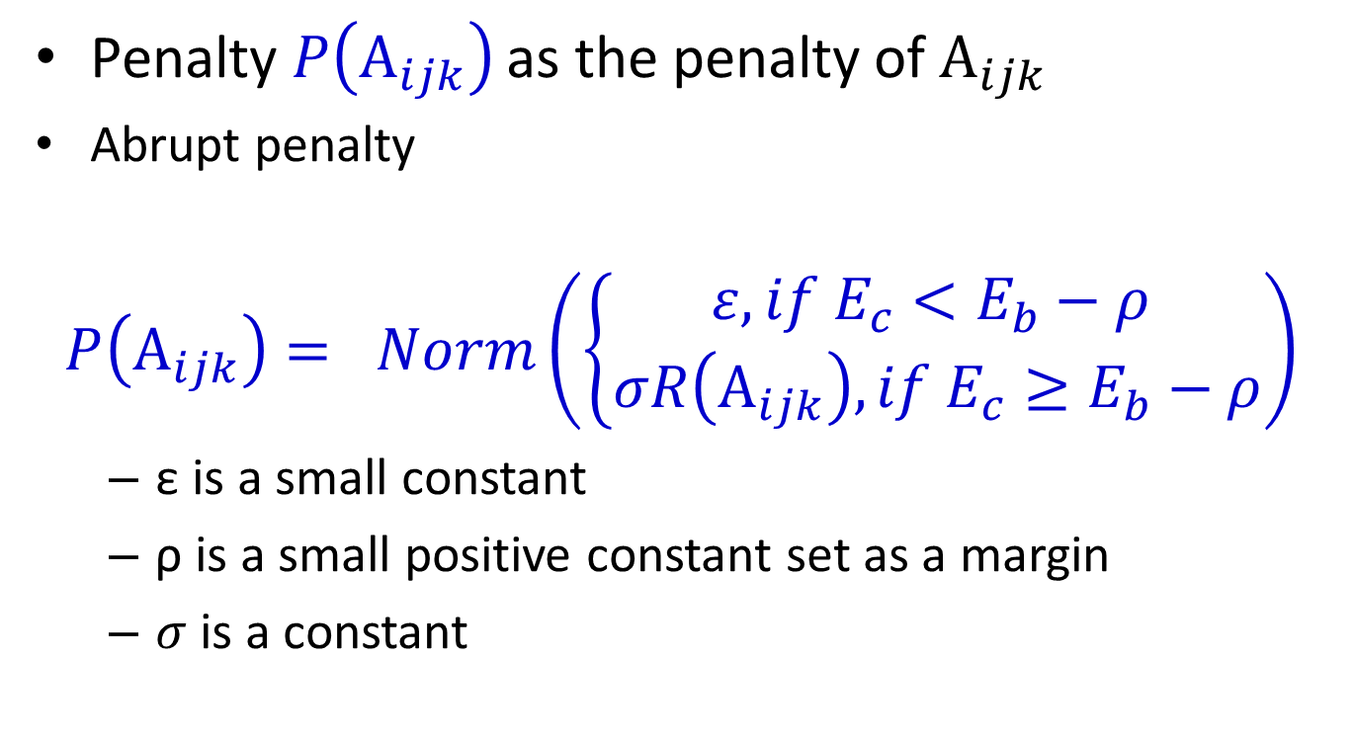
Q-learning Based DVS Scheme
Penalty$P\left(A_{ijk}\right)$ as the penalty of $A_{ijk}$
  Abrupt penalty
$$P\left(A_{ijk}\right)= Norm\left(\left\{\begin{aligned}ε, if E_{c}<E_{b}−ρ \\ σR\left(A_{ijk}\right), if E_{c}≥E_{b}−ρ\end{aligned}\right.\right)$$
  ε is a small constant
  ρ is a small positive constant set as a margin
  $σ$ is a constant

Slide 23

Q-learning Based DVS Scheme
Linearly graded penalty
$$P\left(A_{ijk}\right)=$$
$Norm(\left\{\begin{aligned}ε, if E_{c}<\frac{ε−σ(γ)R(A_{ijk})}{γ}+(E_{b}−ρ) \\ −γ\left[\left(E_{b}−ρ\right)−E_{c}\right]+σ(γ)R\left(A_{ijk}\right), if \frac{ε−σ(γ)R(A_{ijk})}{γ}+(E_{b}−ρ)≤E_{c}<E_{b}−ρ \\ σR\left(A_{ijk}\right), if E_{c}≥E_{b}−ρ\end{aligned}\right.$ )
  γ is grading factor.

Slide 24
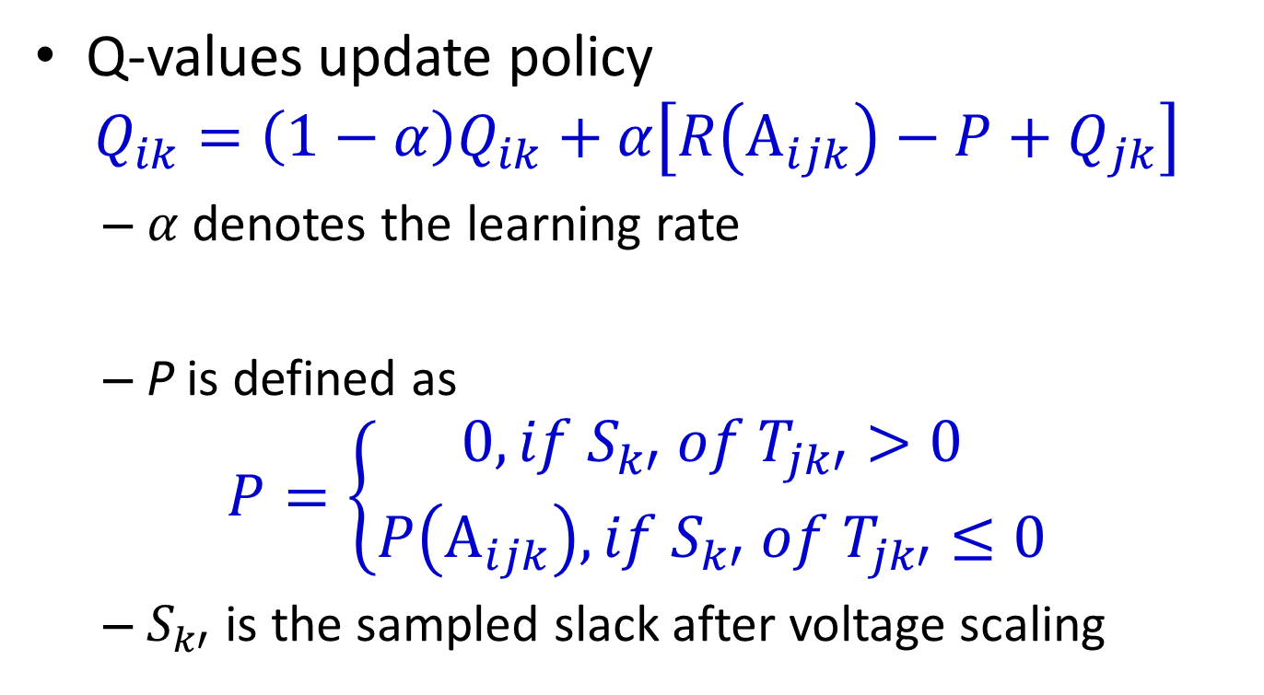
Q-learning Based DVS Scheme
Q-values update policy
$$Q_{ik}=\left(1−α\right)Q_{ik}+α\left[R\left(A_{ijk}\right)−P+Q_{jk}\right]$$
  $α$denotes the learning rate
  P is defined as
$$P=\left\{\begin{aligned}0, if S_{k′} of T_{jk′}>0 \\ P\left(A_{ijk}\right), if S_{k′} of T_{jk′}≤0\end{aligned}\right.$$
  $S_{k′}$ is the sampled slack after voltage scaling

Slide 25
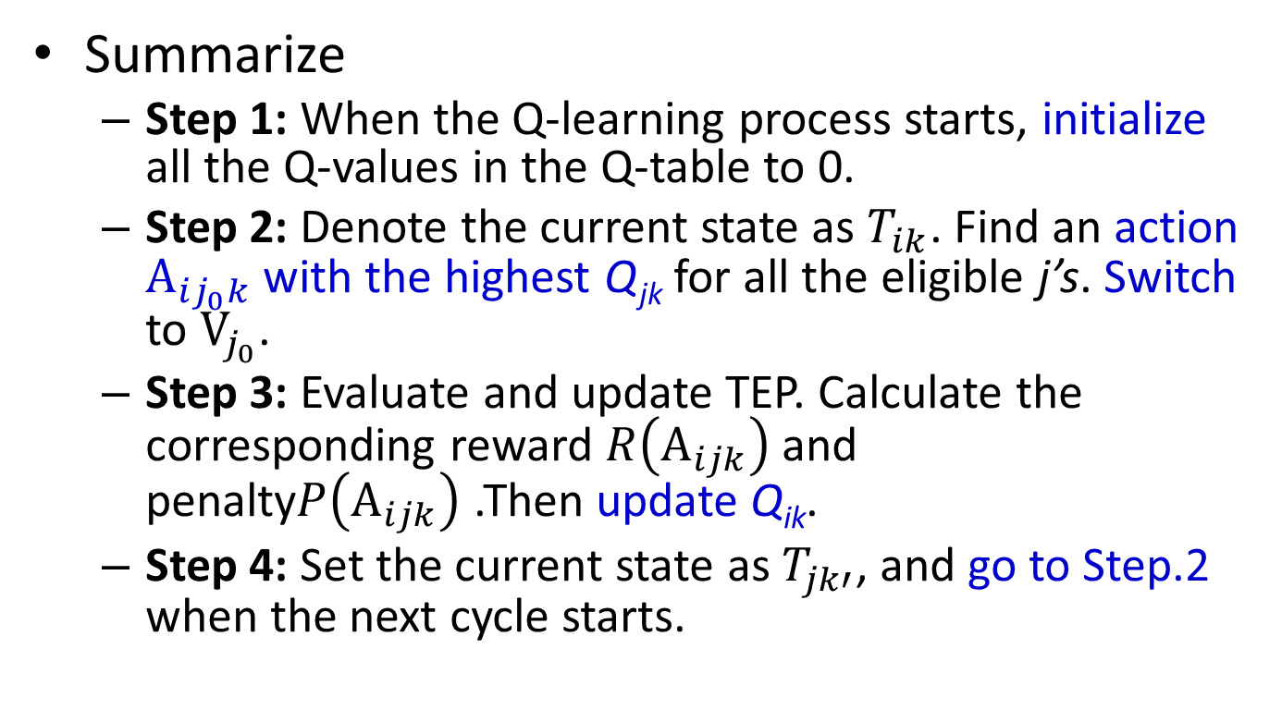
Q-learning Based DVS Scheme
Summarize
  Step 1: When the Q-learning process starts, initialize all the Q-values in the Q-table to 0.
  Step 2: Denote the current state as $T_{ik}$. Find an action $A_{ij_{0}k}$ with the highest Q_{jk} for all the eligible j’s. Switch to $V_{j_{0}}$.
  Step 3: Evaluate and update TEP. Calculate the corresponding reward $R\left(A_{ijk}\right)$ and penalty$P\left(A_{ijk}\right)$ .Then update Q_{ik}.
  Step 4: Set the current state as $T_{jk′}$, and go to Step.2 when the next cycle starts.

Slide 26
Outline
Introduction and Motivation
Q-Learning Based DVS Scheme
Experimental Result
Conclusions

Slide 27
Experimental Results
Three industrial designs with 45nm library
8-core, 2.40GHZ, Intel Xeon E5620 CPU, with 32GB memory, CentOS release 5.9 machine
Voltage candidates are set to 0.8V, 0.9V, 1V, 1.1V, 1.2V
Temperature varies from 20ºC to 35ºC.

Slide 28
Experimental Results
Performance
  stepping based
  JPDF based
  Power is in µW

Slide 29
Experimental Results
Performance
  stepping based
  JPDF based
  Power is in µW

Slide 30
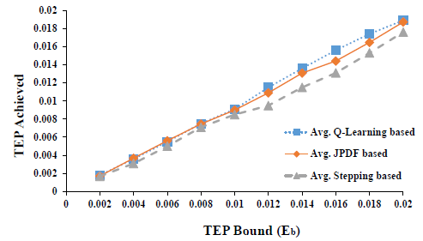
Experimental Results
Different TEP bounds v.s. TPE achieved

Slide 31
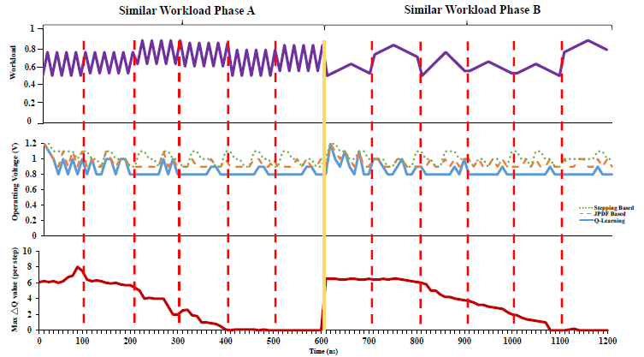
Experimental Results

Slide 32
Outline
Introduction and Motivation
Q-Learning Based DVS Scheme
Experimental Result
Conclusions

Slide 33
Conclusions
We have proposed a Q-learning based DVS scheme dedicated to the designs with graceful degradation.
Proposed Q-learning based scheme can achieve up to 83.9% and 29.1% power reduction respectively with 0.01 TEP bound.

Slide 34
Thank You
Q&A
Notes:
Thanks a lot for your attention.
If you are interesting in this work, plz come to my booth after this section and I can bring more details about this work.

Slide 36
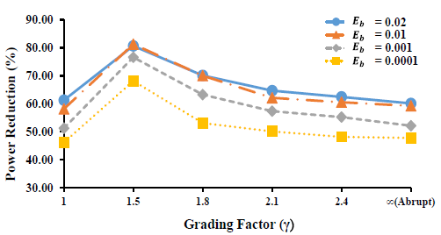
Experimental Results
Impact of the penalty functions

Slide 37
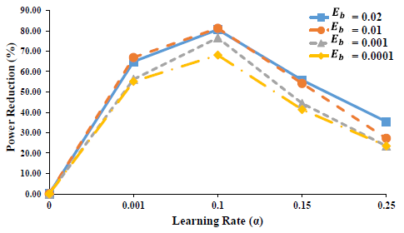
Experimental Results
Learning rate α and the power reduction

Slide 38
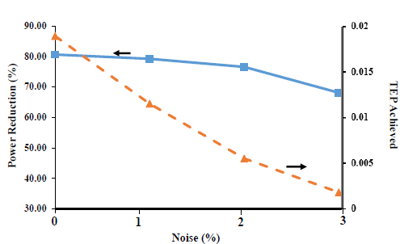
Experimental Results
Noise v.s. power reduction and TEP achieved.

