Slide 1
Machine Learning in Simulation-Based Analysis
Li-C. Wang,
Malgorzata Marek-Sadowska
University of California, Santa Barbara

Slide 2
Synopsis
Simulation is a popular approach employed in many EDA applications
In this work, we explore the potential of using machine learning to improve simulation efficiency
While the work is developed based on specific simulation contexts, the concepts and ideas should be applicable to a generic simulation setting

Slide 3
Problem Setting

Slide 4
Problem Setting
Input random
variables
Mapping Function f( )
(Design Under Analysis)
Output
behavior
X
Y
C
Component random variables
Inputs to the simulation
  X: e.g. input vectors, waveforms, assembly programs, etc.
  C: e.g. device parameters to model statistical variations
Output from the simulation:
  Y: e.g. output vectors, waveforms, coverage points
Goal of simulation analysis: To analyze the behavior of the mapping function f()

Slide 5
Practical View of The Problem
f( )
How to predict the outcome of
an input before its simulation?
Checker
Essential outputs
For the analysis task, k essential outputs are enough
  k << n*m
Fundamental problem:
  Before simulation, how can we predict the inputs that will generate the essential outputs?

Slide 6
First Idea: Iterative Learning
h potentially
important
input samples
l input
samples
Learning &
Selection
Simulation
results
outputs
Checker
Results include 2 types of information:
Inputs that do not produce essential outputs
Inputs that do produce essential outputs
Learning objective: to produce a learning model that predicts the “importance of an input”

Slide 7
Machine Learning Concepts

Slide 8
For More Information
Tutorial on Data Mining in EDA & Test
  IEEE CEDA Austin chapter tutorial – April 2014
  http://mtv.ece.ucsb.edu/licwang/PDF/CEDA-Tutorial-April-2014.pdf
Tutorial papers
  “Data Mining in EDA” – DAC 2014
    Overview and include a list of references to our prior works
  “Data Mining in Functional Debug” – ICCAD 2014
  “Data Mining in Functional Test Content Optimization” – ASP DAC 2015

Slide 9
How A Learning Tool Sees The Data
features
vectors
samples
labels
A learning algorithm usually sees the dataset as above
  Samples: examples to be reasoned on
  Features: aspects to describe a sample
  Vectors: resulting vector representing a sample
  Labels: care behavior to be learned from (optional)

Slide 10
Supervised Learning
(features)
Labels
Classification
  Labels represent classes (e.g. +1, -1: binary classes)
Regression
  Labels are some numerical values (e.g. frequencies)

Slide 11
Unsupervised Learning
(features)
No y’s
Work on features
  Transformation
  Dimension reduction
Work on samples
  Clustering
  Novelty detection
  Density estimation

Slide 12
Semi-Supervised Learning
(features)
Labels for i samples only
Only have labels for i samples
  For i << m
Can be solved as an unsupervised problem with supervised constraints

Slide 13
Fundamental Question
Matrix view
Sample 1
Sample 2
…
Learning tool
?
Sample m
A learning tool takes data as a matrix
Suppose we want to analyze m samples
  waveforms, assembly programs, layout objects, etc.
How do I feed the samples to the tool?

Slide 14
Explicit Approach – Feature Encoding
Samples
Parsing and
encoding method
Set of Features
Need to develop two things:
  1. Define a set of features
  2. Develop a parsing and encoding method based on the set of features
Does learning result then depend on the features and encoding method? (Yes!)
That’s why learning is all about “learning the features”

Slide 15
Implicit Approach – Kernel Based Learning
Sample i
Similarity
Function
Similarity value
Sample j
Define a similarity function (kernel function)
  It is a computer program that computes a similarity value between any two tests
Most of the learning algorithms can work with such a similarity function directly
  No need for a matrix data input

Slide 16
Kernel-Based Learning
Learned model
Learning
Algorithm
Query for
pair (x_{i},x_{j})
Similarity Measure for (x_{i},x_{j})
Kernel function
A kernel based learning algorithm does not operate on the samples
As long as you have a kernel, the samples to analyze
  Vector form is no longer needed
Does learning result depend on the kernel? (Yes!)
That’s why learning is about learning a good kernel

Slide 17
Example:
RTL Simulation Context

Slide 18
Recall: Iterative Learning
h potentially
important
input samples
l input
samples
Learning &
Selection
Simulation
results
outputs
Checker
Results include 2 types of information:
Inputs that do not produce essential outputs
Inputs that do produce essential outputs
Learning objective: to produce a learning model that predicts the “importance of an input”

Slide 19
Iterative Learning
l assembly
programs
h potentially
important
assembly programs
Learning &
Selection
Simulation
results
outputs
Checker
Results include 2 types of information:
Inputs that provide no new coverage
Inputs that provide new coverage
Learning objective: to produce a learning model that predicts the “inputs likely to improve coverage”

Slide 20
Unsupervised: Novelty Detection
: simulated assembly programs
: filtered assembly programs
: novel assembly programs
Boundary captured by a one-class learning model
Learning is to model the simulated assembly programs
Use the model to identify novel assembly programs
A novel assembly program is likely to produce new coverage

Slide 21
One Example
Without novelty detection, 1690 tests are needed
With novelty detection, only 100 tests are needed
Design: 64-bit Dual-thread low-power processor (Power Architecture)
Each test is with 50 generated instructions
Roughly saving: 94%

Slide 22
Another Example
19+ hours simulation
With novelty detection
=> Require only 310 tests
Without novelty detection
=> Require 6010 tests
Each test is a 50-instruction assembly program
Tests target on Complex FPU (33 instruction types)
Roughly saving: 95%
  Simulation is carried out in parallel in a server farm

Slide 23
Example:
SPICE Simulation Context
(Include C Variations)

Slide 24
SPICE Simulation Context
X
Mapping Function f( )
Design Under Analysis
Y
Transistor size variations
C
Mapping function f()
  SPICE simulation of a transistor netlist
Inputs to the simulation
  X: Input waveforms over a fixed period
  C: Transistor size variations
Output from the function: Y – output waveforms

Slide 25
Recall: Iterative Learning
h potentially
important
waveforms
l input
waveforms
Learning &
Selection
Simulation
results
outputs
Checker
Results include 2 types of information:
Inputs that do not produce essential outputs
Inputs that do produce essential outputs
In each iteration, we will learn a model to predict the inputs likely to generate additional essential output waveforms

Slide 26
Illustration of Iterative Learning
X•C space
Y space
i = 0
?
s₁
s₂
i = 1
y₁
y₂
s₃
y₃
s₆
y₆
i = 2
s₅
y₅
s₄
y₄
For an important input, continue the search in the neighboring region
For an unimportant input, avoid the inputs in the neighboring region

Slide 27
Idea: Adaptive Similarity Space
s₂
s₂
Three additional
samples selected
s₁
s₁
Space implicitly defined by k( )
Adaptive similarity space
In each iteration, similarity is measured in the space defined by important inputs
Instead of applying novelty detection, we apply clustering here to find “representative inputs”

Slide 28
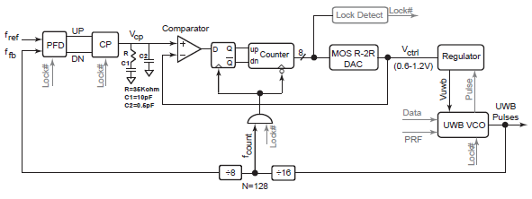
Initial Result – UWB-PLL
I₄
O₄
I₁
O₁
I₂
O₃
O₂
I₃
We will perform 4 sets of the experiments – each set is for each input-output pair

Slide 29
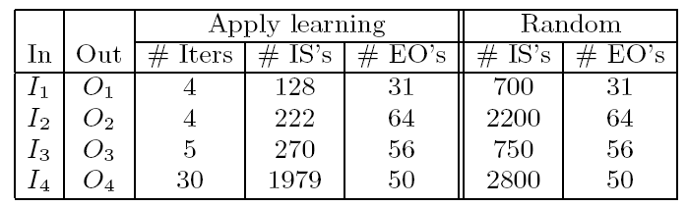
Initial Result
Comparing to random input selection
For each case, the # of essential outputs is shown
Learning enables simulation of less # of inputs to obtain the same coverage of the essential outputs

Slide 30
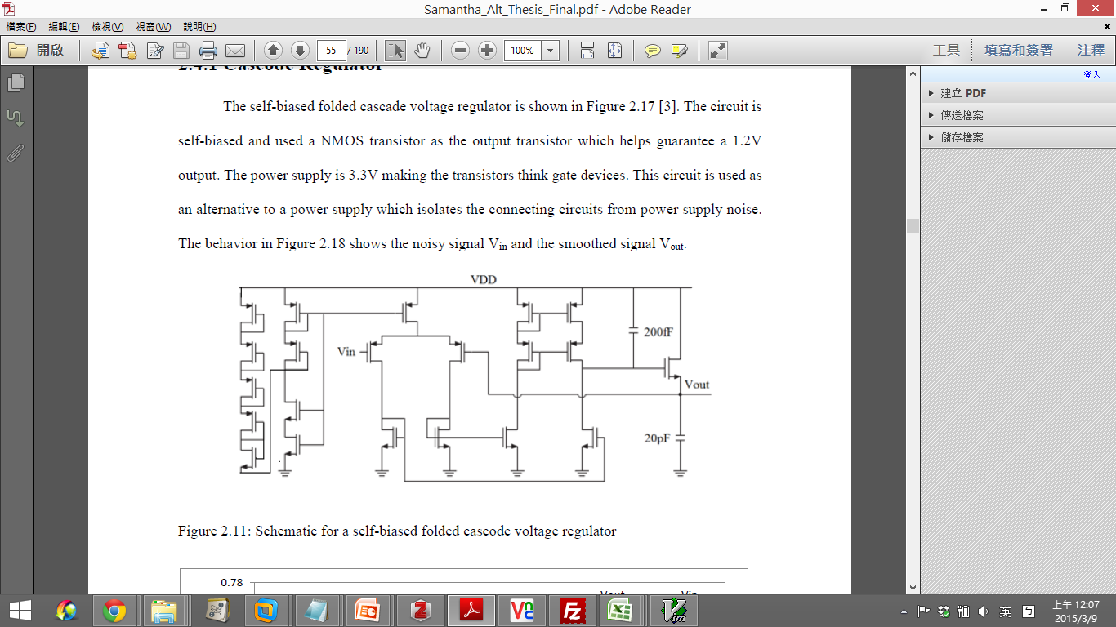
Additional Result – Regulator
I
O₂
O₁
 |  | Apply Learning |  | Random
In | Out | # IS’s | #EO’s | # IS’s | #EO’s
I | O₁ | 153 | 84 | 388 | 84
I | O₂ | 107 | 49 | 355 | 49

Slide 31
Coverage Progress
Regulator I - O₁
~60% cost reduction
# of covered EI’s
Without novelty detection, 388 tests are needed
With novelty detection
=> Require only 153 tests
# of applied tests

Slide 32
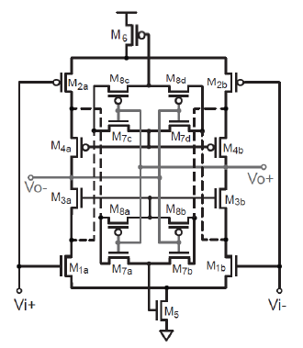
Additional Result – Low Power, Low Noise Amp.
O₁
I₁
 |  | Apply Learning |  | Random
In | Out | # IS’s | #EO’s | # IS’s | #EO’s
I₁ | O₁ | 96 | 75 | 615 | 75

Slide 33
2nd Idea: Supervised Learning Approach
no
Simulation
input
samples
yes
Predicted
outputs
Predictable?
Predictor
Learning model
Simulated outputs
In some applications, one may desire to predict the actual output (e.g. waveform) of an input (rather than just the importance of an input)
In this case, we need to apply a supervised learning approach (see paper for more detail)

Slide 34
Recall: Supervised Learning
(features)
Waveforms
Fundamental challenge:
  Each y’s is a complex object (e.g. a waveform)
How do we build a supervised learning model in this case? (See the paper for discussion)

Slide 35
Conclusion
Machine learning provides viable approaches for improving simulation efficiency in EDA applications
Keep in mind: Learning is about learning
  The features, or
  The kernel function
The proposed learning approaches are generic and can be applied to diverse simulation contexts
We are developing the theories and concepts
  (1) for learning the kernel
  (2) for predicting the complex output objects

Slide 36
Thank you
Questions?

