Slide 1
SVM-Based Routability-Driven Chip-Level Design for Voltage-Aware Pin-Constraint EWOD Chips
Qin Wang¹, Weiran He, Hailong Yao¹, Tsung-Yi Ho², Yici Cai¹
Tsinghua University
National Chiao Tung University

Slide 2
Outline
Background
Problem Formulation
Contributions
Overall Design Flow
SVM-Based Electrode Clustering
Experimental Results
Summary

Slide 3
Digital Microfluidic Biochips (DMFB)
DMFB is one of the many different types of biochips
Based on electrowetting-on-dielectric (EWOD) technology
Control the movement of the droplet
Advantages of DMFB
Reduces sample/reagent consumption
Reduces total analysis time
Dynamically reconfigurable for different types of sequential experiments
As the size of DMFB becomes larger, CAD methods are becoming necessary

Slide 4
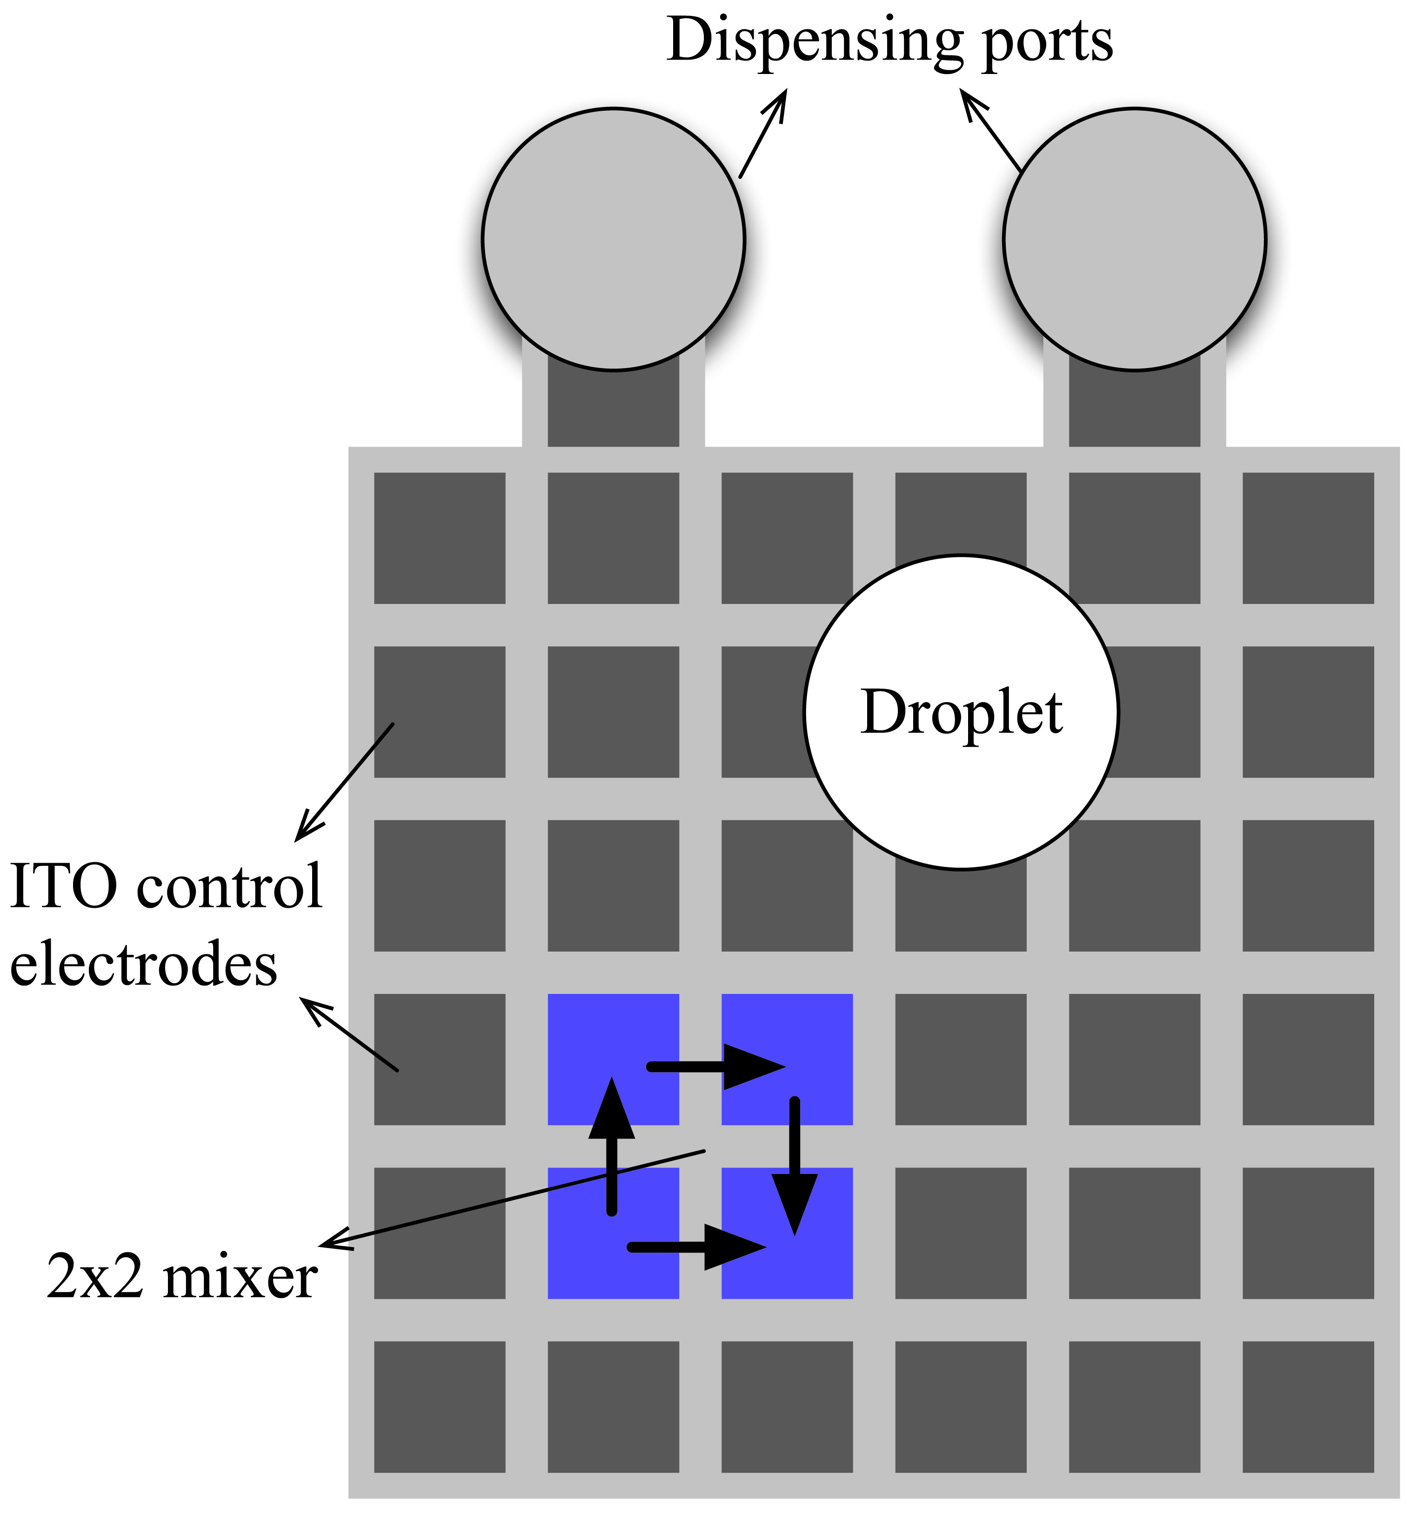
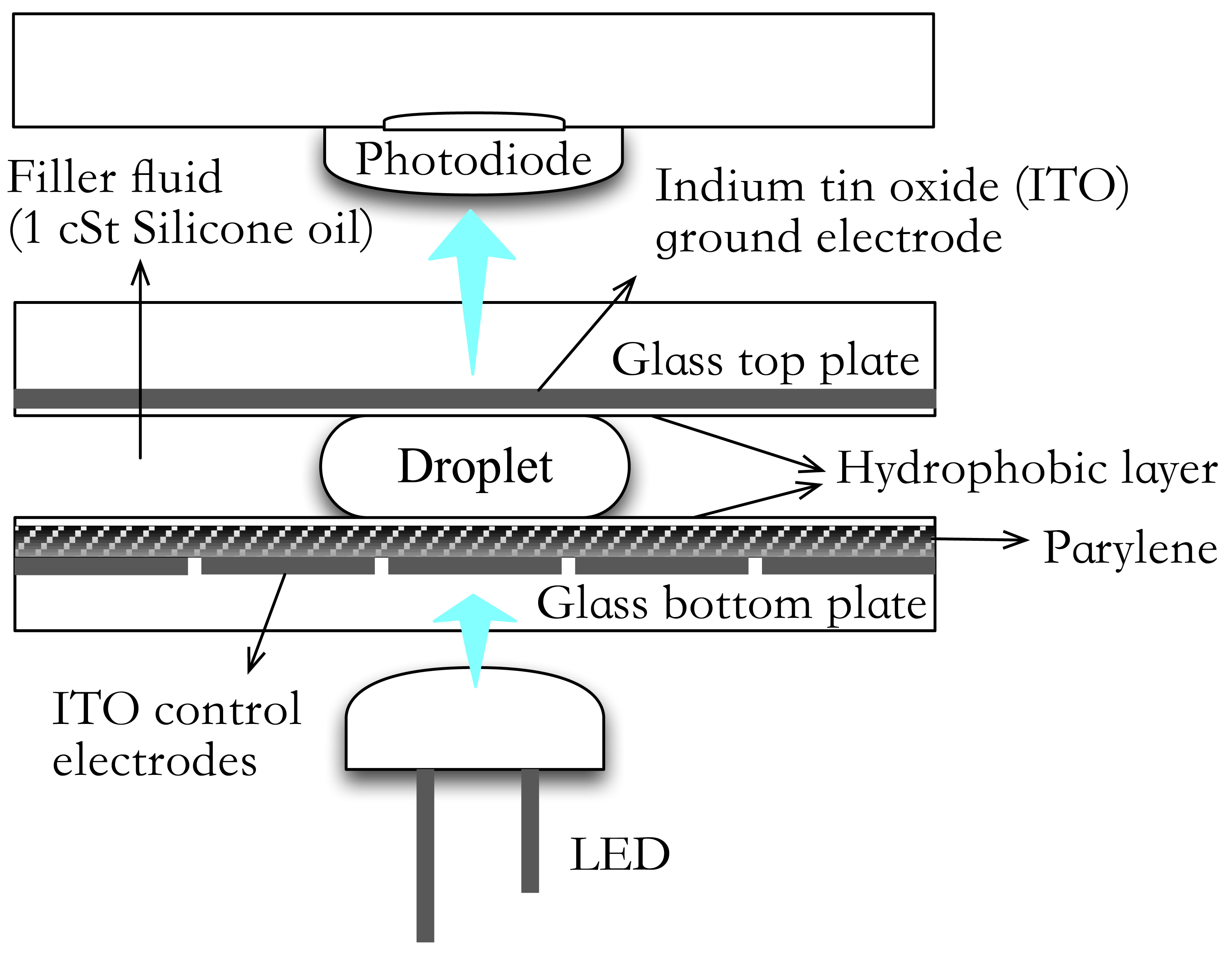
View of the EWOD Chips
2D array of electrodes for controlling the droplet movement
Top view of 2D electrode array
Cross-section View
Top View
Courtesy of K. Chakrabarty and F. Su [1]
[1] K. Chakrabarty and F. Su, “Digital Microfluidic Biochips”, CRC Press, 2006.

Slide 5
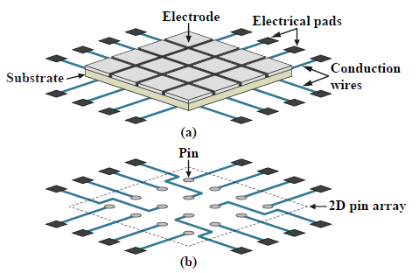
Co-Design of EWOD Chips
Fluidic Layer
Control Layer

Slide 6
Addressing Schemes
Direct Addressing & Broadcast addressing
Conduction wires
Electrodes that share the same control pin
Via
8
4
5
8
1
2
3
4
2
1
10
9
5
6
7
8
4
5
6
7
9
10
11
12
1
2
3
1
13
14
15
16
Electrodes
Control pins
Direct Addressing
Control pins: 16
(b) Broadcast addressing
Control pins: 10

Slide 7
Broadcast Addressing Scheme
Electrode
Droplet
Spacing
High voltage to generate an electrical field
Actuation sequence
0
0
0
X
X
X
0
0
0
X
X
X
1
1
0
0
1
0
0
X
X
1
0
0
1
0
X
X
0
0
1
0
1
0
0
1
0
X
X
0
1
0
0
1
X
X
0
0
1
0
X
X
X
X
0
0
1
0
time
X
X
X
X
0
0
1
7 pins -> 4 pins
Broadcast addressing
Pin of electrode
Wire
External control pins

Slide 8
Regular CAD Flow of DMFBs
[2] T.-Y. Ho, K. Chakrabarty, and P. Pop, “Digital Microfluidic Biochips: Recent Research and Emerging Challenges,” Proc. of CODES+ISSS, 2011.

Slide 9
Routing Failed Problem
Actuation Sequence
Compatible Graph
Electrode Addressing
Cluster Routing & Escape Routing
Routing Failed
[3] ACER: An Agglomerative Clustering Based Electrode Addressing and Routing Algorithm for Pin-Constrained EWOD Chips,” IEEE Trans. on CAD 2014.

Slide 10
Trapped Charge Problem

Slide 11
Outline
Background
Problem Formulation
Contributions
Overall Design Flow
SVM-Based Electrode Clustering
Experimental Results
Summary

Slide 12
Problem Formulation
Given
A set of electrodes, the actuation sequences, the preferred voltage values, a threshold voltage value, the maximum number of allowed control pins, and the control layer design rules.
Constraint
Control pin constraint
Routing constraint
Broadcast-addressing constraint
Voltage constraint
Objective
Find a feasible routing solution from all of the electrodes to the control pins with minimized total routing cost.

Slide 13
Outline
Background
Problem Formulation
Contributions
Overall Design Flow
SVM-Based Electrode Clustering
Experimental Results
Summary

Slide 14

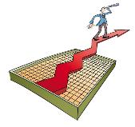

Contributions
The first SVM-based electrode addressing methods
Improve the routability
Improve the reliability induced by the trapped charge problem
Feature Extraction
General Features
Context Features
Cluster Features
Effective ripup and rerouting methods are adopted
Machine Learning
Prediction Model
Physical Design

Slide 15
Outline
Background
Contributions
Problem Formulation
Overall Design Flow
SVM-Based Electrode Clustering
Experimental Results
Summary

Slide 16
Overall Design Flow of Our Approach
Input:
A set of electrodes
Actuation sequences
Constraints
Clustering Stage
Routing Stage
Ripup & Rerouting

Slide 17
Outline
Background
Contributions
Problem Formulation
Overall Design Flow
SVM-Based Electrode Clustering
Experimental Results
Summary

Slide 18

Support Vector Machine(SVM)
SVM is related to statistical learning theory
Solving classification problem
Key area in machine learning
Maximal margin

Slide 19
Training Flow of SVM-Based Clustering

Slide 20
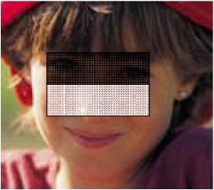
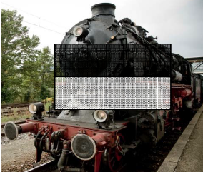
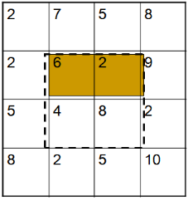
Feature Extraction
The major concern of supervised learning
Having a great influence on experimental results
Features of electrode addressing
General Features
Context Features
Cluster Features
Harra feature in graphics

Slide 21
General Features
Describe a electrode addressing solution in a global view
Number of clusters
Total area of bounding boxes
Number of clusters with a single electrode
Total area of bounding box overlap
Normalization
Area of the chip
Number of electrodes

Slide 22
Context Features
Routing resource information
Congestion information
Computing the bounding box for each cluster
Dividing the whole chip into four quadrants
Each quadrant
collects information separately
Bounding box area
Overlap information
Proportion of overlap area

Slide 23
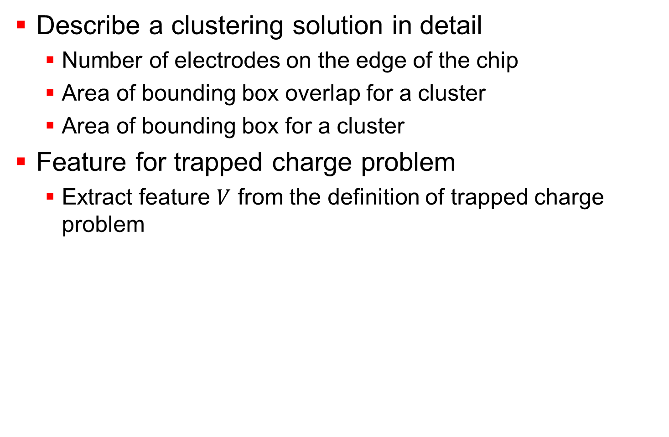
Cluster Features
Describe a clustering solution in detail
Number of electrodes on the edge of the chip
Area of bounding box overlap for a cluster
Area of bounding box for a cluster
Feature for trapped charge problem
Extract feature $V$ from the definition of trapped charge problem

Slide 24

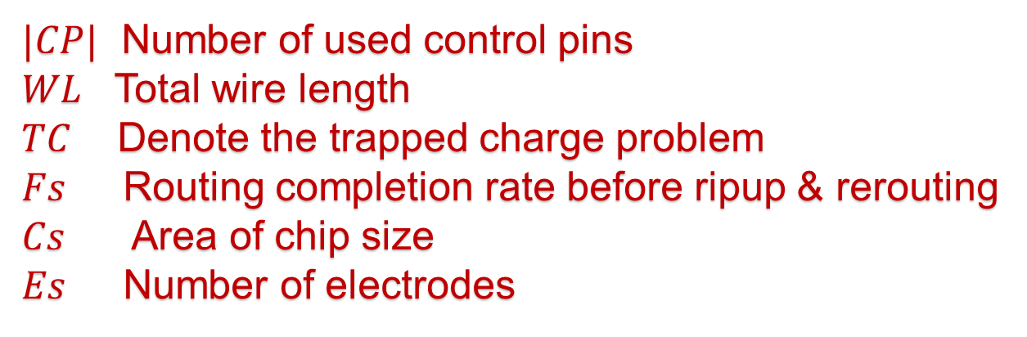
Electrode Addressing Solution Evaluation
$$Score=\frac{R}{α⋅|CP|+β⋅WL+γ⋅TC}⋅C_{S}⋅E_{C}$$
$|CP|$ Number of used control pins
$WL$ Total wire length
$TC$ Denote the trapped charge problem
$Fs$ Routing completion rate before ripup & rerouting
$Cs$ Area of chip size
$Es$ Number of electrodes

Slide 25
Testing Flow of SVM-Based Clustering
Training Flow

Slide 26
Outline
Background
Contributions
Problem Formulation
Overall Design Flow
SVM-Based Electrode Clustering
Experimental Results
Summary

Slide 27
Testcases
Benchmark | Width | Height | Area | #E | Voltage(v)
amino-acid-1 | 6 | 8 | 1008 | 20 | 50
amino-acid-2 | 6 | 8 | 1008 | 24 | 50
protein-1 | 13 | 13 | 3136 | 34 | 50
protein-2 | 13 | 13 | 3136 | 34 | 50
dilution | 15 | 15 | 4096 | 54 | 50
multiplex | 15 | 15 | 4096 | 59 | 50
random-1 | 10 | 10 | 1936 | 20 | 50
random-2 | 15 | 15 | 4096 | 30 | 50
random-3 | 20 | 20 | 7056 | 60 | 50
random-4 | 30 | 30 | 15376 | 90 | 50
random-5 | 50 | 50 | 41616 | 100 | 50
random-6 | 50 | 50 | 41616 | 100 | 50
random-7 | 60 | 60 | 59536 | 150 | 50
Width: the width of the chip
Height: the height of the chip
Area: the routing area considering the routing grids between adjacent electrodes
#E: the number of electrodes
Voltage: the threshold voltage for trapped charge issue

Slide 28
Experimental Results
ACER
S.S.-Y.Liu,C.-H.Chang,H.-M.Chen,andT.-Y.Ho,“ACER:An Agglomerative Clustering BasedElectrode Addressing and Routing Algorithm forPin-Constrained EWOD Chips,” IEEE Trans. on CAD, vol. 33, no. 9, pp. 1316-1327, 2014.
SVM1
General Features
Context Features
Cluster Features
SVM2
General Features
Context Features

Slide 29
Routing Completion Rate Without Ripup & Rerouting
Average
ACER
47.32%
SVM2
56.33%
SVM1
56.41%
SVM2
61.16%

Slide 30
Final Routing Completion Rate After Ripup & Rerouting
SVM1 and SVM2 are both 100%
For some cases, ACER is not 100%
Average
ACER
95.21%
SVM1
100%
SVM2
100%

Slide 31
Number of Ripup & Rerouting Iterations
Average
ACER
25
SVM2
9
SVM1
9
SVM2
9

Slide 32
Number of Used Control Pins
Average
ACER
51
SVM2
48
SVM1
46
SVM2
47

Slide 33
Total Wire Length
Average
ACER
3304
SVM2
3032
SVM1
2991
SVM2
3043

Slide 34
Running Time
Average
ACER
232.21s
SVM2
154.91s
SVM1
225.53s
SVM2
155.44s

Slide 35
Trapped Charge
SVM1 and SVM2 are similar
Average
ACER
19v
SVM2
15v

Slide 36
Outline
Background
Contributions
Problem Formulation
Overall Design Flow
SVM-Based Electrode Clustering
Experimental Results
Summary

Slide 37
Summary
The first SVM-based chip-level design flow
The routability and reliability are both improved
Real-life biochemical applications validate the presented method effectiveness
Thank you!

