Slide 1

A Cell-Based Row-Structure Layout Decomposer for Triple Patterning Lithography Hsi-An Chien, Szu-Yuan Han, Ye-Hong Chen, and Ting-Chi Wang Department of Computer Science National Tsing Hua University TAIWAN

Slide 2
Outline
Introductions
Multiple patterning lithography
Motivation
Problem
TPL layout decomposition
Approach
Graph model
Speed-up
Experimental Results
Conclusion
Notes:
In this paper, we study a TPL layout decomposition problem by extending a great previous work
We also propose several graph simplification techniques to speed-up the extended approach
First of all, I am going to shortly introduce multiple patterning lithography and show the motivation of our work
Next, I will define the TPL decomposition problem and present our approach
Some experimental results and conclusion will be discussed in the end.

Slide 3
Multiple Patterning Lithography (MPL)
MPL uses multiple litho-etch (LE) steps to enhance feature printability
Double Patterning Lithograph (DPL)
20nm/16nm
LELE
Two masks
Triple Patterning Lithograph (TPL)
10nm or beyond
High density layer (M1 layer)
LELELE
Three masks
a
b
a
Mask 1
b
Mask 2
a
b
stitch
Mask 1
Mask 2
Mask 3
Coloring Conflict
DPL
TPL
Notes:
Multiple patterning lithography is a lithography technology to enhance feature printability by using multiple litho-etch steps
The simplest case is double patterning lithography which uses two litho-etch steps to manufacture the layout in a single layer
We can see that the features in a target layout are separated into two masks, which is called layout decomposition and can be referred to as coloring problem
As feature size continues to shrink, layouts have a higher density than before, for example the layout in M1 layer
However, even stitch insertion can not avoid coloring conflict in DPL
But, this problem might be solved by using triple patterning lithography which separates the features into three masks

Slide 4
Existing Research Results
Existing research results
Post-layout stage
TPL layout Decomposition
General layout: NP-hard
Row-structure layout (M1 layer): Polynomial-time solvable
The features in M1 layer mainly come from standard cells
Physical design stage
TPL-aware placement
TPL-aware routing
six cells c_{1~} c₆
c₁
c₂
c₃
VDD
M1 layer
Power/
Ground rails
VSS
Poly layer
VDD
c₄
c₅
c₆
Notes:
There are some research results about TPL
At post-layout stage, we have TPL layout decomposition problem
In general, the problem is NP-hard
But, when a layout is a row-structure layout, it has been shown that the problem is polynomial-time solvable
Basically, the features in M1 layer mainly come from standard cells
In general, there is no coloring conflict
between two nonadjacent cells in the same row
between two cells in different rows
As a result, the layout decomposition problem for each row can be solved independently
When we come to physical design stage, there are also some works for TPL such as TPL-aware placement and TPL-aware routing

Slide 5
Motivation
TPL layout decomposition for row-structure layout
Decomposable layout
Polynomial-time solvable*
Decomposition solution with the minimal stitches
Indecomposable layout
No decomposition solution
Hard to help designers further modify the layout
Resolve coloring conflicts
Decomposition solution with the minimal total cost
Coloring conflicts
Stitches
*H. Tian, H. Zhang, Q. Ma, Z. Xiao, and M. D. F. Wong, “A polynomial time triple patterning algorithm for cell based row-structure layout”, in ICCAD, 2012.
Notes:
Although the layout decomposition problem for row structure layout can be solved in polynomial time by a previous work in ICCAD’2012,
this work can only get a solution when a given layout is a decomposable layout
However, when a layout is not decomposable, this work will return nothing
So, it might be hard to help designers further modify the layout to resolve conflicts
We will show how to extend this work to optimally solve the layout decomposition problem for a row-structure layout whether or not it is decomposable,
and our approach will try to minimize a cost function in terms of coloring conflicts and stitches

Slide 6
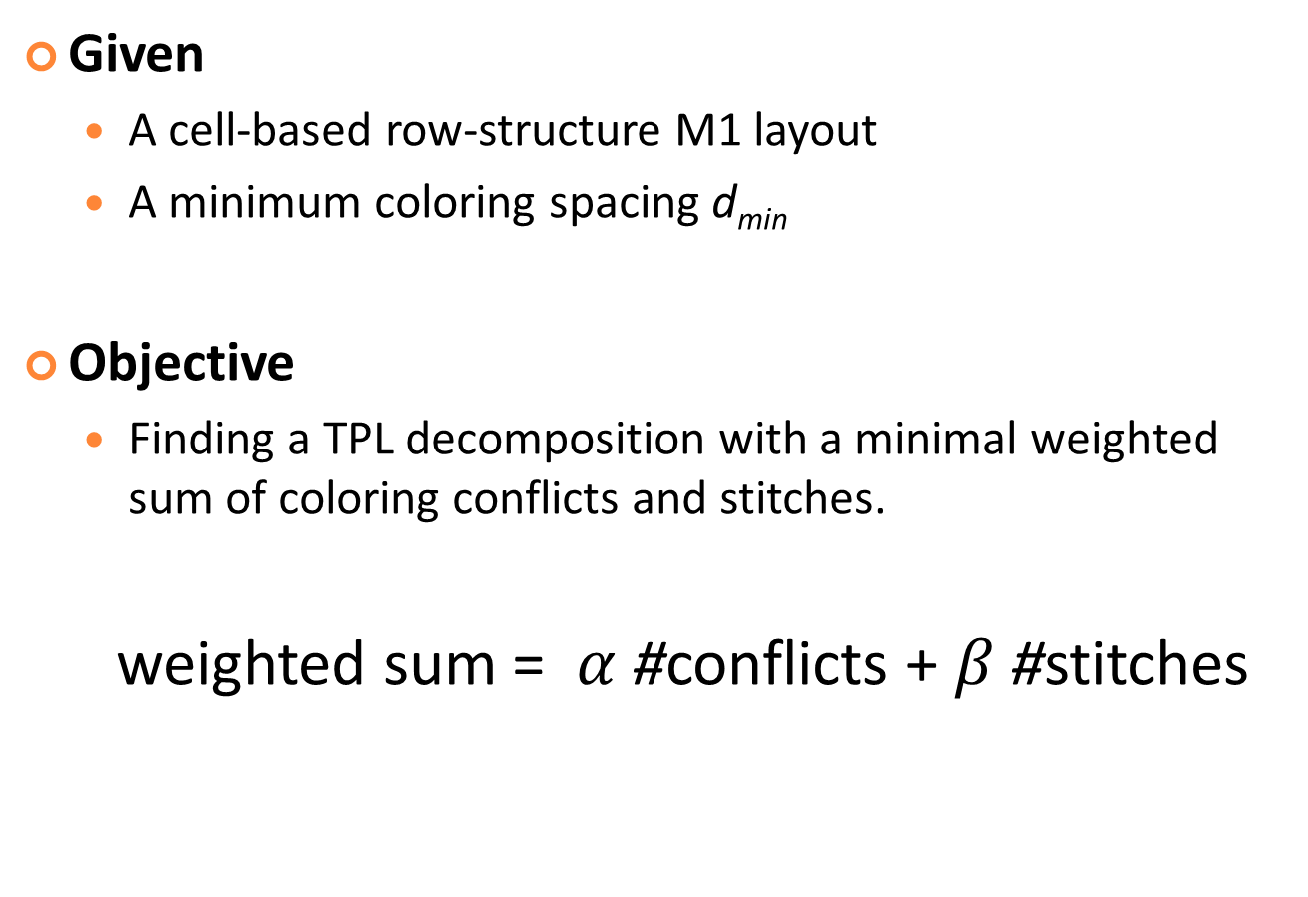
Problem Formulation
Given
A cell-based row-structure M1 layout
A minimum coloring spacing d_{min}
Objective
Finding a TPL decomposition with a minimal weighted sum of coloring conflicts and stitches.
weighted sum = $α$ #conflicts + $β$#stitches
Notes:
This our problem formulation
Given
We want to
In the weighted sum, #coloring conflicts is multiplied by $α$ and #stitches is multiplied by $β$

Slide 7
Review of A Layout Decomposer*
Conflict graph
An undirected graph.
Node: polygon in the given layout.
Edge: the distance between two corresponding polygons is less than d_{min}
Cutting line
A vertical line aligned with the left boundary of at least one polygon
Cutting line set
A set of polygons intersecting with the corresponding cutting line
Cutting lines
l₁
l₂
l₃
Conflict graph
c
a
b
d
s₁
s₂
s₃
{a, b}
{b, c}
{d}
Cutting line sets
*H. Tian, H. Zhang, Q. Ma, Z. Xiao, and M. D. F. Wong, “A polynomial time triple patterning algorithm for cell based row-structure layout”, in ICCAD, 2012.
Notes:
Let’s see some basic definitions in that previous work
conflict graph is an undirected graph, each node corresponds to a polygon
an edge between two nodes means that the two corresponding polygons should be assigned to different masks,
otherwise they will cause a coloring conflict
According to the conflict graph, we have to do polygon dummy extension for some polygons
Cutting line is a vertical line that aligns with the left boundary of at least one polygon
For each cutting line, we have a cutting line set which is a set of polygons intersecting with this cutting line
Basically, polygon dummy extension is used to make sure that for any polygon in a cutting line set, all its conflicting
polygons which are on the left side of this polygon can appear in the previous cutting line set for correctly capturing the conflicts among the polygons

Slide 8
Graph Model (1/3)
Solution Graph (SG): directed graph
Each node records a coloring solution of all the polygons in a cutting line set
All the possible coloring solutions are enumerated
Solution Graph
l₁
l₂
l₃
v₁
v₂
v₃
1,1
1,1
c
1
1,2
1,2
a
1,3
1,3
2,1
2,1
2
……
d
……
……
……
b
3
s₁
s₂
s₃
3,3
3,3
{a, b}
{b, c}
{d}
{a, b}
{b, c}
{d}
Notes:
Our approach will create a solution graph (or SG for short) for a layout and it is a directed graph
Each node records a coloring solution of all the polygons in a cutting line set
By the way, the numbers 1, 2, 3 indicate three different colors or masks
For each cutting line set, we enumerates all the coloring solutions no matter whether each of them is legal or not
–that means–coloring conflicts can exist in a coloring solution
A compatible edge between two adjacent nodes is introduced
For example, there is an edge between two v1 v2 and the polygon b in both the associated cutting line sets,
the colors of polygon b in v1 and v2 must be the same

Slide 9

Graph Model (2/3)
Weight on a node
#conflicts induced by polygons in the ${s′}_{i}^{}$ which is a subset of cutting line set $s_{i}^{}$
Solution Graph
l₁
l₂
l₃
v₁
v₂
v₃
1
1,1
1,1
c
1
1,2
1,2
a
1,3
1,3
2,1
2,1
2
……
d
……
……
……
b
3
s₂
1
3,3
3,3
s₁
s₃
{a, b}
{b, c}
{d}
{a, b}
{b, c}
{d}
Notes:
Each node will be assigned a weight which indicates the amount of conflicts in the coloring solution of the node
Each node v in the cutting line set $s_{i}^{}$ is assigned a weight and the weight indicates the amount of conflicts in the coloring solution of the node v for the polygons in the cutting line set ${s′}_{i}^{}$
${s′}_{i}^{}$ actually is the set of polygons whose left boundaries align with the cutting line of $s_{i}^{}$
Because a polygon might appear in many cutting line sets but a polygon can only create one cutting line.
This is why we count the coloring conflicts for ${s′}_{i}^{}$ but $s_{i}^{}$
For example, a and b are the polygons creating the cutting line $l_{1}^{}$ and also should be assigned different colors to avoid inducing a coloring conflict,
but their colors in the node v₁ are the same, so, the weight of v₁ is 1, that means this coloring solution induces one confilct

Slide 10

Graph Model (2/3)
Weight on a node
#conflicts induced by polygons in the ${s′}_{i}^{}$ which is a subset of cutting line set $s_{i}^{}$
Weight on an edge
#conflicts induced between all pairs of polygons (p, q),
p $∈$ $s_{i−1}$ and q $∈$ ${s′}_{i}^{}$
Solution Graph
l₁
l₂
l₃
v₁
v₂
v₃
1,1
1
1,1
2
c
1
1
1,2
1,2
1
1
1
a
1,3
1,3
1
1
2
2,1
2,1
1
……
d
……
……
……
b
2
3
s₁
s₂
s₃
3,3
1
3,3
{a, b}
{b, c}
{d}
{a, b}
{b, c}
{d}
Notes:
As for the polygons appear in different cutting line sets, their coloring conflicts will be formulated by the weights on edges.
Therefore, we can correctly capture all the coloring conflicts among the polygons

Slide 11
Graph Model (3/3)
v₁
v₂
v₃
Differences
Invalid coloring solution
Node
Edge
Conflict cost
Lemma 1
Each possible decomposition of the layout P without stitch insertion corresponds to a path in the SG of P
Lemma 2
The TPL layout decomposition problem without stitch insertion for P can be optimally solved by finding a least-cost path in the SG of P
1
1,1
1
1,1
2
1
1,2
1,2
1
1
1
1
1,3
1,3
1
1
2
2,1
2,1
1
……
……
……
……
2
3
1
3,3
1
3,3
Notes:
Basically, our solution graph is almost the same as the one proposed by that previous work except that
we could have invalid coloring solutions and conflict costs
Apparently, we have the Lemma 1 for our solution graph, which is that
Each possible decomposition of the layout P without stitch insertion corresponds to a path in the SG of P
We say a path in SG is that a path goes from a node of the first cutting set to a node of the last cutting set
Therefore, the TPL layout decomposition problem without stitch insertion for P can be optimally solved by finding a least-cost path in the SG of P

Slide 12
Stitch Insertion
Given a layout with a set of stitch candidates
Stitch edge in conflict graph
Lemma 3
The TPL layout decomposition problem for P with a given set of stitch candidates can be optimally solved by finding a lest-cost path in the SG of the fractured polygons of P
s:0 β
c:1α
1,1,1
1,1
c:2α
b
c:1α
Stitch candidate
1
s:1 β
1,1,2
c:1α
1
1,2
c:1α
c:1α
d
s:1β
……
2
1,3
2
1,2,3
……
……
a
……
c:1α
……
e
3
c:1α
……
3
s:0β
c
c:1α
3,3
c:1α
c:2α
3,3,3
{a}
{b,c}
{b,c,d}
{e}
{a}
{b,c}
{b,c,d}
{e}
Notes:
Now, let’s see how to insert stitches in a decomposition solution by our approach
Given a layout with a set of stitch candidates, the polygons are fractured into a set of smaller polygons.
An stitch edge denotes that the stitch occurs when two polygons connected by the stitch edge are assigned to the different masks
Similar to the conflict cost, stitch cost are computed and recorded in the solution graph
Again, the layout decomposition problem for P can be optimally solved by finding a least-cost path in the SG of P

Slide 13
Table Look-up (1/2)
Speed-up
Store the SG for each cell in the cell library
Copy the SG from the table for each cell instance
Conflicts between two adjacent cells ?
Boundary conflicting polygon set (BCP)
c₁
d_{min}
d_{min}
c₂
c
f
d
a
e
d
b
e
Conflict graph of the BCP
BCP of c₁ and c₂
Notes:
For a cell-based design, we also use a table look-up method for speed-up
Given a cell library, we first build the solution graph for each cell type and store it in a look-up table
Then, for the cells placed in a row, the solution graph of the row can be constructed by directly reusing the solution graph stored in the look-up table for each cell instance in the row
But, there might be some addition conflicts between the polygons near the cell boundaries of each two adjacent cells
In order to capture these coloring conflicts, we introduce boundary conflicting polygon set (or BCP for short)
The polygons within a distance of dmin from the adjacent boundaries of the cells will be in the BCP
Then we construct the conflict graph and the solution graph for the BCP

Slide 14
Table Look-up (2/2)
Final solution graph
Combine the SGs of the two adjacent cells and the SG of their BCP
SG of c₁
BSG
SG of c₂
1
1
1
1
1,1
2
1
1
1
1
1
1
1
1,2
1
1
1,3
1
1
2
1
2
2,1
2
2
1
2
2
1
2
1
……
……
……
3
1
3
1
3,3
1
3
3
1
3
3
1
3
{a}
{b}
{b,c}
{d}
{d}
{e}
{e}
{f}
1
1
1
1
1,1
2
1
1
1
1
1
1,2
1
1
1,3
1
1
1
2
1
2
2,1
2
2
1
2
……
1
……
……
3
1
3
1
3,3
1
3
1
3
1
3
{a}
{b}
{b,c}
{d}
{e}
{f}
Notes:
After that, we can combine the solution graph of each cell and the solution graph of the BCP of each two adjacent cells to get the final solution graph
Obviously, this way is much faster than directly constructing the whole solution graph for the layout of a cell row.
When we face a routed design, there might be some wire connections overlapping with a set of consecutive cells,
For these cells, we need to reconstruct their solution graph by considering them as one large cell

Slide 15
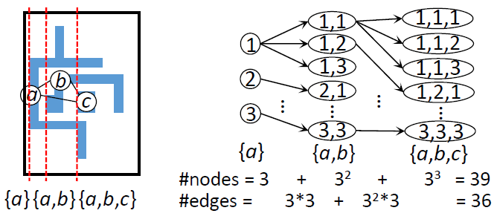
Drawback of Solution Graph
Too many nodes and edges
Graph size Performance
#nodes = 27
#edges = 0
Notes:
Although our approach can optimally solve the layout decompostion problem, we find that there is drawback of our solution graph
Because we directly extend the algorithm in that previous work, our solution graph might create too many nodes and edges
In this example, we have three cutting line sets
Actually, the third one includes all the polygons in the layout, so that there is no need to keep the others when constructing the solution graph
Therefore, the solution graph can be simplified by removing the part belonging to these two cutting line sets
As a result, the graph size can be reduced

Slide 16
Speed-up
Several techniques to reduce the size of solution graph
Simple Solution Graph
Reduced Simple Solution Graph
Reduced Simple Solution Graph for BCP
Accelerating our approach without loss of decomposition quality.
Notes:
In order to simplify solution graph, we devise a new graph model called simple solution graph
Then the simple solution graph will be further simplified to the one called reduced simple solution graph
In addition, these graph simplification techniques do not affect decomposition quality

Slide 17
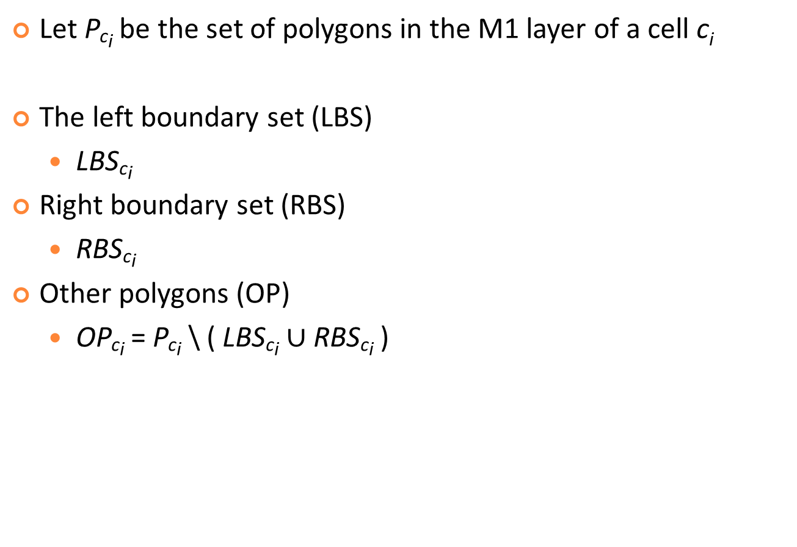
Observation
Let P_{ci} be the set of polygons in the M1 layer of a cell c_{i}
The left boundary set (LBS)
LBS_{ci}
Right boundary set (RBS)
RBS_{ci}
Other polygons (OP)
OP_{ci} = P_{ci} \ ( LBS_{ci} $∪$RBS_{ci} )
d_{min}
d_{min}
b
a
c
{a,b}
LBS
{c}
OP
{b}
RBS
Notes:
Now let me give some definitions
Let P_{ci} be the set of polygons in the M1 layer of a cell c_{i}
We have three polygon sets LBS, RBS, and OP, for the cell
LBS and RBS are the sets of boundary conflicting polygons, respectively, close to left boundary and right boundary of the cell, but OP is not
Because OP will not cause any conflicts with the polygons in other cells, we can try to remove the coloring solutions of OP from the solution graph

Slide 18

Simple Solution Graph
The simple solution graph of P_{ci} is defined as a solution graph for LBS_{ci} $∪$RBS_{ci}
An edge connecting from a node of LBS_{ci} to a node of RBS_{ci}
An optimal coloring solution of OP_{ci} and the corresponding cost
d_{min}
d_{min}
v₁
1,1
coloring solution
({2} , 0)
1,2
corresponding cost
1,3
({3} , 0)
b
2,1
1
v₂
a
c
2,2
2
An edge records an optimal coloring solution and the corresponding cost for the OP = {c}
2,3
3
3,1
3,2
3,3
#nodes = 39
12
{a,b}
LBS
{c}
OP
{b}
RBS
{a,b}
{b}
#edges = 36
9
Notes:
The simple solution graph for the polygons in c_{i} is defined as a solution graph for LBS and RBS
Each edge connecting from a node of LBS to a node of RBS records an optimal coloring solution of OP and the corresponding cost when given the coloring solutions of these two nodes
We can see that the simple solution graph gets a significant reduction in the graph size

Slide 19
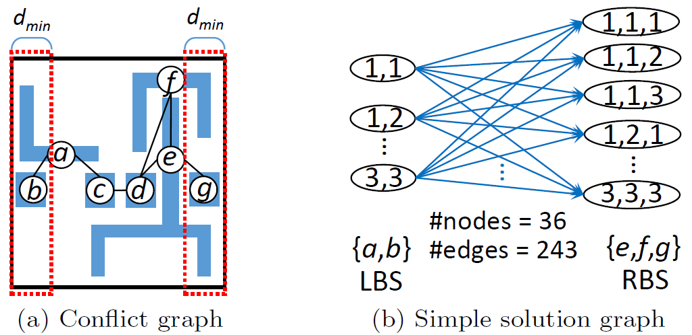
Reduced Simple Solution Graph (1/5)
If the LBS has n polygons and the RBS has m polygons, the number of the edges between them could be up to 3^{m+n}
3²
3³
#nodes = 36
#edges = 243
Notes:
Because the simple solution graph of a cell is constructed based on the LBS and RBS, the amount of edges could dramatically increase as the number of polygons in both the LBS and RBS increases
In this cell, we can see that the number of edges in its simple solution graph is up to 3 to the power of 5

Slide 20
Reduced Simple Solution Graph (2/5)
To reduce the number of the edges
Dummy LBS (DLBS) for the LBS
Dummy RBS (DRBS) for the RBS
The DLBS and DRBS are two subsets of LBS and RBS, respectively
Each polygon in the DLBS (DRBS) might cause a coloring conflict with at least a polygon in RBS (LBS) or OP
Notes:
To reduce the number of edges between the LBS and RBS, we introduce a DLBS and a DRBS into the simple solution graph
Basically, they are two subsets of LBS and RBS, respectively
Each polygon in the DLBS might cause a coloring conflict with at least a polygon in RBS or OP
Similarly, each polygon in the DRBS might cause a coloring conflict with at least a polygon in LBS or OP

Slide 21
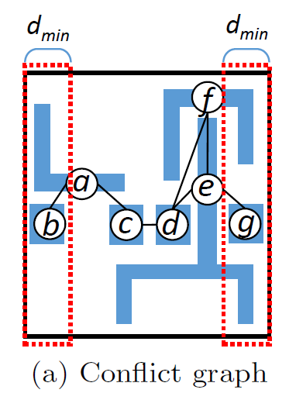
Reduced Simple Solution Graph (3/5)
Scenario 1: DLBS ⊂ LBS and DRBS ⊂ RBS, where both the DLBS and DRBS are not empty sets
Both the DLBS and the DRBS are added into the graph
1,1
1,1
1,1,1
1
1,1,2
1,2
2
1,2
…
1,1,3
…
3
…
…
3,3
3,3
…
1,2,1
…
3,3,3
{a,b}
{a}
{e,f}
{e,f,g}
LBS
DLBS
DRBS
RBS
#nodes = 36
#nodes = 48
#edges = 243
#edges = 63
Notes:
Let’s just see some examples to understand how we add these two dummy sets into the graph
For this cell, we create compatible edges without weights between LBS and DLBS as well as between DRBS and RBS
Then we create the edges between DLBS and DRBS to record the coloring solutions of OP
As long as DLBS and DRBS are two proper subsets of LBS and RBS, respectively, the amount of coloring solutions of OP can be reduced
So, we can see that the total graph size is reduced after adding the DLBS and DRBS even though the number of nodes is more than before

Slide 22
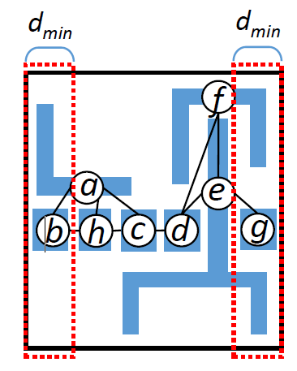
Reduced Simple Solution Graph (4/5)
Scenario 2: DLBS = LBS or DRBS = RBS, where both the DLBS and DRBS are not empty sets
Do not create the DLBS or the DRBS
1,1,1
1,1
1,1
1,1
1,1
1,1,2
1,2
1,2
1,2
1,2
1,1,3
…
…
…
…
1,2,1
…
…
3,3
3,3
3,3
3,3
3,3,3
{a,b}
=
{a,b}
{e,f}
{e,f}
{e,f,g}
LBS
DRBS
DLBS
DRBS
RBS
#nodes = 36
#nodes = 45
#edges = 243
#edges = 108
Notes:
This is another scenario. We can see that the LBS is equal to the DLBS
Intuitively, we should not create the DLBS to avoid enlarging the graph size instead, so, it is removed from the graph
Finally, we get the reduced simple solution graph by adding the edges between nodes, and the graph size is reduced

Slide 23
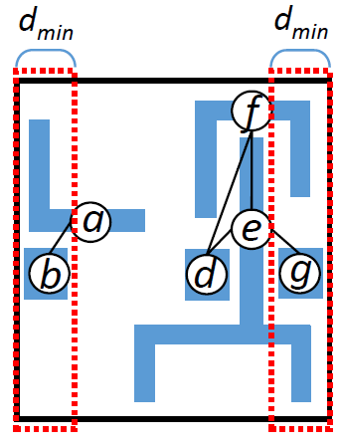
Reduced Simple Solution Graph (5/5)
Scenario 3: DLBS and/or DRBS is an empty set
A pseudo node with weight of 0 is created for the DLBS (DRBS), if DLBS (DRBS) is an empty set
pseudo node
1,1,1
1,1
1,1
1,1,2
1,2
1,2
1,1,3
…
…
…
…
…
1,2,1
3,3
3,3
…
3,3,3
{a,b}
{ }
{e,f}
{e,f,g}
LBS
DLBS
DRBS
RBS
#nodes = 36
#nodes = 46
No conflict with OP or RBS
#edges = 243
#edges = 45
Notes:
The last scenario is that when DLBS and/or DRBS is an empty set, we create a pseudo node without weight for DLBS and/or DRBS
As can be seen from this example, the DLBS is an empty set, so by adding a pseudo node for the DLBS and edges between nodes, we get the reduced simple solution graph
Accordingly, the graph size is reduced

Slide 24
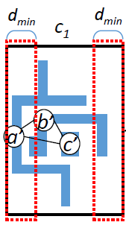
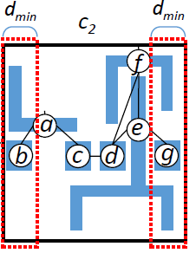
Reduced Simple Solution Graph for BCP
As we redesign the solution graph to be the reduced simple solution graph for a cell, the original solution graph for a BCP cannot be directly used to combine with a reduced simple solution graph.
pseudo node
1,1
1
1,2
1,3
2
2,1
>d_{min}
3
…
…
3,3
{b’}
RBS_{c1}
{ }
DLBS_{c2}
{ }
DRBS_{c1}
{a,b}
LBS_{c2}
#nodes = 12
#nodes = 13
BCP of c₁ and c₂
#edges = 27
#edges = 12
Notes:
Because we redesign the solution graph to be the reduced simple solution graph for a cell, we also use the same way to construct the reduced simple solution graph for a BCP

Slide 25
Overall Approach
Given a cell library and a set of stitch candidates for each cell
Off-line build a look-up table
Reduced simple solution graph
Each cell type
The BCP of each cell pair
For each row
Construct solution graph
Find a least-cost path
Simultaneously solving the TPL layout decomposition problem for each row
Notes:
Finally, Let’s overview our overall approach
Given a cell library and a set of stitch candidates for each cell type
We first off-line build a light-weight look-up table containing the reduced simple solution graph for each cell type and the BCP of each cell pair
For each cell row, we construct the solution graph by using this look-up table and find a least-cost path to get the optimal solution
Finally, the TPL layout decomposition problem for each row can be simultaneously solved

Slide 26
Experimental Results
Workstation with 2.0 GHz Intel Xeon CPU and 96 GB memory
Compare with two state-of-art TPL decomposers
Decomposer-A
Decomposer-B
The stitch candidates*
B. Yu, Y.-H. Lin, G. Luk-Pat, D. Ding, K. Lucas, and D. Z. Pan, “A high-performance triple patterning layout decomposer with balanced density”, in ICCAD, 2013.
H. Tian, H. Zhang, Q. Ma, Z. Xiao, and M. D. F. Wong, “A polynomial time triple patterning algorithm for cell based row-structure layout”, in ICCAD, 2012.
*J. Kuang and E. F. Y. Young, “An efficient layout decomposition approach for triple patterning lithography,” in DAC, 2013.
Notes:
All the experiments were conducted on a linux workstation 2.0 GHz CPU
We compare our approach with the two state-of-the-art TPL decomposers, Decomposer-A and Decomposer-B,
that appear in ICCAD 2013 and 2012, respectively
The stitch candidates of all the test cases are generated by a work in DAC 2013

Slide 27
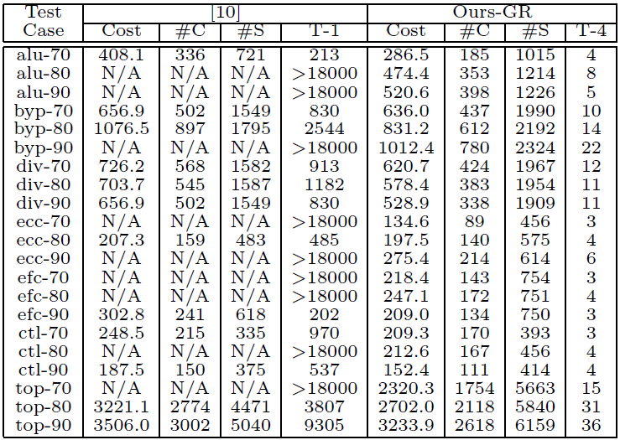
Comparisons with Decomposer-A
Decomposer-A
Test case: OpenSPARC T1 Designs
Notes:
First we compare our approach with Decomposer-A on the OpenSPARC T1 designs
As can be seen from this Table, our approach with graph reduction successfully obtained the decomposition for each test case in few seconds,
However, Decomposer-A could not complete in five hours for almost half of the test cases.
In addition, our approach produced much better decomposition quality and ran much faster for every test case
By the way, Decomposer-A and our approach were executed on 1 and 4 threads, respectively

Slide 28
Comparisons of Our Approaches
Test case: OpenSPARC T1 Designs
Notes:
We also make an analysis for our proposed graph reduction techniques.
With graph reduction, the amounts of nodes and edges can be averagely reduced by 94% and 77%, respectively
Consequently, we get 76~80% runtime improvements on average in the multi-threaded modes with 4 threads, 2 threads, and 1 thread

Slide 29
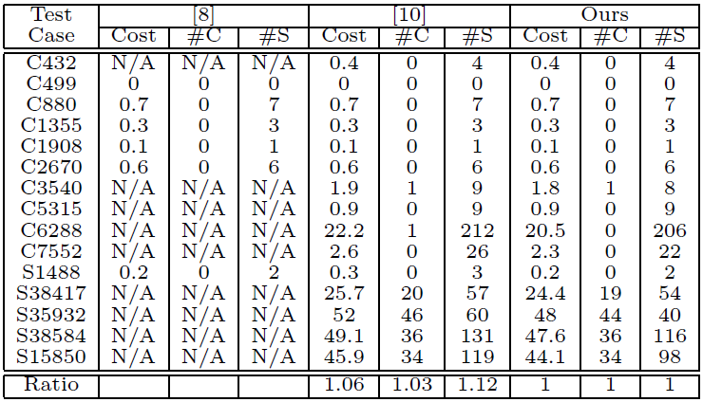
Comparisons with Decomposer-A&-B
Decomposer-B
Decomposer-A
Test case: ISCAS-85&89 circuits
Notes:
To further observe the decomposition quality that our approach can achieve, we compare with both the decomposer on the frequently used ISCAS circuits
Apparently, our approach got better or same results in terms of the amounts of conflicts and stitches

Slide 30
Conclusion
We extend an existing approach to optimally solve a row-structure TPL layout decomposition problem
Several methods to substantially reduce the graph size and hence to speed up the extended approach are also presented
The experimental results show that our approach is not only efficient but also effective
Notes:
Let me conclude my presentation

