Slide 1

Physical Layout Design of Directed Self-Assembly Guiding Alphabet for IC Contact Hole/Via Patterning
H.-S. Philip Wong, Linda He Yi, Maryann C. Tung, Kye Okabe
Dept. Electrical Engineering & Stanford SystemX Alliance
Stanford University

Slide 2
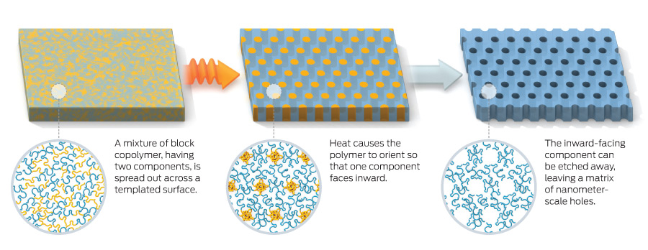
What is Block Copolymer Self-assembly?
Polymer A
Polymer B
Block Copolymer
http://spectrum.ieee.org/semiconductors/nanotechnology/selfassembly-takes-shape

Slide 3
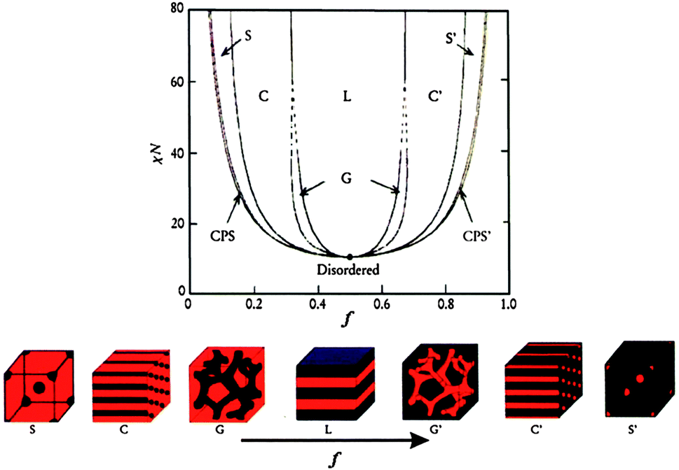
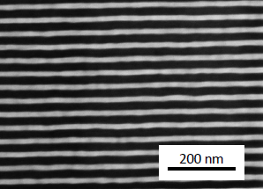

What is Block Copolymer Directed Self-assembly (DSA)?
Sub-20 nm feature size
Sub-40 nm pitch
Low cost
High throughput
R. Ruiz…P. Nealey, Science 321, 936 (2008) [Hitachi, Wisconsin]

Slide 4
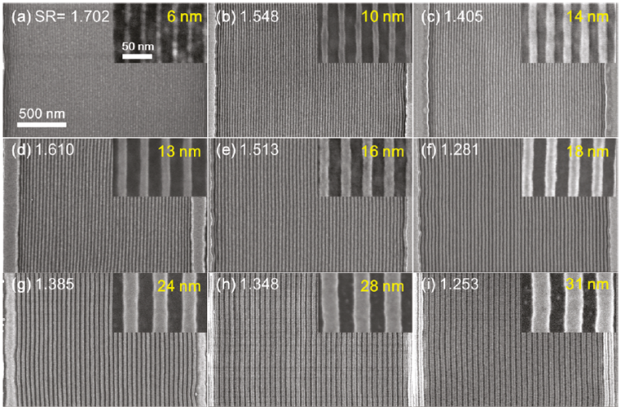
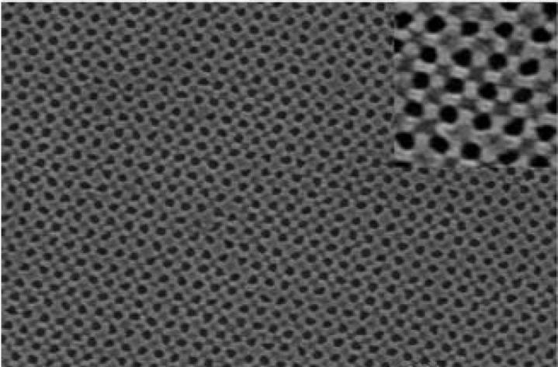
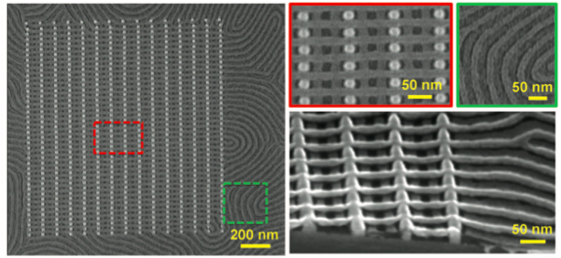
J.W. Jeong...C.A. Ross., Nano Lett. 2011, 11, 4095–4101 [MIT]
C. Tang … C. Hawker, Science, p. 429 (2008). [UCSB]
H. Tsai et al., ACS Nano. 2014, 8, 5, 5227–5232 [IBM]
A. Tavakkoli. K. G, Science, vol. 336 (2012). [MIT]

Slide 5
What can directed self-assembly (DSA) do?

Slide 6
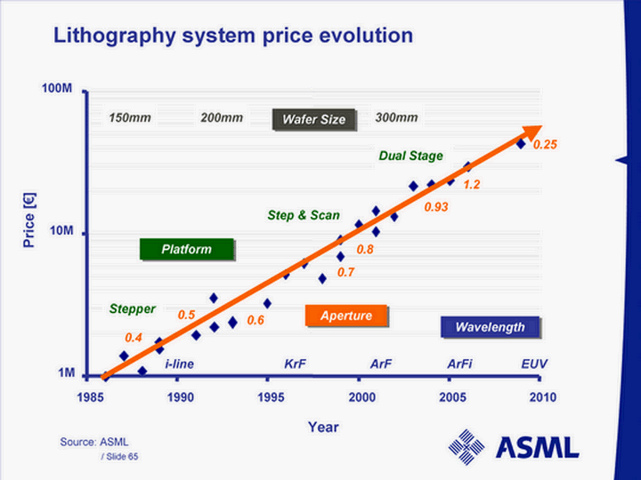
Lithography is the Bottleneck of Scaling
Stringent requirements for smaller technology node: CD and pitch
Limited lithography resolution
Higher cost
Notes:
Traditional lithography uses ultraviolet light to draw and define those tiny features, lines and dots of the transistors. As devices is getting smaller, lithography becomes the bottleneck because the wave length of ultraviolet light is limited. To extend that limit people have put in a lot of effort, and we end up with bigger lithography tools and higher prices. The most advanced lithography tool is much larger than a conference room, and costs more than 100M dollars.

Slide 7
Alternative Lithography Solution is a MUST
 | Cost | Throughput | Resolution
EUV lithography
Multiple Patterning
E-beam direct write
Directed Self-Assembly (DSA)
But why are semiconductor foundries not using it today?

Slide 8
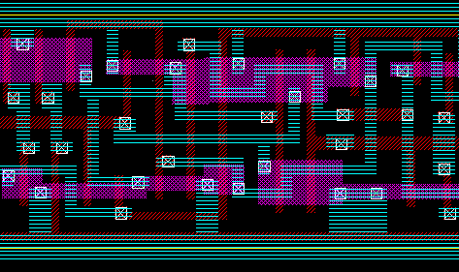
What we have:
What we need:
contact
Metal 1
Poly
Active Region

Slide 9
Periodic
Large area
Uniform
Aperiodic
Position Control
Process Compatibility
Defectivity Control
Design Rules
contact
Metal 1
Poly
Active Region

Slide 10
Goal
Prepare DSA as the next generation lithography for contact hole patterning
contact
Metal 1
Poly
Active Region

Slide 11
From Materials to CAD Design
Goal: Prepare DSA as the next generation lithography for contact hole patterning
Design Rules for DSA
Layout Optimization
DSA Assist Features Design
DSA Contact Patterning
General Design Strategy
DSA contact patterning demonstration
Flexibly control of aperiodic DSA patterns
DSA design space
Alphabet concept
Aperiodic DSA patterns

Slide 12
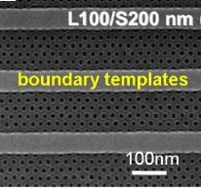
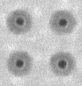
Guiding Templates → Aperiodic DSA Patterns
Guiding Templates
Physical Confinement
PMMA
PS
PS-b-PMMA
Infinite periodic
Boundary periodic
1-hole DSA pattern
Black dots: PMMA
Gray surrounding: PS
Top surface
100 nm
R. Ruiz, Science 321, 936 (2008); L.-W. Chang, IEDM , p. 879, (2009)

Slide 13
Process Flow
PS-b-PMMA
Dissolved in PGMEA
Spin coating
Si
PS is left as a resist mask for pattern transfer
Thermal Annealing
Deep UV radiation
Soaked in
Acetic Acid
PMMA cylinder removal
PMMA
PS

Slide 14
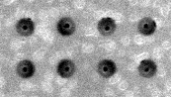
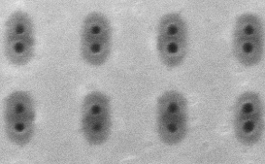
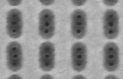
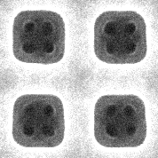
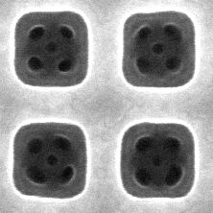
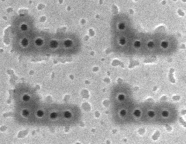
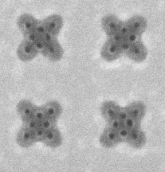
Flexible Control of Aperiodic DSA Patterns
Control Knobs:
Template shape & size
Template density
200nm
75nm
60x110nm
70x145nm
200nm
126 nm
136 nm
200nm
200nm
Square lattice
Rhombic lattice
H. Yi, et al., Adv. Mater. 2012

Slide 15
DSA Design Space
Longer template leads to larger DSA hole pitch → 2-hole turn into 3-hole
Very high density
High density
Low density
Very low density
H. Yi, et al., Nano Letters, 2015

Slide 16
DSA Design Space
Longer template leads to larger DSA hole pitch → 2-hole turn into 3-hole
For different template density, either 2-hole or 3-hole pattern may appear
Very high density
High density
Low density
Very low density
H. Yi, et al., Nano Letters, 2015

Slide 17
From Materials to CAD Design
Design Rules for DSA
Layout Optimization
DSA Assist Features Design
DSA Contact Patterning
General Design Strategy
DSA contact patterning demonstration
Flexibly control of aperiodic DSA patterns
DSA design space
Alphabet concept
Aperiodic DSA patterns

Slide 18
DSA Guiding Template Design Strategy
Contact layout
BCP
Max pitch
Lithography
Resolution
Contact
Min pitch
BCP
Max pitch
Contact
Min pitch
Lithography
Resolution
Contact
Min pitch
BCP
Max pitch
Lithography
Resolution
1st strategy:
1-hole templates for each contact
2nd strategy:
Peanut-shaped templates for closely positioned contacts
3rd strategy:
Multiple-hole templates for closely positioned contacts
H. Yi, et al., Nano Letters, 2015

Slide 19
DSA Guiding Template Design Strategy
Contact layout
Large
Technology Node
Small
H. Yi, et al., Nano Letters, 2015

Slide 20
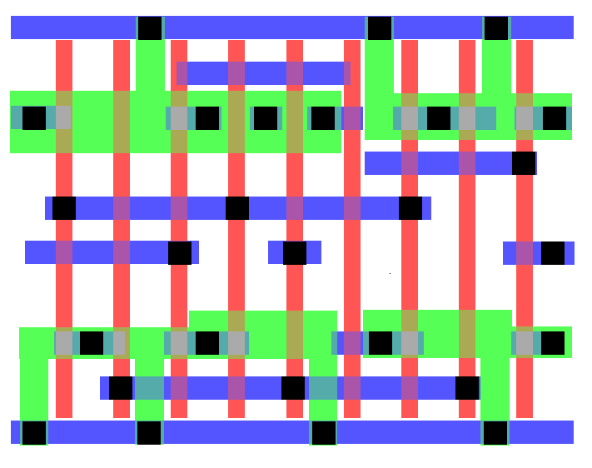
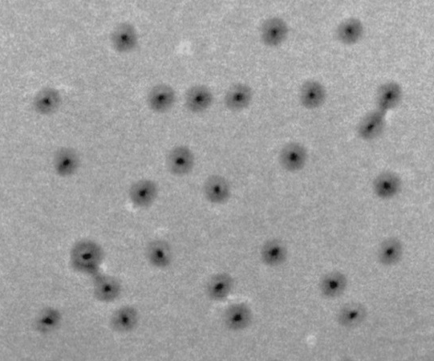
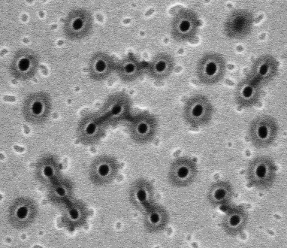
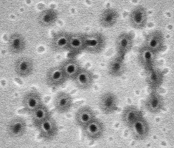
DSA Contact Patterning Demonstration
HA-X1
14 nm
11 nm
7 nm
200 nm
200 nm
200 nm
H. Yi, et al., Nano Letters, 2015

Slide 21
From Materials to CAD Design
Design Rules for DSA
Layout Optimization
DSA Assist Features Design
DSA Contact Patterning
General Design Strategy
DSA contact patterning demonstration
Flexibly control of aperiodic DSA patterns
DSA design space
Alphabet concept
Aperiodic DSA patterns

Slide 22
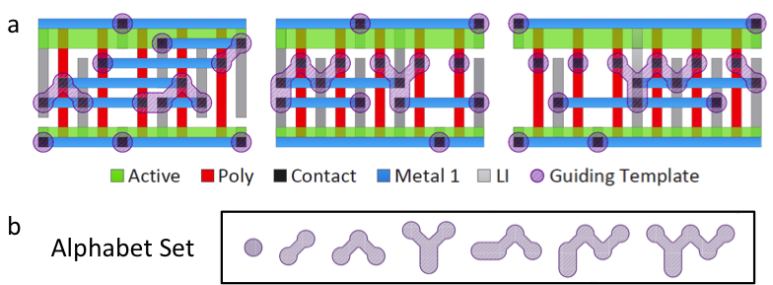
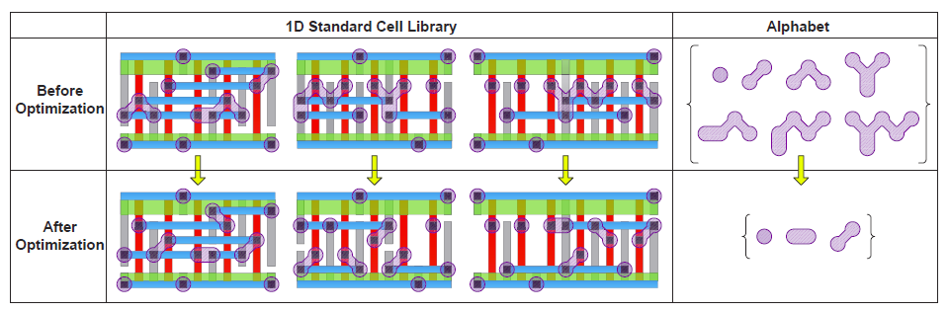
How Many Guiding Template Shapes Needed?
In a standard cell library, there are more than 100 standard cells
On a full chip contact layer, these cells are placed-and-routed many, many times
There are many repeating closely placed contact configurations
Inside the yellow circle is what we called “Peanut Shape”
Y. Du, H. Yi, et al., ICCAD 2013

Slide 23
Peanut Shape Template Needed
When max DSA hole pitch < contact pitch < litho resolution
Guiding template design
DSA result
64 nm
①
X
4 nm
Contact layout
②

64 nm
H. Yi, et al., Nano Letters, 2015

Slide 24
DSA Alphabet – Only Need a Limited Template Set
There exists a set of guiding templates which could cover and compose the desired full chip contact layer
…Just like the alphabets!

Slide 25
DSA-Aware Contact Layer Optimization
Complex shapes are hard to print by lithography
The neck of peanut shape is not preferrable
Y. Du, H. Yi, et al., ICCAD 2013
Collaboration with Prof. Martin Wong (UIUC)

Slide 26
DSA-Aware Contact Layer Optimization
Letter Cost Function
Y. Du, H. Yi, et al., ICCAD 2013
Letter size
Number of peanut pairs
Collaboration with Prof. Martin Wong (UIUC)

Slide 27
Flexible Control of DSA Patterns
Control Knobs:
Template shape & size
Template density
200nm
75nm
60x110nm
70x145nm
200nm
126 nm
136 nm
200nm
200nm
Square lattice
Rhombic lattice
H. Yi, et al., Adv. Mater, 2012

Slide 28
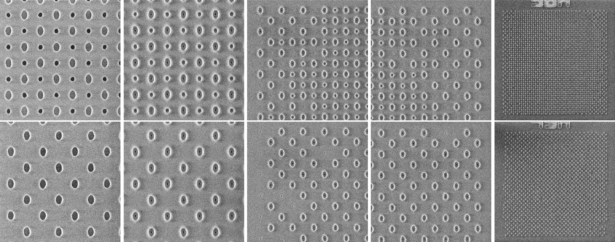
Sub DSA-Resolution Assist Feature (SDRAF)
SDRAF
No SDRAF
H. Yi, et al., SPIE 2015
Scale bar: 150 nm

Slide 29
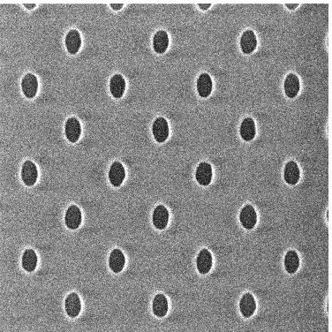
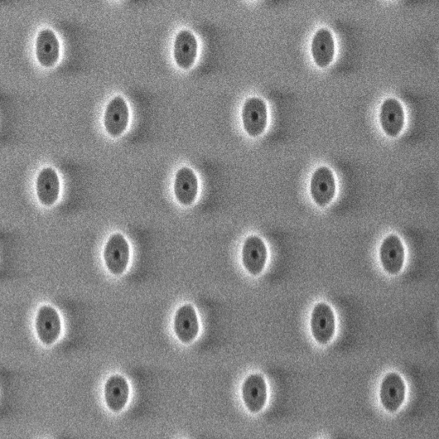
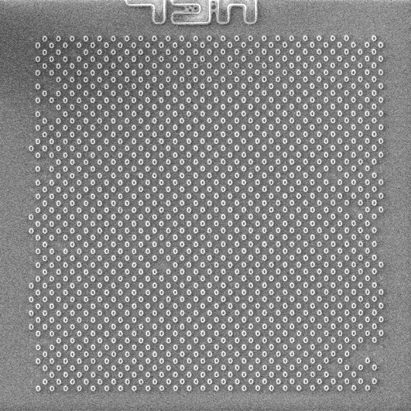
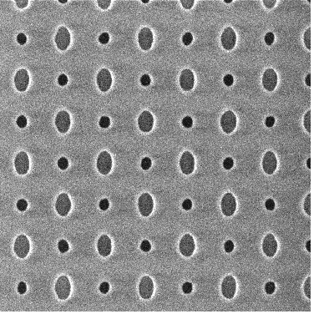
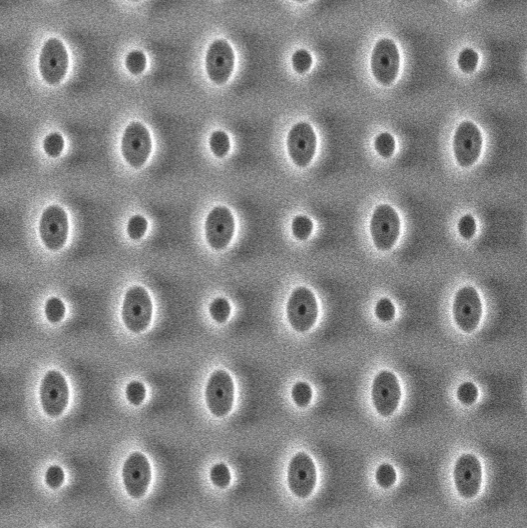
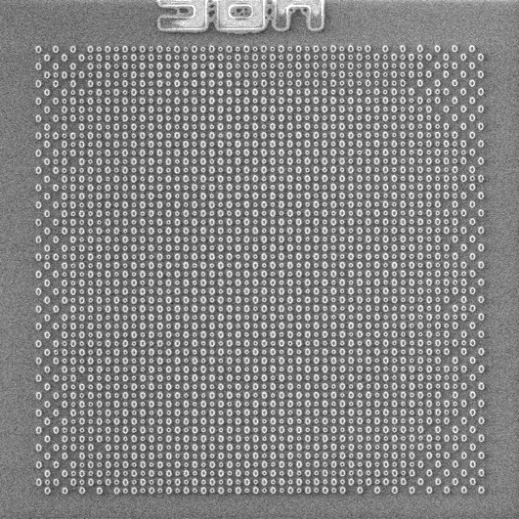
Effectiveness of SDRAF: Center Images
Empty templates
DSA result in the center
Zoom-out view
Template pitch:
150 nm
Oval template size:
82 nm x 53 nm
No SDRAF
SDRAF size:
40 nm
Both DSA results in the center look good
Scale bar: 150 nm
H. Yi, et al., SPIE 2015

Slide 30
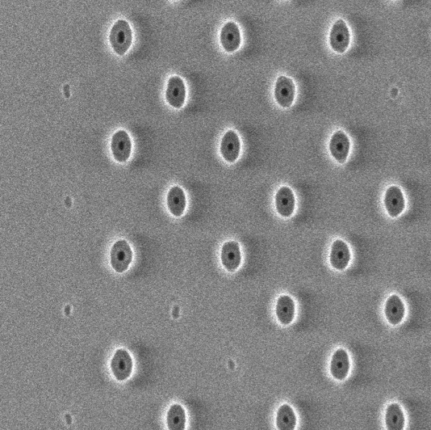
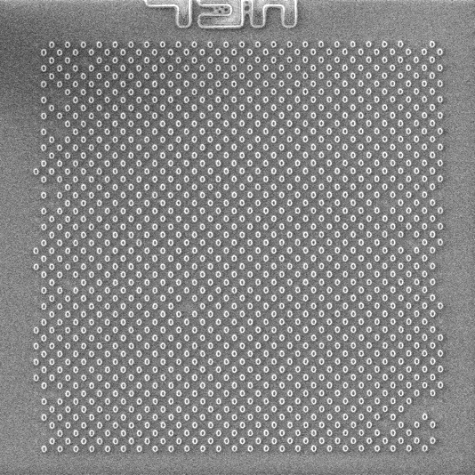
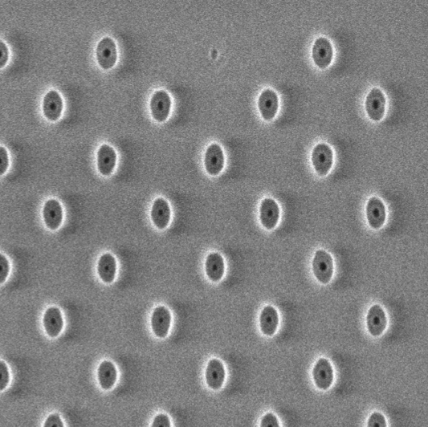
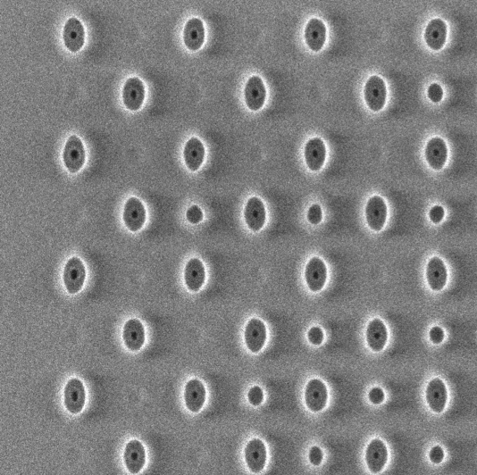
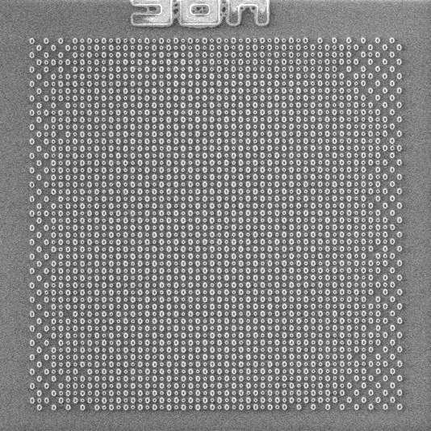
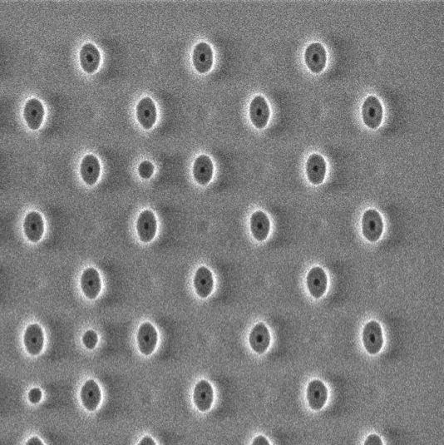
Effectiveness of SDRAF: Corner Images
Left corner
Zoom-out view
Right corner
No SDRAF:
54 DSA contacts missing
With SDRAF:
Zero DSA contacts missing
H. Yi, et al., SPIE 2015
Scale bar: 150 nm

Slide 31
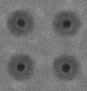
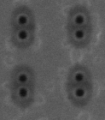
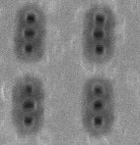
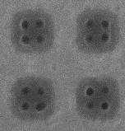
Highlights
Generate and control aperiodic DSA patterns
First demo: demonstrate DSA contact patterning for 14 nm, 11 nm and 7 nm node
First demo: DSA alphabet concept
Scale bar: 100 nm
200 nm
200 nm
200 nm
14 nm
11 nm
7 nm

Slide 32
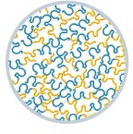
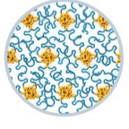
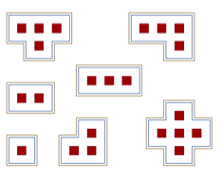




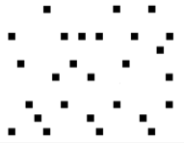
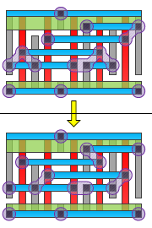
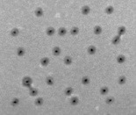
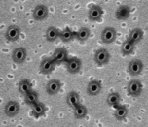
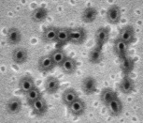
Block Copolymer
DSA
Aperiodic DSA
pattern
H. Yi, et al., Adv. Mater., 2012
DSA Contact
Patterning
Design Rules
for DSA
DSA-Aware Layout Optimization
200 nm
200 nm
200 nm
14 nm
11 nm
7 nm
H. Yi, et al., Nano Letters, 2015
Y. Du, H. Yi, et al., ICCAD, 2014

Slide 33






Collaborators & Sponsors

Slide 34
Block Copolymer
DSA
Aperiodic DSA
pattern
H. Yi, et al., Adv. Mater., 2012
DSA Contact
Patterning
Design Rules
for DSA
DSA-Aware Layout Optimization
200 nm
200 nm
200 nm
14 nm
11 nm
7 nm
H. Yi, et al., Nano Letters, 2015
Y. Du, H. Yi, et al., ICCAD, 2014

Slide 36
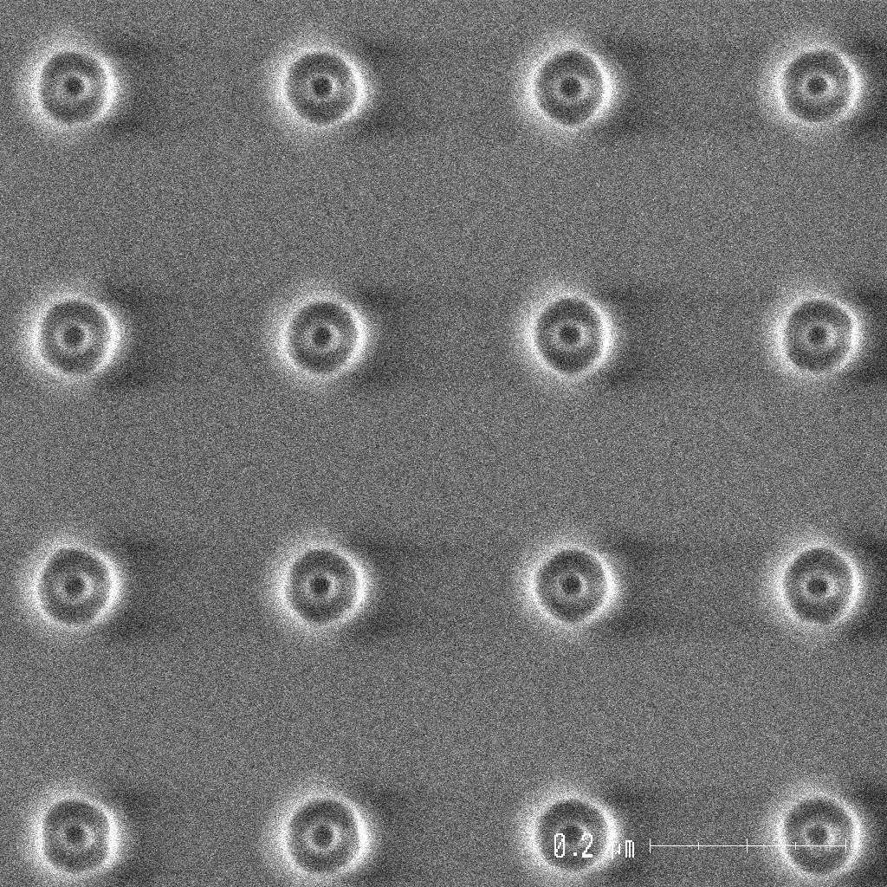
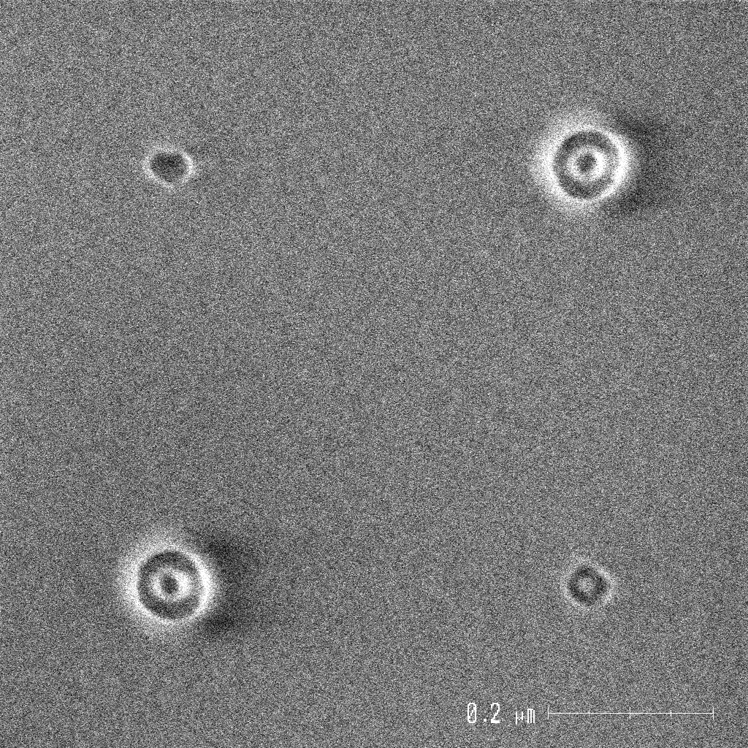
What causes template density influence?
Template density variation results in different fill levels, causing local film thickness variation
Polymer not overfilled
Polymer overfilled
Cross section
Template
Template
Top view SEM
200 nm
200 nm
High density
Low density
H. Yi, et al., SPIE 2015

Slide 37
Sub DSA Resolution Assist Feature (SDRAF)
Polymer not overfilled
Polymer overfilled
Polymer not overfilled
Template
Template
Template
SDRAF
SDRAF:
Small templates to balance low contact density
Will not generate transferrable DSA patterns

Slide 38



SDRAF: Failed Case
Large SDRAF will generate DSA patterns and result in extra holes in pattern transfer
SDRAF size need to be controlled carefully
SDRAF size: 55 nm
Scale bar: 300 nm
H. Yi, et al., SPIE 2015

