Slide 1
A Useful Skew Tree Framework for Inserting Large Safety Margins
Rickard Ewetz and Cheng-Kok Koh
School of Electrical and Computer Engineering, Purdue University
ISPD 2015

Slide 2
Lowering the Point of Divergence and Safety Margins
B
D
A
A
C
B

Slide 3
Skew Constraints
Combinational
Logic
FF_{i}
FF_{j}

Slide 4
Safety Margins
D
A
B
C

Slide 5
SCG
b
Negative cycle =>
no Feasible Arrival times!
d
D Q
D Q
b
D Q
30
d
a
D Q
a
40
10
c
c
20
Insert Safety Margin
M_{user} = 20
10
b
d
a
20
-10
c
0

Slide 6
Cycles of Skew Constraints
10
20
SCG with = 0
=0
Maximum Uniform safety margin
[9] J. Fishburn. Clock skew optimization. IEEE
Transactions on Computers, pages 945–951, 1990.

Slide 7
Greedy-UST/DME
a b c d
Source
b
c
a
d
FSR_{ab} = [-d_{ab}, d_{ba}]
D Q
D Q
D Q
D Q
a b c d
[17] C.-W. A. Tsao and C.-K. Koh. UST/DME: a clock tree router for general skew constraints. ACM TODAES, pages 359–379, 2002.

Slide 8
Insertion of Safety Margins in [17]
Uniform Safety Margins M_{user}
M = 15 ps
100
Yield (%)
46.8
0 15
M_{user} (ps)
[17] C.-W. A. Tsao and C.-K. Koh. UST/DME: a clock tree router for general skew constraints. ACM TODAES, pages 359–379, 2002.

Slide 9
Insertion of Safety Margins in [11]
Source
a b c d
20 20
=ф
FSR_{ab} = [-d_{ab}, d_{ba}]
M = 15 ps
D Q
D Q
D Q
D Q
20
10
a b c d
b
c
[11] W.-C. D. Lam and C.-K. Koh. Process variation robust clock tree routing.
ASP-DAC ’05, pages 606–611, 2005.

Slide 10
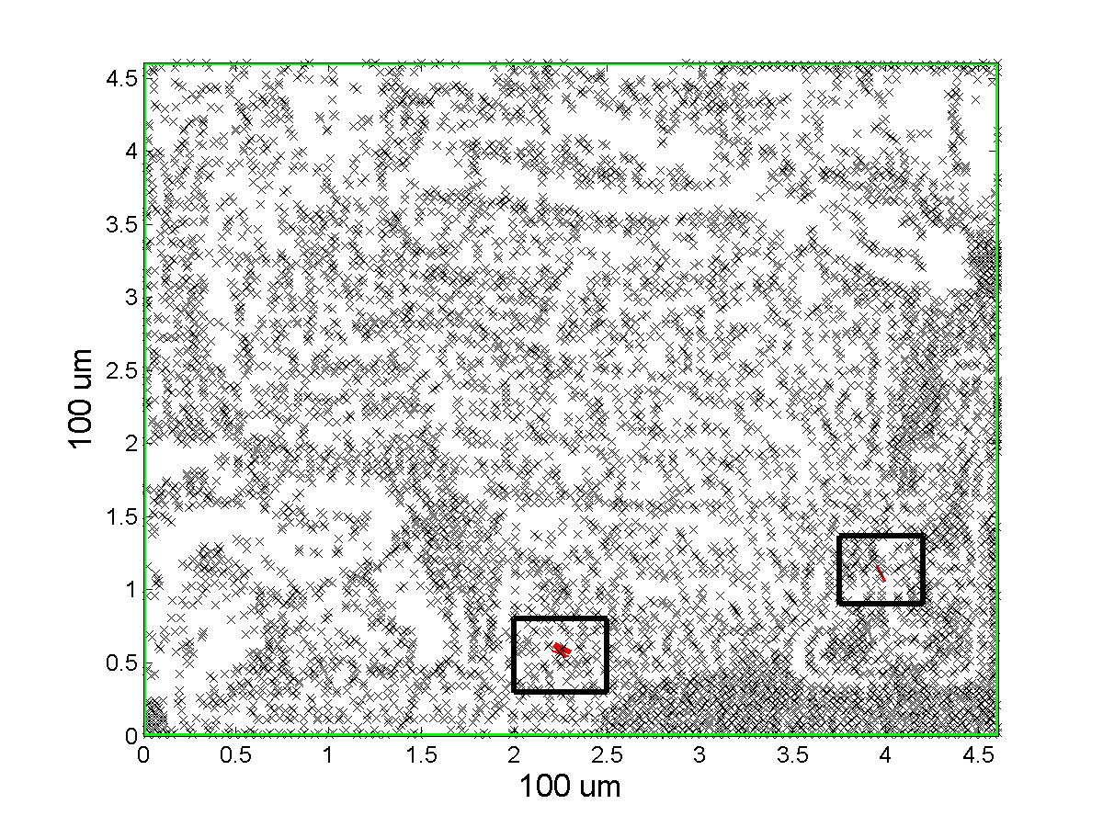
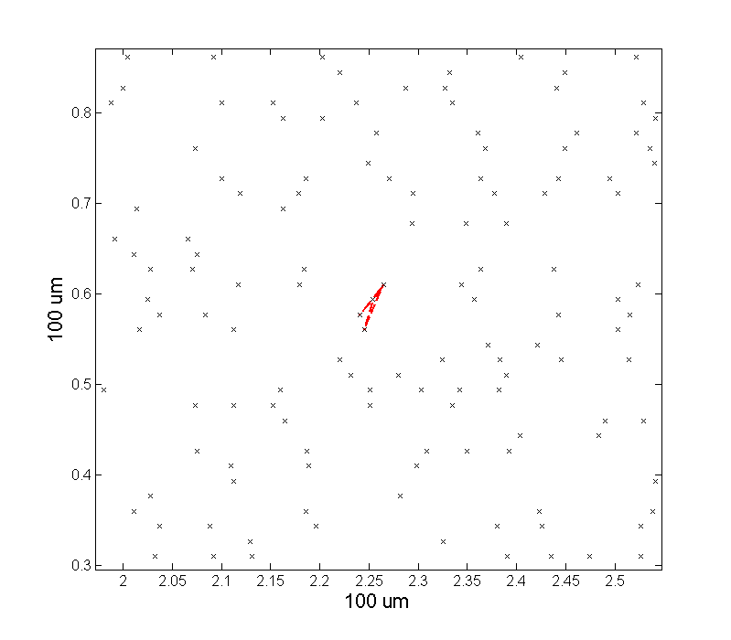
Proposal
Safety margin M_{user} > Max uniform M
Lower point of divergence
Few constraints that limit the magnitude of M!

Slide 11
Flow UST-LSM Framework
Input
Decrease SCG edge
weights with M_{user}
Cycle is non-negative
Pre-synthesis
Detection of negative cycles
Reduction of safety margin from edges of negative cycles
No cycles in SCG
Found one cycle
in SCG
Create clusters from
negative cycles
Synthesis
Construct trees from cluster 2 to K
Construct clock tree from cluster 1 and the trees from cluster 2 to K
Output

Slide 12
8
6
1
2
1
2
1
2
5
3
3
7
2
5
12
2
6
10
0
4
0
3
1
1
3
-2
4
3
-4
4
3
-4
4
10
8
1
2
C₁
C₂
2
1
1
2 3 4
3
-3
4
1
2 3 4
2 3 4

Slide 13
Evaluation of the UST-LSM Framework
Name | Clock period (ns) | Number of nets | Number of cells | Number of sequential elements | Number of skew constraints
scaled_s1423 scaled_s5378 scaled_s15850 | 0.32 0.32 0.32 | - - - | - - - | 74 179 597 | 78 175 318
msp fpu ecg | 12.30 40.00 1.00 | 5239 42104 62164 | 4787 41565 61491 | 683 715 7674 | 44990 16263 63440
[8] R. Ewetz and C.-K. Koh. Benchmark circuits for clock scheduling and synthesis. https://purr.purdue.edu/publications/1759, 2015.

Slide 14
Monte Carlo Framework
Adopted from the ISPD2010 contest [15]
Variations
Supply voltage (15%)
Wire widths (10%)
Temperature (30%)
Channel length (10%)
Spatial correlations
Quad tree model [1]
Stage-by-stage with slew propagation [19]
[15] C. Sze. ISPD 2010 high performance clock network synthesis contest: Benchmark suite and results. ISPD’10, pages 143–143, 2010.
[1] A. Agarwal, D. Blaauw, and V. Zolotov. Statistical timing analysis for intra-die process variations with spatial correlations. ICCAD’03, pages 900–907, 2003.
[19] M. Zhao, K. Gala, V. Zolotov, Y. Fu, R. Panda, R. Ramkumar, and B. Agrawal. Worst case clock skew under power supply variations. TAU ’02, pages 22–28, 2002.

Slide 15
Evaluation metrics
Metrics:
Yield (skew + transition time)
95%-slack
Capacitive cost
Run-time
Designs with loose and tight skew constraints
Loose if no negative cycles with M_{user} = 100 ps

Slide 16
Designs with loose skew constraints
 | Safety margin M_{user} (ps) | Yield | 95%-slack | Cap (fF) | Run-time
msp | ZST No margin 50 100 | 100 100 100 100 | 80.00 80.00 80.00 100.00 | 2473 1872 1872 1977 | 209 193 200 184
fpu | ZST No margin 50 100 | 100 100 100 100 | 49.11 50.00 50.00 87.63 | 3185 2264 2264 4499 | 78 49 46 71
Similar results for scaled_s1423 and scaled_s5378

Slide 17
Designs with Tight Skew Constraints
 | Safety margin M_{user} (ps) | Clustering | C₂ (num) | Max stages C₃ (num) | C₄ (num)
scaled_s15850 scaled_s15850 | M+20=47 M+20=47 | yes no | 3 7 | - - | - -
scaled_s15850 scaled_s15850 | M+50=77 M+50=77 | yes no | 3 9 | - - | - -
ecg ecg | M+15=30 M+15=30 | yes no | 3 6 | 1 8 | - -
ecg ecg | M+25=40 M+25=40 | yes no | 3 3 | 1 6 | 1 1

Slide 18
Tight Skew Constraints
98.8
95.4
96.2
93.0
100
82.6
46.8
Yield (%)
0 15 20 25 30 35 40
M_{user} (ps)

Slide 19
Tight Skew Constraints
BM | Safety Margin M_{user} (ps) | Yield (%) | 95%-slack | Cap (fF) | Run-time
scaled _s15850 | ZST 0 M=27 M+10=37 M+20=47 M+30=57 | 0.0 26.4 96.6 99.6 99.8 100 | -12.98 -14.54 3.23 11.25 17.40 24.30 | 17830 14520 20197 25916 30050 34890 | 136 181 292 678 1092 1484
ecg | ZST 0 M=15 M+5=20 M+10=25 M+15=30 M+20=35 M+25=40 | 0.0 0.0 46.8 82.6 93.0 98.8 95.4 96.2 | -30.53 -19.55 -9.04 -5.34 -1.13 4.64 0.15 5.17 | 25878 22256 44853 47129 56974 66829 89223 96845 | 1771 1118 1827 1761 2127 2360 4011 6388

Slide 20
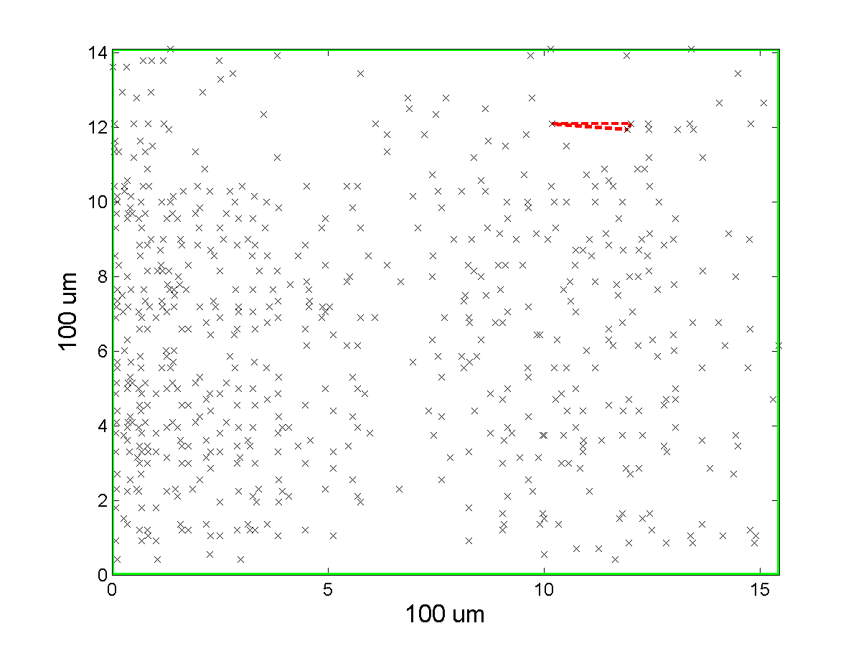
Illustration on scaled_s15850

Slide 21
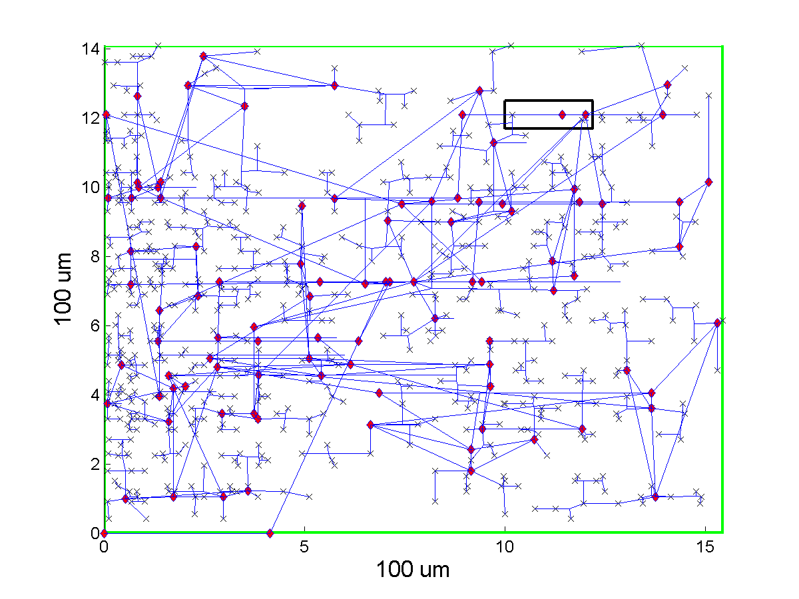
M_{user} = M+ 0 = 27

Slide 22
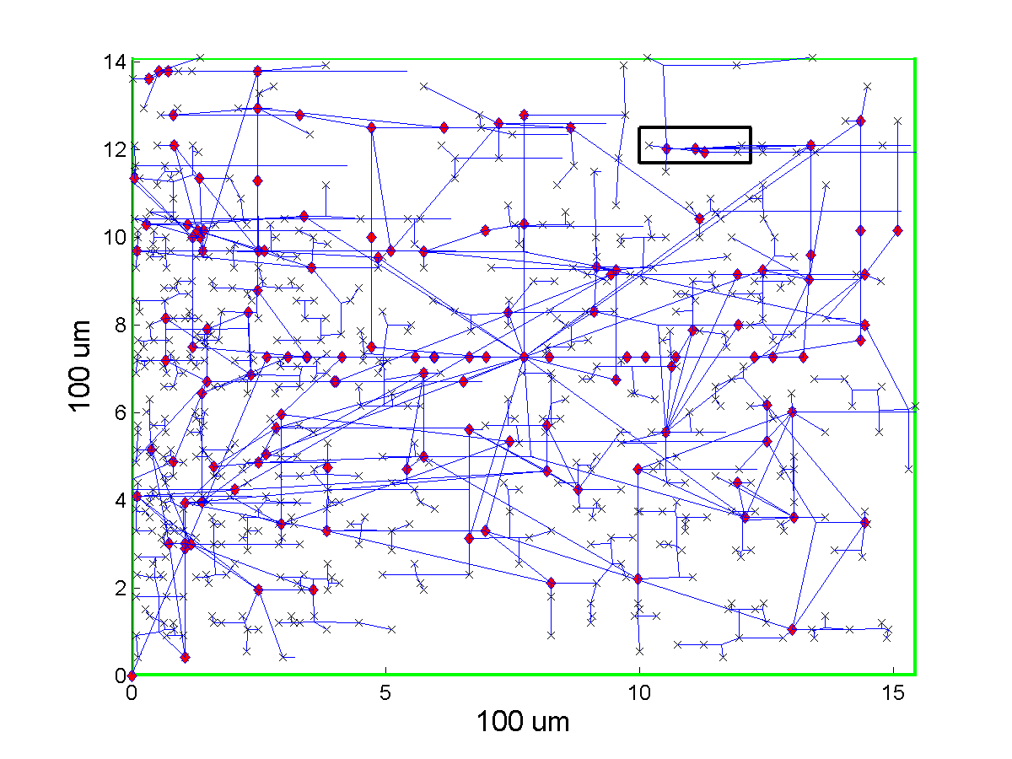
M_{user} = M+10 =37

Slide 23
Summary
Combine the lowering of the point of divergence with insertion of large safety margins!
Questions

Slide 24
Reducing the Cost
BM | Safety Margin M_{user} (ps) | Yield (%) | Cap (fF) ISPD2015 | New Cap
scaled _s15850 | ZST 0 M=27 M+10=37 M+20=47 M+30=57 | 0.0 26.4 96.6 99.6 99.8 100 | 17830 14520 20197 25916 30050 34890 | - 14500 20200 24400 28200 33100
ecg | ZST 0 M=15 M+5=20 M+10=25 M+15=30 M+20=35 | 0.0 0.0 46.8 82.6 93.0 98.8 95.4 | 25878 22256 44853 47129 56974 66829 89223 | - 21800 39500 39600 43800 49900 63300

