Slide 1

Blech Effect in Interconnects: Applications and Design Guidelines
Ali Abbasinasab
Malgorzata Marek-Sadowska

Slide 2
Overview
Introduction
Material Migration: Multiphysics
Blech Effect
CAD Model: New Mortality Criterion
Conclusions

Slide 3
Trends in Interconnect Design Introduction
Current Status
ITRS 2014-2020 (Reliability Challenge)
TCAD / Multiphysics Simulations
Devices, Interconnects and Packaging (nanoscale process)
Chemical, thermal, mechanical and electrical properties of new materials: capping (MnSiO, CuAl , CuTi….), liners (Co, Ru) and thickness, air-gap, low-k ILD
Technology, dual-damascene
CAD
Accurate Compact Models
Chip level assessment

Slide 4
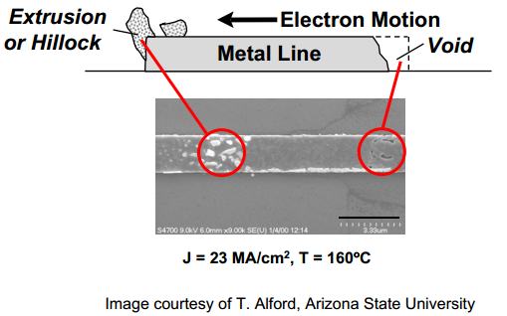
Material Migration Introduction
Material-migration
Material transportation caused by the gradual movement of the atoms in conductor
Electromigration
Stressmigration
Thermomigration
Criticality: Technologies and Applications
Process, Manufacturing, 3D Integration, Packaging
Power and Signal/Clock Lines
Long-Term/Constantly-In-Use Chips: Automotive, Servers and Routers

Slide 5



Material Migration: Multiphysics
Material concentration change (vacancy transport) described by continuity equation:
$\frac{{∂C}_{v}}{∂t}+∇. J=G$
Electro-migration : $J_{em}=−\frac{DC_{v}}{kT}eZ^{∗}jρ$
Thermo-migration : $J_{tm}= −\frac{DC_{v}}{kT}\frac{Q^{∗}}{T}∇T$
Stress-migration : $J_{sm}= −\frac{DC_{v}}{kT}fΩ∇σ$
Diffusion-migration : $J_{mm}=∇C_{v}$
$$\frac{{∂C}_{v}}{∂t}=−∇. \left[−D(\frac{C_{v}}{kT}eZ^{∗}jρ+\frac{C_{v}}{kT}fΩ∇σ+∇C_{v}+\frac{C_{v}}{kT}\frac{Q^{∗}}{T}∇T)\right]−\frac{C_{v}−C_{v0}e^{\frac{fΩσ}{kT}}}{τ_{s}}$$
$$J=−D(\frac{C_{v}}{kT}eZ^{∗}jρ+\frac{C_{v}}{kT}fΩ∇σ+∇C_{v}+\frac{C_{v}}{kT}\frac{Q^{∗}}{T}∇T)$$
$$G= \frac{C_{v}−C_{eq}}{τ_{s}}=− \frac{C_{v}−C_{v0}e^{\frac{fΩσ}{kT}}}{τ_{s}}$$
Notes:
FLUX
Change in atom concentration (or vacancy concentration) can be caused by different sources ranging from electrical, mechanical and thermal to the material chemical properties.
Material concentration change or vacancy transport can be described by continuity equation:
$\frac{{∂C}_{v}}{∂t}+∇. J=G$
where C_{v} is the vacancy concentration, J is the vacancy flux and G is the source/sink model for generation and annihilation of vacancies.
Electro-migration
Electron wind: $J_{em}=−\frac{DC_{v}}{kT}eZ^{∗}jρ$
Stress-migration
Back stress: $J_{sm}= −\frac{DC_{v}}{kT}fΩ∇σ$
Thermo-migration
Joule Heating: $J_{tm}= −\frac{DC_{v}}{kT}\frac{Q^{∗}}{T}∇T$
4th A local variation in the atomic concentration can then occur during the fabrication and mostly in the grain boundary regions during the crystal growth. It can have an important impact on the degradation caused by particles diffusion induced migration.
In the continuity equation, G can be representing both vacancy generation and vacancy annihilation. When the concentration of vacancy is larger than its equilibrium value, vacancies are produced, while vacancies are annihilated when their concentration is less than the equilibrium value.
Tau is the lifetime of a vacancy in the presence of sinks (surface, dislocation) – not necessarily a constant.
These equations are pretty complicated – difficult to use by a designer.

Slide 6

CAD models
What matters to a Designer or a CAD Engineer?
Geometry and Topology
L, W, T and Interconnects Configuration
Electrical
Conductivity and Current Density ($J and ρ$)
Thermal
Joule Heating (Thermal Expansion Coefficient)
Chemical/Physical
Material (Activation energy, Young’s modulus, Diffusion…)

Slide 7
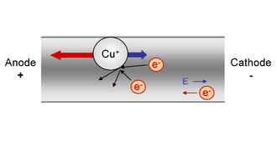
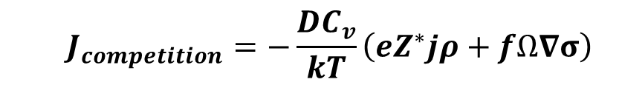

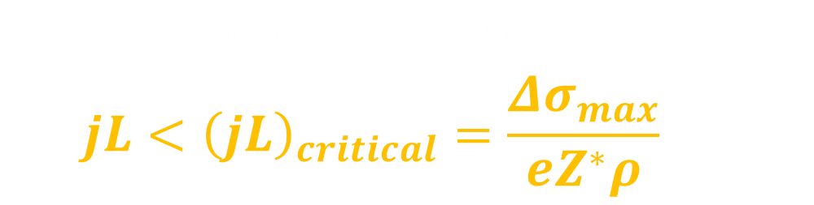
Blech Effect Material Migration: Multiphysics
$$immortal when:$$
$$jL<{\left(jL\right)}_{critical}=\frac{{Δσ}_{max}}{eZ^{∗}ρ}$$
$$J_{em}≈J_{sm}≫J_{tm}≫J_{mm}$$
Competition between two main forces
In steady state, back-stress force balances electron wind force
If stress required for void nucleation is not reached at cathode end in steady state, no void will nucleate
cathode
anode
Hydrostatic Stress Distribution
Critical Tensile Stress
$$J_{competition}=−\frac{DC_{v}}{kT}\left(eZ^{∗}jρ+fΩ∇σ\right)$$
Notes:
P2P where Ps are vias
jL provides a mortality filter – compared to a value characteristic for specific technology.
Effects of these four different driving forces which contribute to the EM process are not equal. Their typical contributions in terms of atomic flux are $\left|J_{tm}\right|≪\left|J_{mm}\right|< \left|J_{sm}\right| ≈\left|J_{em}\right|$
Blech studied EM in
Electron Wind Force:
$$F_{em}=eZ^{∗}E= eZ^{∗}jρ= −eZ^{∗}V \underset{→}{ } J_{em}=−\frac{DC_{v}}{kT}eZ^{∗}jρ$$
Back Stress Force:
$F_{sm}= fΩ∇σ$ $\underset{→}{ } J_{sm}= −\frac{DC_{v}}{kT}fΩ∇σ$
simple end-to-end interconnects and observed that there is no mass transport when current density is less than a certain threshold value for a given wire length
It is suggested that the presence of a back flow of atoms due to the back stress at the anode end opposes the electron wind. If the stress difference between the cathode and anode ends is less than that needed for void nucleation, the stress profile will evolve towards a steady state at which point the net atomic flux becomes zero and the wire is considered immortal. The condition of $J_{sm}$ and $J_{em}$ being equal is mathematically expressed as
Electromigration is electron-flow induced diffusion of atoms in a metal line.
Z* - effective atomic charge number, $ρ$ is electrical resistivity of metal, $σ$ is stress.

Slide 8
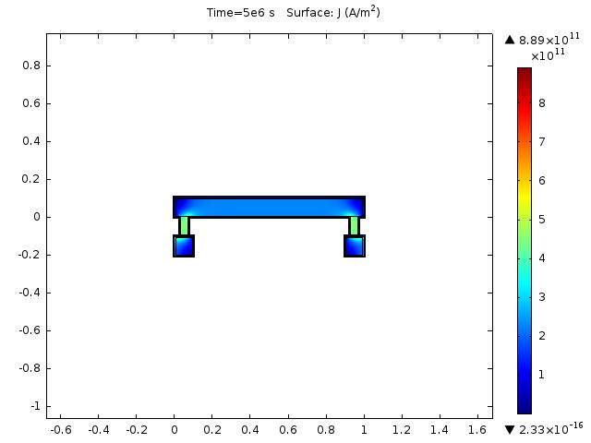
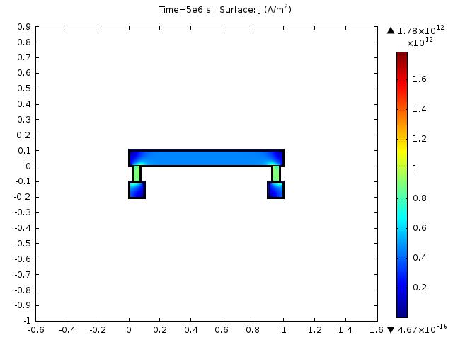
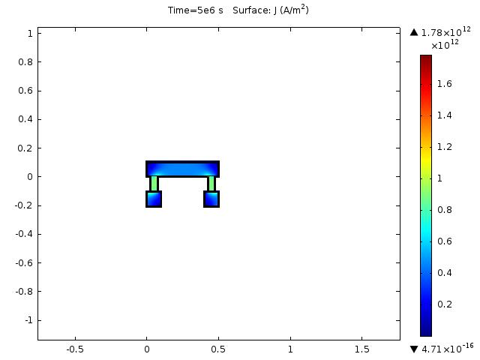
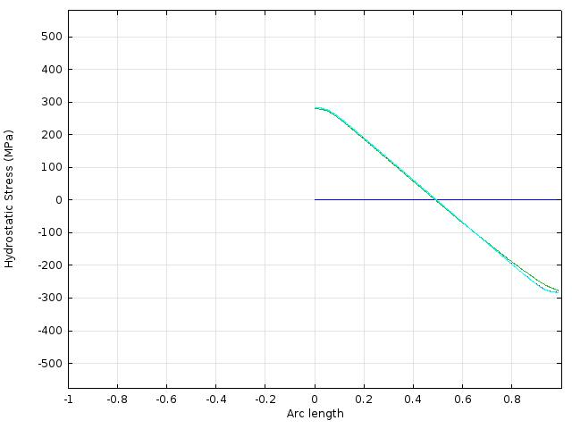
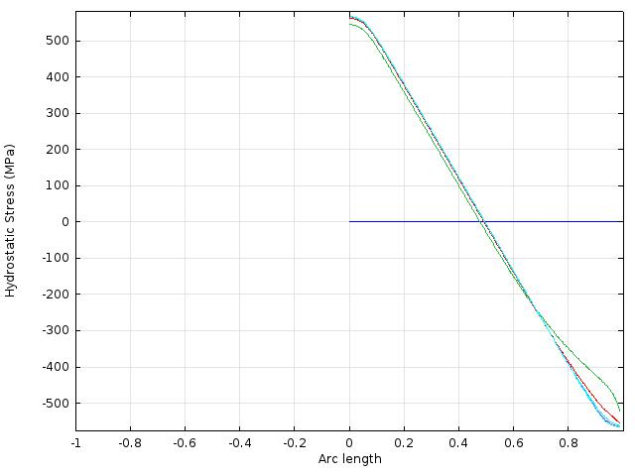
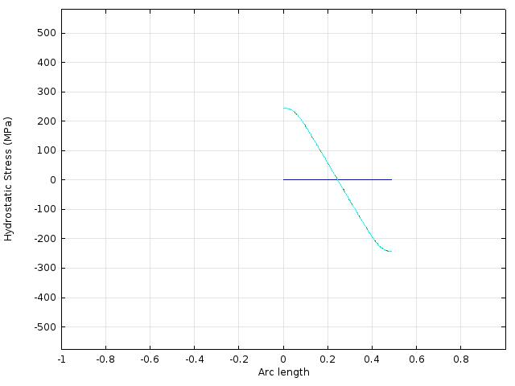



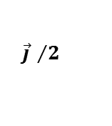

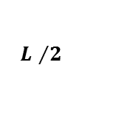
Blech Effect Material Migration: Multiphysics
jL_{Blech} is valid for a simple single bounded wire
Current density
$${\vec{j} }/2$$
$$\vec{j}$$
$$\vec{j}$$
$$L$$
$$L$$
$${L }/2$$
Hydrostatic Stress $∝$ JL
Critical Stress
Critical Stress
Critical Stress
(0.5J)L
JL
J(0.5L)

Slide 9
Motivation and Problem Description CAD Model: new Mortality Criterion
jL is solely used in industry-standard P/G and signal integrity solutions and tools.
Existing EM analysis solutions are not accurate for complex wire structures
Thus they need designers’ time-consuming manual adjustments
QUESTION: Are j and L the only information needed for capturing EM failure precisely?
We reveal the weakness of jL-based methods by motivating examples
j and L are weaker predictors for more complicated interconnect structures
j and L don’t include atomic flux, geometry and material properties correctly

Slide 10
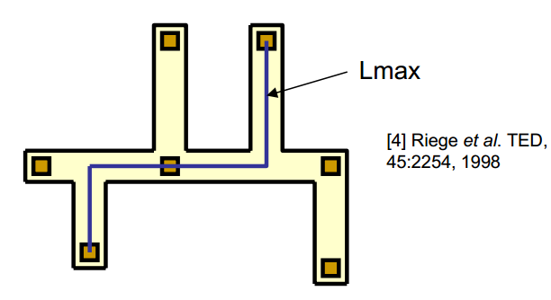
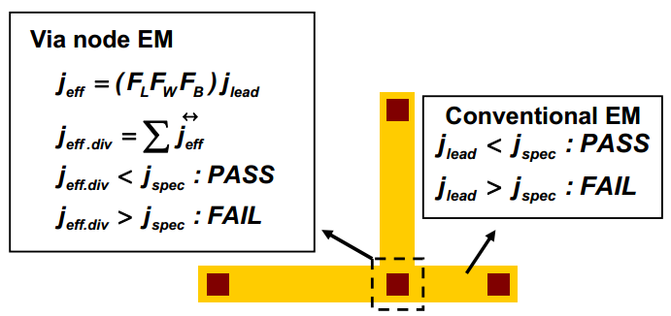

Past Works CAD Model: new Mortality Criterion
Other advanced models:
$\sum{jL}$ [Riege TED‘98]:
Find the longest anode-cathode path with respect to jL
Does not capture interconnect interaction accurately.
Not applicable to complex structures
Via Vector [Park RPS’10]:
Calculate the atomic flux divergence at via nodes
Does not offer a compact model or a systematic analysis
Lack of explanation for experimental observations
Notes:
People observed while sigma JL is true yet the hydrostatic distribution is different

Slide 11
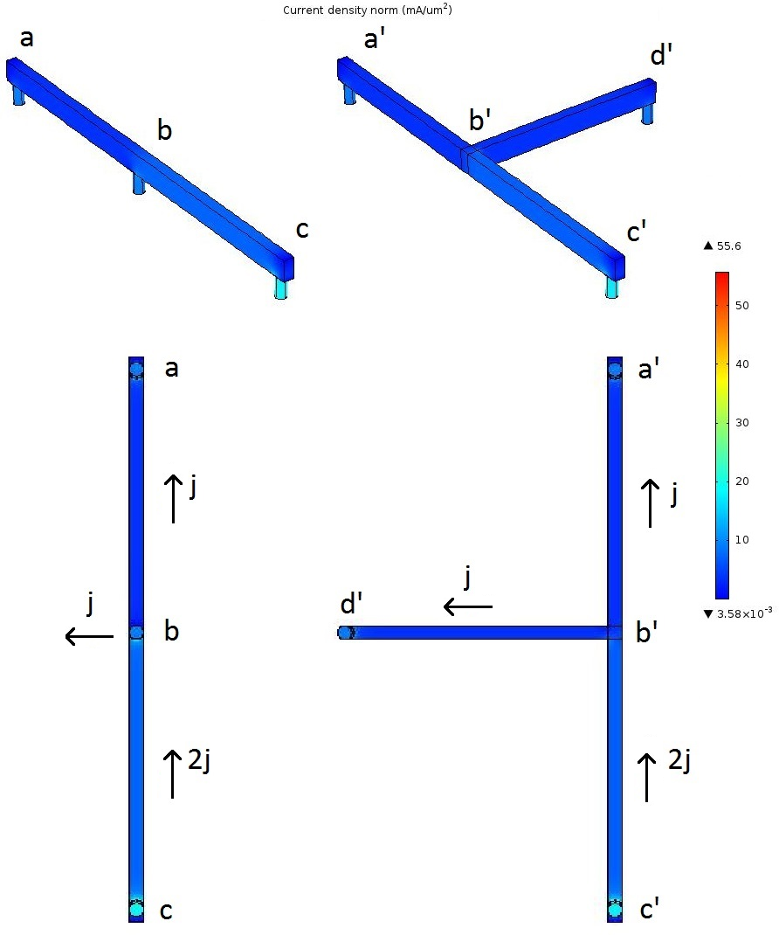
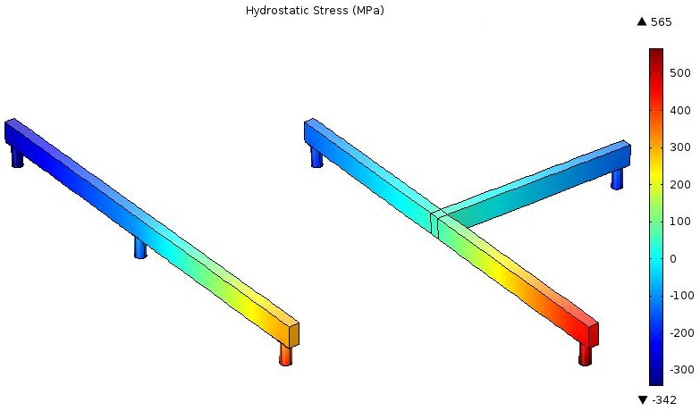
Motivation and Problem Description CAD Model: new Mortality Criterion
Same longest anode-cathode path, yet different hydrostatic stress distribution
Notes:
Adding a limb to a point-to-point structure
The effective $jL$ product ($jL_{eff}$) is calculated and compared to the $jL_{crit_nuc}$. In this method, $Δσ_{max}$ is assumed to be equal to $2σ_{crit_nuc}$ where $σ_{crit_nuc}$ is the critical tensile stress for a void to nucleate. This assumption can be valid for symmetric structures. However, in multi-branch nets with arbitrary topology, $jL_{eff}$ may reach $Δσ_{max}$ but void nucleation may not occur because the stress at the cathode may be less than${ σ}_{crit_nuc}$. Such situations occur for critical compressive stress for low-k dielectric breakage or extrusion

Slide 12
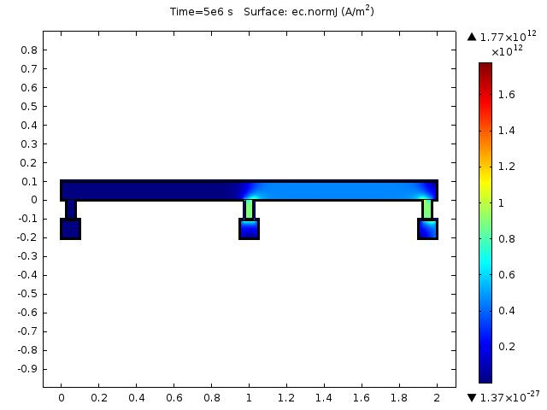
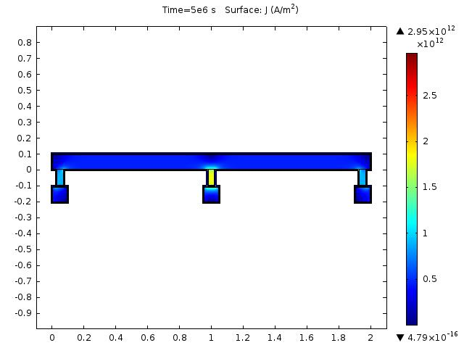
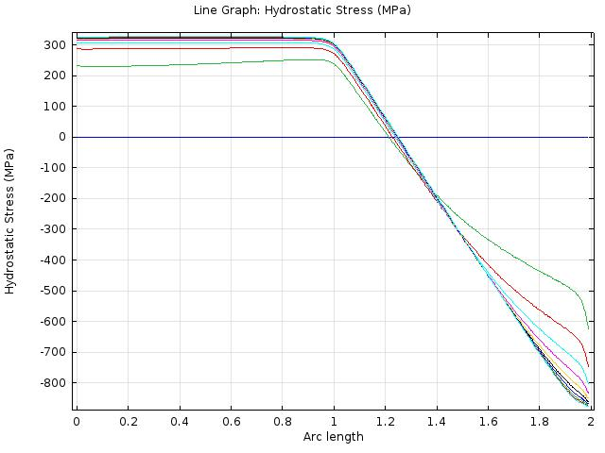
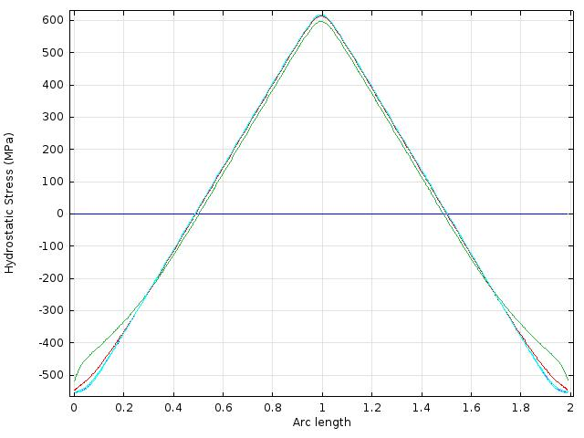






Motivation and Problem Description CAD Model: new Mortality Criterion
jL_{Blech} can be used only for single bounded wire (due to adjacent wire segment interaction)
Current density
$$\vec{j}$$
$$\overset{⃖}{0}$$
$$\vec{j}$$
$$\overset{⃖}{j}$$
$$\vec{j}$$
Hydrostatic Stress $∝$ JL
$$σ_{max}=500MPa$$
$$σ_{max}=300MPa$$
$$σ_{max}=600MPa$$
JL
JL
JL
JL
Notes:
In all cases jl is the same value yet hydrostatic stress is different
Max value is different
Convetional simulation results show that p2p Jl is not applicable directly to complex structures
Sigma jl is not a correct criterion

Slide 13
Motivation and Problem Description CAD Model: new Mortality Criterion
What is missing in previous models?
Electrical
Atomic flux divergence
Geometry (studied only for single bounded wire & other extensions are inaccurate)
Length, Width, Thickness Effect
Angle Effect: Current crowding
Via cut surface, thickness and perpendicularity
Layout Topology
Multi-branch structure and remote connections
Passive segments: dummy vias and reservoirs
Damascene Materials
Interface Thickness: Barrier and Capping
Grain boundaries configuration
Interface Properties: Stiffness (Young’s Modulus)
Can be compacted into a diffusion coefficient
Notes:
Electrical, geometrical properties are not captured properly

Slide 14

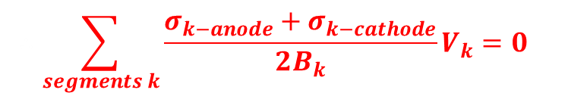


New Compact Model CAD Model: new Mortality Criterion
$$\iiint_{net}{c dV=N_{0}} \underset{→}{ } \iiint_{net}{Δc dV}=0$$
$$\int_{segment}{ΔcdV}= \left({c_{0}\frac{σ_{anode}}{B}−c}_{0}\frac{Z^{∗}eρ}{2BΩ}jL\right)V=\left({c_{0}\frac{σ_{anode}}{B}−c}_{0}\frac{Δσ}{2B}\right)V= \frac{σ_{anode}+σ_{anode}}{2B}V$$
$$\iiint_{net}{Δc dV}=\sum_{segments}{\int_{segment}{Δc dV}}=$$
$$∴\sum_{segments k}{\frac{σ_{k−anode}+σ_{k−cathode}}{2B_{k}}}V_{k}=0 ∎$$
$$\left.c=c_{0}\exp\left(−\frac{σ}{B}\right)≈c_{0}(1−\frac{σ}{B}\right)$$
Notes:
The bulk modulus ( or ) of a substance measures the substance's resistance to uniform compression.
This model offers a systematic way of determining the actual ${\left(jL\right)}_{eff}$ and the actual stress distribution based on the atom conservation principle:
where $c$ is the concentration of atoms along the net and $N_{0}$ is the total number of atoms. The total number of atoms must be equal in the initial state and in the steady state. In other words, the number of atoms accumulated and depleted in different segments of the net is zero:
From Blech’s equation (2), the stress within a segment
A first order approximation of $σ$ depends linearly on the concentration of atomic lattice sites $C$

Slide 15

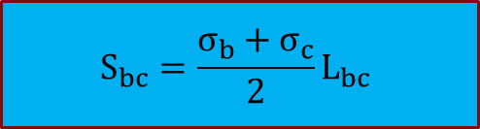
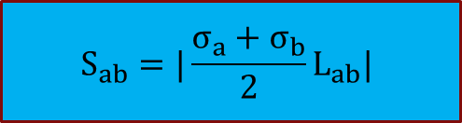

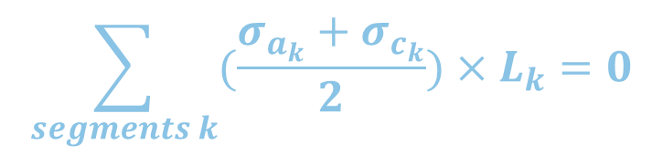
New Compact Model CAD Model: new Mortality Criterion
$$\sum_{segments}{\int_{segment}{Δc dV}}=0$$
$$S_{bc}=\frac{σ_{b}+σ_{c}}{2}L_{bc}$$
$$S_{ab}=|\frac{σ_{a}+σ_{b}}{2}L_{ab}|$$
$$\sum_{segments k}{(\frac{σ_{a_{k}}+σ_{c_{k}}}{2}})×L_{k}=0$$
$${|S}_{ab}|=|S_{bc}|$$
Atom Accumulation = Atom Depletion
Notes:
RED BLUE &&& area && deltaC
How to use: JL belch itself + new!!!
Volume! Rectangular!
The bulk modulus ( or ) of a substance measures the substance's resistance to uniform compression.
This model offers a systematic way of determining the actual ${\left(jL\right)}_{eff}$ and the actual stress distribution based on the atom conservation principle:
where $c$ is the concentration of atoms along the net and $N_{0}$ is the total number of atoms. The total number of atoms must be equal in the initial state and in the steady state. In other words, the number of atoms accumulated and depleted in different segments of the net is zero:
From Blech’s equation (2), the stress within a segment
A first order approximation of $σ$ depends linearly on the concentration of atomic lattice sites $C$

Slide 16
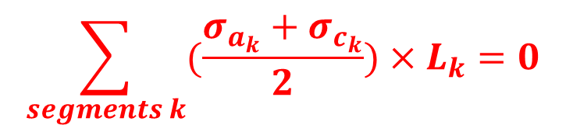



New Compact Model CAD Model: new Mortality Criterion
$$\sum_{segments}{\int_{segment}{Δc dV}}=0$$
$$S_{b′c′}=\frac{σ_{b′}+σ_{c′}}{2}L_{b′c′}$$
$$S_{a′b′}=S_{d^{′}b′}=\frac{σ_{a′}+σ_{b′}}{2}L_{a′b′}$$
$$\sum_{segments k}{(\frac{σ_{a_{k}}+σ_{c_{k}}}{2}})×L_{k}=0$$
$$|S_{a^{′}b^{′}}|+|S_{d^{′}b^{′}}|=|S_{b^{′}c^{′}}|$$
Atom Accumulation = Atom Depletion
Notes:
RED BLUE &&& area && deltaC
How to use: JL belch itself + new!!!
Volume! Rectangular!
The bulk modulus ( or ) of a substance measures the substance's resistance to uniform compression.
This model offers a systematic way of determining the actual ${\left(jL\right)}_{eff}$ and the actual stress distribution based on the atom conservation principle:
where $c$ is the concentration of atoms along the net and $N_{0}$ is the total number of atoms. The total number of atoms must be equal in the initial state and in the steady state. In other words, the number of atoms accumulated and depleted in different segments of the net is zero:
From Blech’s equation (2), the stress within a segment
A first order approximation of $σ$ depends linearly on the concentration of atomic lattice sites $C$

Slide 17
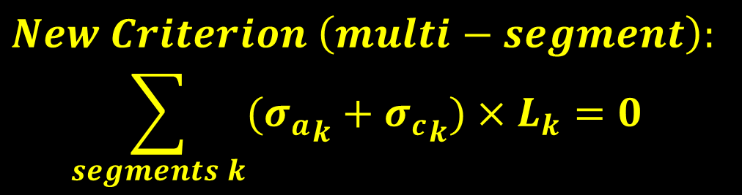

New Compact Model: HOWTO CAD Model: new Mortality Criterion
$New Criterion \left(multi−segment\right):$
$$\sum_{segments k}{({σ_{a}}_{k}+{σ_{c}}_{k})}×L_{k}=0$$
$$Blech Criterion (single−segment):$$
$$eZ^{∗}ρΩ^{−1}=\frac{{σ_{a}}_{k}−{σ_{c}}_{k}}{{(jL)}_{k}}$$
Notes:
RED BLUE &&& area && deltaC
How to use: JL belch itself + new!!!
Volume! Rectangular!
The bulk modulus ( or ) of a substance measures the substance's resistance to uniform compression.
This model offers a systematic way of determining the actual ${\left(jL\right)}_{eff}$ and the actual stress distribution based on the atom conservation principle:
where $c$ is the concentration of atoms along the net and $N_{0}$ is the total number of atoms. The total number of atoms must be equal in the initial state and in the steady state. In other words, the number of atoms accumulated and depleted in different segments of the net is zero:
From Blech’s equation (2), the stress within a segment
A first order approximation of $σ$ depends linearly on the concentration of atomic lattice sites $C$ by

Slide 18



New Compact Model CAD Model: new Mortality Criterion
Simple Net
$$σ_{a}=\frac{5Z^{∗}eρ}{4Ω}jL < σ_{a′}=\frac{Z^{∗}eρ}{Ω}jL$$
$$σ_{b}=\frac{Z^{∗}eρ}{4Ω}jL < σ_{b′}=0$$
$σ_{c}=−\frac{7Z^{∗}eρ}{4Ω}jL$ $< σ_{c′}=−\frac{2Z^{∗}eρ}{Ω}jL$
$$σ_{d′}=\frac{Z^{∗}eρ}{Ω}jL$$
$$Z^{∗}e<0$$
$$Z^{∗}e<0$$
Notes:
RED BLUE &&& area && deltaC
How to use: JL belch itself + new!!!
Volume! Rectangular!
The bulk modulus ( or ) of a substance measures the substance's resistance to uniform compression.
This model offers a systematic way of determining the actual ${\left(jL\right)}_{eff}$ and the actual stress distribution based on the atom conservation principle:
where $c$ is the concentration of atoms along the net and $N_{0}$ is the total number of atoms. The total number of atoms must be equal in the initial state and in the steady state. In other words, the number of atoms accumulated and depleted in different segments of the net is zero:
From Blech’s equation (2), the stress within a segment
A first order approximation of $σ$ depends linearly on the concentration of atomic lattice sites $C$ by

Slide 19

New Compact Model Improved Blech Effect
Complex Net
$$Z^{∗}e<0$$
Notes:
Interesting results illustrate how layering can affect EM performance. (limbs)
The topology is the same yet the part of net which conservation holds true is different, due to the blocking via that was enabled through dual damascene
A multi-segment net. $jL_{eff}=maxΣjL$is the same either segment a1a2 is connected to b1 as a side branch directly in the same layer or a1’a2’ to b1’ with a via through the lower layer. Red and green dots indicate via above and via below, respectively. Blue is the site of a potential via. Hydrostatic stress along the broken line near the interface is shown at the bottom (j$=10mA/{um}^{2}$).

Slide 20
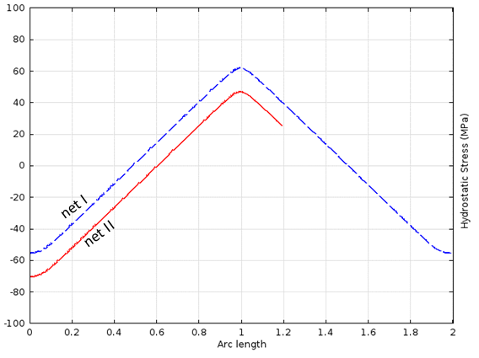
New Compact Model CAD Model: new Mortality Criterion
Current Flows in Different Directions Also Impact Each Other
Critical Stress
Simulation Parameters T=459K, J=40MA/cm² , Critical Stress =120MPa
Notes:
Interesting results
In addition to current density, the stress growth in an interconnect t depends not only on its geometry but also on the geometry of other segments of the same net. The effect of geometry, including length, width and thickness are all captured by ${\left(jL\right)}_{eff}=\max_{\begin{aligned}all junction \\ pairs i,j\end{aligned}}{\sum_{k}{j_{k}L_{k}}}$ and $\sum_{segments k}{\frac{σ_{k−anode}+σ_{k−cathode}}{2B_{k}}}V_{k}=0$
This figure shows the effect of length of adjacent segments. In both nets, all segments carry the same current density j, flowing into the middle via. This can also be explained by the back stress built up in a shorter segment. In net II, the shorter segment sucks fewer atoms from the middle via compared to symmetric situation in net I.

Slide 21
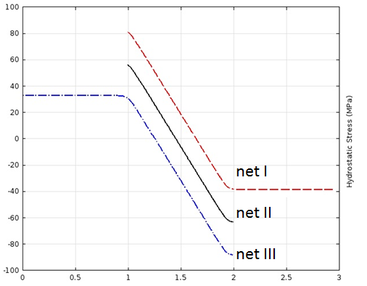
New Compact Model CAD Model: new Mortality Criterion
Segments with No Current Also Impact Active Segments
Critical Stress
worse
better
Notes:
Extension matters, adding extension in anode is detrimental while at cathode is helpful!
The effects of passive elements (i.e. metal extensions with zero current) such as those added at cathode (reservoir), or anode (sink), or dummy vias have been investigated in many works [17]. However, a compact model suitable for CAD tools that can explain and model the underlying physics has not been proposed before.

Slide 22



New Compact Model (passive elements) CAD Model: new Mortality Criterion
Proposed Compact Model Holds True For Passive Elements
$${ σ}_{a}=\frac{L+{2L}_{r}}{\left.2(L_{s}+L+L_{r}\right)}jL$$
$${ σ}_{c}=−\frac{L+{2L}_{s}}{\left.2(L_{s}+L+L_{r}\right)}jL$$
The critical current density for interconnect void nucleation in a wire connected to a passive reservoir and a sink is
$${ j}_{extension−critical}=\frac{L_{s}+L+L_{r}}{L+{2L}_{s}}j_{critical}$$
Notes:
Our method not only explains the active segments but also offers a general model for reservoir and sink extension
This figure shows an interconnect of a length L. This segment is connected to a reservoir and sink of lengths $L_{r}$ and $L_{s}$ respectively. Solving our model for this net is as shown in this slide.

Slide 23
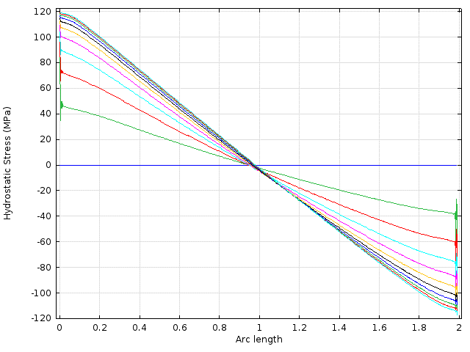
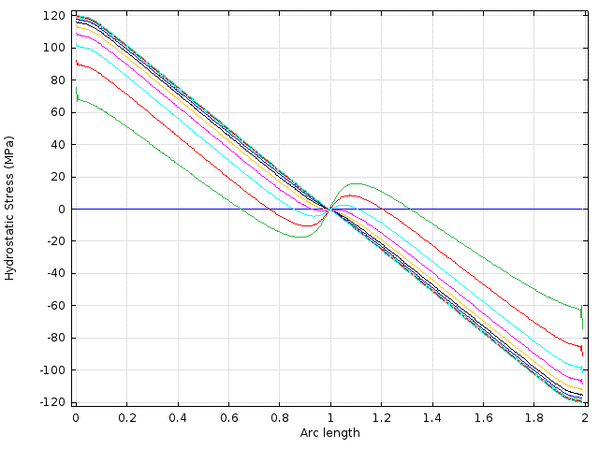
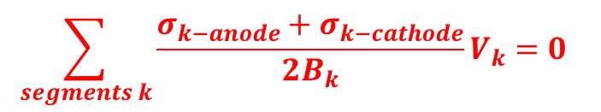
Material Effects on Lifetime CAD Model: new Mortality Criterion
Steady state analysis does not capture temporal effects of microstructure and material properties
low diffusivity
region
B₁~140Gpa
B₁~140Gpa
$$\sum_{segments k}{\frac{σ_{k−anode}+σ_{k−cathode}}{2B_{k}}}V_{k}=0$$
B_{m}
Notes:
The bulk modulus ( or ) of a substance measures the substance's resistance to uniform compression. It is defined as the ratio of the infinitesimal pressure increase to the resulting relative decrease of the volume.
We think that it can be explained by B,
Slows down the diffusion path at interface
The wire live safely under the critical stress for a long time and reach to SS in a much longer time.
This also can be used for EM performance improvement
B=-V dp/dv

Slide 24
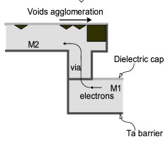
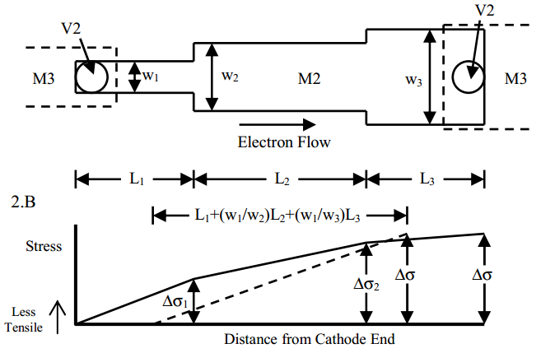
Applications Explored New Mortality Criterion
EM-resilient Design Guideline:
Partial widening
Decreasing width –if helps!
Round L shape connection(avoid current crowding)
Passive Extention
EM-tolerant configuration
Routing through alternative paths and layers!
Multiple vias, Dummy Vias

Slide 25
Conclusions
DONEs:
New compact model that captures
Physical and Electrical Impact
Explains wire segments interactions
TODOs:
EM-Resilient Design Guidelines
Can be readily developed based on the proposed model

