Slide 1

From 2D to Monolithic 3D:
Design Possibilities, Expectations and Challenges
O. Billoint¹, H. Sarhan¹, I. Rayane², M. Vinet¹,
P. Batude¹, C. Fenouillet-Beranger¹, O. Rozeau¹,
G. Cibrario¹, F. Deprat¹, O. Turkyilmaz¹,
S. Thuries¹, F. Clermidy¹
¹Univ. Grenoble Alpes, F-38000 Grenoble, France
CEA, LETI, MINATEC Campus, F-38054 Grenoble, France
²Mentor Graphics, 110 rue Blaise Pascal, 38330 Montbonnot-Saint-Martin, France

Slide 2
Outline
Why 3D, Why Now?
What is Behind 3D-VLSI (Monolithic 3D)?
Design Possibilities
Expectations and Challenges
Conclusion

Slide 3
Context
3D Interconnect Technology
Back End performances are decreasing
TSV [1]
Size : 10x10um²
Pitch : 30um
Cu-Cu [1]
Size : 1,7x1,7um²
Pitch : 2,4um
3D Physical implementation
might be an alternative
Scaling is about to be more and more complex
Energy Efficiency
HD-TSV [1]
Size : 0,85x0,85um²
Pitch : 1,75um
3D-VLSI (28nm) [2]
Size : 0,05x0,05um²
Pitch : 0,11um
[1] Patti B., Tezzaron, inc. « Implementing 2.5D and 3D Devices »
AIDA workshop 2013
[2] Taken from internal Design Rules Manual

Slide 4
Going 3D for What?
Reduce Footprint
Reduce Wirelength
Reduce Power
Reduce Clock Period
Increase Yield?
True if :
Vertical connections have ~100% yield
Circuits are not fabricated sequentially
Two half-size circuits better than a full size one?
Are we able to test half of a design during process?!

Slide 5
Interconnect Flavors
LDPC IP
28nm FDSOI
50% footprint reduction
Reduce Footprint
Minimize
3D interconnects
Inter-Tier vias: 5439
Reduce Wirelength
Reduce Power
Reduce Clock Period
Back to 2D footprint but with a 3D design!
Technology | Size | Pitch
TSV (1) | 10µm | 30µm
HD-TSV (1) | 0,85µm | 1,75µm
Cu-Cu (1) | 1,70µm | 2,4µm
3D-VLSI 28nm (2) | 50nm | 110nm
Increase Yield?
Two half-size circuits better than a full size one?
[1] Patti B., Tezzaron, inc. « Implementing 2.5D and 3D Devices »
AIDA workshop 2013
[2] Taken from internal Design Rules Manual

Slide 6
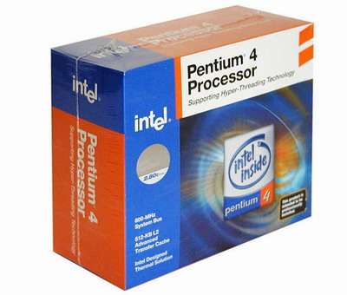
A 3D Solution for Everyone?
Research
15% Power savings
15% Performances gain
50% Footprint reduction
Commercial
[2] 2014
TSV
[1] 2004
Cu-Cu
?
201x
3D-VLSI
[1] Black, B. ; Nelson, D.W. ; Webb, C. ; Samra, N., « 3D processing technology and its impact on iA32 microprocessors »
Computer Design: VLSI in Computers and Processors, 2004. ICCD 2004.
[2] « Samsung Starts Mass Producing Industry’s First 3D TSV Technology Based DDR4 Modules for Enterprise Servers »
Seoul, Korea on Aug. 28. 2014

Slide 7
Outline
Why 3D, Why Now?
What is Behind 3D-VLSI (Monolithic 3D)?
Design Possibilities
Expectations and Challenges
Conclusion

Slide 8
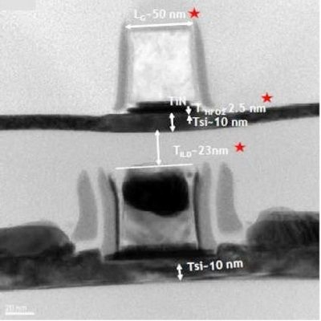
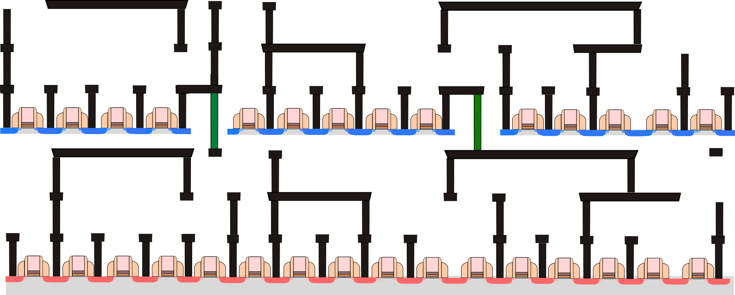
CMOS Sequential Integration
CoolCubeTM process developed at LETI
Copper Back-End
Inter-Tier vias
28nm node
Size: 50x50nm²
Pitch: 110nm
Like a contact
Specific «Cold» CMOS Process
CoolCubeTM
Tungsten Back-End
Regular «Hot» CMOS Process
Batude P. et al, « Demonstration of low temperature 3D sequential FDSOI integration down to 50nm gate length »
In Proceedings of IEEE Symposium on VLSI Technology, 2011

Slide 9
CoolCubeTM Flavors
Transistor Level
Gate (Standard Cell) Level
Not Mainstream right now
Lot of intra-cell 3D vias
Lower standard cell density
Heterogeneous oriented
One MOS type on each tier
CMOS on each tier
Process Boosters Friendly
(SiGe / III-V / …)
Different Node / Process Stacking
Compatible with 2D P&R
Not Compatible with 2D P&R
Requires Standard Cells redesign
No Standard Cells redesign

Slide 10
CoolCubeTM Process Opportunities
Homogeneous / Heterogeneous Integration
Soi
--------------
Soi
Logic
--------------
Memory
Sensor
--------------Analog
--------------Logic
--------------
Memory
Soi
--------------
Cmos
Sensor
--------------
Logic
Soi
--------------
Finfet
Analog
--------------
Logic

Slide 11
Outline
Why 3D, Why Now?
What is Behind 3D-VLSI (Monolithic 3D)?
Design Possibilities
Expectations and Challenges
Conclusion

Slide 12
Design Possibilities
Homogeneous / Heterogeneous Integration
Soi
--------------
Soi
Logic
--------------
Memory
Predictive Design Kit
(Full Custom Analog dedicated)
2D Design Platform
(For Digital Design)
Sensor
--------------Analog
--------------Logic
--------------
Memory
Soi
--------------
Cmos
Sensor
--------------
Logic
Basic Models, Parasitic Extraction, Layout
Plenty of 2D files for 2D tools!
Soi
--------------
Finfet
Analog
--------------
Logic
1st order study : Ring Oscillators, small blocks
Detailed Studies (Performances, Power, Area…)

Slide 13
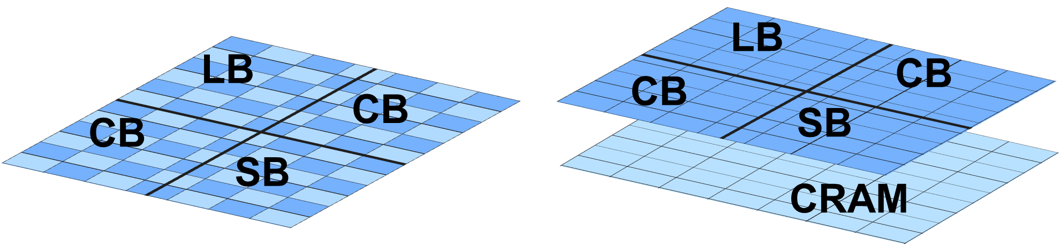
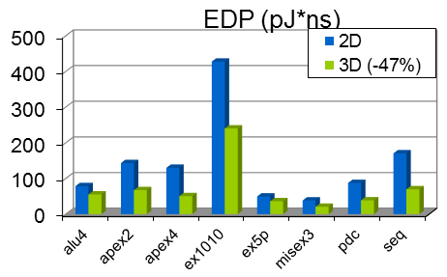
3D-VLSI Using Predictive DK
3D 14nm FDSOI Predictive DK
Application to FPGAs
LB: Logic Block
SB: Switch Box
CB: Connection Box
CRAM : configuration RAM
Turkyilmaz, O. et al « 3D FPGA using high-density interconnect Monolithic Integration »
in Design, Automation and Test in Europe Conference and Exhibition (DATE), 2014

Slide 14
3D-VLSI Using 2D Design Platform
Deflate / Inflate Standard Cells to emulate 3D placement
Single tier routing at a time
Extraction of timing informations tier by tier
Timing Analysis outside of P&R tool
Splitting / Folding Methodology to emulate 3D placement
Tier to Tier routing in one single run
Timing-Driven routing
Single Tool Methodology
[1]
[2]
Useful methodologies to get some trends and concepts but then…
[1Shreepad P. et al, « Design and CAD Methodologies for Low Power Gate-level Monolithic 3D ICs »
In proceedings of ISLPED’14, August 11–13, 2014, La Jolla, CA, USA
[2] Billoint O. et al, « A Comprehensive Study of Monolithic 3D Cell on Cell Design Using Commercial 2D Tool »
In Proceedings of DATE’15, Grenoble, France

Slide 15
Outline
Why 3D, Why Now?
What is Behind 3D-VLSI (Monolithic 3D)?
Design Possibilities
Expectations and Challenges
Conclusion

Slide 16
Expectations
Market Expectations [1]
1 process node advantage
PPA Gains
  30% Power savings
  40% Performances gain
  52% Footprint reduction
[1] Dr. Karim Arabi, Qualcomm, Inc. “Keynote: Mobile Computing Opportunities, Challenges and Technology Drivers”, 51st Design Automation Conference (DAC), 2014.

Slide 17
Challenges
Which cell on which tier?
Design for Test (How do you test ½ chip?)
Process corners
Thermal behavior and workaround

Slide 18
3D Benefits Compared to Scaling
Start
A
Z
A
Z
A
Z
A
Z
A
Z
B
How do we optimize?
Distribute cells on tiers
Cut the long wire(s)!
…
Scaling benefits were
(digital) design independent
Is there a possible better ring oscillator in 3D?
3D Stacking benefits may be architecture dependent
3D Interconnect cost has to be evaluated compared to Wire cost

Slide 19
Tier to Tier Interconnections (1)
Trade Wirelength for
vertical connection
What’s the cheapest solution for point to point connection, wire or via stack?
Above 2,5µm length, is it REALLY worth trading wires for vias?

Slide 20
Tier to Tier Interconnections (2)
Trade Wirelength for
vertical connection
What’s the cheapest solution for point to point connection, wire or via stack?
Adding 2µm of Tungsten routing
Adding 1µm of Tungsten routing
Tungsten resistivity = 6x Copper resistivity
Above 2,5µm length, is it REALLY worth trading wires for vias?
Tungsten Back-End for bottom tier solves contamination issues (process) but creates constraints on tier to tier optimization

Slide 21
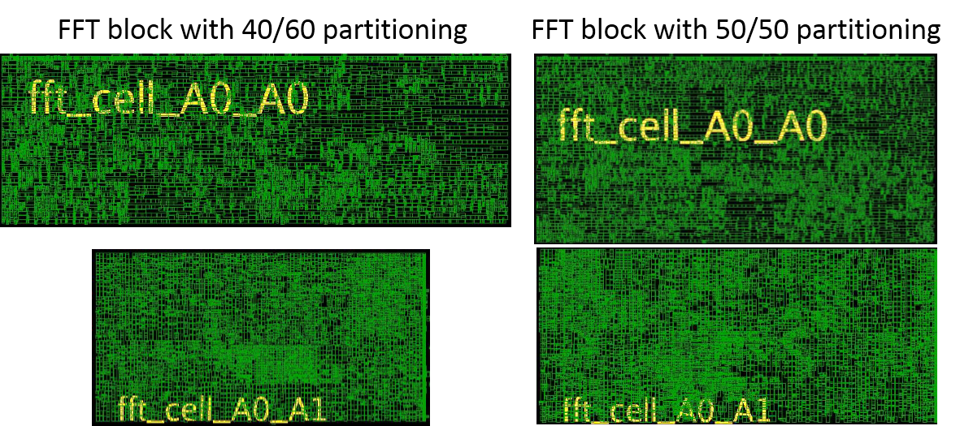
3D-VLSI Concept and Area Ratio
Trade Wirelength for
vertical connection
2D
hMetis [1]
PAP (40-60) [2]
Tungsten resistivity = 6x Copper resistivity
How many long wires to cut do we have?
Reconfigurable FFT
Aiming at 50/50 Area Ratio may not always be the best solution for optimal PPA!
[1] Karypis, G., Aggarwal, R., Kumar, V., and Shekhar, S. “Multilevel hypergraph partitioning: applications in VLSI domain”, Very Large Scale Integration (VLSI) Systems, IEEE Transactions on, 1999, 7(1), 69-79.
[2] Physical Aware Partitioning developed at LETI

Slide 22
Inter-Tier Power Distribution
Intra-Core power supply connections are mandatory to limit IR Drop
Connecting to top tier Power Distribution is the cheapest solution
Y-direction routing obstructions
Wire Length and Power Consumption will be affected

Slide 23
Outline
Why 3D, Why Now?
What is Behind 3D-VLSI (Monolithic 3D)?
Design Possibilities
Expectations and Challenges
Conclusion

Slide 24
Conclusion
ENABLING 3D-VLSI
Process is on the way!
I/Os and ESDs
50% Area reduction
Full 3D Routing in one run with Timing Closure
…etc
Thermal Behavior
Tier-Specific Process Corner Specification
Area Ratio
3D Interconnects are critical
Power Optimization
Inter-Tier Power Supply Distribution
Tier-to-Tier Cell Placement Optimization

Slide 25
Conclusion
Scaling was design independent
3D stacking might be different
Wirelength reduction is a good goal to pursue as Back End performances have started decreasing
Preliminary studies using commercial 2D tools (trustable) for what they’re not supposed to do
Showing the real potential of 3D-VLSI will require to tape-out, measurements, comparisons…
And don’t forget that… 2 tiers is only the very beginning!

Slide 26
O. Billoint¹, H. Sarhan¹, I. Rayane², M. Vinet¹, P. Batude¹, C. Fenouillet-Beranger¹, O. Rozeau¹, G. Cibrario¹, F. Deprat¹, O. Turkyilmaz¹, S. Thuries¹, F. Clermidy¹
¹Univ. Grenoble Alpes, F-38000 Grenoble, France
CEA, LETI, MINATEC Campus, F-38054 Grenoble, France
²Mentor Graphics, 110 rue Blaise Pascal, 38330 Montbonnot-Saint-Martin, France

Slide 27
Thank You

