Slide 1
On Resilient System Performance Binning
Qiang Han
University of Cincinnati

Slide 2
Outline
Introduction
Background
Binning based on at-speed structural testing
Adaptive clock tuning for yield improvement
Experimental results
Summary

Slide 3
Technology Scaling
Gain benefits from transistor scaling
As technology scales, variability in transistor performance will continue to increase, making transistors less and less reliable.
Increasing delay variation of logic elements / wires
Source: Borkar, S.; "Designing reliable systems from unreliable components: the challenges of transistor variability and degradation," IEEE Micro, December 2005.
￼
Notes:
increase transistor density
decrease transistor power consumption

Slide 4
Conservative Design
Reliability problem is resolved by driving the circuit working at the clock frequency with a safe guard-band.
Too pessimistic when the worst case failure occurs infrequently.
Reduce the benefits provided by technology scaling.

Slide 5
Resilient System
Eliminate design marginalities.
  Lower the supply voltage
  Increase the clock frequency
Allow the occurrence of system failures at a low rate and recovering them online.
Reduce power consumption or enhance performance
Notes:
- BEGIN: resilient system is designed to overcome the problem from variability.
- soft error is a transient error, for example, caused by radiation / Cosmic rays.
- ( In the spacecraft industry this kind of error is called a single-event upset. )
- ( the chip's material will decay and release alpha particles into the chip. )
- also, soft error problem becomes more important as technology scales down

Slide 6
Outline
Introduction
Background
Binning based on at-speed structural testing
Adaptive clock tuning for yield improvement
Experimental results
Summary

Slide 7
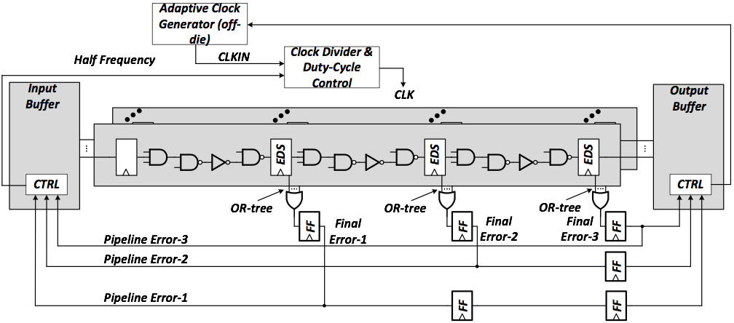
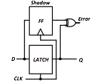
Intel Resilient System
Schematic view of Intel resilient processor design
Error Detection
Sequential
Source: K. Bowman, et al. “Energy-efficient and metastability-immune resilient circuits for dynamic variation tolerance,” IEEE Journal of Solid-State Circuits, vol. 44, no. 1, pp. 49–63, 2009.
Notes:
BEGIN: 3 pipeline stages
4: what is error detection circuit
EDS is able to detect late arrival signal, if there is late signal, it will send out an ERROR
EDSs replaces normal FFs on critical paths, so only some of FFs are replaced.
3: OR-tree collects ERROR signals from EDSs in one stage and goes to Final-Error-FF
input buffer controls which erroneous inst to rerun
output buffer clean out the contaminated registers
rerun inst with a low speed
clock divider and duty-cycle control circuit is able to halve the clock frequency

Slide 8
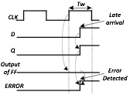
Intel Resilient System
Error Detection Sequential (EDS)
Notes:
latch used to pass data in pipeline,
shadow FF attached to latch
xor-gate produces ERROR signal
Lets see the timing diagram
when there is late arrival signal at D, it locates within Tw, error detection window
latch is transparent at clock’s high-level, so Q bypass this transition
however, FF’s output wont change
therefore an ERROR signal triggered
In short, EDS add an extra time Tw to detect late arrival signal,
if late signal arrive within Tw, EDS detect it

Slide 9
Four Timing Constraints
EDS-max delay constraint
EDS-min delay constraint
FF-max delay constraint
OR-tree delay constraint
Notes:
3 datapath faults and 1 errorpath fault

Slide 10
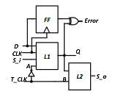
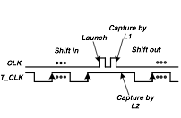
Resilient System DFT
Level-Sensitive Scan Design (LSSD)
Source: Borkar, S.; Q. Han, J. Guo, W.-B. Jone, and Q. Xu, “Path delay testing in resilient system,” in 2013 IEEE 55th International Midwest Symposium on Circuits and Systems, 2013.
Notes:
LSSD-style design
remove mux, save timing overhead
has good area overhead
no testing complexity on EDS-max delay testing
here i wont show how the our design gives this timing diagram on gate logic level,
however, this timing diagram gives us a rough idea that LSSD captures signal at the second fall edge, which is one clock cycle plus the error detection window
this property works well with the EDS max delay constraint
i will show this property a little bit more later

Slide 11
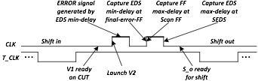
Data-Path Delay Testing
Launch-on-capture timing diagram with three data-path timing constraints in a single test phase.
Notes:
here we talk about our data-path delay testing scheme
LAST: we will show this timing diagram with circuits

Slide 12
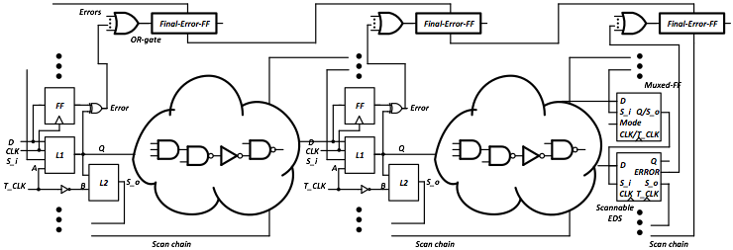
Data-Path Delay Testing
V2
V1
V2
V1
Notes:
BEGIN: two stage pipeline, with scan chain setup
it has SEDS, and muxed-FF
scan FF and scan EDS in one system
scan EDS, EDS, stage three: scan EDS and scan FF in boxes

Slide 13
Data-Path Delay Testing
V2
V1
V2
V1
Notes:
-

Slide 14

Data-Path Delay Testing
V2
V1
V2
V1
EDS Short path
Notes:
at CLK’s high level, that is error detection window, if there is EDS short delay, ERROR signal will be triggered.

Slide 15
Data-Path Delay Testing
Capture
FF long path
V2
V1
Capture
V2
V1
EDS Short path
Notes:
final-error-FF captures the ERROR signal by EDS short path violation
in the meantime, muxed-FF captures the FF-max delay

Slide 16
Data-Path Delay Testing
Capture
FF long path
V2
V1
Capture
EDS long path
Capture
V2
V1
EDS Short path
Notes:
at Tclk + Tw, the SEDS capture the EDS-max delay fault

Slide 17
Data-Path Delay Testing
Capture
Capture
Capture
Notes:
scan FF and scan EDS in one system
ENDING…

Slide 18
Outline
Introduction
Background
Binning based on at-speed structural testing
Adaptive clock tuning for yield improvement
Experimental results
Summary

Slide 19
Traditional Binning Metrics
Speed binning is an industry term that refers to the test procedures used to determine the maximum functional operating frequency of a chip so that it can be offered to customers at an appropriate speed-grade.
The most general form of speed binning starts from the highest rated speed for circuits of high performance.
  The passed circuits are selected into the current bin.
  The failed in this frequency will be tested with a lower speed.
The traditional binning procedure sieves circuits only by their maximal operating frequencies.
Source: D. Belete, et al., “Use of dft techniques in speed grading a 1 ghz+ microprocessor,” in Proc. IEEE International Test Conference (ITC), pp. 1111–1119, 2002.
Notes:
- lets look at traditional binning method first

Slide 20
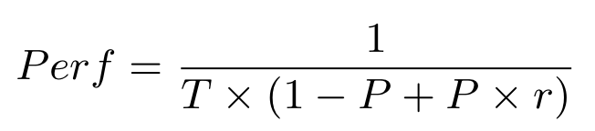
Resilient Circuit Binning Metrics
With the significant process variations, a resilient circuit can have higher or lower error rate than expected, but it may still pass the at-speed structural testing.
The performance of a resilient system [source] is determined by the clock cycle (T), the resilient system error rate (P) and the recovery penalty (r), and it can be estimated in Eq. (5).
(5)
With a given clock, the error rate represents the system performance, and thus resilient circuits can be binned by their error rates.
Source: L. Wan and D. Chen, “Dynatune: circuit-level optimization for timing speculation considering dynamic path behavior,” in Proc. IEEE/ACM International Conference on Computer-Aided Design (ICCAD), pp. 172–179, 2009.
Notes:
3: why? resilient circuit gains benefits by squeezing safe guard bands, what is more, allowing failure at a low rate
testing cannot guarantee this low rate
2: what can reflect the performance of circuits
1: lets see these three parameters,
T is clock cycle, it is usually fixed
r is determined by system
therefore, if we know the error rate, we know the performance
The basic idea of our proposed method is using the timing error count information from at-speed structural testing to bin resilient circuits to greatly reduce the binning cost.

Slide 21
Performance Binning Basics
With a fixed clock and recovery penalty, the error rate represents the system performance, and thus resilient circuits can be binned by their error rates.
Traditional method uses functional binning — too time-consuming.
The basic idea of our proposed method is using the timing error count information from at-speed structural testing to bin resilient circuits to greatly reduce the binning cost.
Notes:
point 2: for example, we need to load windows system to test a processor.
point 3: Timing error count can reflect error rate.

Slide 22
Performance Binning Basics
The number of timing errors (at final-error-FFs) during structural testing is counted, since the value of this error count represents the circuit performance.
We use the EDS max-delay and FF max-delay fault testing to count the number of timing errors, because the test vectors for these two kinds of faults essentially have high correlation to trigger long path delay faults.

Slide 23
Performance Binning Basics
Two bins are assumed.
The timing error number of the golden design on EDS max-delay and FF max-delay testing is used as the pivot for bin selection.
This golden value (pivot) can be obtained by fault simulation:
  with same test vectors
  on the golden design (with no variation)
  prior to the actual binning procedure
Notes:
TWO: we already assume the timing error number can represent the circuit performance
now we need a standard/line
for example, circuits with the timing error count above the line are bad, else they are good

Slide 24
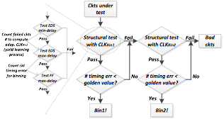
Performance Binning Flow
Notes:
Binning flow for two bins
1: count timing error for each chips

Slide 25
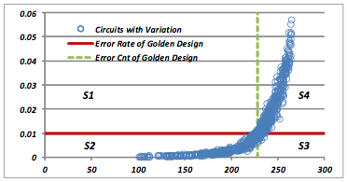
Binning Validation
Actual Error Rate
Error Count
The X axis stands for the timing error number counted in the at-speed delay testing.
The Y axis is the error rate of circuits by timing simulation.
The dotted line is the pivot from the error fault simulation on golden design.
The solid line is from the error rate of golden design by timing simulation.
D. Dumas, P. Girard, C. Landrault, and S. Pravossoudovitch, “An implicit delay fault simulation method with approximate detection threshold calculation,” in Test Confer- ence, 1993. Proceedings., International. IEEE, 1993, pp. 705–713.
Notes:
Plot of the timing error count versus the error rate for C2670 benchmark circuit.
each circle represents a chip
The performance binning procedure is simulated on benchmark circuits for each circuit with intra- and inter-die variations on gate and wire delays.
x-axis is error count, and this timing error number is obtained by applying testing vectors and counting the number of timing errors during it.
y-axis is error rate from the timing simulation
it is a classical binary classification problem
this experiment only validate if error count is a good solution for binning,
BUT NOT means we only bin the circuits into two bins.

Slide 26
Binning Validation
Actual Error Rate
Error Count
The C2670 circuits in S1 + S2 are selected into Bin1.
The circuits in S3 + S4 need to be tested for Bin2.
The circuits in S1 + S3 are wrongly binned. (false positive + false negative)
Our experimental results on benchmark circuits show average 6.99% wrongly binned.
Notes:
- LAST: we will show our results in the experiment section

Slide 27
Outline
Introduction
Background
Binning based on at-speed structural testing
Adaptive clock tuning for yield improvement
Experimental results
Summary

Slide 28
Recall the Three Types of Faults
FF long path
EDS long path
EDS Short path
Notes:
- at Tclk + error detection window period, EDS long path should arrive at EDSs

Slide 29
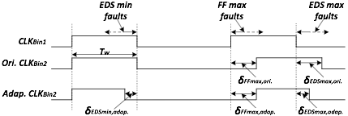
Adaptive Clock Configuration
Notes:
- we put the three types of timing faults into one timing diagram.

Slide 30
Adaptive Clock Configuration
Original CLKBin2 only saves the failed circuits from FF max-delay and EDS max-delay faults.
Our proposed method tries to find optimal way to apportion the timing slack to the different timing constraints to save more failed circuits.
Adaptive CLKBin2 borrows some timing slack from EDS max-delay faults for EDS min-delay faults.
Notes:
for Bin2 clock, we cannot change Tw, because if we make Tw longer, that will worsen the timing constraint on eds min-delay fault

Slide 31
Adaptive Clock Configuration
Both CLKBin2 has 10% extra time (δFFmax,adap. = 0.1 × CLKBin1)
⇒ δEDSmin,adap.+ δEDSmax,adap. = 0.1 × CLKBin1
Notes:
by adding 10% timing slack, delta ff max adaptive is fixed
delta eds min adap + delta eds max adap has to equal to this 10 percentage (which is 0.1 times CLKbin1), because the high-level of clock needs to be consistent
we define the ratio
the ratio of delta eds min adap to delta eds max adap equals to failed ckt number by eds min over failed ckt number by eds max

Slide 32
Review Binning Flow
Notes:
LAST: ( for example, there are 10,000 chips, 7,000 out of them pass bin1 test, 3,000 do not.
( in these 3,000 chips, we found there are 1,000 chips failed by EDS min-delay fault, 1,000 chips failed by EDS max-delay fault. Then the time slack for these two faults will make an even deal.
note that, not all the fabricated chips are needed to get this number, only part of chips
this process is called yield learning process

Slide 33
Outline
Introduction
Background
Binning based on at-speed structural testing
Adaptive clock tuning for yield improvement
Experimental results
Summary

Slide 34
Binning Experiments
The performance binning procedure is simulated on ISCAS85 benchmark circuits for 1,000 times for each circuit with intra- and inter-die variations on gate and wire delays.
Synopsys Design Compiler and Primetime are used for logic synthesis and timing analysis using a 45nm technology.
About top 10% critical FFs are converted to EDSs manually, and then buffers are inserted to meet the EDS min-delay constraint.
Benchmark circuits examined paths #/ testable paths #/ test vectors # for the three timing constraint testing.
Notes:
the current research does not take test vector selection method for delay faults into consideration.
but it is a good perspective to view this search
like, K-longest path per gate

Slide 35
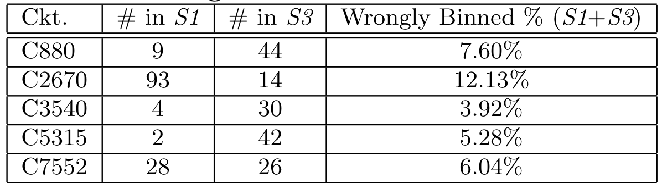
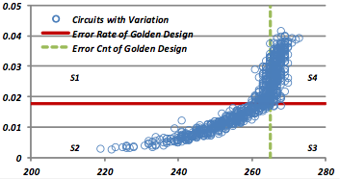
Results on Binning
Columns two and three correspond to the numbers of circuits falling into regions S1 and S3.
Column four is the ratio of the number of wrongly binned circuits (S1 + S3) to the total number of circuits in both Bin1 and Bin2 by our adaptive clock configuration method.
The average wrongly binned rate is 6.99%.

Slide 36
Adaptive Clock Configuration Experiments
Our adaptive binning method improves yield by 11.9% on average.
C880 has the largest yield improvement, because in C880 testing there exists a large proportion of EDS min-delay faults.
The improvement on C7552 is minor, because there are few circuits failed by EDS min-delay faults.
Notes:
- in C880, our adaptive method assigns more time slack to save circuits failed by eds-min faults

Slide 37
Outline
Introduction
Background
Binning based on at-speed structural testing
Adaptive clock tuning for yield improvement
Experimental results
Summary

Slide 38
Conclusion
Study performance binning metrics for resilient systems for the first time
Propose a performance binning method based on at-speed delay testing
Adaptive clock configuration for yield improvement

Slide 39
Future Work
Develop an efficient hybrid solution combining our error count based method and functional binning method to reduce wrongly binned percentage
Extend our binning method to multi-stage pipeline circuits
Extend our binning method to multiple bins

Slide 40
Questions?
Thank you!

