Slide 1
Force-Directed Placement of VLSI Circuits
PDF Solutions
March 31, 2014
Hans Eisenmann

Slide 2
Timeline VLSI Placement at the EDA Institute
Global placement objective | Quadratic (Space, Gordian et. al) |  |  |  |  |  |  | Linearized quadratic (GordianL) |  |  |  |  |  | bounding box based, per-pin, linearized quadratic (Kraftwerk2)
Global placement overlap free constraint | constant repulsive forces between modules |  | repulsive force function btw modules (Space) |  |  | Partitioning with COG (Gordian) |  | multi region iterative bipartioning (GordianL) |  |  | Spatial distribution based forces (Kraftwerk, Kraftwerk2)
Final placement | Simple |  |  | transportation problem (Space) |  |  |  |  | network flow (Domino) |  |  |  |  |  | Dynamic Programming (Abacus)
Year | 1975 | 1980 |  |  | 1985 |  | 1990 |  |  | 1995 |  | 2000 | 2005 |  |  | 2010 | 2015
This Talk

Slide 3
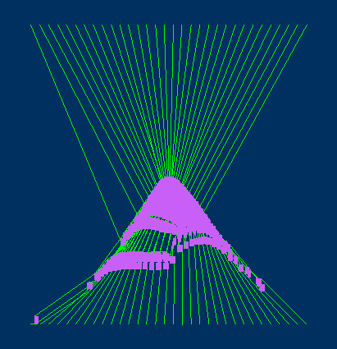
Illustration
Based on force directed method
Additional forces for overlap removal

Slide 4
Quadratic Placement
Formulation as a quadratic minimization problem
Solution of linear
equation system
Analogy
  Nets as springs
  Solution:
  Equilibrium
C · p + d = 0

Slide 5
Additional Forces
Additional force working on each cell
Placement
determined by
calculating the state
of equilibrium
Access to complete
solution space
  One-to-one map
  between forces and
  places
C · p + d + d´ = 0

Slide 6
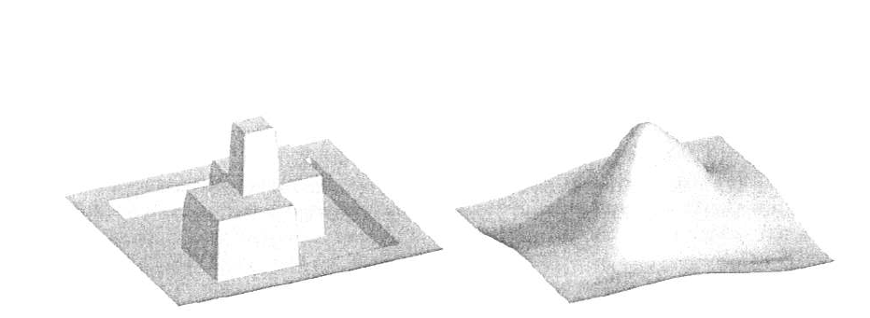
Spatial Representation
Map modules and placement area onto a spatial representation
  Supply demand model, no circular additional forces
Use convolution to achieve a global orientation
  Computational efficient
Two cells and their placement area
Spatial representation
After convolution
Gradient gives the forces
Images: courtesy Bernd Obermeier

Slide 7
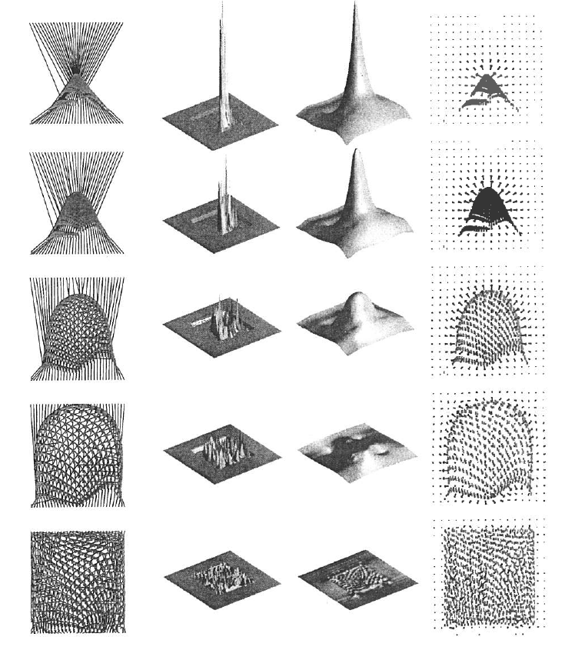
Iterations
Spatial
representation
Convo-
luted
Gradient
Placement
Start with placement without additional forces
  Repeat:
  Update forces according to placement
  Calculate equilibrium as new placement
Until even distribution

Slide 8
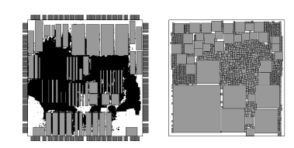
Properties
Geometrical flexibility
  Straightforward modeling of
    cell boxes
    non-rectangular cells (macro and mixed block placement)
    Non-rectangular placement area
Images: courtesy Peter Spinderl

Slide 9
Properties
Geometrical flexibility
  Straightforward modeling of
    cell boxes
    non-rectangular cells (macro and mixed block placement)
    Non-rectangular placement area
No hard decision
  Decisions are revocable, not dependent on making an early decision
  Allows concurrent changes
Continuous
  Small changes of input data result in small changes of placement

Slide 10
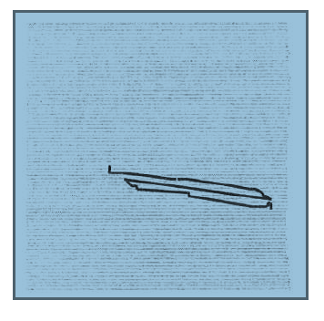
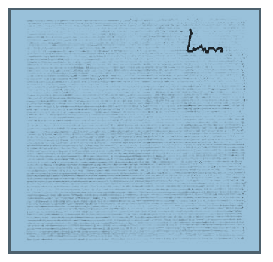
Timing
Longest path without timing optimization
Longest path with timing optimization

Slide 11
Properties
Geometrical flexibility
  Straightforward modeling of
    cell boxes
    non-rectangular cells (macro and mixed block placement)
    Non-rectangular placement area
No hard decision
  Decisions are revocable, not dependent on making an early decision
  Allows concurrent changes
Continuous
  Small changes of input data result in small changes of placement
Updates of data is easy
  Various optimization goals can be applied to an quasi-legal placement
    ECO, timing, congestion, heat distribution and other metrics

Slide 12
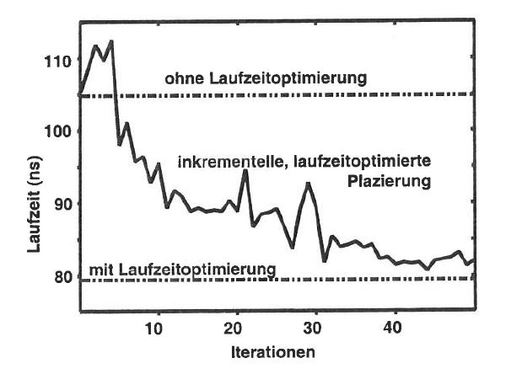
Timing Optimization For Legal Placement
Without timing optimization
Timing optimization after creating a quasi-legal placement
Runtime (ns)
With timing optimization right from the beginning
Iterations

Slide 13
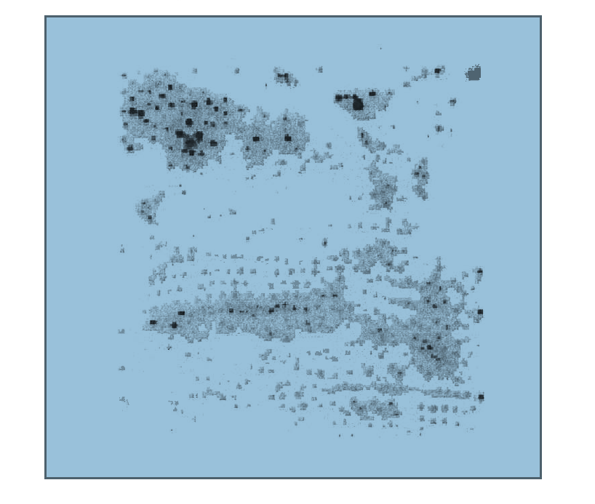
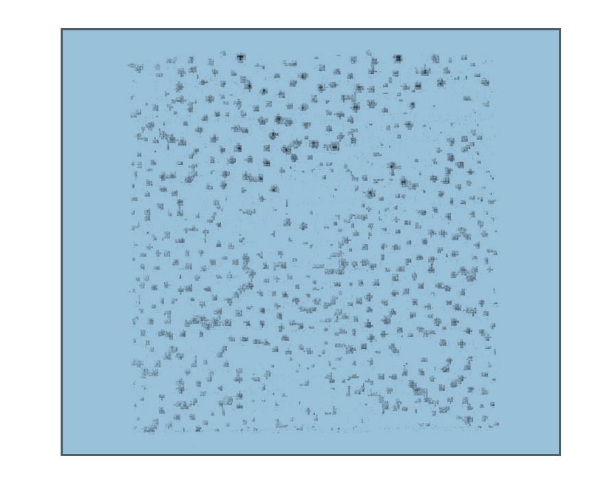
Heat Optimization
Images: courtesy Bernd Obermeier
Non heat-aware placement
Heat aware placement

Slide 14
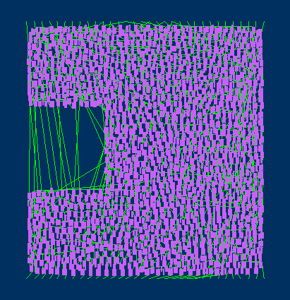
Placement Area Change Of Quasi-Legal Placement
Given situation:
Macrocell at the left
Desired result:
Macrocell at the right

Slide 15
Layout Verification Algorithms Revisited
A Tribute to Kurt Antreich
an algorithm from the early EDA era
Hans Eisenmann, PDF Solutions
March 31, 2015

Slide 16
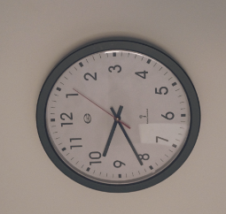
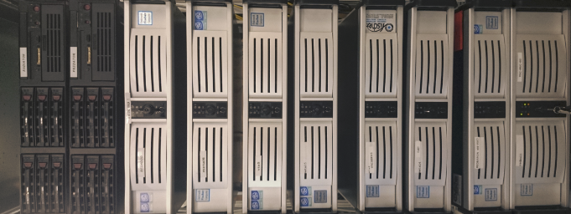
Motivation Layout Verification
Todays layouts undergo a complex series of checking and modification steps
  DRC, retargeting, OPC, mask making
This happens at all stages of the process
  Often performed in iterations: Run, fix, run again
  Used from early design to tape-out and during manufacturing
Layout verification algorithms are the workhorse for this
Runtimes can be in the days, even in highly parallel compute environments.
Layout verification is not an optimization problem! The correct answer is known. All what counts is speed.
!

Slide 17
Algorithmic Approaches
Before 1981, bitmap based approaches were the state of the art
After 1981, scanline based approaches were the state of the art
Global placement optimization | Quadratic (Space, Gordian et. al) |  |  |  |  |  |  |  | Linearized quadratic (GordianL) |  |  |  |  |  | bounding box based, per-pin, linearized quadratic (Kraftwerk2)
Global placement overlapfree constraint | constant repulsive forces between modules |  |  | repulsive force function between modules |  |  | Partitioning with COG (Gordian) |  | multi region iterative bipartioning (GordianL) |  |  | Spatial distribution based forces (Kraftwerk, Kraftwerk2)
Final placement | Simple |  |  |  | transportation problem (space) |  |  |  |  | network flow (Domino) |  |  |  |  |  | Dynamic Programming (Abacus)
Year | 1975 | 1980 |  |  |  | 1985 |  | 1990 |  |  | 1995 |  | 2000 | 2005 |  |  | 2010 | 2015
Layout verification | Bitmap based |  | Scanline based
Start of Munich EDA Institute
Layout synthesis
Placement research from the institute in Munich
This Talk
Worldwide academia
and industry

Slide 18
Bitmap Based
Represent layout as bitmap
Perform operation on bitmap
000000000000000000000
000000000000000000000
001111111111100000000
Boolean OR
001111111111100000000
001111111111100000000
001111111111100000000
001111111111111000000
001111111111111000000
001111111111111000000
001111111111111000000
001111111111111000000
001111111111111000000
000000001111111000000
000000001111111000000
000000001111111000000
000000001111111000000
000000000000000000000
000000000000000000000
Characteristics: Matrix style arrangement, matrix element represents area

Slide 19
Variable Bitmap
Variable bitmap approaches use only existing coordinates
0 0 0 0 0
Boolean OR
0 1 1 0 0
0 1 1 1 0
0 0 1 1 0
0 0 0 0 0

Slide 20
Edge Based Scanline
Sort Edges according to Y start coordinates
Move a “scanline” from bottom to top
Have edges on the scanline (active edges) sorted by X
Check and resolve when edges start, end or cross
Characteristics:
Edge representation
scanline divides into past, present, future
N log N complexity

Slide 21
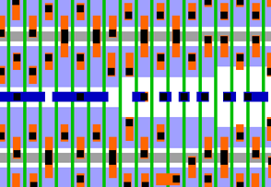
Comparison
Compared to scanline approaches,
bitmap approaches are
Memory consuming
Constraint to rectilinear geometries
Slow
Memory consuming | Store partitioned rectangles and do bitmap conversion on the fly
 | This fits today’s layout style
Slow | Competitive speed for today’s layout styles

Slide 22
Matrix Based Representation
Use
matrix style from bitmap
edge representation from scanline
0
0
0
0
+1
0
-1
0
+1
+1
-1
-1
0
+1
0
-1
0
0
0
0
Matrix element represent vertical edges
  In addition to the edge information, it has a net index and a polygon index for each edge

Slide 23
Matrix Based Edge Representation
Alternatively, represent start edges only with width as attribute
Results in less column
2
3
0
0
3
0
3
2
0
2
0
0

Slide 24
Matrix Based Operation
Scan from left to right
Rows are independent. In example below we process them bottom-up
0
0
0
0
0
0
0
0
0
0
3
0
3
3
3
0
0
0
3
3
3
2
2
2
0
0
2
2
0
0

Slide 25
Matrix Based Operation
Rows can be calculated independently, thus:
Arrange data consecutive in columns to give fast data access
Process column by column, each column bottom up
Enables vectorization computations (in this example, two calculations at the same time)
0
0
0
0
0
0
0
0
0
3
0
0
0
0
3
0
3
2
3
2
2
2
2
0
2
2
2
2
0
0
0
0
0

Slide 26
Experimental Results
Testcase: Mixture of product styles, technologies and compute intensive layers, each layout is run with 27 combinations of two-layer booleans.
Runtime
Write-out
Two layer booleans
Load and layout prep
Matrix based approach
Physical verification tool
from a major EDA vendor

Slide 27
Experimental Results
Benchmark | Tech | Layers | Speed-Up Total Runtime | Speed-Up Two layer OP
Testchip | 28 nm | Up to M2 | 2.0 | 2.5
Product chip (logic/SRAM) | 20 nm | Up to M1 | 2.5 | 3.1
Random stdcell placement | 14 nm | Up to M1 | 2.8 | 3.2
Standard hardware (Xeon E5-2630), standard language/compiler (gcc-4.9.3). No hardware specifics such as inline assembler, instruction intrinsics or similar.

