Slide 1
Early Days of Circuit Placement
Martin D. F. Wong
Department of Electrical and Computer Engineering
University of Illinois at Urbana-Champaign

Slide 2
Overview
Focus
  GORDIAN (1988, 1991)
  GORDIANL (1991)
  DOMINO (1991, 1992, 1994)
Before GORDIAN
  Cluster growth
  Iterative cell exchanges
  Quadratic placement (1970)
  Force-directed placement (1979)
  Resistive network analogy (1984)
  Min-cut placement (1985)
  TimberWolf (Simulated Annealing) (1985)

Slide 3
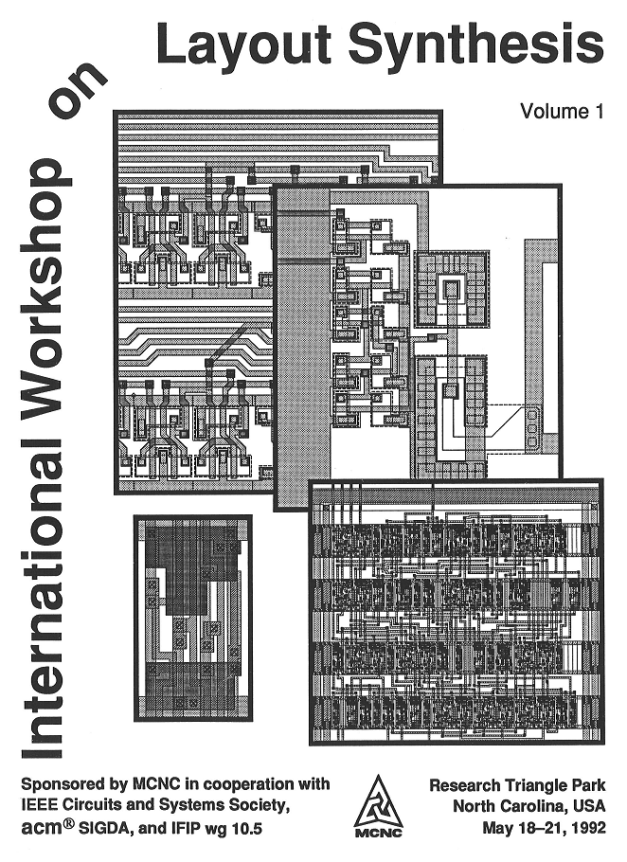
Overview
Focus
  GORDIAN (1988, 1991)
  GORDIANL (1991)
  DOMINO (1991, 1992, 1994)
Before GORDIAN
  Cluster growth
  Iterative cell exchanges
  Quadratic placement
  Force-directed placement
  Resistive network analogy
  Min-cut placement
  TimberWolf (Simulated Annealing)
TimberWolf Hunt
Placement Contest
1992 MCNC Layout Synthesis
Workshop

Slide 4
Placement Problem
Standard Cell
Macro Cell

Slide 5
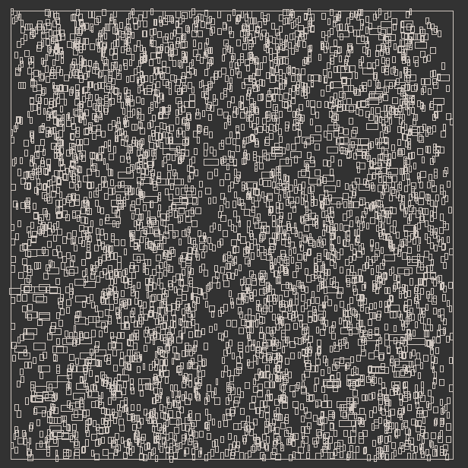
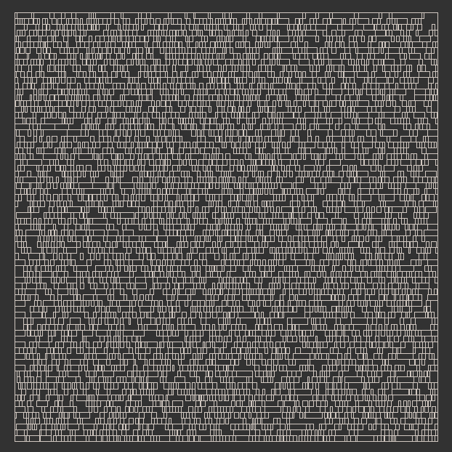
Placement Problem
Global placement
Detailed/Final placement

Slide 6

Simulated Annealing
“Timberwolf Placement and Routing Package” Sechen, Sangiovanni-Vincentelli 1985
Cost function
?
Solution Space

Slide 7
Min-Cut Placement
Breuer 77, Lauther 79, Dunlop & Kerninghan 85, Suaris & Kedem 87
Minimize
Minimize

Slide 8
Min-Cut Placement
Each region has ≤ K cells
Detailed placement
1
1
1
1 , 2
1, 2
1, 2
1, 2
2
2
2 , 3
2 , 3
2 , 3
Dunlop & Kernighan 1985
Standard-cell layout
Terminal propogation
K = 6
2, 3
3
3
3
3, 4
3, 4
3, 4
3,4
4
4
4
4
5
5
4,5
4,5
5
5
5
5

Slide 9
Forced-Directed Placement
(X₁,Y₁)
Quinn & Beuer 79, Antreich et al 82
Hooke’s Law : Spring constant ∝ net weight
Attractive force: Shorten wire length
Repulsive force: Avoid cell overlaps
Fi(x): Sum of forces at Cell i
Solve system of non-linear equations for
equilibrium state:
C₁₂
C₁₃
(X₃,Y₃)
(X₂,Y₂)
C₁₄
C₂₄
C₃₄
F1(x) = 0
F2(x) = 0
.
.
Fn(x) = 0
i
(X₄,Y₄)

Slide 10



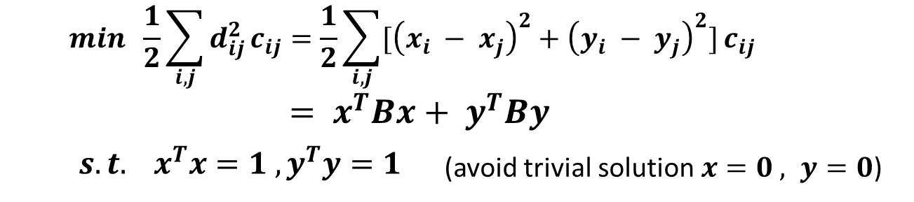

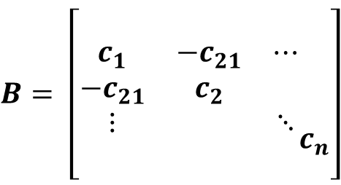




Quadratic Placement
Hall 1970
Connectivity matrix
B : Real eigenvalues
Corresponding eigenvectors
Placement solution
Lapacian Matrix
(avoid trivial solution and highly correlated x and y)

Slide 11
GORDIAN
GORDIAN: Global Optimization
GORDIAN: Recursive Dissection
GORDIAN = Quadratic Placement + Min-Cut Placement

Slide 12
GORDIAN
module coordinates
Global
Optimization
Minimization
of
wire length
Partition
Of the module set
and dissection of
the placement
region
positioning constraints
Data flow in the placement procedure of GORDIAN
module
coordinates
regions
with ≤ k
modules
Final
Placement
Adaption to
style-dependent
constraints
Input :
Net list
Cell library
Geometry
Of the chip
Output :
Legal
module
placement

Slide 13
center of gravity
partition
Partition induced by point-placement;
Apply KL/FM to refine solution
partition
partition
partition

Slide 14
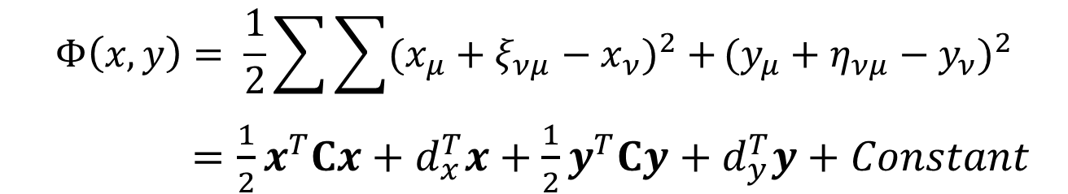
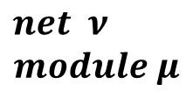




GORDIAN
Objective function:
Star Net Model

Slide 15
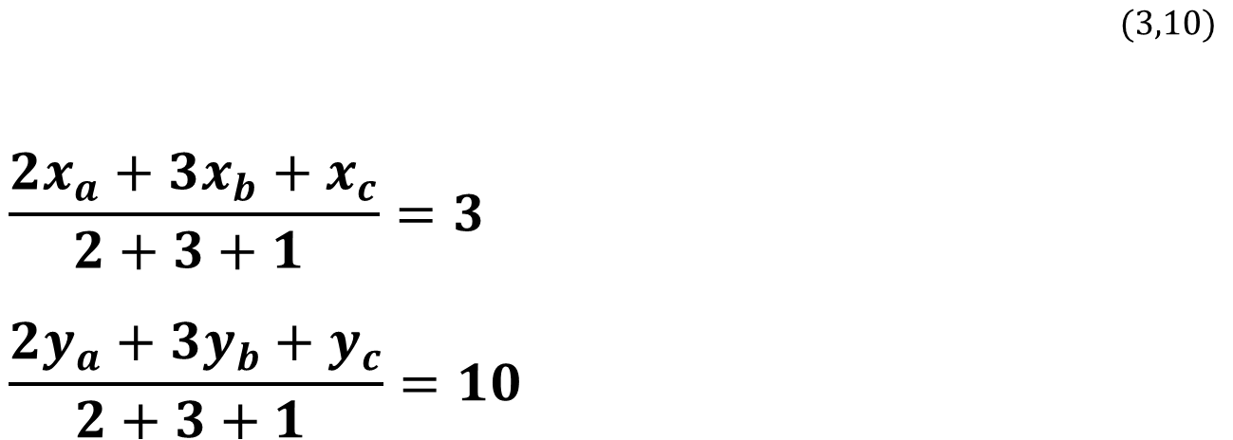
GORDIAN
How to avoid trivial solution :
  Add constraint. Fix center of gravity of all modules in the center of region
Linear Constraints:
a
c
A = 2
Center
A = 1
b
A = 3

Slide 16

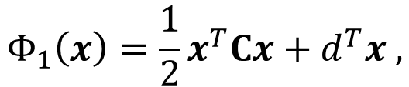
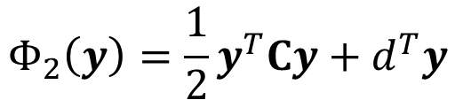
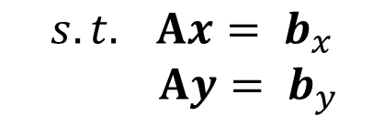
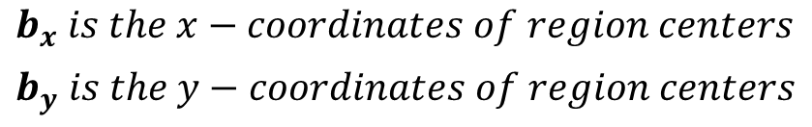
GORDIAN
Problem:
Minimize Φ₁ and Φ₂ separately
Φ₁ and Φ₂ are convex, C is positive definite
Global optimal solution can be obtained

Slide 17
GORDIAN
Each region has ≤ 35 cells
Detailed placement:
1
1
1
1 , 2
1, 2
1, 2
1, 2
2
2
2 , 3
2 , 3
2 , 3
Standard Cells
Dunlop & Kernighan
2, 3
3
3
3
Macro blocks
Otten, van Ginneken, Stockmeyer
3, 4
3, 4
3, 4
3,4
4
4
4
4
5
5
4,5
4,5
5
5
5
5

Slide 18
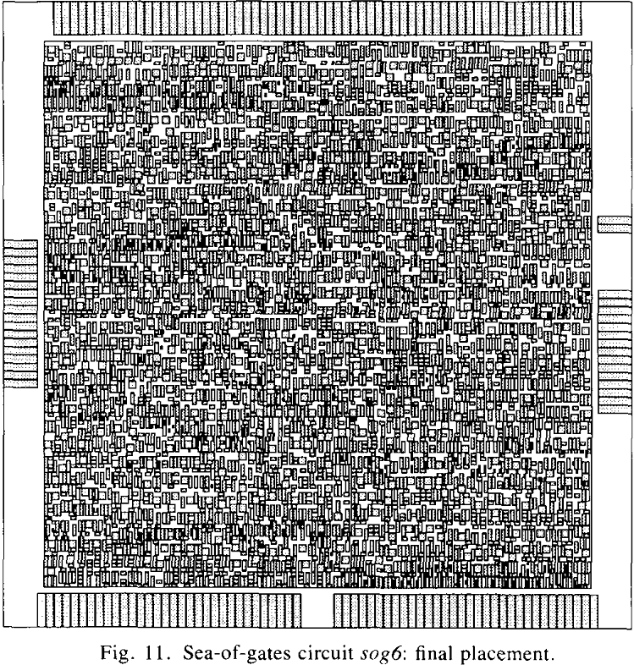
GORDIAN
Final placement for
sog6

Slide 19
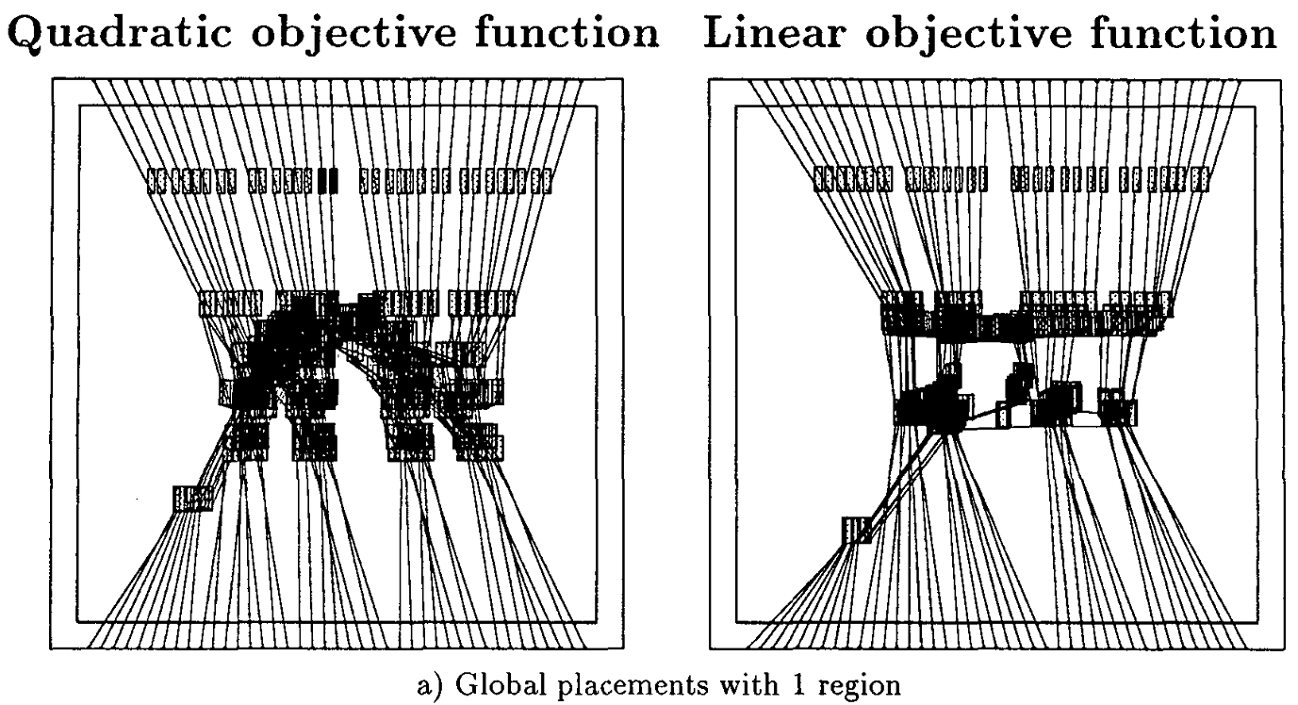
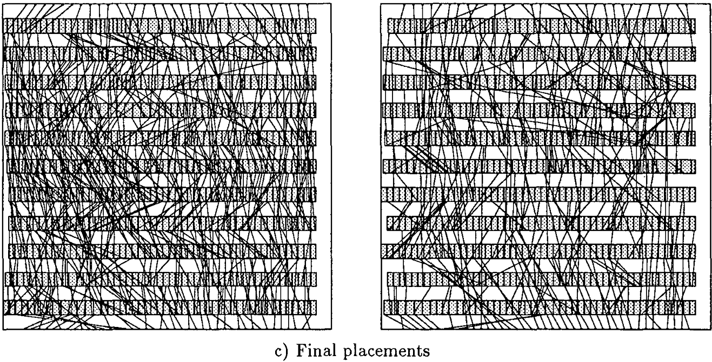
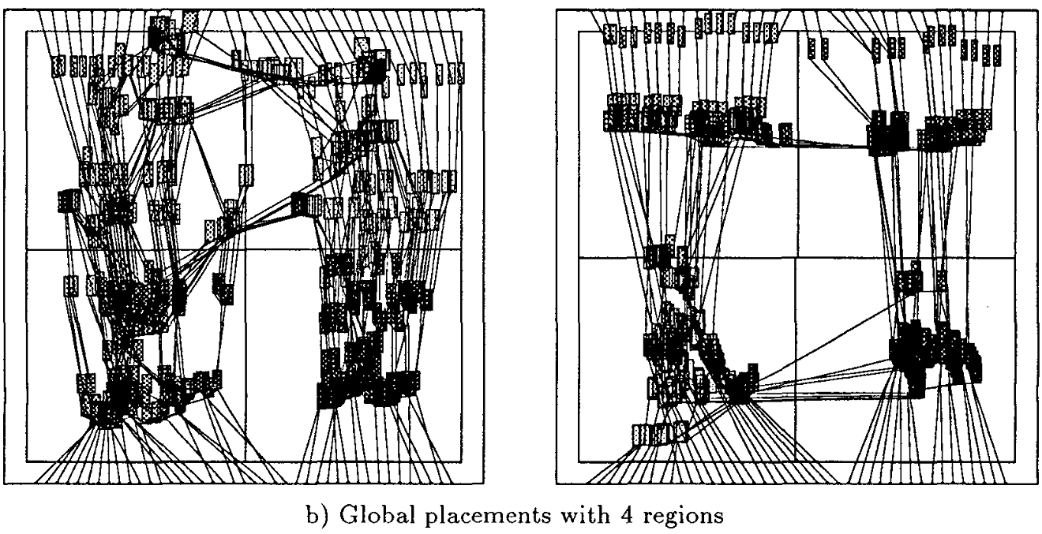
GORDIANL
- DAC 1991
- Linear v.s. quadratic objective function
- Approximate linear objective by quadratic functions
- Iteratively solve quadratic optimization

Slide 20
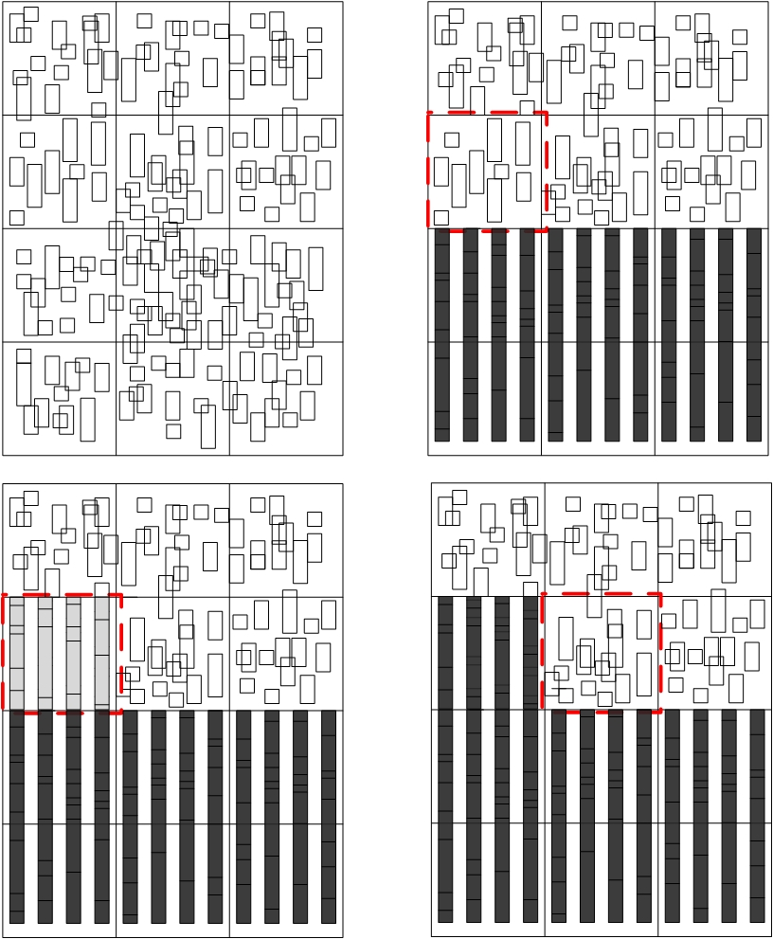
DOMINO
Iterative placement by Network flow Method
After initial placement
Divide the layout into regions
Iterate through all regions until no improvement
In each region, generate an improved placement without overlapping cells by min-cost network flow

Slide 21
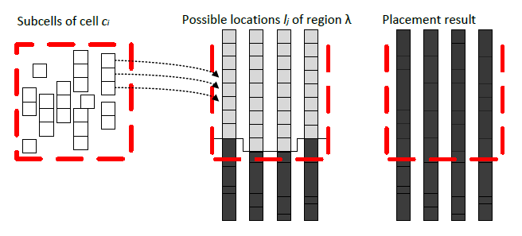
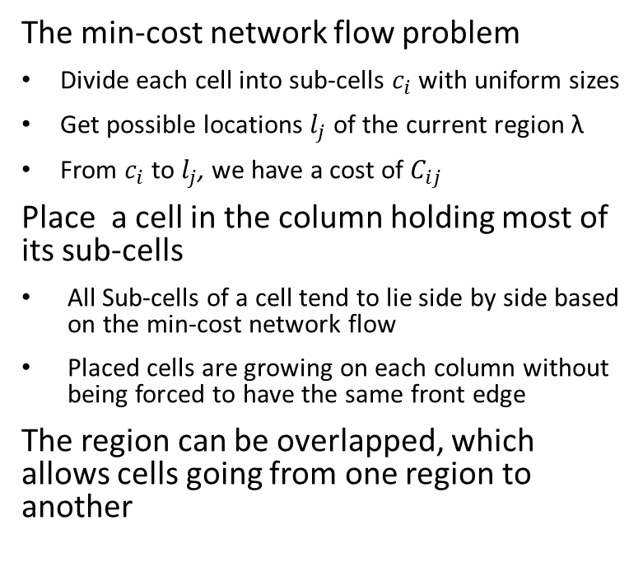
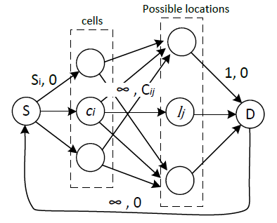
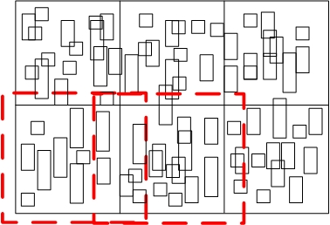
Closer look into one region

Slide 22
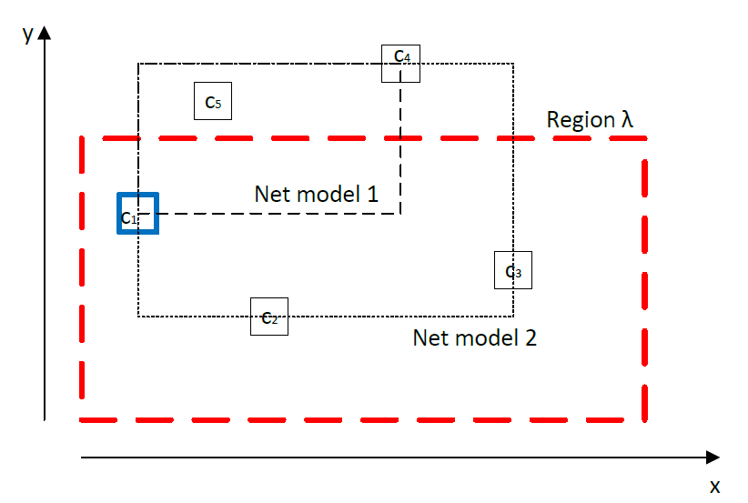
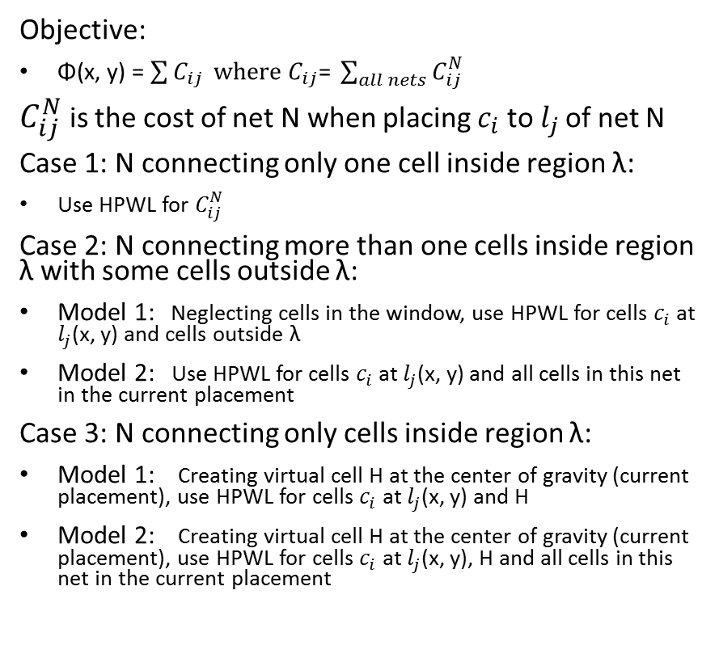
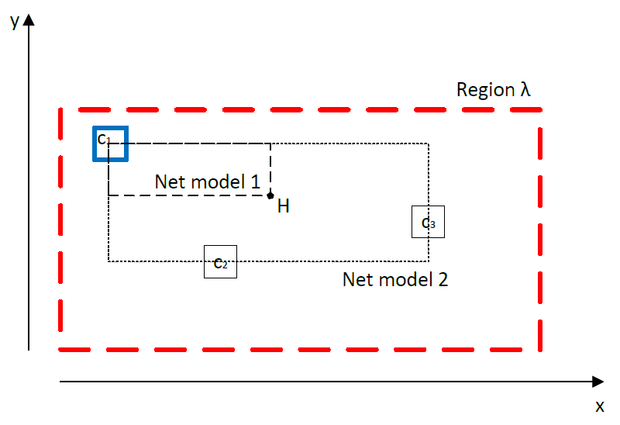
Cost models

Slide 23
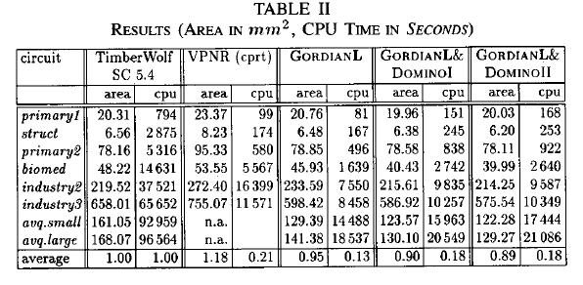
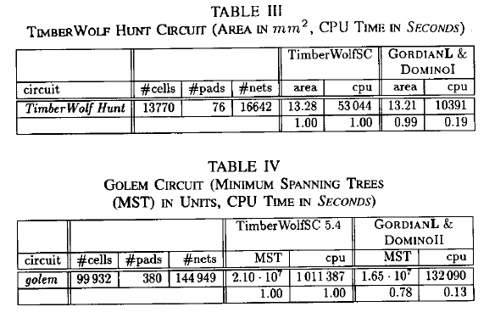
Experimental results
DOMINO with cost model 1 and 2 are compared with TimberWolf, VPNR, and GordianL
Benchmark circuits contain approximately 800 to 25000 cells
With GordianL as initial placement, DOMINO can achieve the best layout area and with less computation time than TimberWolf and VPNR in Table II and III
In large circuit with about 100000 cells, MST length and runtime are all improved compared to TimberWolf
TimberWolf Hunt
Placement Contest
1992 MCNC Layout Synthesis
Workshop

Slide 24
Conclusion
We presented two major EDA contributions GORDIAN & DOMINO from the Technical University of Munich.
Congratulations to Prof. Kurt Antreich!

