Slide 1
Closing the Gap between Global and Detailed Placement:
Techniques for Improving Routability
C.-K. Wang, C.-C. Huan, S.-Y. Liu, C.-Y. Chin,
S.-T. Hu, W.-C. Wu, and H.-M. Chen
National Chiao Tung University, Hsinchu, Taiwan

Slide 2
Outline
Routability Driven Placement
Placement Migration
The Proposed Placement Framework
Experimental Results
Conclusions

Slide 3
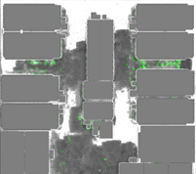
Routability Driven Placement
Routability becomes a critical issue
Global routing congestion
  Large layouts with millions of connections
  Preplaced macros occupy routing resources
  Techniques used: cell inflation & density control
Detailed routing violations
  Pre-routed wires block pin geometries
  Advanced tech node DRC rule
  (e.g. non default rules, end-of-line spacing constraints)
  Pin access issue
  Cannot be captured by global routing

Slide 4
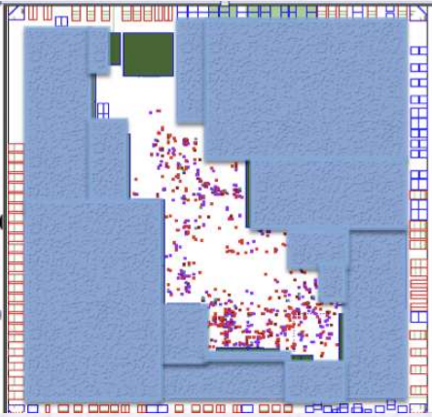
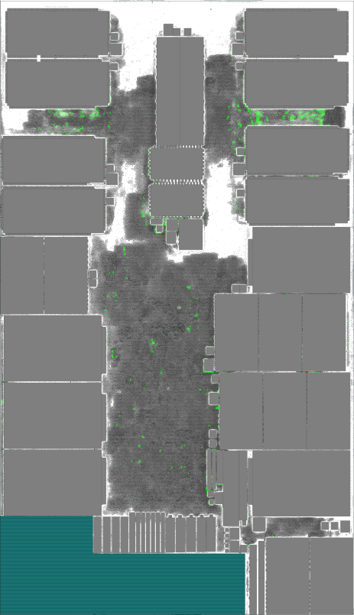
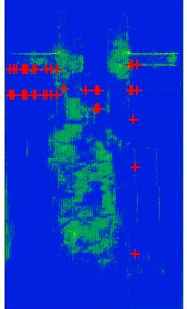
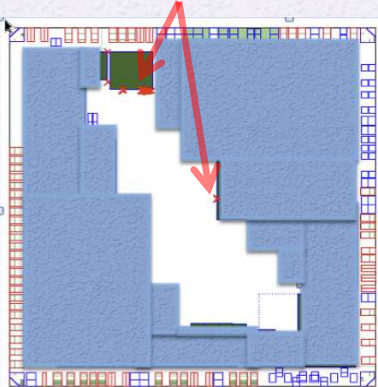
GR Congestion v.s. DR Violation
mgc_superblue_11
V. Yutsis, I. S. Bustany, D. Chinnery, J. R. Shinnerl, and W.-H. Liu. “ISPD 2014 benchmarks with sub-45nm technology rules for detailed-routing-driven placement.” ISPD, pages 161-168, 2014.

Slide 5
Outline
Routability Driven Placement
Placement Migration
The Proposed Placement Framework
Experimental Results
Conclusions
GP
Incremental Placement
Legalization
DP

Slide 6
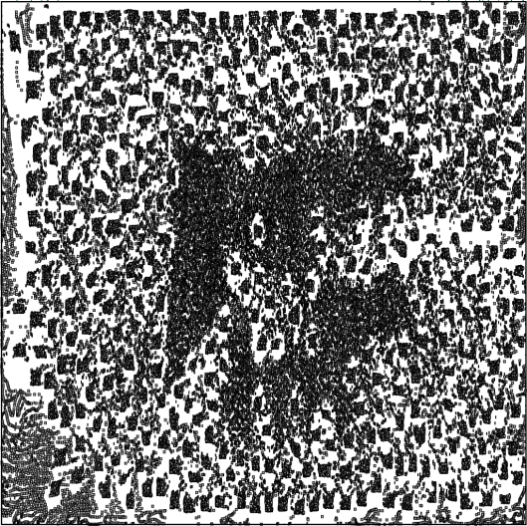
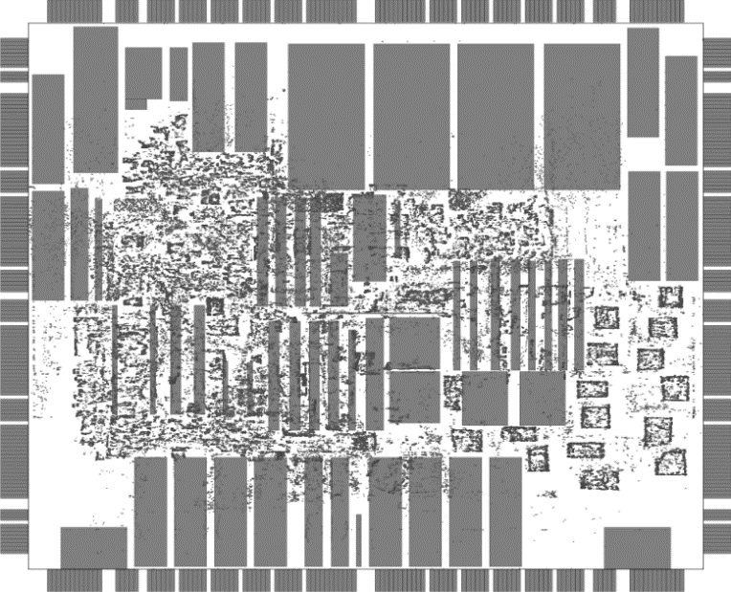
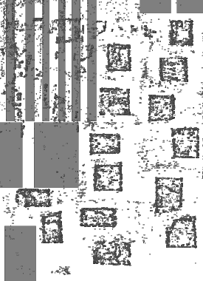
HPWL Driven Placement using B2B Model
Quadratic formulation
  Easy to implement
  Commonly used
Observations:
  local overlaps among cells
  legalization disturbs GP results
  -> worse WL & routability
[10] M.-C. Kim, N. Viswanathan, C. J. Alpert, I. L. Markov, and S. Ramji. “MAPLE: Multilevel Adaptive Placement for Mixed-Size Designs.” In ISPD, pages 193-200, 2012.

Slide 7

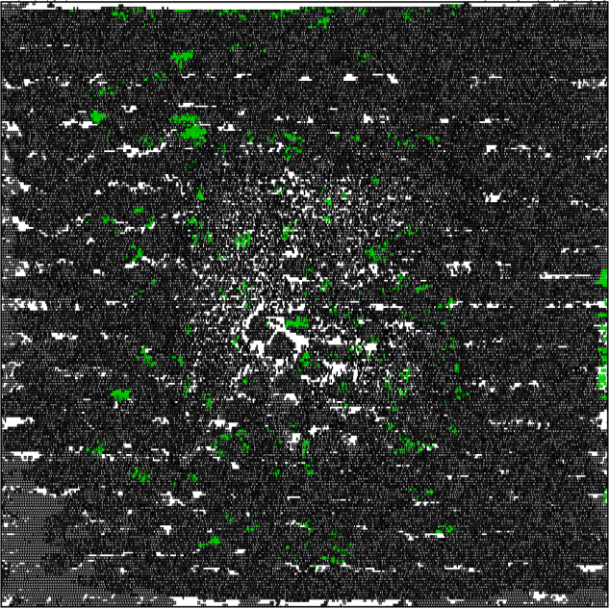
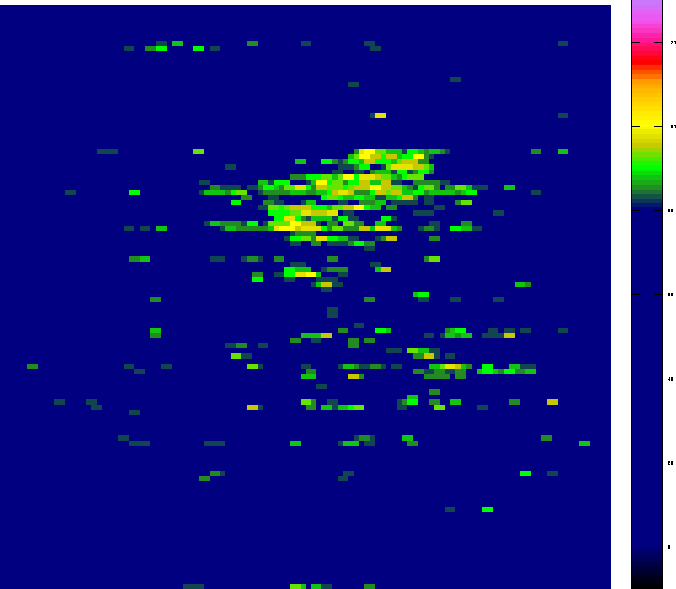
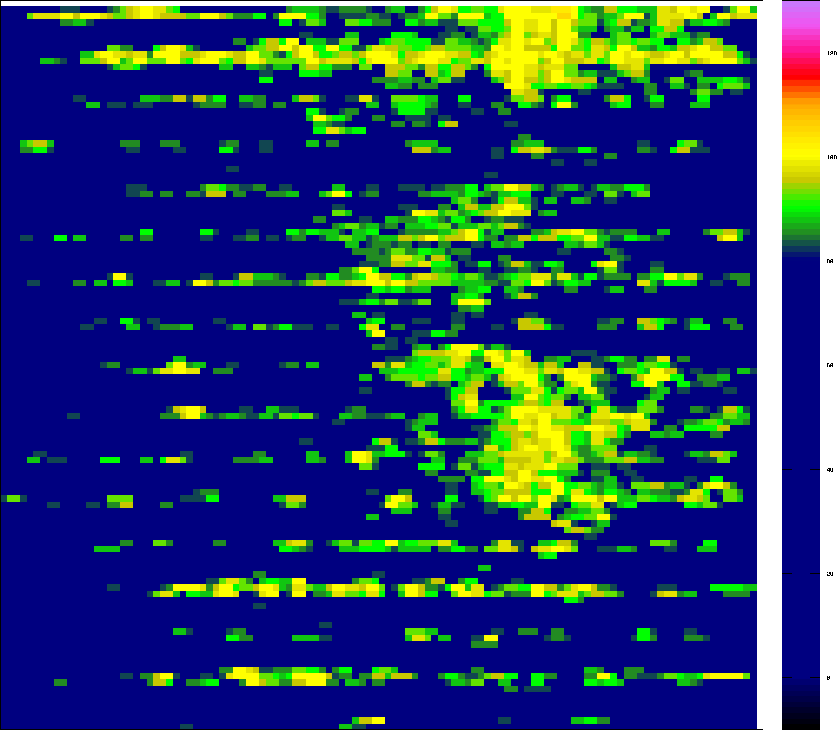
HPWL Driven Placement using B2B Model
- Routability

Slide 8
Placement Migration
Concept
  Perturb the original placement as little as possible, when addressing post-placement design-closure.
Previous works
  Computational-geometry-based [13] & diffusion-based [14]
  Timing, heat distribution, routability optimization
This work
  Routability
  Similar approach to Kraftwerk2 [17]
[13] T. Luo, H. Ren, C. J. Alpert, and D. Z. Pan. “Computational geometry based placement migration.” In ICCAD, pages 41-47, 2005.
[14] H. Ren, D. Z. Pan, C. J. Alpert, and P. Villarrubia. “Diusion-Based Placement Migration.” In DAC, pages 515-520, 2005.
[17] P. Spindler, U. Schlichtmann, and F. M. Johannes. “Kraftwerk2 - A Fast Force-Directed Quadratic Placement Approach Using an Accurate Net Model.” In IEEE TCAD, 27(8):1398-1411, Aug. 2008.

Slide 9
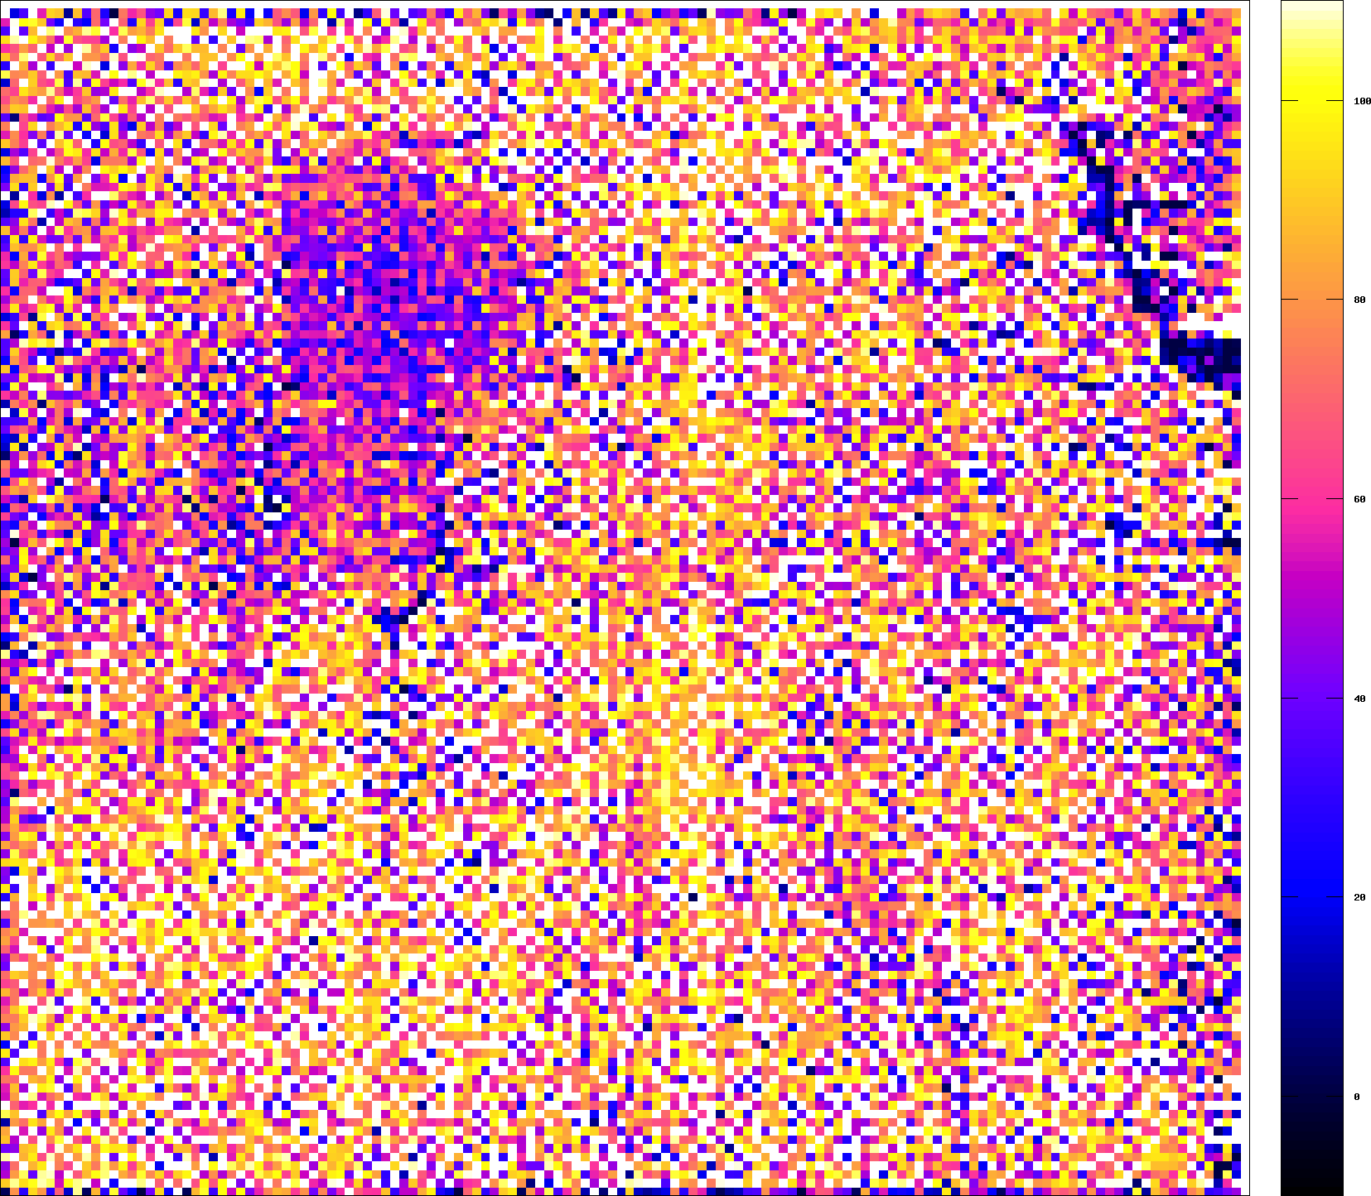
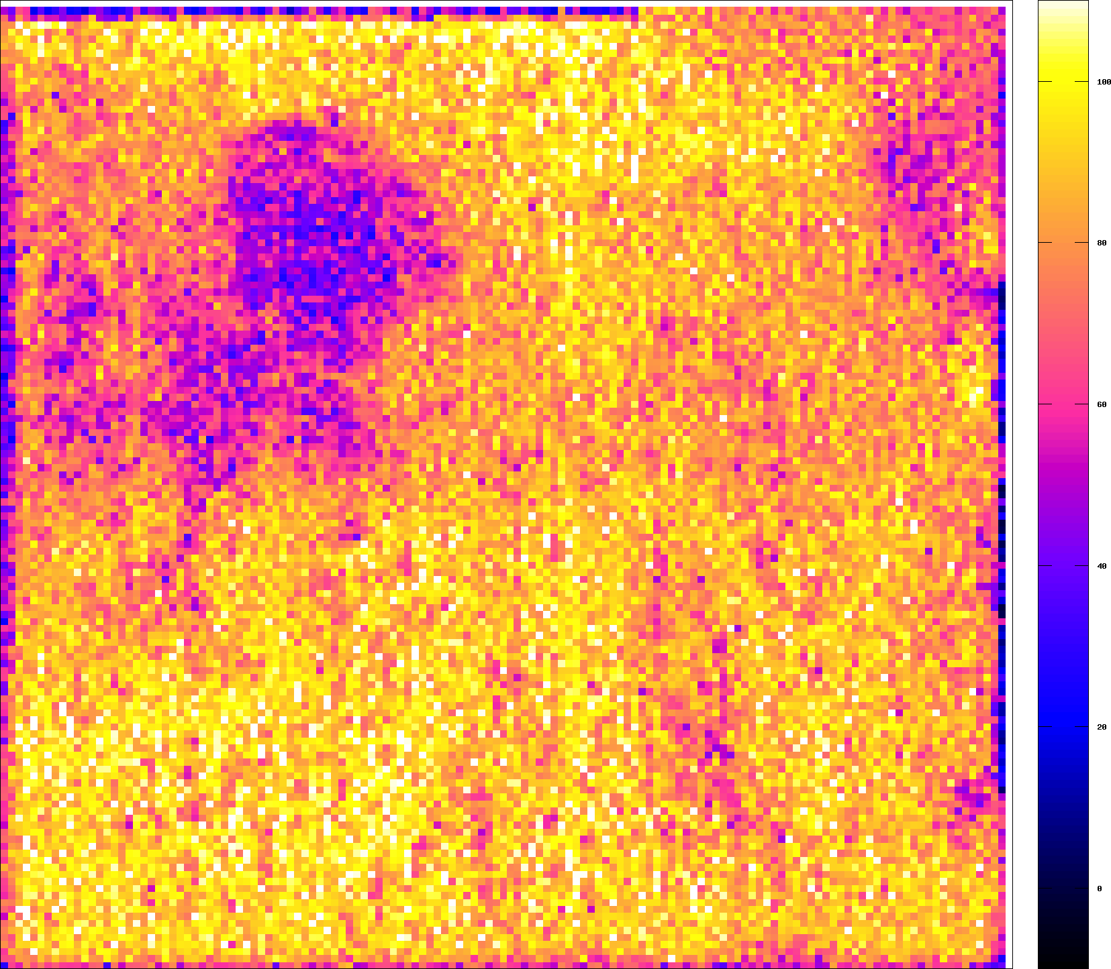
Incremental Placement - Method
3-force system
  Net force, hold force, and move force
Move force calculated according to the gradient of Gaussian blurring density map
  Maintain global density integrity

Slide 10
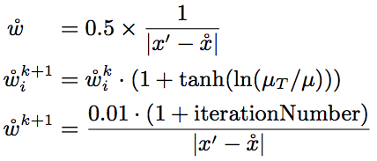
Incremental Placement - Method
Move force magnitude
  Original move force magnitude in Kreaftwerk2
  Move force in this work
  Anchor force used in simPL*
* M.-C. Kim, D.-J. Lee, and I.L. Markov, “SimPL: an effective placement algorithm,” In ICCAD 2010.
Notes:
target movement μ_{T} is too global to remove local density overflow

Slide 11
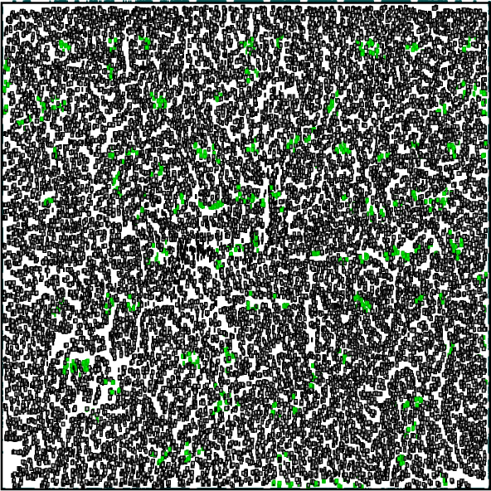
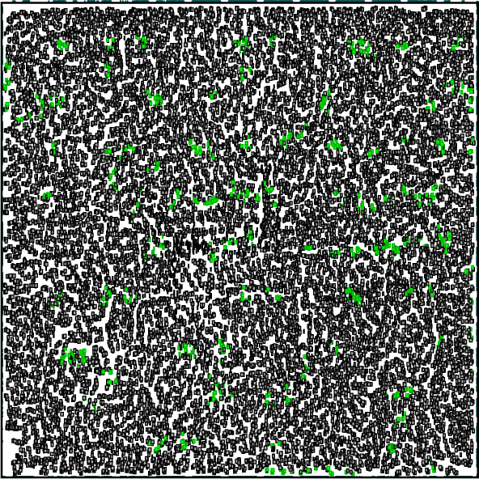
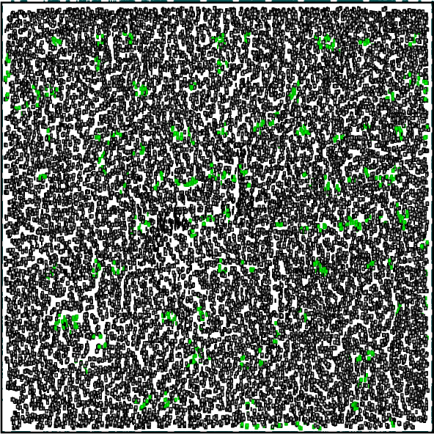
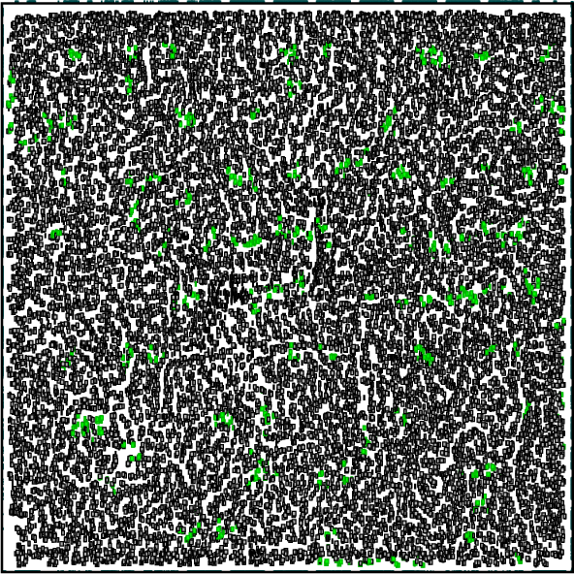
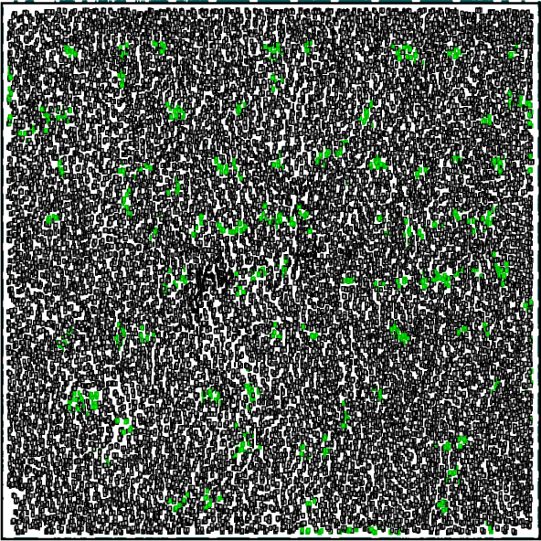
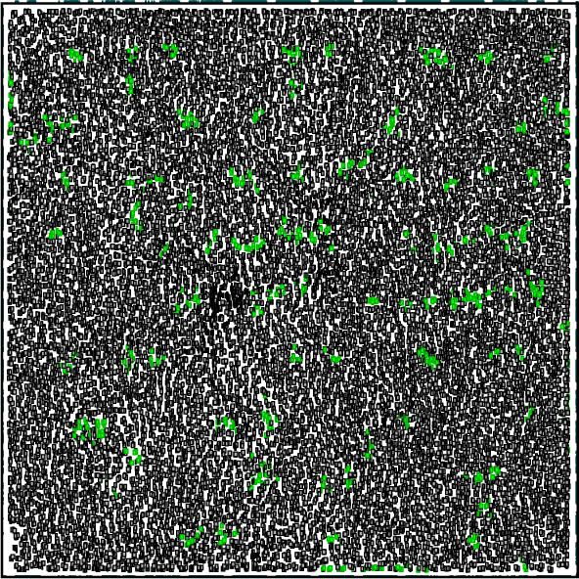
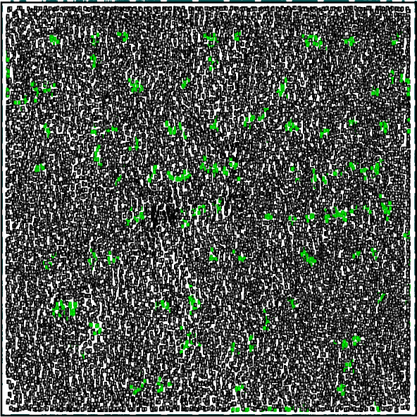
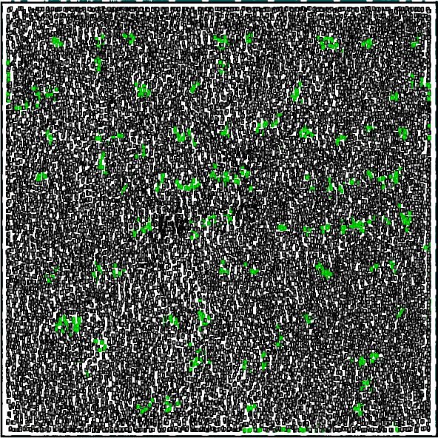
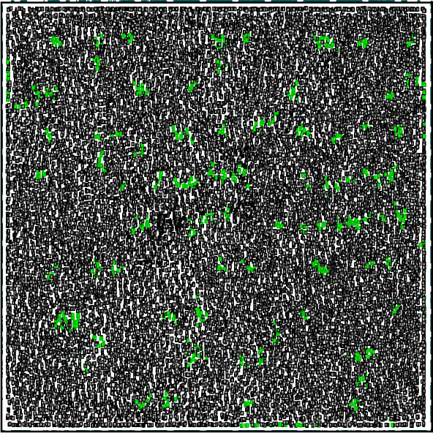
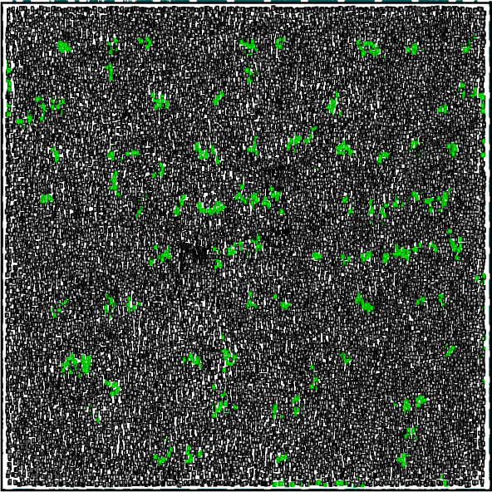
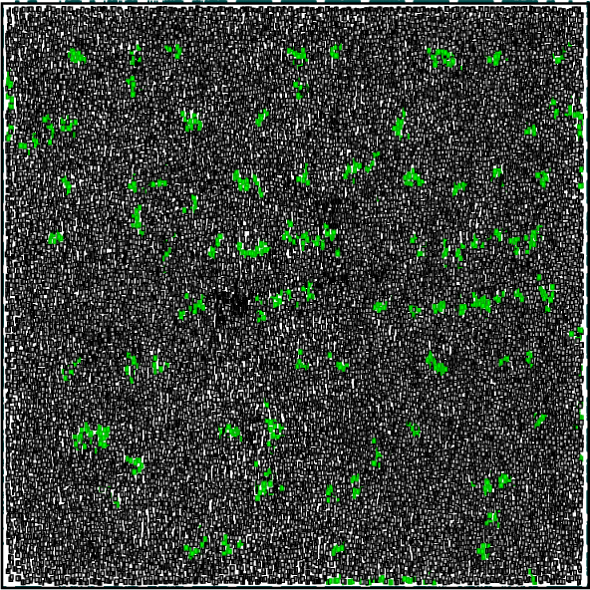
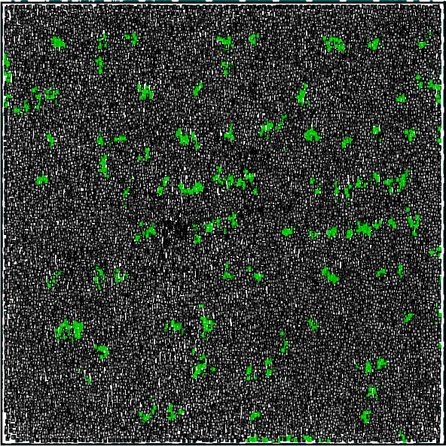
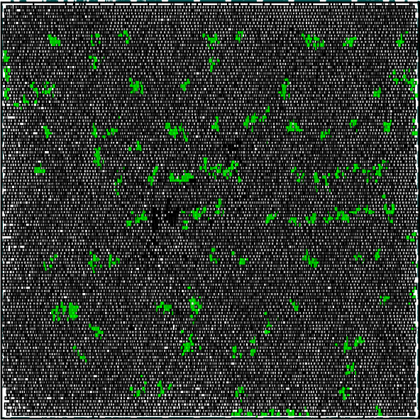
Incremental Placement: an Example
Input placement
final placement

Slide 12
Incremental Placement – effect on DR
Prevent legalization disturb global placement results
  Maintain GR quality
Reduce DR violations
w/o incremental place
w/ incremental place
DR violations
GP-to-LG displacement
case: mgc_matrix_mult

Slide 13
Outline
Routability Driven Placement
Placement Migration
The Proposed Placement Framework
Experimental Results
Conclusions

Slide 14
Routability Placement Problem
ISPD 2014 detailed routing driven placement contest
Input
  tech.lef – metal layers with width/spacing constraints
  cell.lef – cell library with pin position/shape
  floorplan.def – floorplan, Power/Ground stripes, routing tracks
  design.v – netlist
  Non default rule, L-shape pin, EDGETYPE constraints
Objective
  Minimizing routing wirelength and violations (shorts/open…)
  Placement results in DEF format

Slide 15
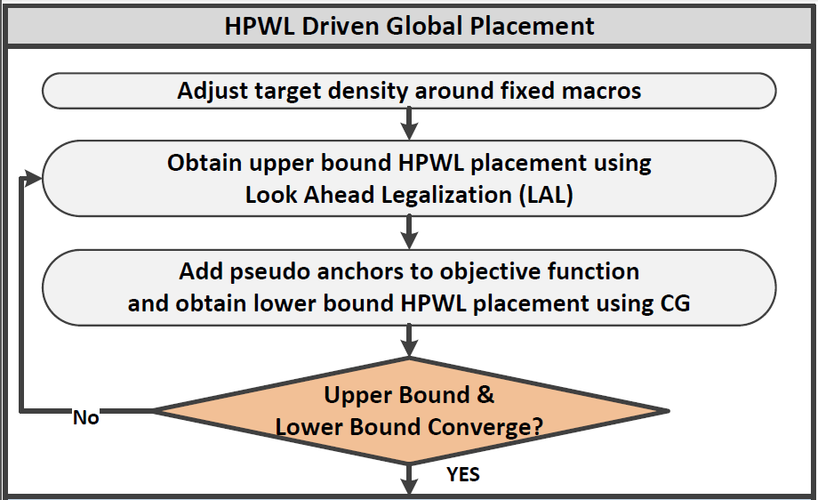
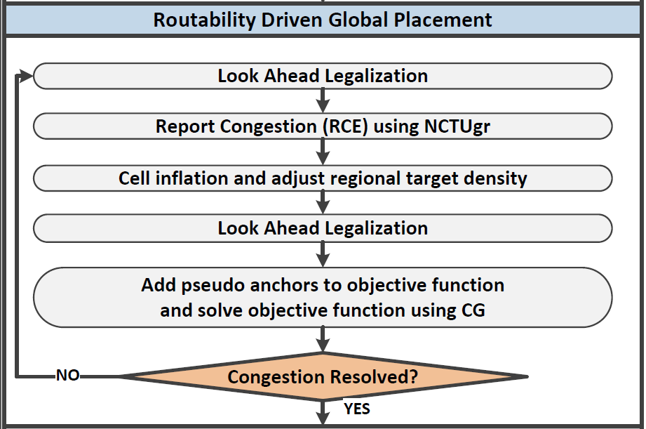
Overall Flow (1/2)

Slide 16
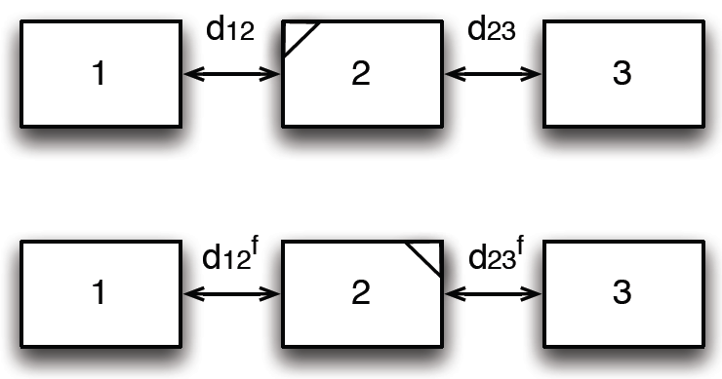
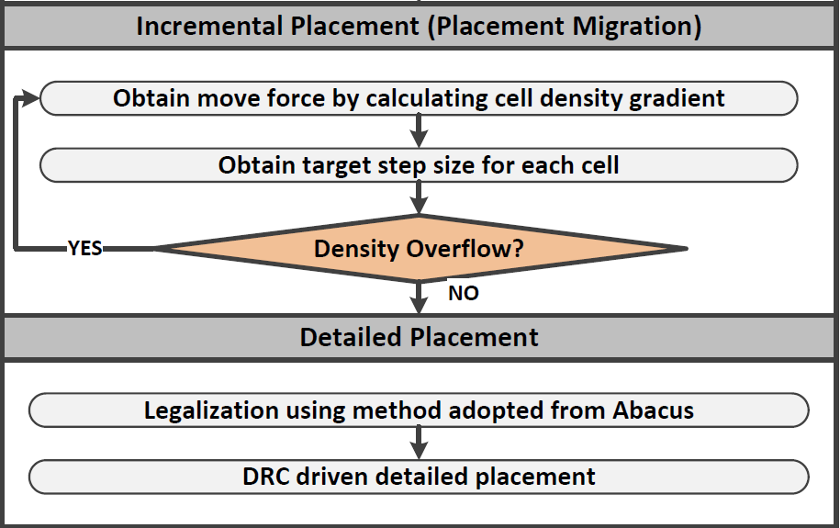
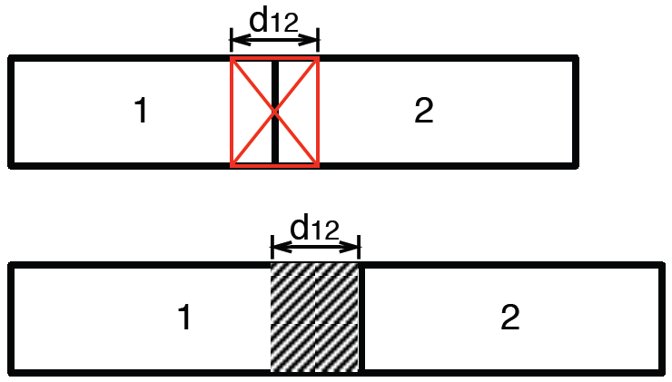
Overall Flow (2/2)
Calculate Δx for each cell
Flip cell to reduce cell-to-cell spacing
Inflate cell for spacing constraint

Slide 17
Outline
Routability Driven Placement
Placement Migration
The Proposed Placement Framework
Experimental Results
Conclusions

Slide 18
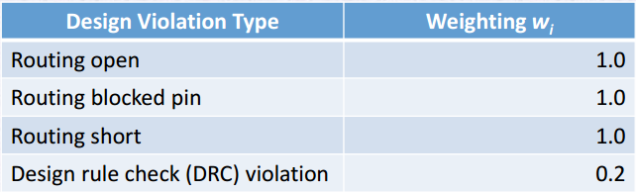
Experimental Results - Setting
Verified by Mentor Graphics OLYMPUS
  Placement results is first refined by OLYMPUS before routing
Score
  DP score – displacement between submitted & refined placement
  DR score
    Routing WL
    Routing violations

Slide 19
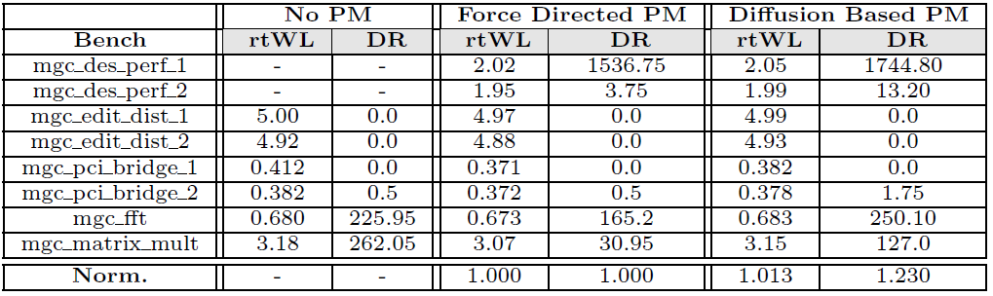
Experimental Results
Comparison between w/ and w/o Incremental Placement

Slide 20
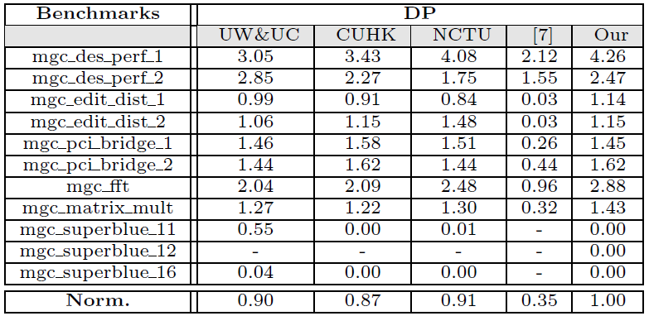
Experimental Results
Comparison among ISPD2014 contestants – DP score
[7] A. Kennings, N. K. Darav, and L. Behjat. Detailed placement accounting for technology constraints. In VLSI-Soc, 2014

Slide 21
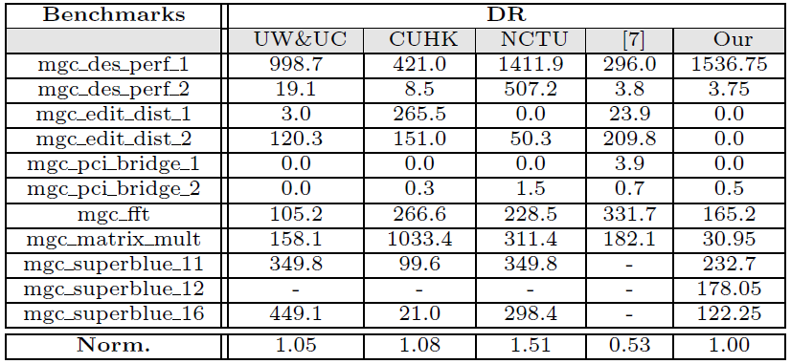
Experimental Results
Comparison among ISPD2014 contestants – DR score
--

Slide 22
Conclusions
For B2B model-based placer, placement migration is effective in reducing detailed routing violations
A placement framework is proposed considering both global routatbility and detailed routability, including
  An incremental placement to reduce cell overlapping with better relative order, eliminate potential detailed routing problem
  A detailed placer to reduce design rule violations
Experimental results demonstrate the effectiveness of the proposed framework

Slide 23
Thanks

