Slide 1
ISPD 2015
Detailed Routing-Driven Placement Contest with Fence Regions and Routing Blockages
Ismail Bustany
David Chinnery
Joseph Shinnerl
Vladimir Yutsis
www.ispd.cc/contests/15/ispd2015_contest.html

Slide 2
Outline
Motivation
Benchmarks
Evaluation metrics
Results
Acknowledgements

Slide 3
1. Motivation

Slide 4
Why another placement contest?
Increasing complexity of design rules
  Miscorrelation between global routing (GR) and detailed routing (DR)
  Global routing does not adequately consider
  short nets that are within global routing cells
Placement constraints impacting routability
  Floorplan: irregular placeable area, narrow channels between blocks
  Design rules: min-spacing, pin geometry, edge-type, and end-of-line
Example routability challenges for placement
  Netlist: high-fanout nets, data paths, timing objectives
  Routing: non-default rules, routing layer restrictions and blockages
Notes:
Additional constraints beyond the ISPD 2014 benchmark suite are highlighted in green.

Slide 5
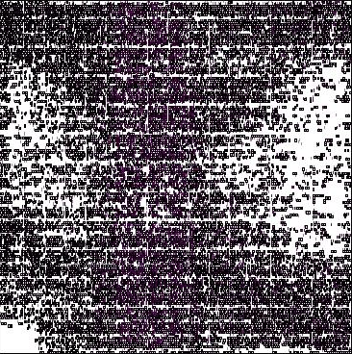
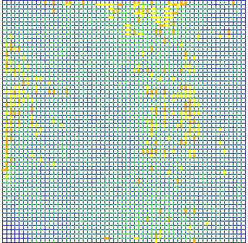

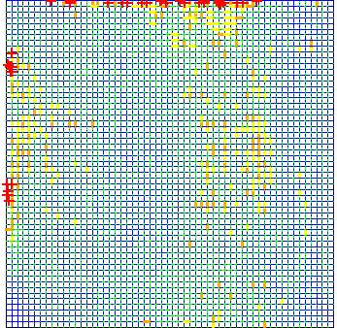

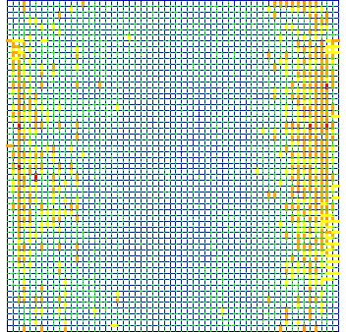

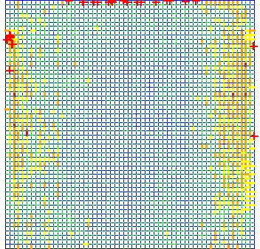
Is global routing congestion a sufficient metric?
Placement
GR edge overflow & node congestion
DR violations
with GR response
0.0% GR edge overflow
67 DR shorts
more
evenly
spread
0.4% GR edge overflow
55 DR shorts
Notes:
Example placements for the mgc_fft_2 design from the ISPD 2014 contest.

Slide 6
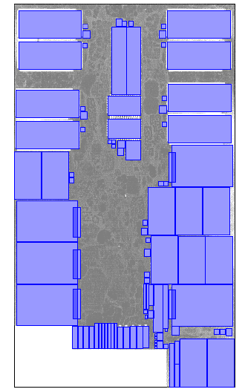
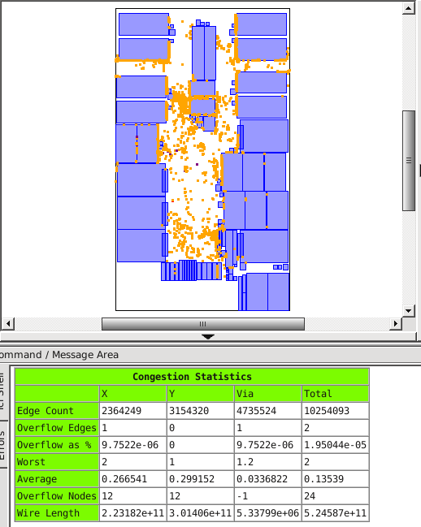
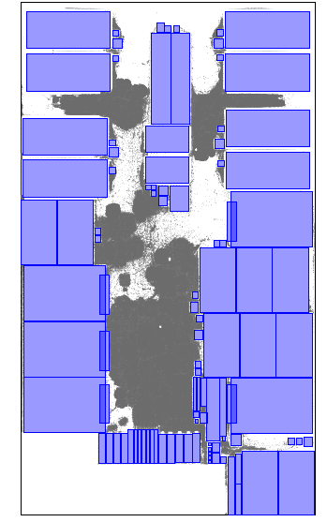
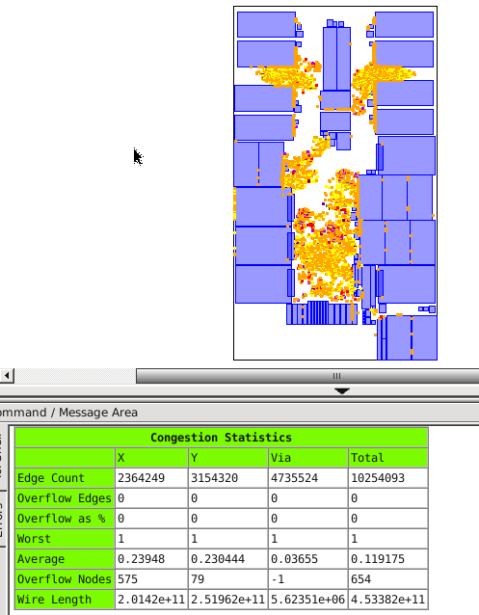
Why impose a density limit?
Cell spreading is needed for timing optimization,
as cell sizing and buffering will increase area usage
Can also help reduce routing congestion
Example: mgc_superblue11 placements with different density limits and corresponding global routing congestion maps showing detailed routing shorts
worse routing congestion
Even spread placement with 65% density limit, detail routed wire length 53.6m.
Placement with 95% density limit,
detail routed wire length 46.3m.

Slide 7
2. Benchmarks

Slide 8
Benchmarks
They are based on designs originally provided by
  Intel in the ISPD 2013 gate sizing contest
  IBM in the DAC 2012 routability-driven placement contest
They are adapted from the 2014 ISPD Detailed Routing-Driven Placement Contest’s benchmark suites A and B
There are 20 designs in this year’s contest
  16 were available to contestants
  4 blind benchmarks

Slide 9
What was added in 2014?
Enhancements for the 2014 contest:
Added representative sub-45nm design rules, e.g.:
edge-type, min spacing, end-of-line, non-default routing
Rectangular and rectilinear pin shapes, some metal2 pins
Added a power and ground mesh
  Pin access can be blocked by this if it is not considered
Restricted routing layers to increase routing difficulty
Use detailed routing as the final arbiter of quality

Slide 10
What have we added this year?
Increased floorplan area to add large macros with routing blockages and narrow placement channels to the Intel benchmarks
  These help simulate top-level place-and-route problems
  The Intel benchmark suite previously had no macros
Fence placement regions (e.g. voltage regions)
  All cells assigned to a region must be placed within it,
  no other cells are allowed in.
  A region may be disconnected, consisting
  of several non-abutting rectilinear pieces.
Maximum density limit
  Some submitted 2014 ISPD placement contest solutions
  had local area utilization of 100% to minimize wirelength
  Reserve space for cell sizing and buffering in a place-route flow
  Penalty to detailed wire length score if density limit is violated

Slide 11
Retained benchmark characteristics
Eight designs were retained from the 2014 ISPD contest,
but we added a maximum density limit constraint – NEW!
 |  |  |  |  |  | %Area Utilization
Design | # Macros | # Cells | # Nets | # Fence Regions | # Primary Inputs & Outputs | Standard Cells | Standard Cells & Macros | Density Limit %
mgc_des_perf_1 | 0 | 112,644 | 112,878 | 0 | 374 | 90.6 | Same | 90.6
mgc_fft_1 | 0 | 32,281 | 33,307 | 0 | 3,010 | 83.5 | Same | 83.5
mgc_fft_2 | 0 | 32,281 | 33,307 | 0 | 3,010 | 49.9 | Same | 65.0
mgc_matrix_mult_1 | 0 | 155,325 | 158,527 | 0 | 4,802 | 80.2 | Same | 80.2
mgc_matrix_mult_2 | 0 | 155,325 | 158,527 | 0 | 4,802 | 79.0 | Same | 80.0
mgc_superblue12 | 89 | 1,286,948 | 1,293,413 | 0 | 5,908 | 44.0 | 57.0 | 65.0
mgc_superblue14 | 340 | 612,243 | 619,697 | 0 | 21,078 | 55% | 77% | 56.0
mgc_superblue19 | 286 | 506,097 | 511,606 | 0 | 15,422 | 52% | 81% | 53.0
Blind benchmarks are shown in red!
Notes:
Note: the number of nets excludes the two power/ground nets, vdd and vss.

Slide 12
Modified benchmarks this year
These twelve designs incorporate the new modifications
(shown in green) applied to the 2014 ISPD benchmarks
 |  |  |  |  |  | %Area Utilization
Design | # Macros | # Cells | # Nets | # Fence Regions | # Primary Inputs & Outputs | Standard Cells | Standard Cells & Macros | Density Limit %
mgc_des_perf_a | 4 | 108,288 | 110,281 | 4 | 374 | 56.7 | 71.7 | 56.7
mgc_des_perf_b | 0 | 112,644 | 112,878 | 12 | 374 | 56.3 | 49.7 | 56.3
mgc_edit_dist_a | 6 | 127,413 | 131,134 | 1 | 2574 | 54.1 | 61.6 | 54.1
mgc_fft_a | 6 | 30,625 | 32,088 | 0 | 3,010 | 28.5 | 74.0 | 50.0
mgc_fft_b | 6 | 30,625 | 32,088 | 0 | 3,010 | 30.9 | 74.0 | 60.0
mgc_matrix_mult_a | 5 | 149,650 | 154,284 | 0 | 4,802 | 44.9 | 76.8 | 60.0
mgc_matrix_mult_b | 7 | 146,435 | 151,612 | 3 | 4,802 | 34.2 | 72.6 | 60.0
mgc_matrix_mult_c | 7 | 146,435 | 151,612 | 3 | 4,802 | 32.7 | 72.6 | 60.0
mgc_pci_bridge32_a | 4 | 29,517 | 29,985 | 4 | 361 | 64.0 | 50.8 | 64.0
mgc_pci_bridge32_b | 6 | 28,914 | 29,417 | 3 | 361 | 27.3 | 50.6 | 27.3
mgc_superblue11_a | 1,458 | 925,616 | 935,613 | 4 | 27,371 | 35.1 | 73.0 | 65.0
mgc_superblue16_a | 419 | 680,450 | 697,303 | 2 | 17,498 | 50.2 | 73.9 | 55.0
Blind benchmarks are shown in red.

Slide 13
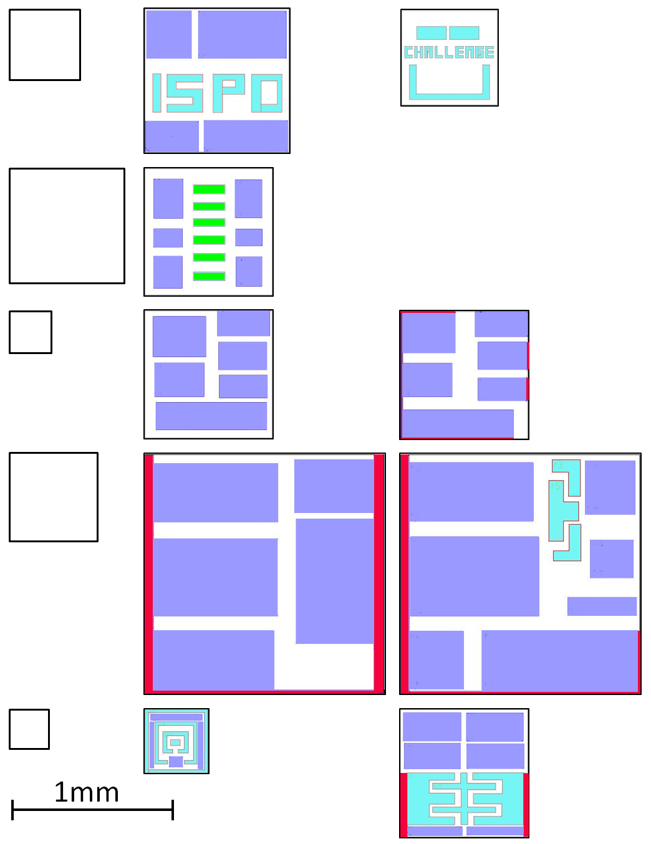

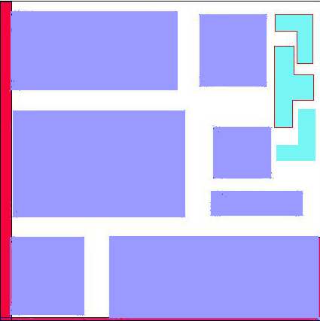
ISPD 2015 floorplans – Suite A
ISPD 2014
Floorplans
ISPD 2015 Floorplans
Benchmark
Variant A
Variant B
LEGEND:
mgc_des_perf
placement blockage
macro
separate regions
mgc_edit_dist
disconnected region
mgc_fft
mgc_matrix_mult
mgc_pci_bridge32
mgc_matrix_mult_c
Notes:
mgc_matrix_mult_c is a blind benchmark.

Slide 14
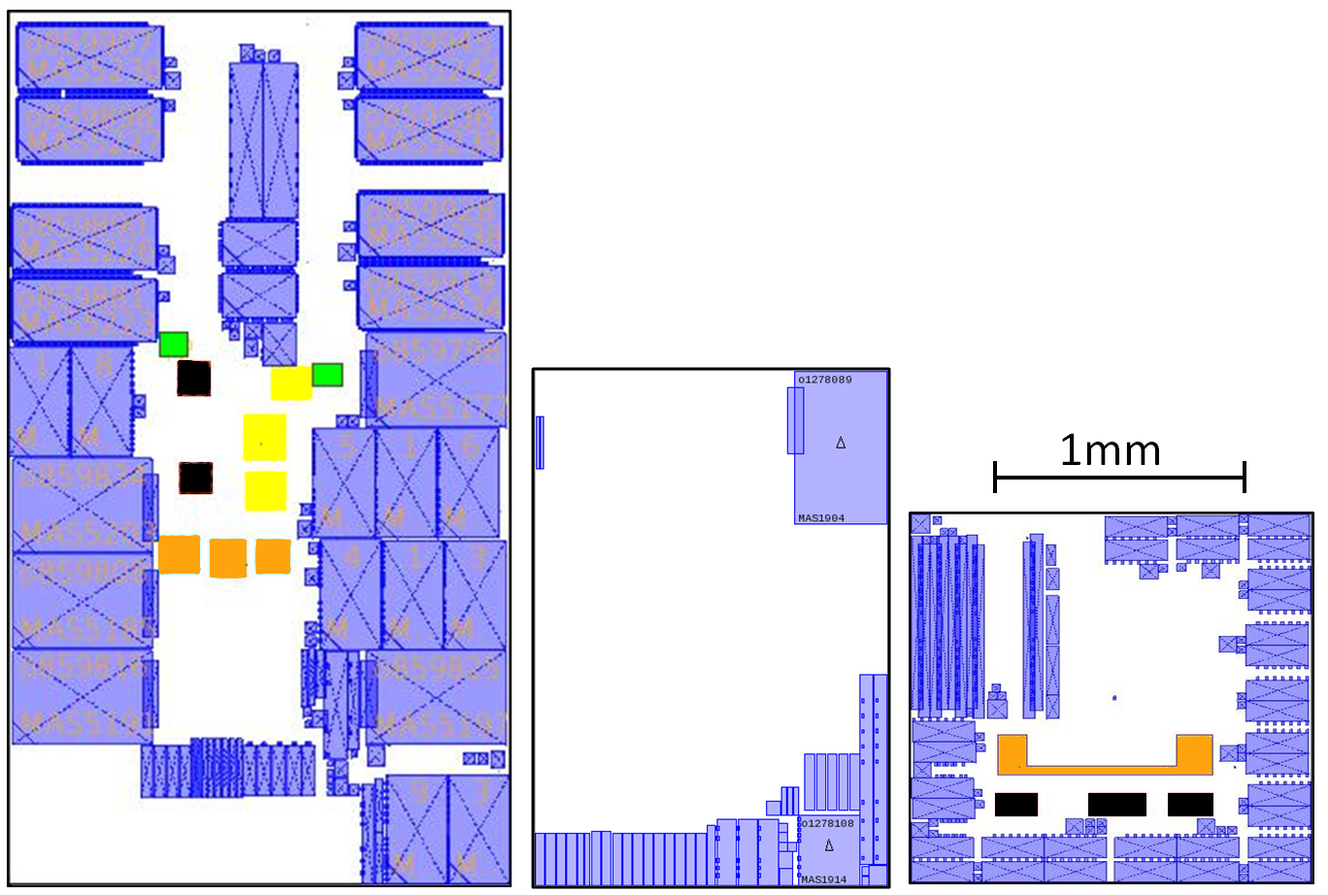
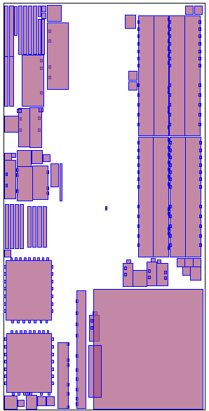
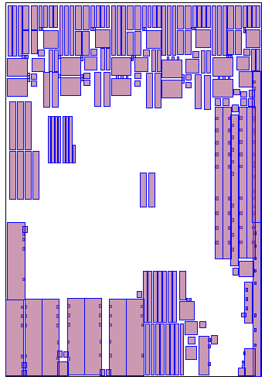
ISPD 2015 floorplans – Suite B
LEGEND:
placement blockage
macro
separate regions
disconnected region1
disconnected region2
disconnected region3
disconnected region4
mgc_superblue11_a
mgc_superblue12
mgc_superblue16_a
mgc_superblue14
mgc_superblue19
Notes:
mgc_superblue14 and mgc_superblue19 are blind benchmarks.

Slide 15
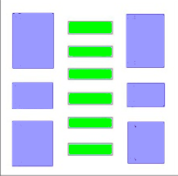
Disconnected fence regions
Disconnected regions are difficult as the placer
has to decide which portion to place cells in
No team produced a routable placement for this design
a single disconnected region
Design | # Cells | # Nets | #Regions | Cells Area Utilization
mgc_edit_dist_a | 127,413 | 131,134 | 1 | 54.1%

Slide 16
3. Evaluation metrics

Slide 17
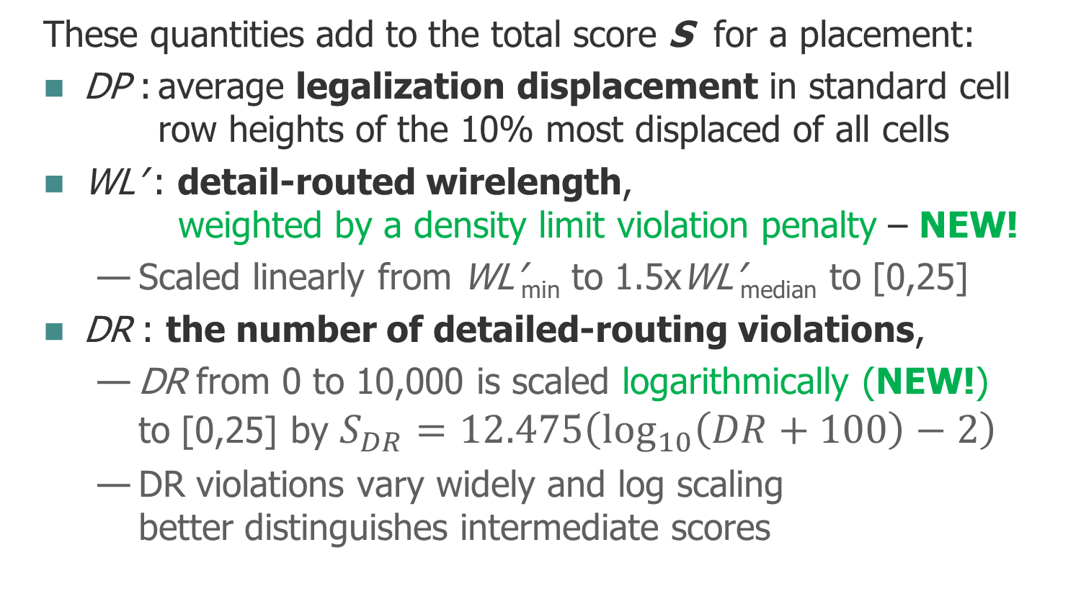
Total score S = min{S_{DP} + S_{DR} + S_{WL} , 50}
These quantities add to the total score S for a placement:
DP : average legalization displacement in standard cell
row heights of the 10% most displaced of all cells
WL’ : detail-routed wirelength,
weighted by a density limit violation penalty – NEW!
  Scaled linearly from WL’_{min} to 1.5xWL’_{median} to [0,25]
DR : the number of detailed-routing violations,
  DR from 0 to 10,000 is scaled logarithmically (NEW!)
  to [0,25] by $S_{DR}=12.475\left(\log_{10}\left(DR+100\right)−2\right)$
  DR violations vary widely and log scaling
  better distinguishes intermediate scores

Slide 18
Total score S = min{S_{DP} + S_{DR} + S_{WL} , 50}
Placements receive the maximum score S = 50 if
There are fence region violations – NEW!
DP ≥ 25 standard cell rows
GR edge overflow exceeds GR_{edge_max} of 0.3% for
mgc_superblue designs and 3% for the other benchmarks
DR violations exceed 10,000

Slide 19
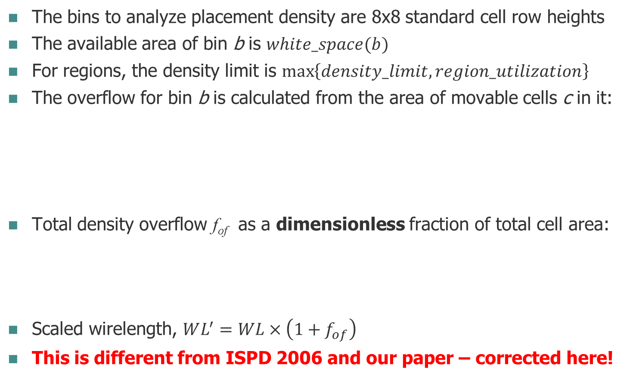

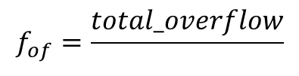
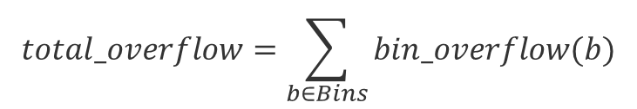
Wire length scaling by density violations
The bins to analyze placement density are 8x8 standard cell row heights
The available area of bin b is $white_space(b)$
For regions, the density limit is $\max\left\{density_limit,region_utilization\right\}$
The overflow for bin b is calculated from the area of movable cells c in it:
Total density overflow f_{of} as a dimensionless fraction of total cell area:
Scaled wirelength, $WL^{′}=WL×\left(1+f_{of}\right)$
This is different from ISPD 2006 and our paper – corrected here!
$$bin_overflow\left(b\right)=\max\left\{0,\left(\sum_{ c∈b}{area(c∩b) }\right)−white_space(b)×density_limit\right\}$$
$$total_overflow=\sum_{b∈Bins}{bin_overflow(b)}$$
$$f_{of}=\frac{total_overflow}{ }$$
$$\sum_{c∈Cells}{area(c)}$$

Slide 20
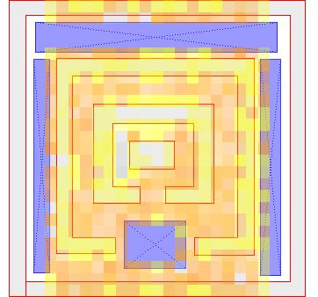
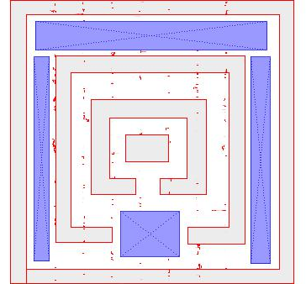
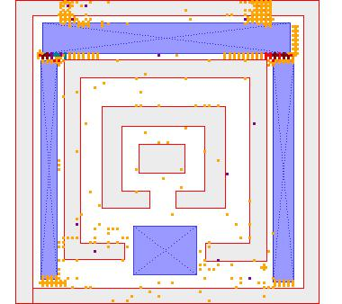
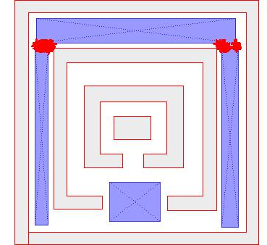
Example raw scores for pci_bridge32_a which has rectilinear regions
Density overflow 0.42, so WL’ = WL x 1.42
Legalization displacement 0.0
GR edge overflow 0.12%
GR node overflow 112
Violation Type | Count | Weight | Contribution
cut proj. space | 7 | 0.2 | 1.4
cut size | 4 | 0.2 | 0.8
end of line | 12 | 0.2 | 2.4
min diff space | 9 | 0.2 | 1.8
min hole | 2 | 0.2 | 0.4
short | 254 | 1.0 | 254.0
Detailed routing violations total: |  |  | 260.8
Detailed routing violations 260.8
Detail routed wire length 0.836m
Notes:
We originally proposed taking the square root of detailed routing violations, normalized by the median wire length. However, this resulted in little difference between scores when the median DR score was high.
Run time and memory usage were not scored this year.
They were not needed as a tie-breaker between similar scores.

Slide 21
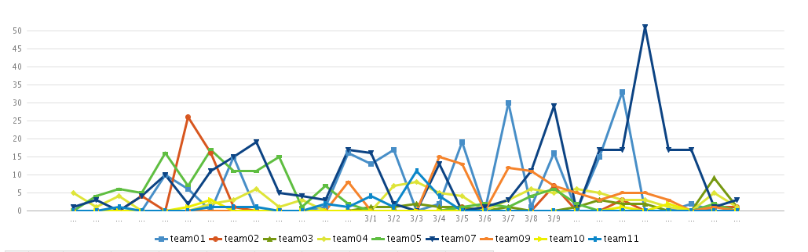
Contest scores were published daily – heavy competition between teams!
Density Overflow Factor | Global Routing |  |  | Detailed Routing |  | Scaled Scores |  |  | Total Score | Team
 | %Edge Overflows | Node Overflows | Wire Length (m) | Wire Length (m) | Detailed Routing Violations | SDP | SWL | SDR
0.017 | 0.001 | 84 | 4.50 | 4.66 | 7.0 | 0.00 | 0.00 | 0.37 | 0.4 | ispd07
0.009 | 0.023 | 933 | 5.00 | 5.20 | 111.8 | 0.00 | 4.04 | 4.07 | 8.1 | ispd01
0.088 | 0.015 | 1,080 | 4.43 | 4.61 | 179.0 | 0.84 | 2.22 | 5.56 | 8.6 | ispd11
0.150 | 0.127 | 2,657 | 4.70 | 4.93 | 1713.8 | 0.00 | 7.47 | 15.70 | 23.2 | ispd04
0.069 | 0.238 | 4,625 | 6.16 | 6.36 | 8853.4 | 0.00 | 16.42 | 24.35 | 40.8 | ispd10
0.066 | 10.399 | 66,123 | 29.08 |  |  |  |  |  | 50.0 | ispd02
Team activity during the competition
Notes:
Example from final benchmark scores for mgc_matrix_mult_a.

Slide 22
4. Results

Slide 23
Participation statistics
Rank | Prize
1st | $2,000
2nd | $1,000
3rd | $500
12 teams initially participated from Canada, China,
France, Germany, Hong Kong, Taiwan, USA
7 final placer binary submissions
ID | University | Team Lead and Members | Advisor
1 | University of Calgary and University of Waterloo | Nima Karimpour Darav, Aysa Fakheri Tabrizi, David Westwick | Lalah Behjat Andrew Kennings
2 | Dresden University of Technology | Andreas Krinke,Sergii Osmolovskyi, Johann Kenctel, Matthias Thiele, Steve Bigalke | Jens Lienig
4 | Chinese University of Hong Kong | Wing-Kai Chow, Peisahn Tu, Jian Kuang, Zhiqing Liu | Evangeline Young
5 | University of Illinois | Chun-Xun Lin, Zigang Xiao, Haitong Tian, Daifeng Guo | Martin Wong
7 | National Taiwan University | Chau-Chin Huang, Sheng-Wei Yang, Chin-Hao Chang, Hsin-Ying Lee, Szu-To Chen, Bo-Qiao Lin | Yao-Wen Chang
10 | National Chiao Tung University | Ching-Yu Chin | Hung-Ming Chen
11 | National Chung Cheng University | Xin-Yuan Su | Mark Po-Hung Lin

Slide 24
Comparison of detailed routing violations for best placement results in 2015 vs. 2014
*mgc_superblue11_a and mgc_superblue16_a have fence region constraints in the 2015 contest, but still have comparable results.
Significant improvement in most results versus last year!

Slide 25
Detailed routing violation scores for the top three teams – lower is better!
Placement quality was evaluated by detailed routing in Mentor Graphics’ Olympus-SoCTM place-and-route tool.

Slide 26
Total scores for each design for the top three teams – lower is better!
Total Score = min { S_{DP} + S_{DR} + S_{WL} , 50}

Slide 27
Final rankings!
Very competitive results with significant improvements as
the contest progressed. Congratulations to all teams.
Each of the top four teams had at least one benchmark with
fewer detailed routing violations than all other teams!
 |  | Number of Designs with
Place | Team | Unroutable | Fewest Detailed Routing Violations | Shortest Detail Routed Wire Length Scaled by Density Overflow | Best Score for Design | Total Score
1st | Team 7 | 3 | 9 | 7 | 9 | 299
2nd | Team 1 | 3 | 6 | 5 | 3 | 357
3rd | Team 4 | 4 | 5 | 5 | 7 | 439
4th | Team 11 | 11 | 1 | 2 | 0 | 714
5th | Team 10 | 13 | 0 | 0 | 0 | 794
6th | Team 5 | 17 | 0 | 0 | 0 | 937
7th | Team 2 | 20 | 0 | 0 | 0 | 1,000

Slide 28
5. Acknowledgements

Slide 29
Acknowledgements
Many thanks to the following colleagues for valuable insights and help
(in alphabetical order):
  Chuck Alpert
  Yao-Wen Chang
  Wing-Kai Chow
  Chris Chu
  Kevin Corbett
  Nima K. Darav
  Azadeh Davoodi
  Clive Ellis
  Igor Gambarin
  John Gilchrist
  John Jones
  Andrew B. Kahng
  Ivan Kissiov
Professor Evangeline Young and her student Wing-Kai Chow generously provided their RippleDP detailed placer to the contest.
Dr. Wen-Hao Liu generously provided his NCTUgr global router to the contest.
  Alexander Korshak
  Shankar Krishnamoorthy
  Wen-Hao Liu
  Igor L. Markov
  Mustafa Ozdal
  Cliff Sze
  Liang Tao
  Alex Vasquez
  Natarajan Viswanathan
  Alexander Volkov
  Yi Wang
  Benny Winefeld
  Evangeline F. Y. Young

Slide 30
Backup slides

Slide 31
Appendix A:
Sample design rules

Slide 32
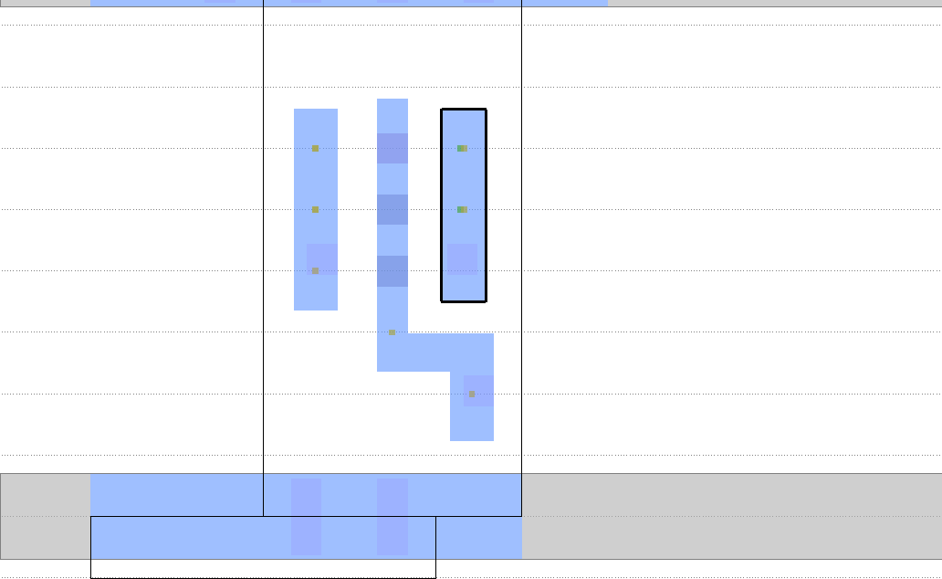
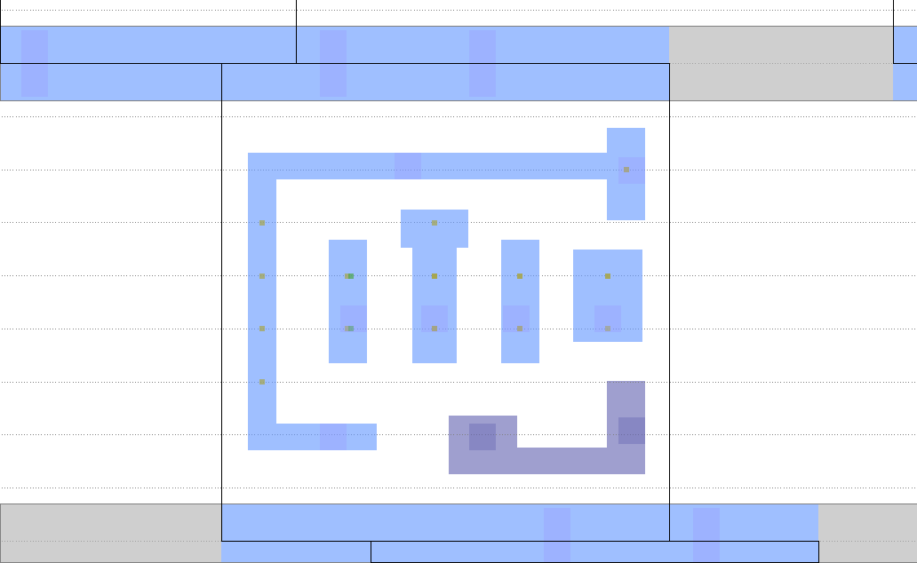
Place and routing challenges
Dense metal1 pins, pin accessibility, power/ground grid
Complex DRC rules: cut space, minimum metal area,
end-of-line rules, double patterning rules, edge-type, etc.
Challenging to pre-calculate routable combinations
Easy to route
Harder to route
many tracks available
2 tracks available
No detail routing checks in contests prior to ISPD 2014!

Slide 33
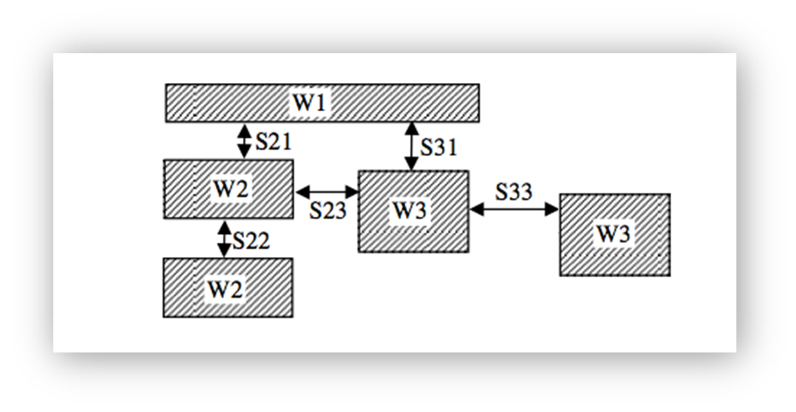
Minimum spacing rule
There is a required minimum spacing between any two metal edges.
The minimum spacing requirement depends on:
  The widths of the two adjacent metal objects.
  The parallel length between the two adjacent metal objects.
parallel lengths between adjacent metal objects

Slide 34
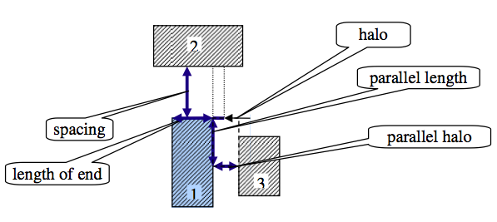
End of line rule
EOL spacing applied to objects 1 and 2:
  As object 3 overlaps the parallel length from the top of edge 1, EOL spacing between objects 1 and 2 will be required.
  Object 3 must remain outside the parallel halo.
2
3
1

Slide 35
Non-default routing (NDR) rule
Non-default routing rules may specify:
  Increased wire spacing for a net
  Increased wire width for a net
  Increased via (cut) number at selected junctions
NDR may be assigned to a cell pin for wires
or vias connecting to it
NDR may or may not accompany increased pin width
or specific non-rectangular pins
NDRs are specified in the floorplan DEF file but
may be assigned to a pin in the cell LEF file

Slide 36
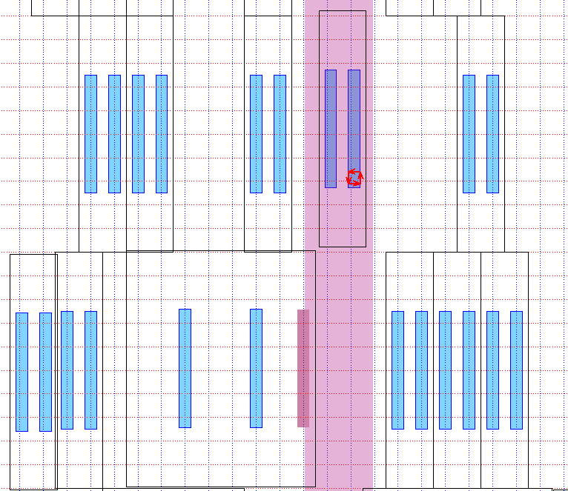
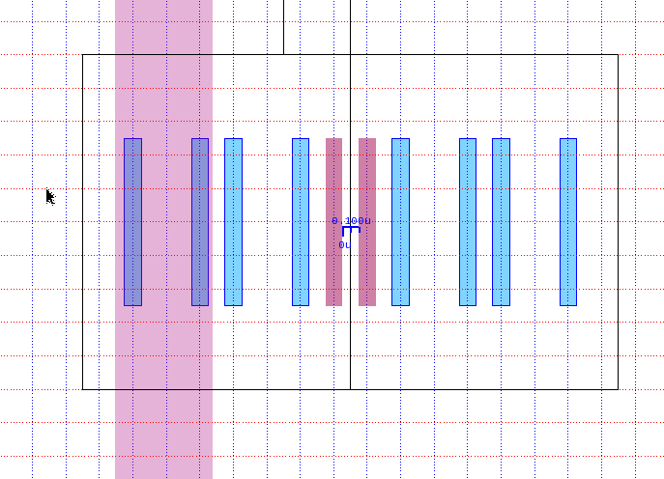
Blocked pin access violation
A blocked pin cannot be reached
by a via or wire without violations.
Metal1 pins under metal2 stripe are not accessible by via1 vias
Metal2 pins with NDR assigned
are placed too close to each other
Metal2 pin overlaps metal2 stripe

Slide 37
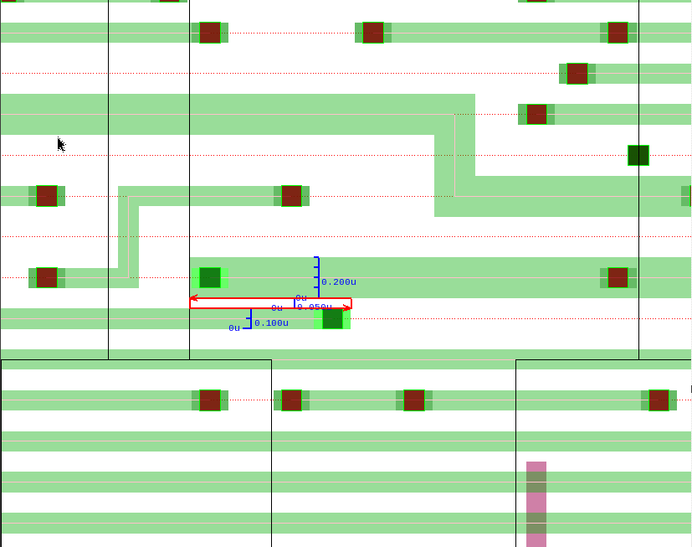
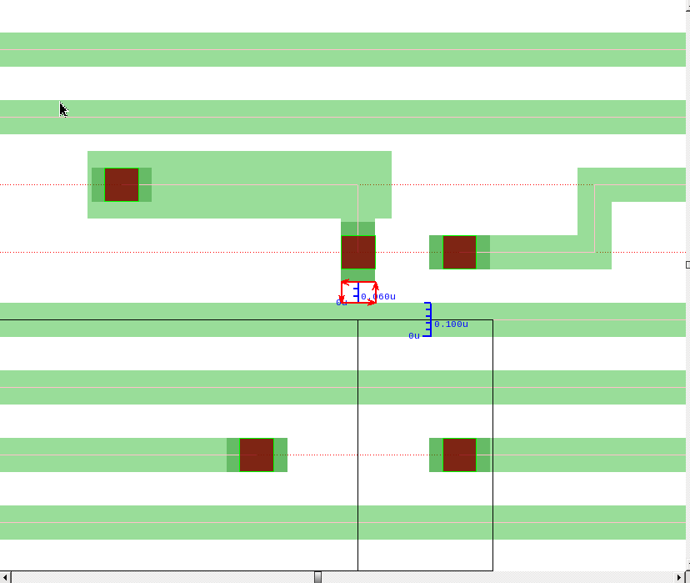
Min spacing and end-of-line spacing violation examples
Example minimum spacing and EOL spacing violations between routing objects in congested areas. Many such violations are in the vicinity of pins assigned an NDR rule.

Slide 38
Appendix B:
More benchmark details

Slide 39
Industry standard data format
Each benchmark has five input files:
  floorplan.def: with unplaced standard cells, net connectivity,
  fixed I/O pins and fixed macro locations, and routing geometry
  cells.lef (physical LEF): detailing physical characteristics of the
  standard cells including pin locations & dimensions, macros, & I/Os
  tech.lef (technology LEF): design rules, routing layers, and vias
  design.v: flat netlist of cells, I/Os, & net connectivity (per floorplan)
  placement.constraints: specifies density limit % (non-standard)
Outputs from contestant’s placement tool:
  Globally placed DEF file with all standard cells placed
  No changes allowed in cell sizes or connectivity
  The Library Exchange Format (LEF) and Design Exchange Format (DEF)
  are detailed here: http://www.si2.org/openeda.si2.org/projects/lefdef

Slide 40
Modifications to ISPD 2013 gate-sizing benchmark designs
Adapted five designs from the ISPD 2013 suite with a 65nm cell library
Added sub-45nm design rules (see Appendix B): edge-type,
min-spacing, end-of-line, non-default rules (NDRs) for routing
Pin-area utilizations per cell of about 20%
L-shaped output pins on 8% of cells in 2 designs, and 2% of cells on 1 design
Cells were downsized to minimum area
One cell output pin on M2 to check ability to avoid power/ground rails
Five routing layers are available: M1, M2, M3, M4, and M5
  M5 is not allowed for mgc_fft_2 – NEW!
M1 is only for vias to metal1 pins, & is otherwise not allowed for routing
Added macros with narrow channels as place-and-route blockages, and enlarged the floorplan footprints from ISPD 2014 contest – NEW!
Added fence regions: e.g. single-disconnected region in mgc_edit_dist_a, and three non-rectangular regions in mgc_matrix_mult_c – NEW!
Added blockages to show how to simplify placement, e.g. mgc_fft_b – NEW!

Slide 41
Modifications to the DAC 2012 routability benchmark designs
Adapted three designs from the DAC 2012 suite
(mgc_superblue11, mgc_superblue12, and mgc_superblue16)
Added 28nm design rules
Pin-area utilizations per cell of about 3%
All pins are rectangular (no L-shaped pins)
Cells were left at their original sizes
Seven routing layers are available: M1, M2, M3, M4, M5, M6, and M7
M8 is allowed on mgc_superblue16 to reduce routing difficulty – NEW!
Fence regions were added – NEW!
  Four disconnected fence regions in mgc_superblue11_a
  One disconnected fence region and one non-rectangular
  fence region in mgc_superblue16_a

Slide 42
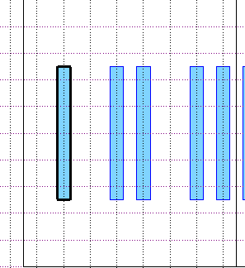
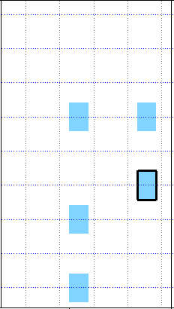
Standard cell libraries for our benchmarks
mgc_edit_dist, mgc_des_perf, mgc_fft, mgc_pci_bridge32, & mgc_matrix_mult:
65nm technology
Routing pitch 200nm
10 routing tracks per cell row
All standard cells are one row high
mgc_superblue11_a, 12, 14, 16_a, and 19:
28nm technology
routing pitch 100nm
9 routing tracks per cell row
All standard cells are one row high
Routing pitch 200nm
Routing pitch 100nm
Typical
65nm
standard
cell
Row height 900nm
Pin height 84nm
Row height 2000nm
Pin width 56nm
Pin height 1000nm
Typical 28nm
standard cell
Pin width 100nm

Slide 43
Power/ground (PG) mesh
Dense PG meshes have been inserted in all benchmarks
adding to routing difficulty and increasing realism
Each routing layer has uniformly spaced PG rails
parallel to its preferred routing direction
Rail thickness is constant on each layer but varies by layer
PG routing-track utilization varies across layers and designs
Suite A metal layer | M1 | M2 | M3 | M4 | M5
PG routing track utilization | 11% | 6% | 27% | 24% | 30%
mgc_superblue11, 12, 14, 16, & 19 | M1 | M2 | M3 | M4 | M5 | M6 | M7
PG routing track utilization | 0% | 1% | 5% | 8% | 5% | 9% | 5%

Slide 44
Appendix C:
Evaluation details

Slide 45
Detailed routing violation score DR
The weighted sum of detailed routing violations DR is computed from the number of violations v_{i} of routing violation type i and weight w_{i} in the table below
$$DR=w_{1}v_{1}+w_{2}v_{2}+w_{3}v_{3}+w_{4}v_{4}$$
Design Violation Type | Weighting w_{i}
Routing open | 1.0
Routing blocked pin | 1.0
Routing short | 1.0
Design rule check (DRC) violation | 0.2

Slide 46
Why use a log scale for DR violations?
Square root has less difference in S_{DR} when normalizing by large DR_{median}
E.g. comparing DR of 100 vs. 1000, S_{DR} differs by 5.4 with square root,
but they differ by 9.2 with the log scale
Added 100 inside logarithm so there is not too much difference
in DR scores with a small number of routing violations
Notes:
Added +1 to raw Detailed Routing Violations as showing on a log scale.

Slide 47
Placement legalization
Olympus-SoCTM legalization fixes these issues in placement DEF files:
Edge-type violations & overlaps between cells or with blockages
Cells not aligned on the standard cell rows
Cells with incorrect orientation
Cell pins that short to the PG mesh
Blocked cell pins that are inaccessible due to the PG mesh
DRC placement violations between standard cells
Significant legalization displacements are penalized (S_{DP} score).
If there are cells outside their fence region, or cells inside a fence region that are not assigned to it, then the placement is invalid! – NEW!

Slide 48
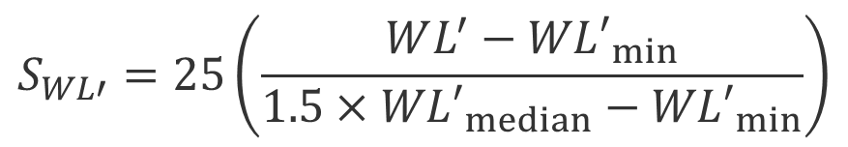
Affine scaling for wire length
Simple affine scaling [WL’_{min} , 1.5xWL’_{median} ] → [0,25]
is used for wire length:
where
$$S_{WL′}=25\left(\frac{WL^{′}−{WL′}_{min}}{{1.5×WL′}_{median}−{WL′}_{min}}\right)$$
$${WL′}_{min}≤WL′≤{1.5×WL′}_{median}$$

Slide 49
Appendix D:
Contest result details

Slide 50
All the teams!
ID | University | Team Lead and Members | Advisor
1 | University of Calgary & University of Waterloo | Nima Karimpour Darav, Aysa Fakheri Tabrizi, David Westwick | Lalah Behjat Andrew Kennings
2 | Dresden University of Technology | Andreas Krinke,Sergii Osmolovskyi, Johann Kenctel, Matthias Thiele, Steve Bigalke | Jens Lienig
3 | National Tsing Hua University | Chung-Yi Kao, Yu-Ming Sung, Pin-Xin Liao, Chen-Hong Lin, Chen-Yeh Yang | Ting-Chi Wang
4 | Chinese University of Hong Kong | Wing-Kai Chow, Peisahn Tu, Jian Kuang, Zhiqing Liu, | Evangeline Young
5 | University of Illinois | Chun-Xun Lin, Zigang Xiao, Haitong Tian, Daifeng Guo | Martin Wong
6 | Chung Yuan Christian University | Te-Jui Wang | Shih Hus Huang
7 | National Taiwan University | Chau-Chin Huang, Sheng-Wei Yang, Chin-Hao Chang, Hsin-Ying Lee, Szu-To Chen, Bo-Qiao Lin | Yao-Wen Chang
8 | Paris’6 Computer Science Lab | Gabriel Gouvine | Jean-Pau Chaput
9 | National Central University | Li-Yuan Pang, Yu-Shiun Wang | Tai-Chen Chen
10 | National Chiao Tung University | Ching-Yu Chin | Hung-Ming Chen
11 | National Chung Cheng University | Xin-Yuan Su | Mark Po-Hung Lin
12 | Texas A & M University | Zhiyang Ong | NA

Slide 51
Total scores for each design for the top three teams – lower is better!
Close race for 2nd and 3rd, but Team 1 scored significantly lower on 3 designs (mgc_matrix_mult_1, mgc_superblue12, and mgc_superblue19)
Team 4 only scored significantly lower on 1 design (mgc_des_perf_a),
and had one more unroutable placement for a design

Slide 52
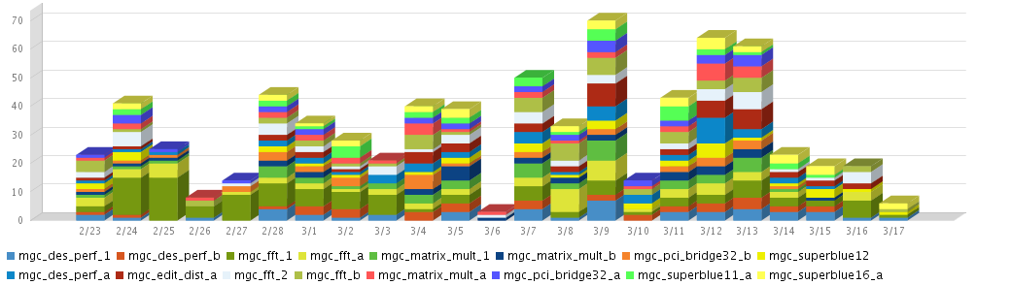
Team activity during the contest
Team activity
Activity by design
52

