Slide 1

FreePDK15 An Open-Source Predictive Process Design Kit for 15nm FinFET Technology
NC STATE UNIVERSITY
Kirti Bhanushali, W. Rhett Davis (NCSU)
International Symposium on Physical Design
April 1, 2015

Slide 2
Motivation
Problem
Restrictions on PDKs prevent sharing of design data, impede research & teaching
Solution
Free Predictive PDK, establishes a baseline for research & teaching in design, architecture, manufacturing, and automation
FreePDK45 accomplished this for 45nm, FreePDK15 seeks to do the same for 15nm

Slide 3
Process Cross Section
Active Interconnect Level-2 (AIL2)
Level-2 Contact to Metal-1
(Applies to AIL-2 and GIL)
Metal-1
BEOL
Active Interconnect Level-1 (AIL1)
Layer Interconnect Overlap Level
AIL2
GIL
AIL2
AIL1
Gate
AIL1
Gate Interconnect Layer (GIL)
Fins
FEOL
Si
What everyone should know: FinFETs & MOL layers
Thanks to Alex Toniolo (NanGate) for suggesting layers
Schuddinck, et al (IEDM 2012) suggested dimensions

Slide 4
Width Quantization Of Active
Active width grows in increments of 40nm
W_{eff} = 2*H_{fin} + W_{fin}
FinFETs have integer number of fins
48nm
88nm
128nm
40nm

Slide 5
Planar Device vs. FinFET
FINS
Fin Interconnect
Traditional planar
MOS
FinFET in Layout View
FinFET on Physical Mask

Slide 6
MOL Layers in Layout View
Vias for connecting higher metal layers to Gate and Active interconnects
Metal1
Interconnect PMOS & NMOS
Interconnect to Power rails
MOL Layers reduce resistance, improve density

Slide 7
Multiple-Patterning Rules
Two colors for Gate, MOL, and 1X Metal Layers
Metal pitch for different colors is small
Metal pitch for the same color is larger
Optional uncolored layer post layout coloring (GATE only)
Also: Gate Cut Layer
Metal1A
Metal1A
Metal1A
Metal1B
54nm
36nm
36nm

Slide 8
Other Restrictive Rules
Width and spacing is orientation-dependent, to account for off-axis illumination
AIL1, AIL2, GIL and GATE should not bend, to reduce pinching
28nm
Metal1A
Metal1A
56nm

Slide 9
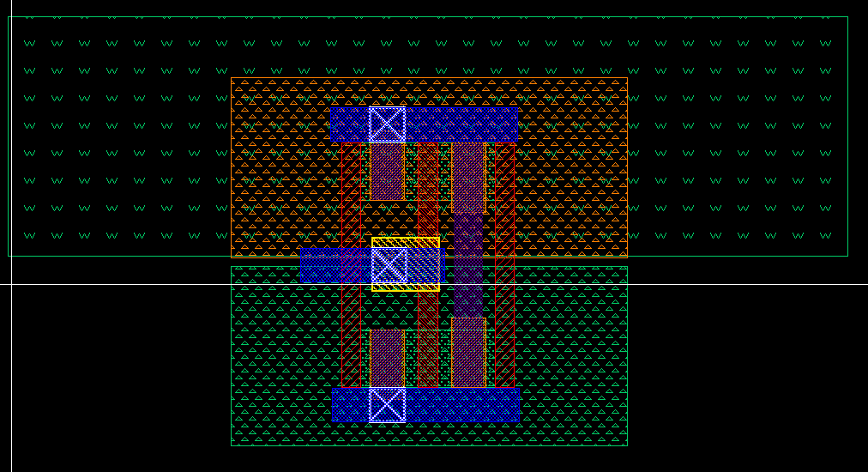
Layout – Inverter
Inverter Layout
AIL1
GIL
Dummy Gate
AIL2
Notes:
1:1 PMOS to NMOS

Slide 10
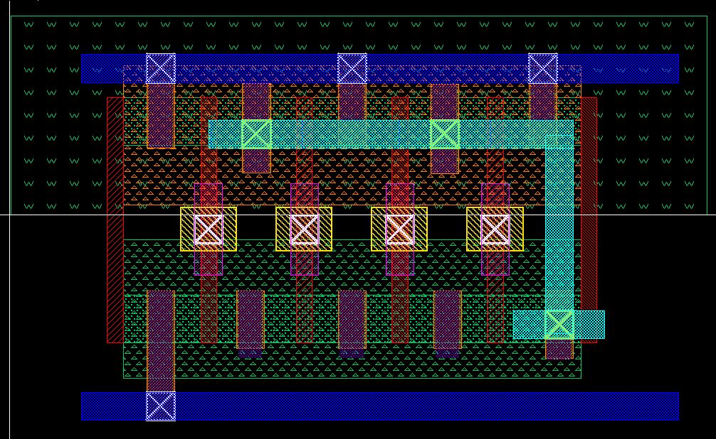
NAND4
NAND4 Layout
GATEA
MINT1
GATEB
M1B

Slide 11
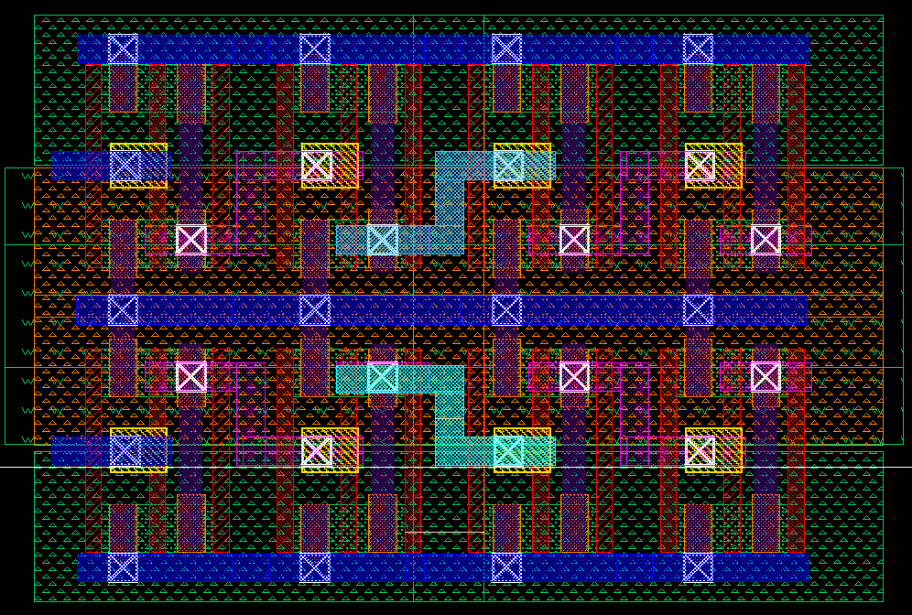
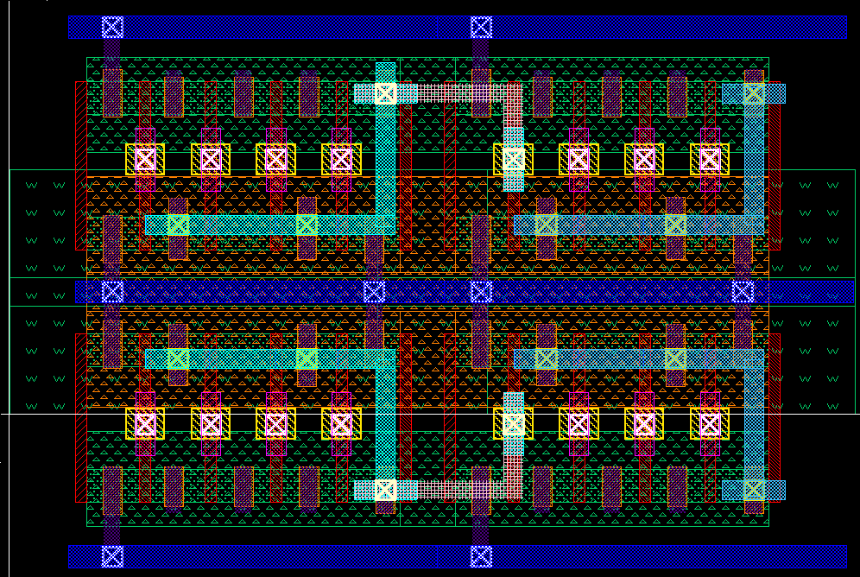
Complex Layouts
Complex Layouts
Inverter cell
NAND4 cell

Slide 12
Layout Density Comparison
Density Evaluation
FinFET inverter @14nm : MOS Inverter @45nm
Ideal shrink factor- 1:9
Achieved shrink factor- 1:6
FinFET layout density is 1.3x MOSFET (Alioto, ICM 2009)
Cause
Width Quantization
Higher H_{fin} for same W_{eff}

Slide 13
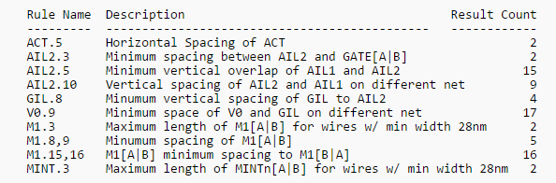
Comparison to NanGate Library
NanGate evaluation: Rules not dense enough
DRC errors for SDFFRNQ_X1 cell given below
Working with NanGate to revise rules

Slide 14
Future Releases
LVS, PEX rules in development
Planned for release summer 2015
Global M1x4 (260 nm thick)
Semi Global M1x2
(130 nm thick)
Intermediate M1x1
(60 nm thick)
M1 (60 nm thick)
Metal 1 Pitch

Slide 15
Licensing
Licensed for Academic Use under 3-clause BSD License
Caveat: Cannot distribute a Cell Library until Summer 2016
Please contact us for commercial license
Click through license may be possible with your help

Slide 16
Conclusion
First-pass FreePDK15 with DRC is now available, including new 15nm features
FinFETs
MOL Layers
Multiple Patterning
LVS & PEX rules available in summer
How you can help
Feedback on design rules
Request a commercial use license

Slide 17
Acknowledgement
Acknowledgements
Alex Toniolo
Joseph Davis, Tarek Ramadan, Ahmed Hammed Fathy, Omar El-Sewefy , Ahmed El-Kordy, Hend Wagieh (Mentor Graphics)

