Slide 1

Open Cell Library in 15nm FreePDK Technology
Mayler Martins, Jody Matos, Renato Ribas, Andre Reis, Guilherme Schlinker, Lucio Rech and Jens Michelsen

Slide 2
Outline
Part I - Layout
Library Creation Flow
Cell Template
DFF Layout example
Dummies and Diffusion Gaps
Double patterning
Design rule negotiation
Part II – Library Content
Cells
Available descriptions
Part III – Synthesis Example
Conclusion

Slide 3
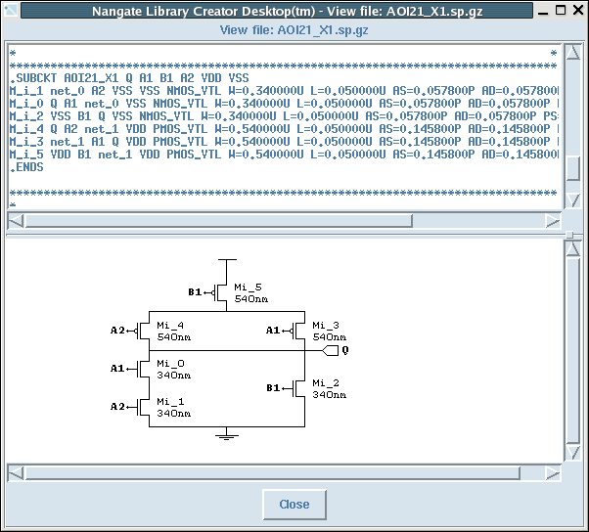
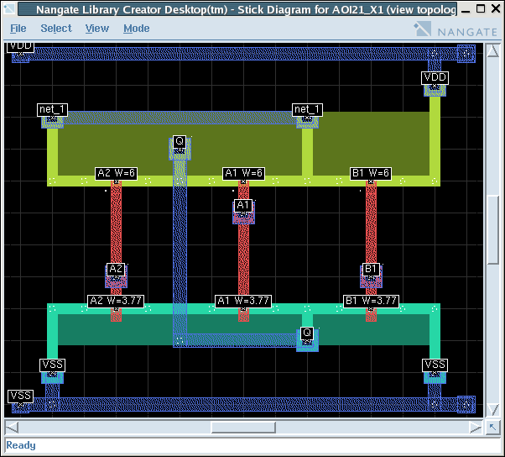
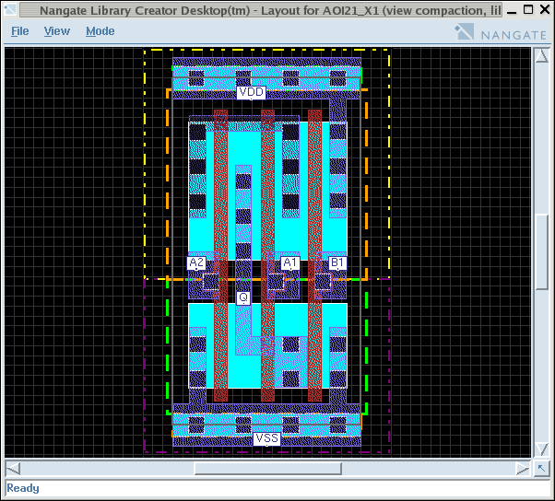
Standard Cell Creation Flow
Library Definition

Cell Architecture
Cell Mix
Drive Strength/Skew Granularity
Rule adjustments
Library Definition
Library N
Cell N
Specification
Logic restructuring
Circuit optimization
Circuit Synthesis
Circuit Synthesis

Circuit Re-ordering
Transistor Placement/Routing
Topology Creation
Topology Creation
Layout Creation
Structural Layout generation
Simplified design rules
Layout Creation
Multiple Iterations
Compaction
2D Cleanup Compaction
Migration to related technology
Compaction
Q = !((A1 * A2) + B1)
Characterization
LVS, DRC, PEX
Parasitic extraction
Verification
View Export
.lib/LEF, GDSII, CDL
Verilog, Vital, Edif
OpenAccess
View Export
Block Level Evaluation of:
Design Rules Impact
timing
power
area


Block Benchmark
Block Benchmark
Notes:
Let the animation run after the first click, to shorten the number of clicks for this slide. Advise audience to watch for the full slide deck on this during Library Creator presentation

Slide 4
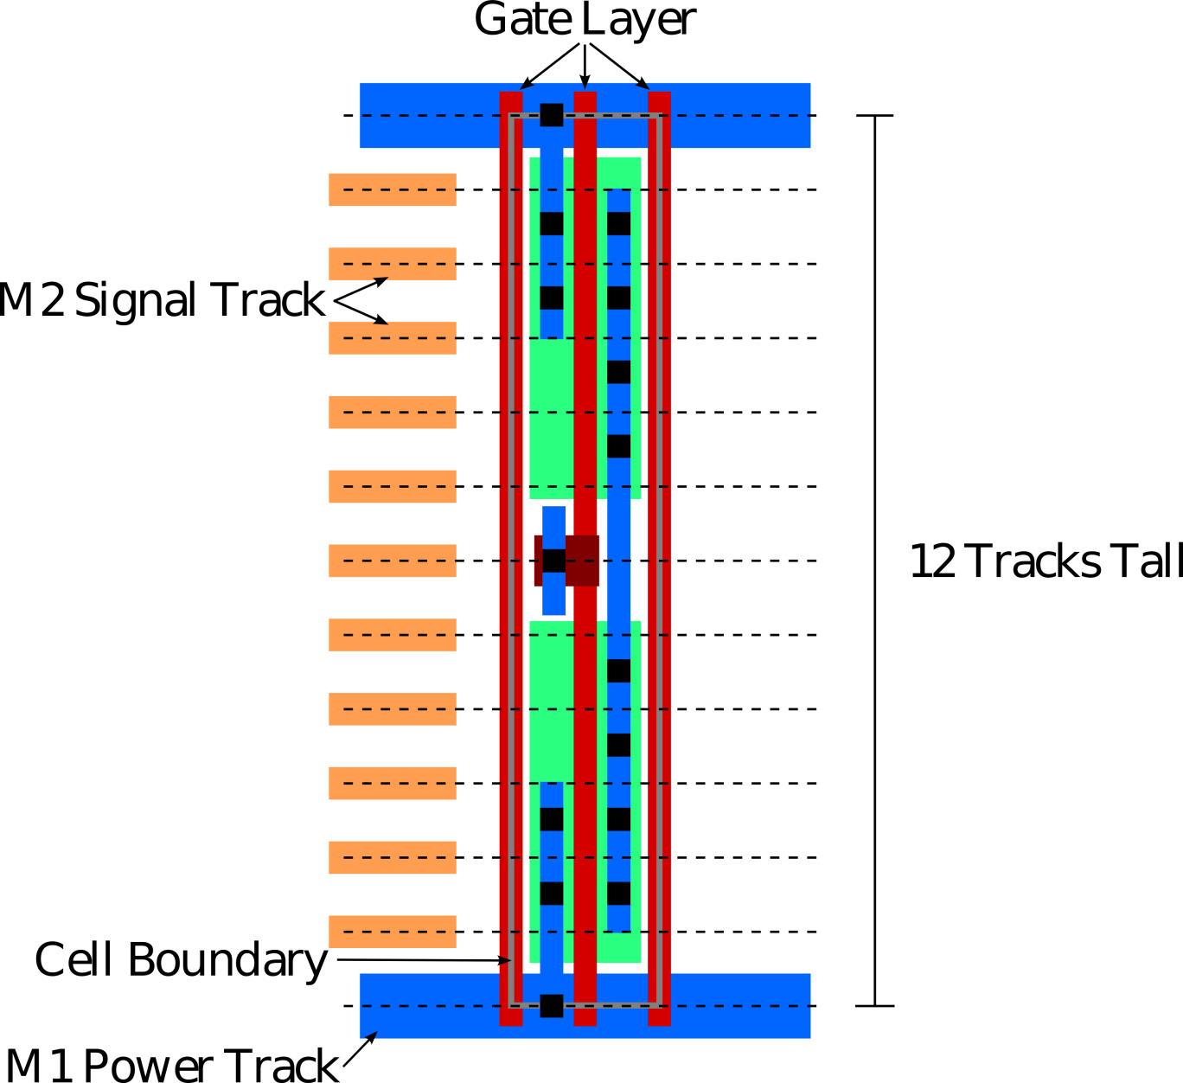
Cell Template
Cell template is 12 track tall
Gate layer is regularly spaced
Dummy gates are inserted in the cell boundaries

Slide 5
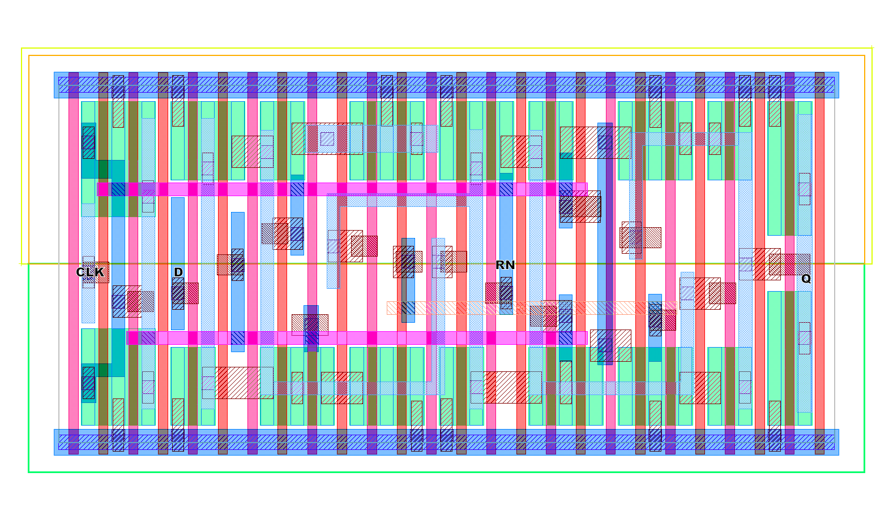
FFD Layout Example
This is an example of a DFF layout

Slide 6
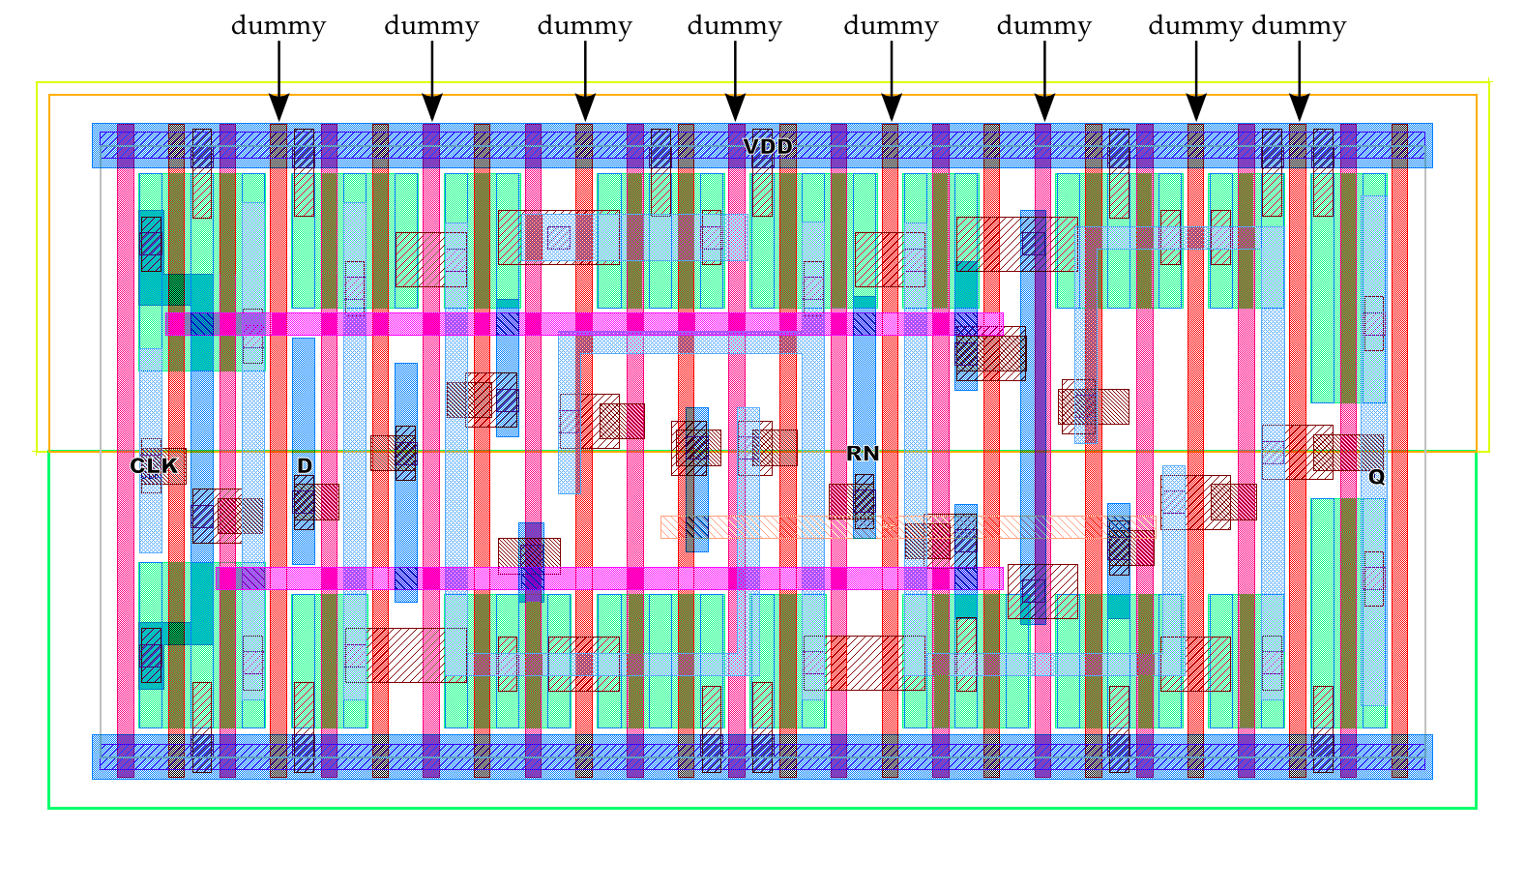
Dummy Gates

Slide 7
Dummy Gates - 2
Dummy gates are necessary at cell boundaries

Slide 8
Dummy Gates - 3
Only two successive gates can have contacts, dummy gates are used as spacers

Slide 9
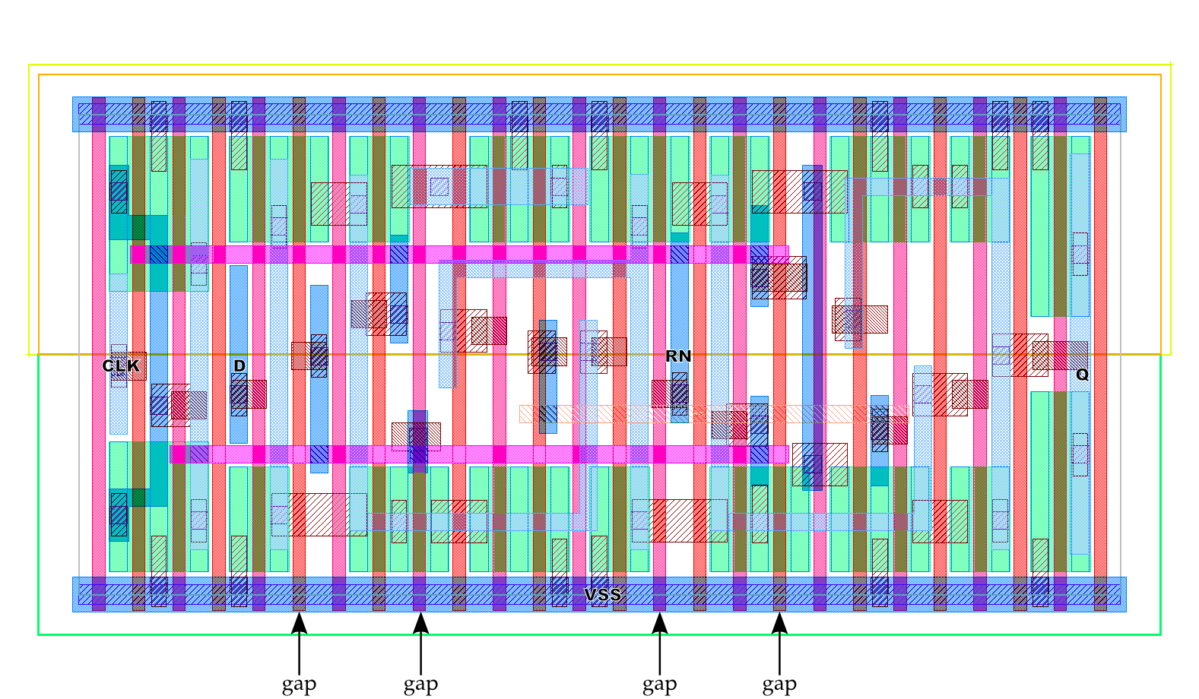
Diffusion Gaps
Diffusion Gaps (with at least one functional gate) can also be necessary

Slide 10
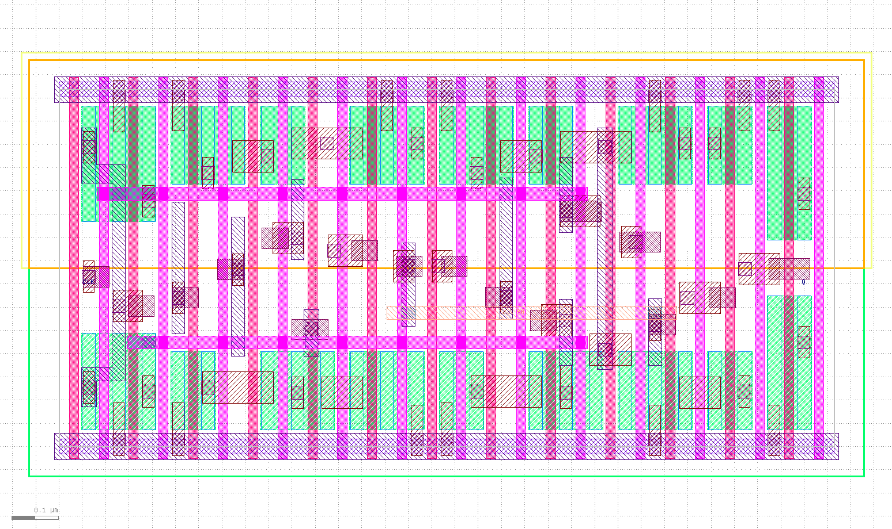


Double Patterning

Slide 11
Double Patterning

Slide 12
Double Patterning

Slide 13
Double Patterning

Slide 14
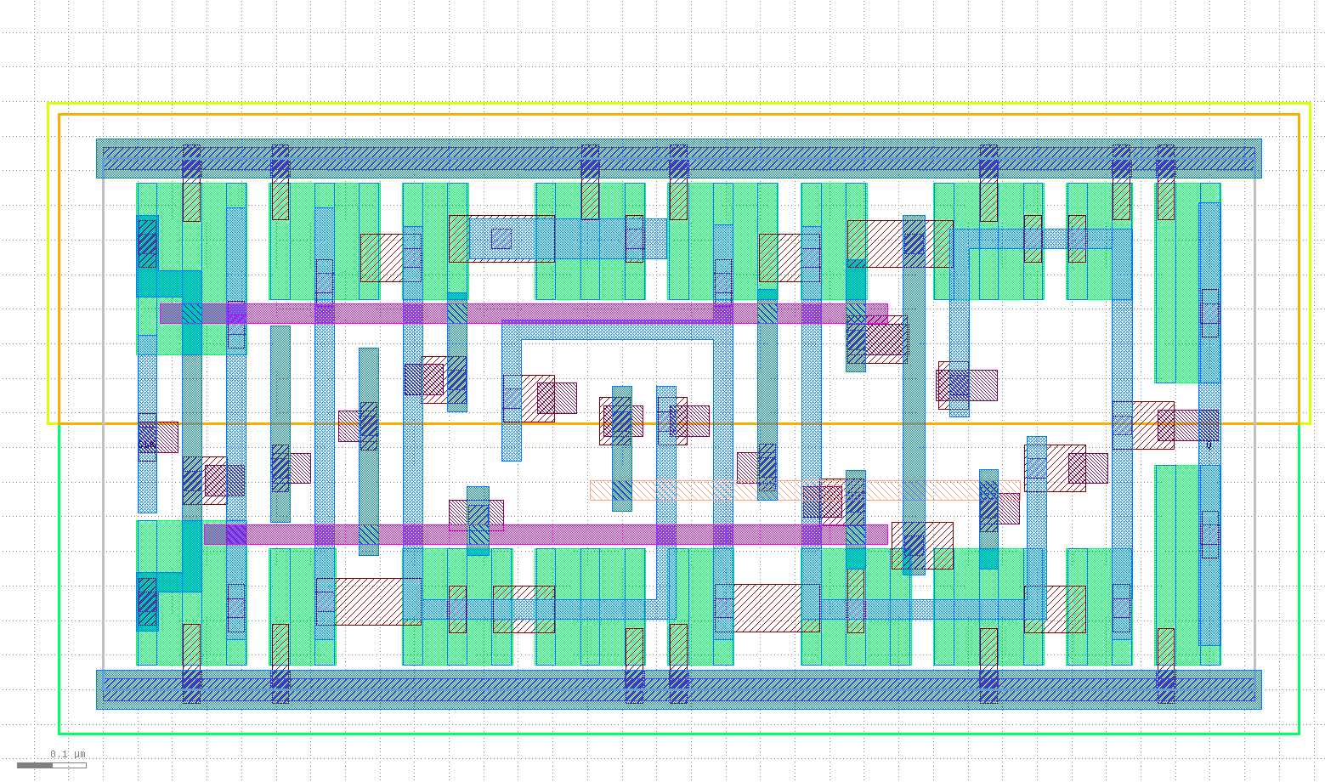


Double Patterning

Slide 15
Double Patterning

Slide 16
Double Patterning

Slide 17
Double Patterning

Slide 18
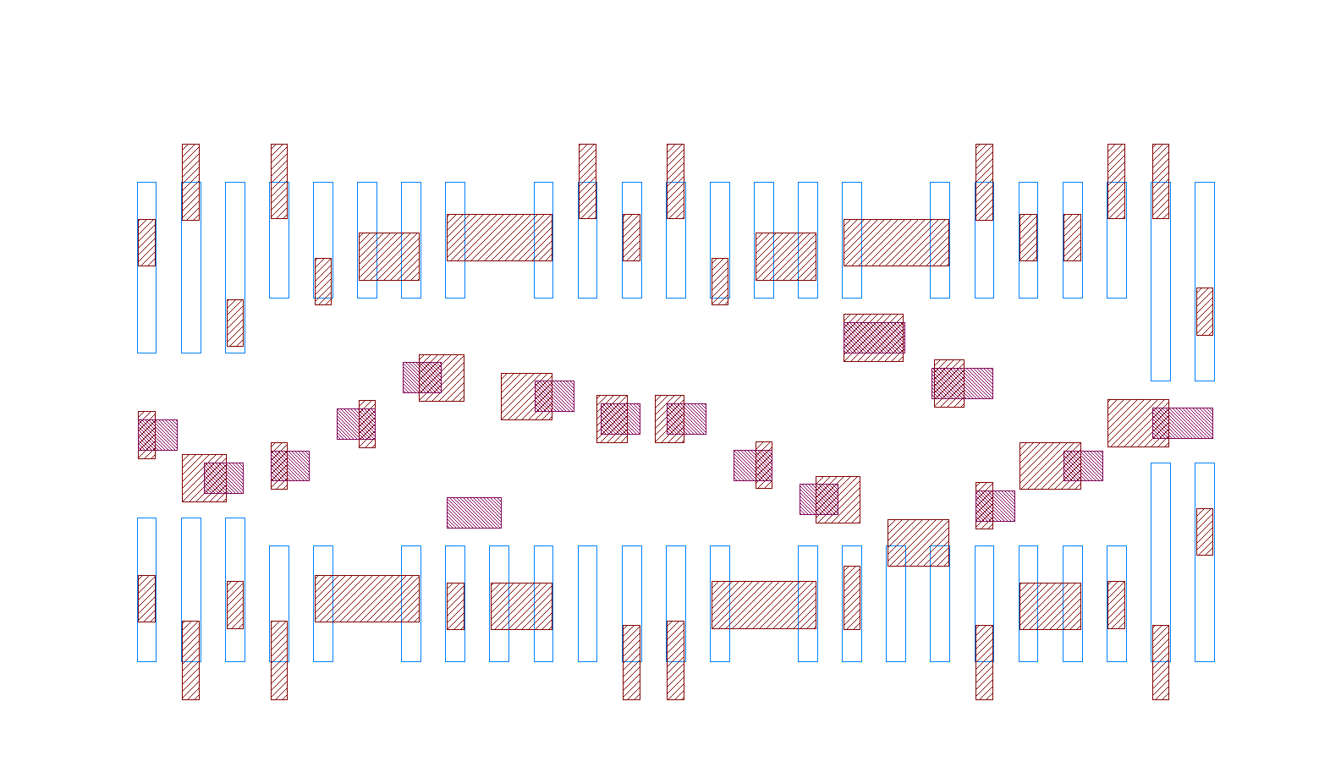
Design Rule Negotiation
New design rules were introduced in the design kit during library development
This negotiation happens also during the development of real design kits
For example, design rules related to local interconnection layers were adapted to allow the use of these layers for routing intents
DFF Layout
Local Interconnection Layers

Slide 19
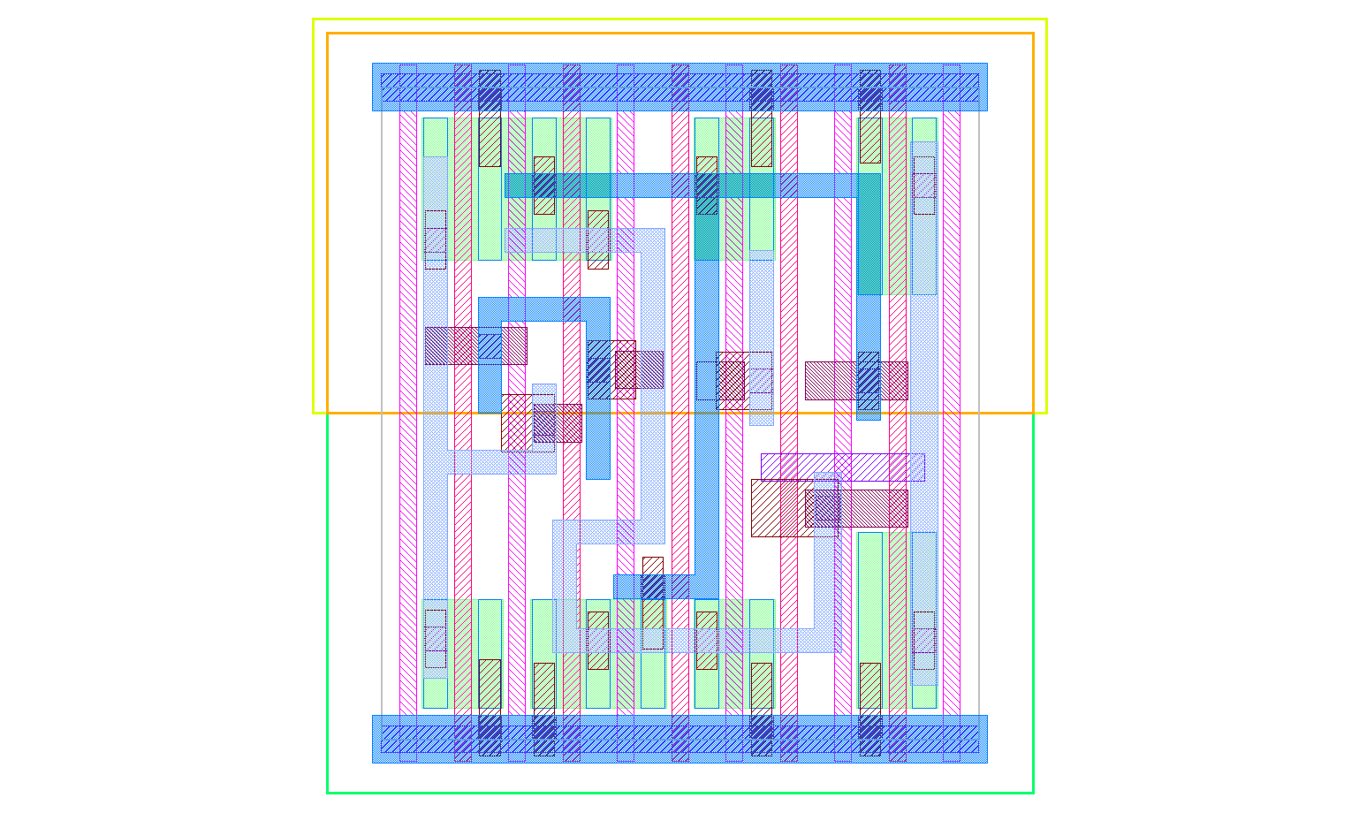

Design Rule Negotiation
Another example is the introduction of Gate Cut layer, to allow two different transistors in the same poly layer
Tri-state Buffer layout
Gate Cut Layer

Slide 20
Outline
Part I - Layout
Cell Template
FFD Layout example
Dummies and Diffusion Gaps
Double patterning
Design rule negotiation
Part II – Library Content
Cells
Available descriptions
Part III – Synthesis Example
Conclusion

Slide 21
Library Content - Cells
COMBINATIONAL CELLS
Cell Name | #In | Description | Drive Strengths | #Cells
BUF | 1 | Buffer cells | X1 to X16 | 6
INV | 1 | Inverter cells | X1 to X16 | 6
AND | 2, 3 and 4 | AND cells | X1 and X2 | 6
OR | 2, 3 and 4 | OR cells | X1 and X2 | 6
NAND | 2, 3 and 4 | NAND cells | X1 and X2 | 6
NOR | 2, 3 and 4 | NOR cells | X1 and X2 | 6
MUX2 | 3 | Multiplexer cell | X1 | 1
XOR | 2 | XOR cell | X1 | 1
XNOR | 2 | XNOR cell | X1 | 1
AOI | 3 and 4 | AND-OR-Inverter cells | X1 and X2 | 4
OAI | 3 and 4 | OR-AND-Inverter cells | X1 and X2 | 4
FA | 3 | Full-adder cell | X1 | 1
HA | 2 | Half-adder cell | X1 | 1
 |  |  | TOTAL | 49

Slide 22
Library Content - Cells
SEQUENTIAL CELLS
Cell Name | #In | Description | Drive Strengths | #Cells
DFFRNQ | 3 | D flip-flop with asynchronous !reset | X1 | 1
DFFSNQ | 3 | D flip-flop with asynchronous !set | X1 | 1
SDFFRNQ | 5 | D flip-flop with scan and asynchronous !reset | X1 | 1
SDFFSNQ | 5 | D flip-flop with scan and asynchronous !set | X1 | 1
LHQ | 2 | High enable Latch | X1 | 1
 |  |  | TOTAL | 5

Slide 23
Library Content - Cells
ADDITIONAL CELLS
Cell Name | #In | Description | Drive Strengths | #Cells
CLKBUF | 2 | Clock buffer cells | X1 to X16 | 6
TBUF | 2 | Tri-state buffer cells | X1 to X16 | 6
FILL | - | Filler cells | X1 to X16 | 5
CLKGATETST | 3 | Clock gate with test pin | X1 | 1
ANTENNA | - | Antenna cell | - | 1
FILLTIE | - | Cell to tie the wells | - | 1
TIEH | - | Tie-high cell | - | 1
TIEL | - | Tie-low cell | - | 1
 |  |  | TOTAL | 22

Slide 24
Library Content - Cells
SUMMARY
Combinational cells |  | 49
Sequential cells |  | 5
Additional cells |  | 22
 | TOTAL | 76

Slide 25
Library Content - Descriptions
View | File Extension | View Description
Technology Library | .lib | Provide logic, timing, power and area information of the cells in the library
Geometric Library | .lef | Provide information about the physical layout of the library in plain text, including design rules and abstract information about the cells
Simulation Library | .v | Provide a behavioral information of the cells for simulation intents
Cell Layouts | .gds | Provide information about planar geometric shapes, text labels, and other layout information in a binary format
Cell Netlists | .spi | Provide an instance-based transistor netlist, representing instances, nets, and some attributes
OpenAccess | .oa | Provide a database containing layouts and netlists

Slide 26
Outline
Part I - Layout
Cell Template
FFD Layout example
Dummies and Diffusion Gaps
Double patterning
Design rule negotiation
Part II – Library Content
Cells
Available descriptions
Part III – Synthesis Example
Conclusion

Slide 27
Synthesis Example
 | 15nm | 45nm | Reduction
Library Characteristics
Operation Voltage (V) | 0.8 | 1.1 | N/A
Operation Frequency (GHz) | 1.0 | 1.0 | N/A
Characterization Corner | Typical | Typical | N/A
Area Results
Total Area (um²) | 21706.92 | 211068.87 | 89.7%
Cell Area (um²) | 15437.17 | 68566.29 | 77.5%
#Cells | 31442 | 36583 | 14.1%
Timing Results
Timing Slack (ps) | 307.5 | 0 | N/A
Power Results
Leakage Power (mW) | 0.542 | 1.365 | 60.3%
Dynamic Power (mW) | 37.767 | 94.919 | 60.2%
Total Power (mW) | 39.309 | 96.284 | 60.2%

Slide 28
Conclusions
Complete and functional library provided in freePDK15 technology
Compatible with commercial tool formats
Liberty, lef, verilog, gds, spice and openaccess files available
This library is a key enabler for research in physical design in advanced technology nodes
We believe this effort is very relevant for this community
Available for download at
http://www.nangate.com/?page_id=22

Slide 29

Thank you!
Questions?

