Slide 1
A Benchmark Suite to Jointly Consider Logic Synthesis and Physical Design
Jody Matos, Augusto Neutzling, Renato Ribas and Andre Reis

Slide 2

Introduction
Practical
problem
Which helps
to solve
Motivates
Research
answer
Research
question
For which
is found
Defines
Research
problem

Slide 3

Introduction
Polya's First Principle: Understand the problem
  Do you understand all the words used in stating the problem?
  What are you asked to find or show?
  Can you restate the problem in your own words?
  Can you think of a picture or diagram that might help you understand the problem?
  Is there enough information to enable you to find a solution?

Slide 4
Introduction
Practical
problem
Industry
Which helps
to solve
Motivates
Research
answer
Research
question
Benchmarks
For which
is found
Defines
Research
problem
Academia

Slide 5
Two separate communities
RTL description
Logic synthesis benchmarks and problem definition
Logic Synthesis
≠
Netlist
Physical design benchmarks and problem definition
Physical Design
Layout

Slide 6
Synthesis Goals
Area vs delay/power
Target Delay
Area
Cost
Positive
slack
Circuit
Delay

Slide 7
Synthesis Goals
Area vs delay/power
Target Delay
Area
Cost
Circuit
Delay

Slide 8
Synthesis Goals
Area vs delay/power
Negative
slack
Target
Delay
Area
Cost
Circuit Delay

Slide 9
Synthesis Goals
Area vs delay/power
Target
Delay
Area
Cost
Circuit Delay

Slide 10
Circuit delay sources
Circuit delay is composed of three main components
Circuit delay has to be matched against e required time
Circuit Delay
Late Arrival
Wire Delay
Gate Delay
Required time

Slide 11
Circuit delay sources vs files
Late arrival times and required times are described in design constraints files
  Typically not distributed with benchmarks
Circuit Delay
Late Arrival (.sdc)
Wire Delay
Gate Delay
Required time (.sdc)

Slide 12
Circuit delay sources vs files
Wire delay depends on
  Pin placement and floorplanning (.def files)
  Also depend on routing resources, for which we have to include some different flavors in the benchmark set (to be done)
  the liberty files (.lib), for cell sizes
Circuit Delay
Late Arrival
Wire Delay
(.def, .lib)
Gate Delay
Required time

Slide 13
Circuit delay sources vs files
Gate delay depends on
  Gate delay tables (.lib)
  Logic structure (.aag, .verilog)
Circuit Delay
Late Arrival
Wire Delay
Gate Delay
(.lib, .aag, .verilog)
Required time

Slide 14
A simple (motivational) example
Consider a small four input circuit f(a,b,c,d)
Input d has a very late arrival time
Inputs a, b and c have a lot of slack
d
f
a
b
c

Slide 15
A simple (motivational) example
Consider a small four input circuit f(a,b,c,d)
Input d has a very late arrival time
Inputs a, b and c have a lot of slack
d
f
a
b
f
c

Slide 16
A simple (motivational) example
Consider a small four input circuit f(a,b,c,d)
Input d has a very late arrival time
Inputs a, b and c have a lot of slack
d
f
f
a
b
c

Slide 17
A simple (motivational) example
Consider a small four input circuit f(a,b,c,d)
Input d has a very late arrival time
Inputs a, b and c have a lot of slack
d
f
f
f1
a
b
f0
c

Slide 18
A circuit is not a benchmark
A benchmark is determined by full context
Late Arrival
.sdc
Wire Delay
.def, .lib
Gate Delay
.lib, .aag, .verilog
Circuit Delay
Required time

Slide 19
A circuit is not a benchmark
If a path is dominated by late arrival, we need to keep wire and gate delay under control
Circuit Delay
Late Arrival
Wire
Delay
Gate
Delay
Required time

Slide 20
A circuit is not a benchmark
If a path is dominated by wire delay, the solution is on floorplanning
The other way around, if gate delay is small, this net is not a priority in place/route
Circuit Delay
Late
Arrival
Wire Delay
Gate
Delay
Required time

Slide 21
A circuit is not a benchmark
If a path is dominated by gate delay, the solution is in logic synyhesis
Logic synthesis must be sure that wire delay is small
Physical design must respect this afterwards
Circuit Delay
Late
Arrival
Wire
Delay
Gate Delay
Required time

Slide 22
Case Studies
More to demonstrate that the benchmarks go through a standard flow
Demonstrates that “there is something to gain” by going physical aware
What is best at the logical level, can become worst in terms of routability
 | Standard Flow | Physical aware | %
Target Time | 3802 ps | 3802 ps | N/A
#Cell Instances | 133913 | 137035 | + 2%
Area Estimation | 0.527 um² | 0.565 um² | + 7%
Power Estimation | 118.98 mW | 133.31 mW | + 12%
Routing Violations | 98791 | 35149 | - 64%

Slide 23
Conclusions
Circuit delay can have different sources, for instance
  Late arrival times
  Wire delay
  Gate delay
To be able to see these different sources, a more complete design context is necessary
  Netlist
  Floorplan
  Design constraints
We provide a set of benchmarks describing complete design context for circuits
Considering physical design early in the flow has the potential to produce much better designs

Slide 24
Conclusion
Polya's First Principle: Understand the problem
  Do you understand all the Files used in stating the problem?
  What are you asked to find or show?
  Can you restate the problem in your own words?
  Can you think of a picture or diagram that might help you understand the problem?
  Is there enough information to enable you to find a solution?
    To what problem?
    Can files be ignored?

Slide 25

Conclusion: being discussed for a while – IWLS03

Slide 26
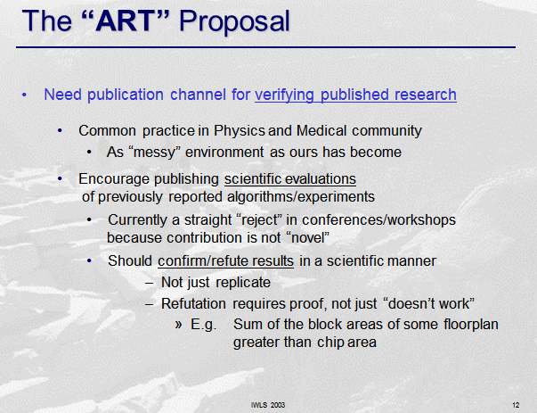
Conclusion: being discussed for a while – IWLS03

Slide 27
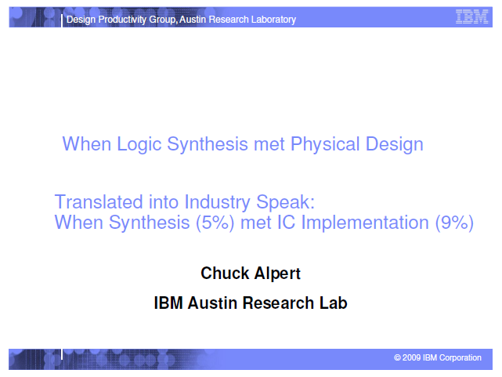
Conclusion: being discussed for a while – IWLS13

Slide 28
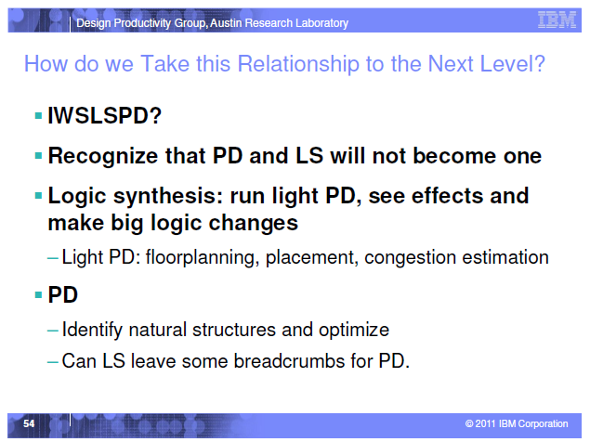
Conclusion: being discussed for a while – IWLS13
Change brings
opportunity

Slide 29
Conclusion
There is a need for a design flow that mixes logic and physical synthesis more tightly
Benchmarks (contests?) are needed to go in the right direction
Efforts have to be made jointly by both communities
  ISPD
  IWLS

